Slide 1
Pathways & Ramping Up to CTE
Cheryl Aschenbach, ASCCC Executive Committee
Kim Harrell, Dean of CTE, Consumnes River College
Lorraine Slattery-Farrell, ASCCC Executive Committee
Curriculum Institute, Riverside, July 14, 2017

Slide 2
Breakout Description
As part of the Doing What Matters campaign, the CTE Enhancement Funds of 2014, and the new Strong Workforce Funding, there is an emphasis on the need to work regionally to provide training programs that meet labor market demand. Come learn how the North Far North region utilized research and collaboration to develop and support programs at three community colleges in one healthcare sector. These educational programs not only meet the cross-training needs of healthcare providers, but actually feed enrollment between colleges!

Slide 3
www.doingwhatmatters.cccco.org
Regional approach to identify:
Labor market trends
College’s responsiveness to market demands
Regional program capacity
Which programs should be prioritized
How programs will be delivered
May 12, 2012 California Economic Summit
“prioritize existing workforce-training and career-education resources to focus on major regional industry sectors.”

Slide 4
2014 CTE Enhancement Funds
“…develop, enhance, retool, and expand quality career technical education offerings that build upon existing community college regional capacity to respond to regional labor market needs.”
“$50M CTE Enhancement Fund.” (Click here for full language of the bill.)
http://doingwhatmatters.cccco.edu/WEDDGrants/CTEEnhancementFunds.aspx

Slide 5
Strong Workforce Funding

Slide 6
2013 California Career Pathways – AB86
The 2013 Budget Act provided $250 million in Proposition 98 General Fund for the State Superintendent of Public Instruction (SSPI) to award regional and local implementation grants.
Establish or expand career pathway programs in grades nine through fourteen (community college).
Prepare students for high-skill, high-wage jobs in emerging and growing industry sectors in the local or regional economy.
Commitment to sustain program costs 2 years beyond end of grant funding.
http://www.cde.ca.gov/ci/ct/pt/

Slide 7
2014 California Career Pathways
2014 Budget Act - additional $250 million in Proposition 98 General Fund for a second round of CCPT grant awards.
SB 858 codified the CCPT in the California Education Code. Chapter 32 - set aside up to 1 percent of the total amount provided for in the trust for one or both of the following purposes:
To provide planning grants
To contract with an LEA for the provision of technical assistance to applicants and grant recipients
Pursuant to Chapter 32, the CDE chose to establish planning grants, known as consortium development and implementation grants, with the first year essentially constituting a planning grant and the second year consisting of an implementation grant.
http://www.cde.ca.gov/ci/ct/pt/

Slide 8
How do students benefit?
Increased employment opportunities: Developing pathways regionally in collaboration with consortia and industry better ensures opportunities for qualified students
Better educated, bigger benefits: Adding one year of schooling to the average educational attainment among employed workers with at least a high school diploma is associated with an increase in real GDP per capita of 17.4% and an increase in real wages per worker of 17.8% (Milken Institute, A Matter of Degrees)

Slide 9
One Regional Example North Far North Regional Consortium Imaging Programs

Slide 10
Doing What Matters!
Greater Sacramento
Priority Sectors
Health
Agriculture, Water & Environmental Technology
Small Business

Slide 11
Regional, regional, regional!
Regional Supply
Yuba College – Radiology Technology Degree
CRC – Diagnostic Medical Sonography Degree
FLC – Regional Demand?
2014 - 40% CTE Enhancement
CA driven by regional economies
Students attend multiple colleges
High priority sectors
Supply / Demand deficit
Regional Curriculum Alignment

Slide 12
Use your Resources
Health Sector Navigator
Deputy Sector Navigator - Health
Greater Sacramento Service Area (GSSA) Imaging Study
Paid consultant to define:
Imaging hospital partners
Workforce imaging training needs
Clinical sites available

Slide 13
GSSA Imaging Diagnostic Workforce Development Project
Sponsored by Linda Zorn Statewide Director/ Sector Navigator Health Workforce Initiative Grant Funding
Conducted by John Paul Gallagher, Inc.
Interviewed Regional Hospital Partners
Dignity Health
Marshall Medical Center
Rideout Health
Sutter Health
UCD Health Systems
Notes:
Imaging directors, students and staff interviewed

Slide 14
Technical Advances = Specialization
General radiology, CT, MRI, Interventional Radiology, Mammography, Ultrasound/ Vascular lab, Nuclear Medicine/ PET CT, Picture Archiving and Communication System

Slide 15
Feasibility Study

Slide 16
Regionally Aligned Curriculum
Yuba College
FLC
CRC
Radiology
Ultrasound
CT, MRI, IR

Slide 17
Pathways
Career
FLC
CRC
Community College
BS Program
High School
Yuba
High school to Yuba
Yuba to FLC
Community college to CRC
CRC, Yuba, & FLC to career
Career to FLC
FLC to higher paying career
Community college to bachelor’s program

Slide 18
Regional Advisory Board

Slide 19
CTE Enhancement Grant + Perkins Funds
NFN Regional Consortium announcement
Industry expert - stipend
Past curriculum chair - stipend
Develop CT, MRI, IR programs
NFN recommendation
Chancellor’s Office certification

Slide 20
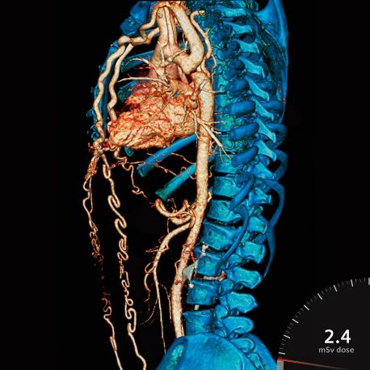
Industry-Driven Regional Collaborative Grant
Pilot the CT program
3 incumbent workers from 3 healthcare partners = 9
Coordinator costs
Equipment costs

Slide 21
Benefits of Regionalization
All workforce training specialization needs met
No competition between colleges for students
No competition for clinical placements
No saturation of the market
Graduates get jobs
Sharing best practices for outside accreditation

Slide 22
Benefits of Priority Sector Focus
Graduates get job
Hospital workforce needs met
Consumer healthcare needs met
Strong Workforce funding eligible

Slide 23
Who should be involved?
Faculty!
Managers and deans
Administrators
Regional consortia
Sector navigators and deputy sector navigators
Industry partners

Slide 24
What examples do you have?

Slide 25
Questions?

Slide 26
Thank you!
Cheryl Aschenbach: caschenbach@lassencollege.edu
Kim Harrell: Kimberley.Harrell@crc.losrios.edu
Lorraine Slattery-Farrell: lfarrell@msjc.edu

