Slide 1
Cultural Competency Across the Curriculum
Randy Beach, Southwestern College Cynthia Reiss, ASCCC Curriculum Committee, West Valley College

Slide 2
Description
Central to an institutional framework of equity and inclusion necessary for closing the success and persistence gaps for disproportionately impacted student populations is having a sense of our student’s capacity as learners and knowing that our students learn and demonstrate their learning better in culturally sensitive learning environments. In a culturally-sensitive environment, students’ prior learning and experiences are central to the design of their instruction. While this type of environment is laudable, faculty sometimes struggle with strategies to create it. How are faculty at your college achieving this? Is the institution as a whole engaged in supporting cultural-sensitive instruction? Are there models to promote cultural competency across the curriculum? Practitioners will provide models and examples to consider when working to make progress in this area locally.
ASCCC Curriculum Institute July 11-14, 2018 Riverside Convention Center

Slide 3
What brings you to this breakout? What do you hope to learn?
ASCCC Curriculum Institute July 11-14, 2018 Riverside Convention Center

Slide 4
What is Cultural Competency?
Cultural competence refers to a set of congruent attitudes, practices, policies, and structures that come together in a system or agency to enable professionals to work more effectively with members of culturally distinct groups in a manner that values and respects the culture and worldview of those groups.
ASCCC Curriculum Institute July 11-14, 2018 Riverside Convention Center
Notes:
Cindi

Slide 5
What is a Culturally Competent Organization?
Organizations have a "culture" of policies, procedures, programs, and processes, and incorporate certain values, beliefs, assumptions, and customs.
A culturally competent organization brings together knowledge about different groups of people -- and transforms it into standards, policies, and practices that make everything work.
Hanley, J. (1999). “Beyond the tip of the iceberg: five stages toward cultural competence.” Today’s Youth: The Community Circle Of Caring Journal, 3(2), 9-12.
ASCCC Curriculum Institute July 11-14, 2018 Riverside Convention Center

Slide 6
Cultural Knowledge, Awareness, Sensitivity
WHAT’S THE DIFFERENCE?
ASCCC Curriculum Institute July 11-14, 2018 Riverside Convention Center
Notes:
Cindi will add sub bullets if needed

Slide 7
Cultural Competence Is Important because…
Cultural competence acknowledges and validates who people are Focuses on the organization's culture; no need to blame and assume guilt
Since becoming culturally competent focuses on the "how-to" of aligning policies and practices with goals, everyone is involved in the process. This "inside-out" model relieves the outsiders (or excluded groups) from the responsibility of doing all the adapting.
ASCCC Curriculum Institute July 11-14, 2018 Riverside Convention Center

Slide 8
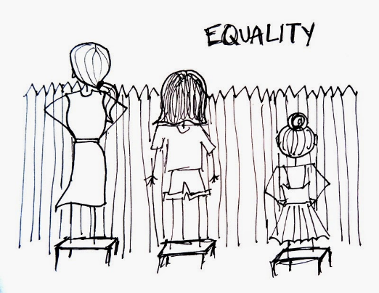
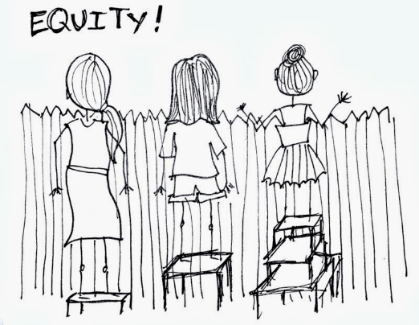
Cultural Competence And Equity
If we do not know who our students are , where they come from, what their experiences are…how can we genuinely create an effective culturally competent environment?
ASCCC Curriculum Institute July 11-14, 2018 Riverside Convention Center
Notes:
Look for graph or visual to demo this concept

Slide 9
What do the data say?
Diversity of CC student populations even more varied
Students from diverse backgrounds/minorities comprise 45% of the student population in community colleges nationwide ³
Community college mission (open access/affordability) supports a diverse student population
Ethnic diversity in the US
Ethnic diversity of California Community College students
Ethnic diversity of California community college faculty
3 American Association of Community Colleges (2012). Students at community colleges. Retrieved from http://www.aacc.nche.edu/Pages/default.aspx.
ASCCC Curriculum Institute July 11-14, 2018 Riverside Convention Center
Notes:
Randy add hyperlinks or notation to slides at end of presentation

Slide 10
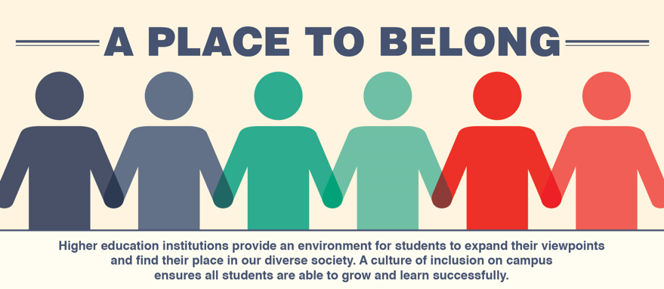
Characteristics of a Culturally Competent Learning Environment
Values diversity and similarities among people
Understands and effectively responds to cultural differences
Engages in cultural self-assessment at the individual/organizational levels
Uses assessment data; adapts delivery of services and supports
Institutionalized cultural knowledge
ASCCC Curriculum Institute July 11-14, 2018 Riverside Convention Center
Notes:
Randy

Slide 11
Creating the Culturally Competent Environment: Prior Learning and Experiences
Do we know our students?
Do faculty meet students where they are rather than adapting wholly to instructor’s experience?
Are program and curricular development designed with what students bring to the table and how those skills/experiences affect their learning in the program/course?
ASCCC Curriculum Institute July 11-14, 2018 Riverside Convention Center
Notes:
Randy

Slide 12
Creating the Culturally Competent Environment: Prior Learning and Experiences
Staff agree with the notion that instruction should attempt to meet the student where they begin rather than student adapting wholly to an instructor’s experience
Program development that considers cultural competency asks what do students bring to the table and how does it affect their learning in the program/course
ASCCC Curriculum Institute July 11-14, 2018 Riverside Convention Center
Notes:
Randy

Slide 13
Creating the Culturally Competent Environment: Prior Learning and Experiences
Learning outcomes and skills taught align with cultural competency goals of the institution as stated in institutional learning outcomes, the mission, educational planning
ASCCC Curriculum Institute July 11-14, 2018 Riverside Convention Center
Notes:
Randy

Slide 14
Creating the Culturally Competent Environment: Strategies in the Classroom⁶
Recognize/communicate to students cultural competency as an institutional value
Review syllabi for inclusive language
Incorporate readings/examples/assignments that challenge dominant narratives
Create ground rules for community discussion
Teaching techniques for varied learning styles
⁶ ”Faculty Teaching Strategies for Creating Inclusive Classrooms.” Kristie Ford, Skidmore College; Kelly Maxwell, University of Michigan; Teresa Nance, Villanova University; Kathleen Wong (Lau) San Jose State University. PowerPoint. AACU Conference: Diversity, Learning and Student Success. March 15, 2017-March 17, 2017
ASCCC Curriculum Institute July 11-14, 2018 Riverside Convention Center
Notes:
Randy

Slide 15
Creating the Culturally Competent Environment: Strategies in the Classroom⁶
Take temperature of class climate; request feedback
Model appropriate forms of engagement; mutual sharing; risk taking and acknowledge when students do the same
Be conscious of visible/invisible social identities, including your own
Practice empathy-take on others’ perspectives
ASCCC Curriculum Institute July 11-14, 2018 Riverside Convention Center
Notes:
Randy

Slide 16
Creating the Culturally Competent Environment: Challenges in the Classroom⁶
How much of one’s own identity to share?
How to engage in a topic when there’s only one student that represents that positionality (solo status)?
How to represent identities that aren’t in the room?
How to deal with micro/macro aggressions?
How to deal with conflict when it surfaces?
ASCCC Curriculum Institute July 11-14, 2018 Riverside Convention Center
Notes:
Cindi

Slide 17
Creating the Culturally Competent Environment: Challenges in the Classroom⁶
How to create a safe space--balancing freedom of expression in today’s political climate? What is a brave space?
How to signal to students that I (as a faculty member) am someone that is safe to talk to about a variety of challenging campus and personal issues?
ASCCC Curriculum Institute July 11-14, 2018 Riverside Convention Center

Slide 18
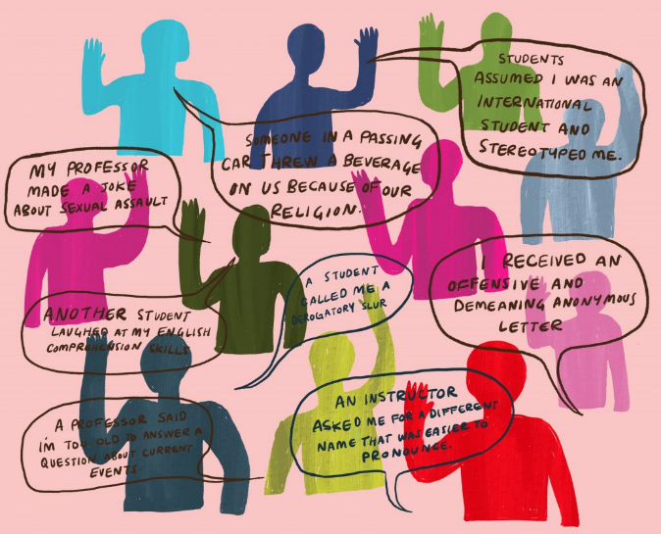
Creating the Culturally Competent Environment: The Faculty
Where are the barriers? Resistance?
Question of academic freedom
Often careers didn't begin with a specific goal to teach; choice came later to teach within community colleges
Community college instructors are often hired with no or minimum academic preparation teaching and learning
ASCCC Curriculum Institute July 11-14, 2018 Riverside Convention Center

Slide 19
Creating the Culturally Competent Environment: The Faculty
Advocating for cultural competency and diversity as a value in faculty hiring
Discussing values around student diversity and equity in curriculum development and program management
Valuing culturally competent instructional/assessment methods
Establishing demonstration of cultural competency as a learning outcome or graduation requirement
ASCCC Curriculum Institute July 11-14, 2018 Riverside Convention Center

Slide 20
Creating the Culturally Competent Environment: The Faculty
Little training training to search for and infuse diverse readings and pedagogical methods
Course objectives vs. metacognition focus (too little time)
It is easier to ignore diversity than acknowledge it; changing instructional practices to reflect diverse viewpoints may result in conflict between students
ASCCC Curriculum Institute July 11-14, 2018 Riverside Convention Center

Slide 21
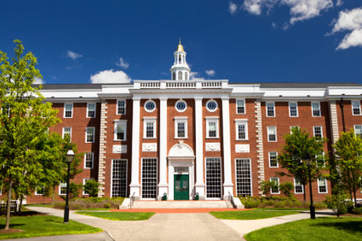
Creating the Culturally Competent Environment: The Institution
Cultural competency and diversity as a value in all hiring and professional development
Promoting cultural competency as an institutional value in the mission and strategic planning
Holding everyone accountable for clearly defined standards of conduct
ASCCC Curriculum Institute July 11-14, 2018 Riverside Convention Center
Notes:
Cindi

Slide 22
Cultural Competence and Global Engagement
Equips our students to thrive in a global economy
Cultivates the capacity for all students to see themselves in other shoes and see the world from multiple perspectives
Builds global confidence
Creates experiences in the world through service learning, study abroad and capstone projects to compel students to observe, reflect on and take action
Engages students by using high-impact practices which engage students prior learning and experiences in observing, reflecting on and creating solutions
ASCCC Curriculum Institute July 11-14, 2018 Riverside Convention Center
Notes:
Cindi

Slide 23
Cultural Competence and Global Engagement
Case Studies:
West Valley College Global Initiatives
College of the Canyons Service Learning
Miami Dade Community College
ASCCC Curriculum Institute July 11-14, 2018 Riverside Convention Center
Notes:
Cindi

Slide 24
Best intentions, but are we listening?
Can cultural competency really improve student success if we don’t act on what we learn?
What do we do when faculty and administration assume student success is not their responsibility?
Are faculty sometimes blinded to the lack of student engagement?
ASCCC Curriculum Institute July 11-14, 2018 Riverside Convention Center
Notes:
Randy

Slide 25
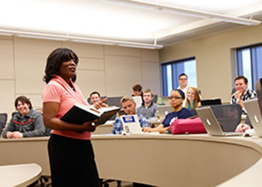
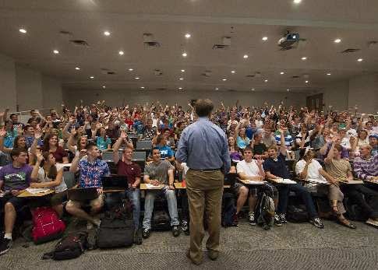
What can you do? Faculty
Approve a cultural competency requirement for the associates degree
Integrate culturally diverse readings/materials into assignments
Use real world scenarios that involve cultural differences in critical thinking exercises and projects
Promote class environments as “brave spaces”
ASCCC Curriculum Institute July 11-14, 2018 Riverside Convention Center
Notes:
Randy

Slide 26
What can you do? Institution
Integrate cultural competency and global awareness learning outcomes
Hold the institution accountable for hiring and promoting staff with a mindset for equity, cultural awareness, and diversity
Be transparent about gaps, be aspirational in goal-setting
ASCCC Curriculum Institute July 11-14, 2018 Riverside Convention Center
Notes:
Randy

Slide 27
Questions?
Do you have any additional questions for us? Randy Beach, Southwestern College, rbeach@swccd.edu
Cynthia Reiss, ASCCC Curriculum Committee, West Valley College
cynthia.reiss@westvalley.edu
ASCCC Curriculum Institute July 11-14, 2018 Riverside Convention Center

Slide 28
What do the data say?
276 ethnic groups in the US ¹
By 2044, more than half of all Americans will identify as a member of a “minority” group (2015) ²
The number of people who identify as multiracial is projected to triple from eight to 26 million by 2060 ²
1 Gollnick, D. M., & Chinn, P. C. (2002). Multicultural education in a pluralistic society (6th ed.). Upper Saddle River, NJ: Merrill Prentice Hall. 2 Colby, S. L. & Ortman, J. M. (2015). Projections of the size and composition of the U.S.population: 2014 to 2060. Retrieved from http://www.census.gov/content/dam/Census/library/publications/2015/demo/p25-1143.pdf?

Slide 29
California’s Community Colleges Students⁴
42.5 percent of students identified as Hispanic;
27.4 percent as White;
6.4 percent as African American;
11.6 percent as Asian;
3.2 percent as Filipino or Pacific Islander; and
3.7 percent as multi-ethnic
4 California Community College Chancellor’s Office. “California Community Colleges Key Facts” (2017). http://californiacommunitycolleges.cccco.edu/PolicyInAction/KeyFacts.aspx

Slide 30
What about faculty?
According to CCCCO DataMart… 18,593 Tenure and Tenure Track Faculty (FA 16)
African-American | 1,080 | 5.81%
American Indian/Alaskan Native | 117 | 0.63%
Asian | 1,731 | 9.31%
Hispanic | 2,851 | 15.33%
Multi-Ethnicity | 222 | 1.19%
Pacific Islander | 68 | 0.37%
Unknown | 1,279 | 6.88%
White Non-Hispanic | 11,245 | 60.48%

