Slide 1
Supplemental Instruction, Learning Centers, and Tutoring Programs
Randy Beach, Southwestern College LaTonya Parker, ASCCC South Representative

Slide 2
Description
Tutoring and supplemental instruction services may generate state apportionment. This session surveys the current regulations and proposed legislation that seeks to enhance apportionment for tutoring programs. Learn about the types of credit and noncredit courses that may be eligible for enhanced funding, and about the ways that tutoring and supplemental instruction can be offered. As guidance about AB 705 implementation continues to be released, learn how supplemental instruction and similar programs may be used to enhance student learning as curriculum changes.

Slide 3
What brings you to this breakout? What do you hope to learn?
ASCCC Curriculum Institute July 11-14, 2018 Riverside Convention Center

Slide 4
Noncredit Basics

Slide 5
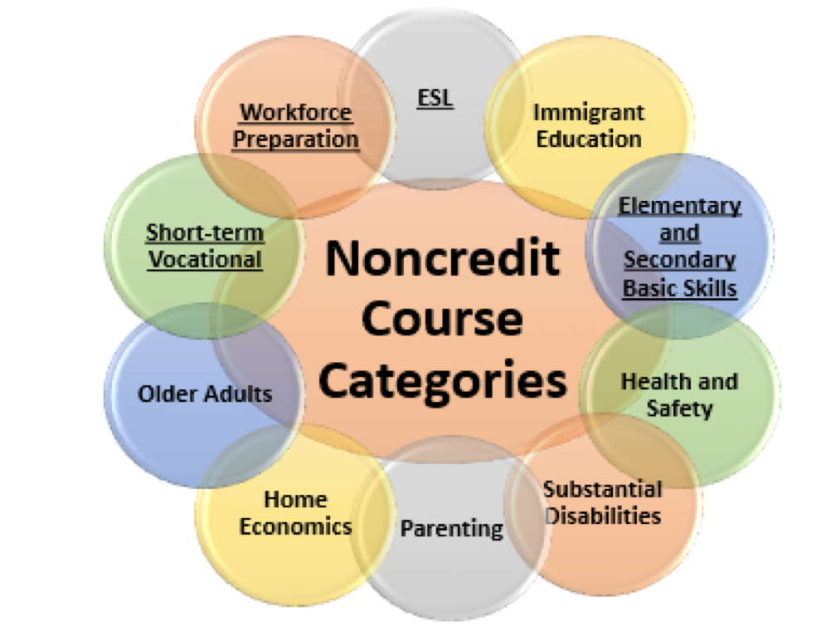
Noncredit Courses: Ten Categories
English as a Second Language (ESL)*
Immigrant Education
Elementary and Secondary Basic Skills*
Health and Safety
Substantial Disabilities
Parenting
Home Economics
Courses for Older Adults
Short-term Vocational*
Workforce Preparation*
*Areas (1), (3), (9), (10) are eligible for Enhanced Funding if associated with an approved noncredit program.
ASCCC Curriculum Institute July 11-14, 2018 Riverside Convention Center

Slide 6
Tale of the Tape: Side by Side Comparison
Credit and CTE
Generate apportionment; student fees apply
Fees
Unit granting
Degree applicable and non-degree applicable (basic skills)
Certificates of Achievement
Not designated as repeatable (except in limited circumstances)
Auto-approval and chaptering at the CCCCO
Noncredit
Generate apportionment—two levels (noncredit and enhanced noncredit)
No student fees
No units (positive attendance taken)
Certificates of Competency & Completion
Designated as repeatable
Requires CCCCO approval
ASCCC Curriculum Institute July 11-14, 2018 Riverside Convention Center

Slide 7
Career Development and College Preparation (CDCP)Funding
EC 84750.5 (d)
Established uniform funding rate for noncredit courses and an enhanced rate for CDCP
FY 2014-15, the California State Legislature approved the enhanced CDCP noncredit rate to be equivalent to the credit FTES funding rate, effective July 1, 2015
2015-16 budget included $49 million to fund the rate increase
ASCCC Curriculum Institute July 11-14, 2018 Riverside Convention Center

Slide 8
Career Development and College Preparation (CDCP)
Preparation for employment or success in college-level credit coursework
Four categories of courses that, if combined into a noncredit certificate, can be eligible for apportionment funding equal to credit
Four categories: ESL, Basic Skills, Short-term Vocational, Workforce Prep
Overall Noncredit requirements established in Ed. Code 84760
ASCCC Curriculum Institute July 11-14, 2018 Riverside Convention Center

Slide 9
CDCP Funding
 | 2006-07 | 2016-17 | 2017-18
Basic (Regular) Noncredit | $2626 | $2840 | $3050
Enhanced Noncredit (CDCP) | $3254 | $4724 | $5072
Credit | $4367 | $4724 | $5072
ASCCC Curriculum Institute July 11-14, 2018 Riverside Convention Center

Slide 10
Title 5

Slide 11
Title 5 Regulations and Tutoring
§ 58168. Tutoring
A method of instruction in credit and noncredit that involves a student tutor who has
been successful in a particular subject or discipline
who has demonstrated a particular skill
who has received specific training in tutoring methods
who assists one or more students in need of special supplemental instruction in the subject or skill.
ASCCC Curriculum Institute July 11-14, 2018 Riverside Convention Center
Notes:
Randy

Slide 12
Title 5 Regulations and Tutoring
§ 58170. Apportionment for Tutoring
Apportionment may be claimed for individual student tutoring only if all the following conditions are met
individual student tutoring is conducted through a designated learning center
designated learning center is supervised by a learning skills coordinator or instructor, or tutoring coordinator who meets the minimum qualifications (§ 53415)
ASCCC Curriculum Institute July 11-14, 2018 Riverside Convention Center
Notes:
Randy

Slide 13
Title 5 Regulations and Tutoring
§ 58170. Apportionment for Tutoring
Tutors successfully complete instruction in tutoring methods and the use of appropriate written and mediated instructional materials
All students are enrolled in a noncredit course carrying a TOP code 4930.09 titled “Supervised Tutoring
Aligns with noncredit “Elementary and secondary basic skills and other courses and classes such as remedial academic courses or classes in reading, mathematics, and language arts”
ASCCC Curriculum Institute July 11-14, 2018 Riverside Convention Center
Notes:
Randy

Slide 14
Title 5 Regulations and Tutoring
§ 58170. Apportionment for Tutoring
Students enroll after referral by a counselor or an instructor
An attendance accounting method is positive attendance
District does not claim state apportionment for tutoring services paid by state categorical funds
BOG considering change to allow for student referral
ASCCC Curriculum Institute July 11-14, 2018 Riverside Convention Center
Notes:
Randy

Slide 15
Title 5 Regulations and Tutoring
§ 58172. Learning Assistance
Apportionment for supplemental learning assistance in credit and noncredit dependent on:
It’s required for all students
or
or it’s optional and is provided through an open entry/open exit course
ASCCC Curriculum Institute July 11-14, 2018 Riverside Convention Center
Notes:
Randy

Slide 16
Title 5 Regulations and Tutoring
§ 58164. Open Entry/Open Exit Courses
refers to courses in which students enroll at various times, and complete at various times or at varying paces
one unit of credit shall be awarded for approximately 48 hours of recitation, study, or laboratory work
to provide support for another course or courses, the COR for the OE/OE must identify the other course(s) it supports and the specific learning objectives and competencies
ASCCC Curriculum Institute July 11-14, 2018 Riverside Convention Center
Notes:
Randy

Slide 17
Legislation and Tutoring: Proposed Changes
Two bills focused on tutoring requirements
SB 1009 (Wilk)
Provides apportionment for supervised tutoring
basic skills, degree applicable, or transfer level
removes requirement for a referral
removes ESL and workforce preparation classes for immigrants the list of courses eligible for noncredit apportionment for supervised tutoring
ASCCC Curriculum Institute July 11-14, 2018 Riverside Convention Center

Slide 18
Legislation and Tutoring: Proposed Changes
Two bills focused on tutoring requirements
AB 1935 (Irwin)
authorizes noncredit apportionment for supervised tutoring to assist students in degree-applicable and transfer-level courses
ASCCC Curriculum Institute July 11-14, 2018 Riverside Convention Center

Slide 19
What about AB 705?
All about placement processes
AB 705 (signed October 13, 2017) requires colleges to use one or more of the following when placing students into courses in math and English:
High School Coursework
High School GPA
High School Grades
If colleges are not able to obtain official transcript data, they can use self reported data or guided placement
ASCCC Curriculum Institute July 11-14, 2018 Riverside Convention Center
Notes:
adult transcripts still have validity 10 years out for placement.

Slide 20
What about AB 705?
A community college district or college shall maximize the probability that a student will enter and complete transfer-level coursework in English and mathematics within a one-year timeframe
One year will be defined as two semesters
Currently, these two semesters are not required to be consecutive because colleges cannot force students into a specific behavior.
The “clock” will begin when the student enrolls in a course that is part of the sequence leading to transfer level. The initial course could be credit or noncredit.
Notes:
There is some discussion as to what noncredit courses can be construed as beginning the clock. Noncredit can still offer basic math and basic English for students wanting to improve in these areas. What the Chancellors doesn’t want to happen is credit students going to noncredit to do remedial work. Noncredit ESL and credit ESL boundaries still under determination.

Slide 21
What about AB 705?
The likelihood of students succeeding at the transfer level can be increased by offering some type of support (tutoring, SI, corequisite course)
AB 705 specifically permits colleges to implement corequisite models
A community college district or college may require students to enroll in additional concurrent support, including additional language support for ESL students, during the same semester that they take a transfer-level English or mathematics course, but only if it is determined that the support will increase their likelihood of passing the transfer-level English or mathematics course.

Slide 22
What about AB 705?
How are these corequisite support courses validated? Does the language in Title 5 §55003 need to be modified?
What data will need to be collected to ensure there is no disproportionate impact?
Will there be different levels of corequisite support for a single parent course? If yes, how can a placement model be developed to choose the “ideal” amount of support?
Notes:
AB705 has already said that noncredit could be used as a corequisite. The issue is that noncredit courses can not be required. For example, we are piloting a noncredit coreq where students can
choose to either take one level below transfer course (if that is where they were placed) OR start with the transfer level course with a noncredit co-req. Advantages of noncredit: no use of financial aid. Downside may affect units needed for financial aid. As far as the comment of parent course being at the transfer level, what is the difference if a student has SI in the course, or embedded tutoring, or visits the learning center.

Slide 23
Supplemental Instruction and Tutoring:
A Case to Consider

Slide 24
Close to Home: What Does SI Look Like on Your Campus
Supplemental Instruction (SI) is a series of weekly review sessions for students taking historically difficult courses. SI is a peer-facilitated group discussion associated with collaborative learning. It is not tutoring. The SI Leader is a facilitator who has taken the subject and will disseminate course material to help students succeed. Research shows that students that attend SI sessions increase the probability of earning a better grade. These sessions are free of charge and provide the students with alternative avenues for learning; such as collaborative thinking, social skills, and address individual learning styles. SI review sessions are informal, so bring your notes, your textbooks, and your questions.
ASCCC Curriculum Institute July 11-14, 2018 Riverside Convention Center

Slide 25
Benefits to Students
Students who attend SI sessions discover appropriate application of study strategies, such as note taking, organization, etcetera.
SI Resources provided by the Learning Center:
Laptops
SI session materials and resources
Course textbooks
SI planning resources
Classroom facilitated sessions provided by SI Leader
Better competence of classroom mater
ASCCC Curriculum Institute July 11-14, 2018 Riverside Convention Center

Slide 26
Who Are the SI Leaders
SI Leaders...
Are students who have successfully completed the course (in most cases) with assigned instructor
Foster critical thinking and strengthen study skills in order to improve individual performance and achievement
Become better facilitators and mentors
Assist students in passing courses you have already taken
Must be requested by faculty and approved by SI Program staff
ASCCC Curriculum Institute July 11-14, 2018 Riverside Convention Center

Slide 27
On Campus Tutoring: Moreno Valley College
Tutorial Services provides FREE on-site group and one-on-one tutoring in most academic subjects to all currently registered MVC students.
Students are allowed two 50 minute sessions per enrolled subject per week.
Appointments are available on a first come, first serve basis (on the hour) with a maximum of two hours per week, depending on availability of tutor or subject.
Scheduling for tutoring sessions begins one week in advance beginning Wednesday at 3:00 PM for the following week.
ASCCC Curriculum Institute July 11-14, 2018 Riverside Convention Center

Slide 28
On Campus Tutoring: Moreno Valley College
Appointments can be made at the Tutorial Learning Center (TLC) located on the second floor in the SAS building, room 206.
Students participating in the EOPS, ACES and Guardian Scholars program receive additional 50-minute sessions per week.
We do not provide tutoring for English and Reading courses. Please call 951-571-6128 or visit the Writing Reading Center site for more information.
ASCCC Curriculum Institute July 11-14, 2018 Riverside Convention Center

Slide 29
Online Tutoring Service
NetTutor® is a comprehensive online tutoring service for all college courses. This service available to assist students with homework and studying. The tutors are fully trained experts in the courses for which they tutor. NetTutor is available 24/7/365, ! https://www.google.com/url?q=http%3A%2F%2Fwww.nettutor.com%2F
How Students Access NetTutor:
Log into Blackboard/Open Campus
Click on your course.
Look on the course homepage for the NetTutor link. If you do not have access to NetTutor, please request it from your instructor.
Click the NetTutor link (you must allow pop-ups).
Join a Live Tutorial, submit a question to the Q&A Center, or submit a paper to the Paper Center and get help quickly and easily.
ASCCC Curriculum Institute July 11-14, 2018 Riverside Convention Center

Slide 30
NetTutor Subjects
Students Log on NetTutor for assistance with the following subjects:
Accounting
Arts
Algebra
Astronomy
Biology
Calculus
Chemistry
Criminal Justice
Differential Equations
Economics
English Composition/Writing
Finance
Foreign Language
General Mathematics
Geometry
History
Information Technology
Management
Nursing/Allied Health
Paralegal Studies
Physics
Social Sciences
Statistics
Trigonometry
ASCCC Curriculum Institute July 11-14, 2018 Riverside Convention Center

Slide 31
ASCCC Support for Supplemental Instruction
Resolution FA11 13.19 Supplemental Instruction and Student Success Task Force Recommendation 5.1
Resolution FA 11 13.20 Supplemental Instruction Survey and Glossary
Resolutions establish ASCCC support for Supplemental Instruction
“Supplemental Instruction Revisited” Rostrum, April 2018
info@asccc.org
www.asccc.org
ASCCC Curriculum Institute July 11-14, 2018 Riverside Convention Center

Slide 32
Questions?
ASCCC Curriculum Institute July 11-14, 2018 Riverside Convention Center

