Slide 1
Curriculum and Accreditation

Slide 2
Curriculum and Accreditation
Cheryl Aschenbach, Secretary, Academic Senate for California Community Colleges
Randy Beach, Commissioner and Educational Programming Committee Chair, Accrediting Commission for Community and Junior Colleges
Stephanie Droker, President, Accrediting Commission for Community and Junior Colleges

Slide 3
Breakout Description
Curriculum is a key component of the accreditation standards, and the relationship between curriculum and accreditation is critical for understanding the accreditation process. In this breakout, explore the interplay of curriculum requirements in relation to the requirements of accreditation and the importance of curriculum specialists, curriculum chairs, articulation officers, and others in the accreditation process.

Slide 4
Overview
Updates in accreditation processes
Accreditation Standards on Curriculum
Evidence and Documentation
During the Team Visit
Recent Changes
Discussion…

Slide 5
What's New in Accreditation
Formative/Summative Review Approach (Pilot Phase)
Standards Review (2021)
ACCJC Leadership Transition
Negotiated Rulemaking: Distance Education

Slide 6
Standard I
Mission, Academic Quality and Institutional Effectiveness
I.A.3
I.B.5
I.C.2

Slide 7
Accreditation Standards on Curriculum
I.A.3. The institution’s programs and services are aligned with its mission. The mission guides institutional decision-making, planning, and resource allocation and informs institutional goals for student learning and achievement.
The institution can demonstrate that its programs and services align with its mission.
The Curriculum Committee relates decisions to the college’s mission
Baccalaureate Degrees are a part of the mission

Slide 8
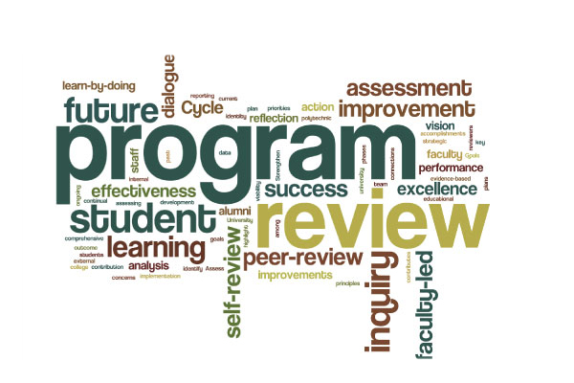
Accreditation Standards on Curriculum
I.B.5. The institution assesses accomplishment of its mission through program review and evaluation of goals and objectives, student learning outcomes, and student achievement. Quantitative and qualitative data are disaggregated for analysis by program type and mode of delivery.
Curriculum review in program review process
Data assessment and analysis drive college planning to improve student learning and student achievement.
Data used for assessment and analysis is disaggregated to reflect factors of difference among students, as identified by the institution.

Slide 9
The Standards and the Catalog
I.C.2. The institution provides a print or online catalog for students and prospective students with precise, accurate, and current information on all facts, requirements, policies, and procedures listed in the “Catalog Requirements” (ER 20)
Catalog Requirements
Course, Program, and Degree Offerings
Student Learning Outcomes for Programs and Degrees
Academic Freedom Statement
Acceptance and Transfer of Credits
The institution provides a print or online catalog, which is easily accessible to all interested parties.
The catalog presents accurate and current information for all required details listed in “Catalog Requirements.”
Notes:
Randy

Slide 10
Standard II
Student Learning Programs and Support Services
II.A.1
II.A.2
II.A.3
II.A.4
II.A.9
II.A.12
II.A.13
II.A.16

Slide 11
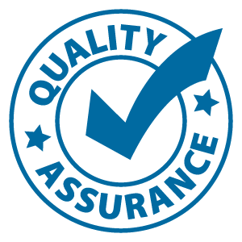
Accreditation Standards on Curriculum
II.A.1. All instructional programs, regardless of location or means of delivery, including distance education and correspondence education, are offered in fields of study consistent with the institution’s mission, are appropriate to higher education, and culminate in student attainment of identified student learning outcomes, and achievement of degrees, certificates, employment, or transfer to other higher education programs.
Role of curriculum committee in ensuring educational quality
All course and program offerings, whether traditional or distance education and/or correspondence education (DE/CE), baccaleaureat, align with the stated mission of the institution.
Program descriptions include expected student learning outcomes and list the degrees and certificates that can be earned.
Notes:
Unpacking the Standard-- SD

Slide 12
Accreditation Standards on Curriculum
II.A.2 (2019) Faculty, including full time, part time, and adjunct faculty, regularly engage in ensuring that the content and methods of instruction meet generally accepted academic and professional standards and expectations. In exercising collective ownership over the design and improvement of the learning experience, faculty conduct systematic and inclusive program review, using student achievement data, in order to continuously improve instructional courses and, programs thereby ensuring program currency, improving teaching and learning strategies, and promoting student success.
Curriculum review in program review process
Ouctomes and achivement data for degrees and certificates

Slide 13
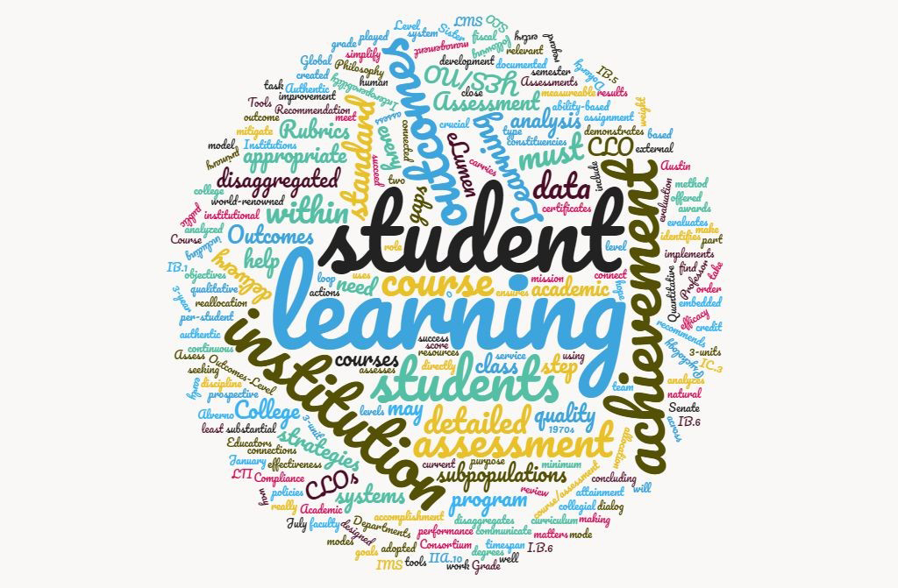
Accreditation Standards on Curriculum
II.A.3. The institution identifies and regularly assesses learning outcomes for courses, programs, certificates and degrees using established institutional procedures. The institution has officially approved and current course outlines that include student learning outcomes. In every class section students receive a course syllabus that includes learning outcomes from the institution’s officially approved course outline.
The institution has established a procedure for identifying student learning outcomes for courses, programs, certificates, and degrees.
Role of curriculum committee in SLO process
Role of curriculum committee and union regarding SLO
Intent of Standard is integrity-focused. Making sure the public/ students understand the intended outcomes of the course.
Notes:
address makikng sure the syllabi and COR SLOs match

Slide 14
Accreditation Standards on Curriculum
II.A.4. If the institution offers pre-collegiate level curriculum, it distinguishes that curriculum from college level curriculum and directly supports students in learning the knowledge and skills necessary to advance to and succeed in college level curriculum.
Role of curriculum committee in determining pre-collegiate from college-level courses
There is alignment between pre-collegiate level curriculum and college level curriculum in order to ensure clear and efficient pathways for students.
Course sequencing from pre-collegiate to college-level is clearly described

Slide 15
Accreditation Standards on Curriculum
II.A.5. The institution’s degrees and programs follow practices common to American higher education, including appropriate length, breadth, depth, rigor, course sequencing, time to completion, and synthesis of learning. The institution ensures that minimum degree requirements are 60 semester credits or equivalent at the associate level, and 120 credits or equivalent at the baccalaureate level.
Role of curriculum committee in determining appropriate degrees and programs
The academic credit awarded for upper division courses within baccalaureate programs is clearly distinguished from that of lower division courses.

Slide 16
Accreditation Standards on Curriculum
II.A.9. The institution awards course credit, degrees and certificates based on student attainment of learning outcomes. Units of credit awarded are consistent with institutional policies that reflect generally accepted norms or equivalencies in higher education. If the institution offers courses based on clock hours, it follows Federal standards for clock-to-credit-hour conversions.
Role of curriculum committee in ensuring this occurs
Objectives should lead to learning outcomes
Assessments should reflect objectives, content, outcomes
The institution can demonstrate that at the course level, passing grades on assignments or exams link directly to students’ demonstration of achieving learning outcomes.
Notes:
objectives, outcomes and assessments,

Slide 17
Accreditation Standards on Curriculum
II.A.12. The institution requires of all of its degree programs a component of general education based on a carefully considered philosophy for both associate and baccalaureate degrees that is clearly stated in its catalog. The institution, relying on faculty expertise, determines the appropriateness of each course for inclusion in the general education curriculum, based upon student learning outcomes and competencies appropriate to the degree level. The learning outcomes include a student’s preparation for and acceptance of responsible participation in civil society, skills for lifelong learning and application of learning, and a broad comprehension of the development of knowledge, practice, and interpretive approaches in the arts and humanities, the sciences, mathematics, and social sciences.
Role of curriculum committee in general education standards
The institution has a faculty developed rationale for general education that serves as the basis for inclusion of courses in general education and is listed in the catalog.
FOR INSTITUTIONS WITH A BACCALAUREATE DEGREE:
At least 36 semester units or equivalent of lower division general education is required, including at least nine semester units or equivalent of upper division general education coursework.
Notes:
how do you articulate this to students? Where is it documented?

Slide 18
Accreditation Standards on Curriculum
II.A.13. All degree programs include focused study in at least one area of inquiry or in an established interdisciplinary core. The identification of specialized courses in an area of inquiry or interdisciplinary core is based upon student learning outcomes and competencies, and include mastery, at the appropriate degree level, of key theories and practices within the field of study.
Role of curriculum committee in degree standards

Slide 19
Accreditation Standards on Curriculum
II.A.16. The institution regularly evaluates and improves the quality and currency of all instructional programs offered in the name of the institution, including collegiate, pre-collegiate, career-technical, and continuing and community education courses and programs, regardless of delivery mode or location. The institution systematically strives to improve programs and courses to enhance learning outcomes and achievement for students.
Role of curriculum committee in community education or community service programs (typically not a curriculum committee area of purview)
The program review process is consistently followed for all college programs, regardless of the type of program (collegiate, developmental, etc.).
Notes:
program review; CTE is called out. College definition of program is important. Even without an award (degree or cert) there should still be evaluation and review (program review). Fee-based and community ed courses. Who is responsible for that? What is the process? How is it analyuzed to imprvoe institutionla effectviness?

Slide 20
Standard IV
Leadership and Governance
IV.A.4

Slide 21
Accreditation Standards on Curriculum
IV.A.4. Faculty and academic administrators, through policy and procedures, and through well-defined structures, have responsibility for recommendations about curriculum and student learning programs and services.
Role of curriculum committee in making recommendations on curriculum
Institutional policies and procedures describe the official responsibilities and authority of the faculty and of academic administrators in curricular and other educational matters

Slide 22
Policies Aligned to Curriculum
Make sure your Curriculum Committee is aware of these local policies, which are addressed in the ISER:
Transfer of Credit
Distance Education and Correspondence Education
Clock to Credit Hours
Policy on Institutional Degrees and Credits
Transfer Policies

Slide 23
Evidence and Documentation
Types of evidence:
Curriculum Handbooks
Training Materials for Curriculum Committees
Course Outlines of Record including addendums
Meeting notes/minutes from Curriculum committee meetings
Inter-district Curriculum meetings (multi-college districts)
SLO and Program Review discussions related to curriculum
Curriculum information to the Board of Trustees
CCCCO Curriculum Inventory
More…

Slide 24
During the Team Visit
Team members may ask to meet with the Curriculum Chair and/or the members of the Curriculum Committee
Curriculum Chair should be familiar with (or have participated in the writing of Standards related to curriculum
Have examples ready of courses, programs, addendums ready for team if they request documentation
Have your curriculum inventory updated and your curriculum management system updated.
Curriculum Chair and committee members should be able to explain to visiting member curriculum process (training)
Curriculum Chair and committee members should be able to explain how the evaluate and make changes for improvement in curriculum process

Slide 25
Questions

Slide 26
References and Resources
ASCCC Accreditation Committee Website:
“Effective Practices in Accreditation: A Guide for Faculty” (ASCCC, 2015)
ACCJC Website
ACCJC Guide to Institutional Self-Evaluation,Improvement, and Peer Review
ACCJC Standards (2014)
ACCJC Formative/Summative Review Approach
info@asccc.org
accjc@accjc.org

Slide 27
THANK YOU!

