Slide 1
Online/Distance Education- Addendums, Compendiums, Guidelines, & Faculty Preparation

Slide 2
Description
Attendees of this breakout will be informed about the requirements regarding curriculum for teaching courses in a distance education modality and will consider some examples of processes for approving courses to be offered via distance education. Discussion will include where course modality fits in the curriculum development and approval process, why distance education courses undergo a separate curriculum approval process, and what elements are important and critical to support the success of students.

Slide 3
Agenda
Department of Education Updated Regulations
Title 5 Proposed Amendments
Professional Development for Faculty
Supporting students
Notes:
Timing:
Intro - 5 min [Suzanne]
Suzanne [10 min] - Updates to DE federal guidelines as of July 1 (from the WCET PPT/presentation) & implications for CCCs, and how these may impact Ed Code and Title 5 (?)
Robert [10 min] - Overview of proposed updates to Title 5 DE sections; Info about participating/giving input to BOG public hearing and 45 day public comment period, and Update on DE Guidelines from CCCCO
Karen [30 min] - Walk through the slides on: Faculty Preparation for DE (ask for input on PD); Types of DE; Communicating Expectations To Students; Providing Equitable Online Experiences. Create the
Karen & Robert [20 min]: moderate the ending discussions of 1) How expectations are being communicated to students and 2) general Q&A

Slide 4
Presenters
Karen Chow, ASCCC Area B Representative
Robert L Stewart Jr, ASCCC Area C Representative
Suzanne Wakim, Butte College

Slide 5
Department of Education Updated Regulations
In place as of July 1, 2021
Regular and Substantive Interaction, 34 CFR 600.2
Title 5 changes being made to align
Minor changes (should not affect CCC)
Defines instructor as the individual responsible for delivering course content and relies on accreditation standards for approval
Important changes
Defining Regular and Substantive Interaction

Slide 6
Substantive Interaction (definition added)
34 CFR 600.2 Definitions
For purposes of this definition, substantive interaction is engaging students in teaching, learning, and assessment, consistent with the content under discussion, and also include at least two of the following:

Slide 7
Substantive Interaction (components)
Providing direct instruction;
Assessing or providing feedback on a student’s coursework;
Providing information or responding to questions about the content of a course or competency;
Facilitating a group discussion regarding the content of a course or competency; or
Other instructional activities approved by the institution’s or program’s accrediting agency.

Slide 8
Regular Interaction (definition added)
An institution ensures regular interaction between a student and an instructor or instructors by, prior to the student's completion of a course or competency
Providing the opportunity for substantive interactions with the student on a predictable and scheduled basis commensurate with the length of time and the amount of content in the course or competency; and
Monitoring the student's academic engagement and success and ensuring that an instructor is responsible for promptly and proactively engaging in substantive interaction with the student when needed on the basis of such monitoring, or upon request by the student.

Slide 9
TITLE 5 PROPOSED AMENDMENTS
SECTIONS 55200, 55204, 55206, 55208 OF ARTICLE 1 OF SUBCHAPTER 3 OF CHAPTER 6 OF DIVISION 6 OF TITLE 5 OF THE CALIFORNIA CODE OF REGULATIONS
SECTION 55005 OF ARTICLE 1 OF SUBCHAPTER 1 OF CHAPTER 6 OF DIVISION 6 OF TITLE 5 OF THE CALIFORNIA CODE OF REGULATIONS

Slide 10
HOW TO PROVIDE INPUT TO THE BOARD OF GOVERNORS REGARDING PROPOSED TITLE 5 CHANGES
There is a 45 day public comment period (find a handout regarding this process under the “files” tab in Pathable)
Public can attend BOG meeting and comment in person
Public can submit written comments

Slide 11
Definition and Application of DE
§ 55200. DEFINITION AND APPLICATION.
(a) “Distance education” means education that uses one or more of the technologies listed below to deliver instruction to students who are separated from the instructor(s) and to support regular and substantive interaction between the students and instructor(s) either synchronously or asynchronously. instruction in which the instructor and student are separated by time and/or distance and interact through the assistance of technology.

Slide 12
Technologies that may be used to offer distance education include:
The internet;
One-way and two-way transmissions through open broadcast, closed circuit, cable, microwave, broadband lines, fiber optics, satellite, or wireless communications devices;
Audio conference; or
Other media used in a course in conjunction with any of the technologies listed in paragraphs (1) through (3) of this subdivision.
(b) The definition of “distance education” does not include correspondence courses. All distance education is subject to the general requirements of this chapter, as well as the specific requirements of this article. In addition, instruction provided as distance education is subject to the requirements of the Americans with Disabilities Act (42 U.S.C. § 12100 et seq.) and section 508 of the Rehabilitation Act of 1973, as amended (29 U.S.C. § 794d).

Slide 13
Why do DE courses need separate approval, and what should it encompass?
§ 55206. SEPARATE COURSE APPROVAL.
(a) If any portion of the instruction in a new or existing course is to be provided through distance education, an addendum to the official course outline of record shall be required. In addition to addressing how course outcomes will be achieved in a distance education mode, the addendum shall at a minimum specify and how the portion of instruction delivered via distance education meets:
(a) Regular and effective contact the requirement for regular and substantive interaction between instructors and students (and among students where applicable) as referenced in title 5,specified in section 55204.(a); and
(b) Requirements of the Americans with Disabilities Act (42 U.S.C. § 12100 et seq.) and section 508 of the Rehabilitation Act of 1973, as amended, (29 U.S.C. § 749d)
(b) The addendum shall be separately approved according to the district's adopted curriculum approval procedures.
Notes:
https://www.cccco.edu/-/media/CCCCO-Website/Office-of-General-Counsel/distance-education-attendance-notice-of-rulemaking-45-day-commentfinal-1-13-a11y.pdf?la=en&hash=6B2D3E0315766F4398CF096E24B86F3AC5F6ABFC
De Anza Online/Hybrid DE Addendum Guide can be found here: http://dilbert.fhda.edu/curriculum/
https://www.cccco.edu/-/media/CCCCO-Website/Office-of-General-Counsel/45-day-text-distance-education-final-6-18-2021-a11y.pdf?la=en&hash=C2C3F925EBCA650F73BD80A9BAD7BE7AD0E0A90F

Slide 14
Title 5 Proposed Changes: Regular and effective contact becomes Regular and Substantive Interaction
§ 55204 – Instructor Contact
In addition to the requirements of section 55002 and any locally established requirements applicable to all courses, district governing boards shall ensure that:
(a) Any portion of a course conducted through distance education includes regular effective contact and substantive interaction between the instructor(s) and students, (and among students where applicable), either synchronously or asynchronously, through group or individual meetings, orientation and review sessions, supplemental seminar or study sessions, field trips, library workshops, telephone contact, voice mail, e-mail, or other activities. Regular effective contact is an academic and professional matter pursuant to sections 53200 et seq.

Slide 15
Title 5 Proposed Changes: Regular and effective contact becomes Regular and Substantive Interaction
(b) “Substantive interaction” means engaging students in teaching, learning, and assessment, consistent with the content under discussion, and also includes at least two of the following:
(1) Providing direct instruction;
(2) Assessing or providing feedback on a student’s coursework;
(3) Providing information or responding to questions about the content of a course or competency;
(4) Facilitating a group discussion regarding the content of a course or competency; or
(5) Other instructional activities approved by the institution’s or program’s accrediting agency.

Slide 16
Title 5 Proposed Changes: Regular and effective contact becomes Regular and Substantive Interaction
(c) Regular interaction between a student and instructor(s) is ensured by, prior to the student’s completion of a course or competency:
(1) Providing the opportunity for substantive interactions with the student on a predictable and scheduled basis commensurate with the length of time and the amount of content in the course or competency; and
(2) Monitoring the student’s academic engagement and success and ensuring that an instructor is responsible for promptly and proactively engaging in substantive interaction with the student when needed on the basis of such monitoring, or upon request by the
student.

Slide 17
Title 5 Proposed Changes: Regular and effective contact becomes Regular and Substantive Interaction
(d) Regular and substantive interaction is an academic and professional matter pursuant to sections
53200 et seq.
(e) For purposes of calculating instructional time in the context of asynchronous distance
education, a week of instructional time is any week in which:
(1) The institution makes available the instructional materials, other resources, and instructor
support necessary for academic engagement and completion of course objectives; and
(2) The institution expects enrolled students to perform educational activities demonstrating
academic engagement during the week.
This part was removed:
(b)Any portion of a course provided through distance education is conducted consistent with guidelines issued by the Chancellor pursuant to section 409 of the Procedures and Standing Orders of the Board of Governors.

Slide 18
COURSE STANDARDS NEED TO BE DISCLOSED TO STUDENTS
§ 55005. PUBLICATION OF COURSE STANDARDS.
For each course offered, a community college shall make available to students through college publications all of the following facts before they enroll in the course:
(a) The designation of Whether the course is designated as a degree-applicable credit course, non degree-applicable credit course, a noncredit course, or a community services offering.
(b) Whether the course is transferable to baccalaureate institutions.
(c) Whether the course fulfills a major/area of emphasis or general education requirement.
(d) Whether the course is offered on the “pass-no pass” basis.
(e) Whether the course is offered in a distance education format, and if so, includes the
following information:
(1) All online and in-person synchronous meeting days/dates and times
(2) Any required asynchronous in-person activities
(3) Any required technology platforms, devices and applications
(4) Any test or assessment proctoring requirements.

Slide 19
Why is preparation required to teach online?
§ 55208. FACULTY SELECTION AND WORKLOAD.
(a) Instructors of course sections delivered via distance education are individuals responsible for delivering course content who meet the qualifications for instruction established by an institution’s accrediting agency. Instructors technology shall be selected by the same procedures used to determine all instructional assignments. Instructors shall possess the minimum qualifications for the discipline into which the course's subject matter most appropriately falls, in accordance with article 2 (commencing with section 53410) of subchapter 4 of chapter 4, and with the list of discipline definitions and requirements adopted by the Board of Governors to implement that article, as such list may be amended from time to time.
(b) Instructors of distance education shall be prepared to teach in a distance education delivery method consistent with the requirements of this article, local district policies, and negotiated agreements.
Notes:
Karen

Slide 20
Faculty Preparation for DE
May already be agreed upon or contractual
Summer, flex, or virtual trainings needed to prepare faculty
Resources available from @one,
What PD is your district offering? How has your local academic senate been involved? Share on Googledoc: https://docs.google.com/document/d/1qBgaRTlexM0cJyBatWj10kQJ0UlUl98wt_IvqoFApj4/edit?usp=sharing
Notes:
Karen

Slide 21
Equity Consideration
Synchronous
Asynchronous
Mirrors the face-to-face experience
Allows for real-time questions
Students have to log-in at designated time, even if sheltered-in-place with large family and limited devices/resources
Content is created in advance
Real-time questions can still be answered during office hours;
Provides students more opportunities to engage at their own pace
Notes:
Karen

Slide 22
COMMUNICATING EXPECTATIONS TO STUDENTS
Notes:
Karen

Slide 23
Students need to know . . .
If course is actually hybrid
If course has in-person, place-certain assessments or activities that cannot be completed from home
If the course is synchronous and requires them to log on at certain times
. . . before they enroll
Notes:
Karen

Slide 24
Students need to know . . .
Technology requirements (browser, how to access Canvas, if Zoom is needed)
How to remotely secure texts in advance of course
If special materials are also needed
How to reach the professor
How to access virtual tutoring and support services
Course requirements
Notes:
Karen

Slide 25
Providing EQUITABLE ONLINE EXPERIENCES
Notes:
Karen

Slide 26
Students have limited devices and space
Students have limited resources, devices, and space to learn from home
Students share space with others
Synchronous delivery may be impossible for some
Jill Toyoshiba
Notes:
Karen

Slide 27
OER Increase Access to Content
OER enable students to have access to materials before first day and save costs
ASCCC OER Resources: https://asccc-oeri.org/
Notes:
Karen

Slide 28
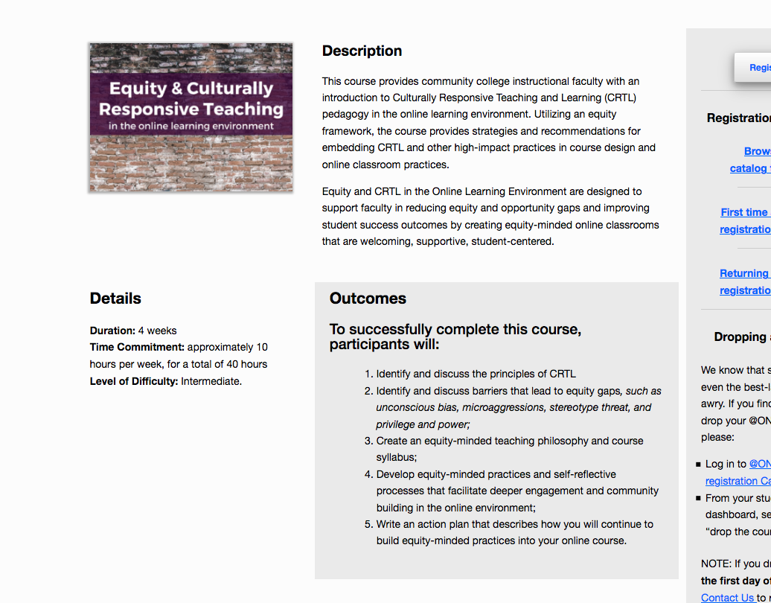
@ONE
Equity and Culturally Responsive Teaching Courses
Notes:
Karen

Slide 29
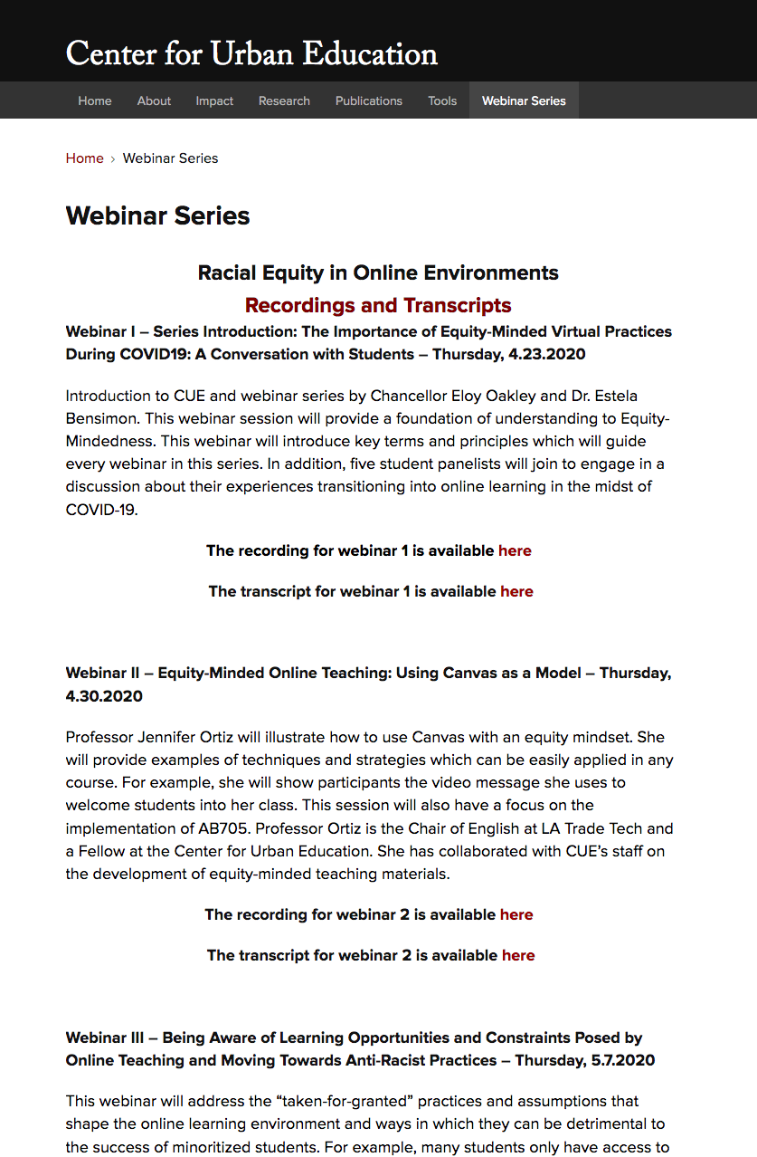
Archived Center for Urban Excellence Webinars on Racial Equity in Online Environments:
https://cue.usc.edu/events/
Notes:
Karen

Slide 30
Putting it all together . . .
Local approval of DE addenda
Meets course outcomes
Regular and Effective Contact
Accessible
PD Might Focus on:
Equity-minded practices for online learning
Canvas basics
OER
Notes:
Suzanne

Slide 31
Questions?
Thank You!
Karen Chow chowkaren@fhda.edu
Robert L. Stewart Jr. stewarrl@lasc.edu
Suzanne Wakim wakimsu@butte.edu

Slide 32
Types of DE
Fully online
Partially online (hybrid)
Fully online with flexible in-person component
Was included in DE Guidelines. DE Guidelines are not to be released by CCCCO to the field. Rather, the CCCCO may decide to release sections of it in Guidance Memos.
DE Compendium is being reviewed by ASCCC and DECO to determine its release to the field.
Asynchronous online
Synchronous online
All require separate review/approval of DE addenda and preparation for faculty

