Slide 1
Open Educational Resources (OER) and Open Educational Practices (OEP) – Accessible and Flexible Teaching Tools and Practices

Slide 2
Description
OER provides equitable access to course resources for students while allowing faculty to personalize their teaching resources based on their students’ backgrounds, skills, and demographics. OEP takes this one step further by inviting students to become contributors to academia rather than just passive recipients. What evidence is there that OER and OEP improve student success? This session will explore the what, why, and how of OER and OEP.
Notes:
Timing -
5 min - intro
5 min - cost data
15 min - Shagun
25 min - Suzanne
15 min - Jennifer
10 min - Q&A

Slide 3
Your Presenters
Shagun Kaur, Communication Studies, De Anza
Jennifer Paris, ECE, College of the Canyons
Suzanne Wakim, Biology, Butte

Slide 4
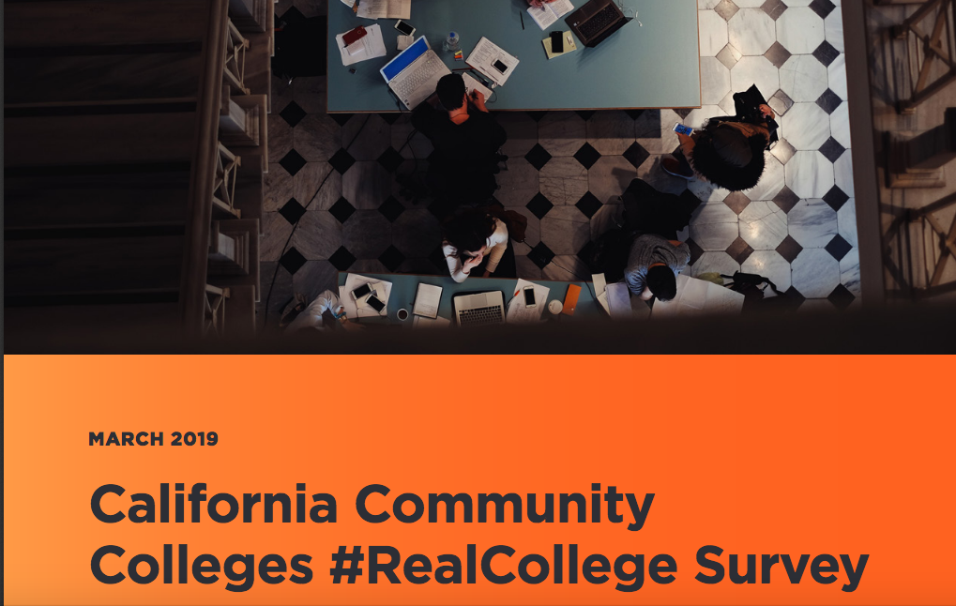
Our Students (before the pandemic)...
60% were housing insecure in the previous year
19% were homeless in the previous year
50% of respondents were food insecure in the prior 30 days.
Seven in 10 experienced one of the above during the previous year
Disparities based on demographics, academic, economic, and life experiences, and life circumstances
Source: https://hope4college.com/wp-content/uploads/2019/03/RealCollege-CCCCO-Report.pdf

Slide 5
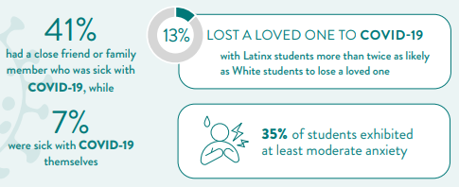
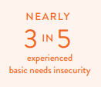
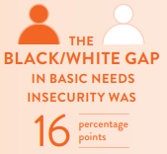
The Impact of the Pandemic - Real College 2021 Basic Needs Insecurity During the Ongoing Pandemic
Academic impact: declines in enrollment and full-time load
Economic Impact
Health Impact
Source: https://hope4college.com/wp-content/uploads/2021/03/RCReport2021.pdf

Slide 6
The Crushing Costs of Textbooks
Students have no control over the cost of their books
Access codes and automatic billing
50% of CC students use financial aid to buy their books
1 million students default per year
32% of students with $5,000 or less in debt will default (vs 14% of those with $35,000+)
If every student had just one textbook replaced with OER it would save students over $1,000,000,000/year!
Sources: https://uspirg.org/sites/pirg/files/reports/NATIONAL%20Fixing%20Broken%20Textbooks%20Report1.pdf; https://uspirg.org/sites/pirg/files/reports/Fixing-the-Broken-Textbook-Market_June-2020_v2.pdf; https://uspirg.org/sites/pirg/files/reports/Automatic-Textbook-Billing/USPIRG_Textbook-Automatic-Billing_Feb2020_v3.pdf; https://uspirg.org/sites/pirg/files/reports/Automatic-Textbook-Billing/USPIRG_Textbook-Automatic-Billing_Feb2020_v3.pdf

Slide 7
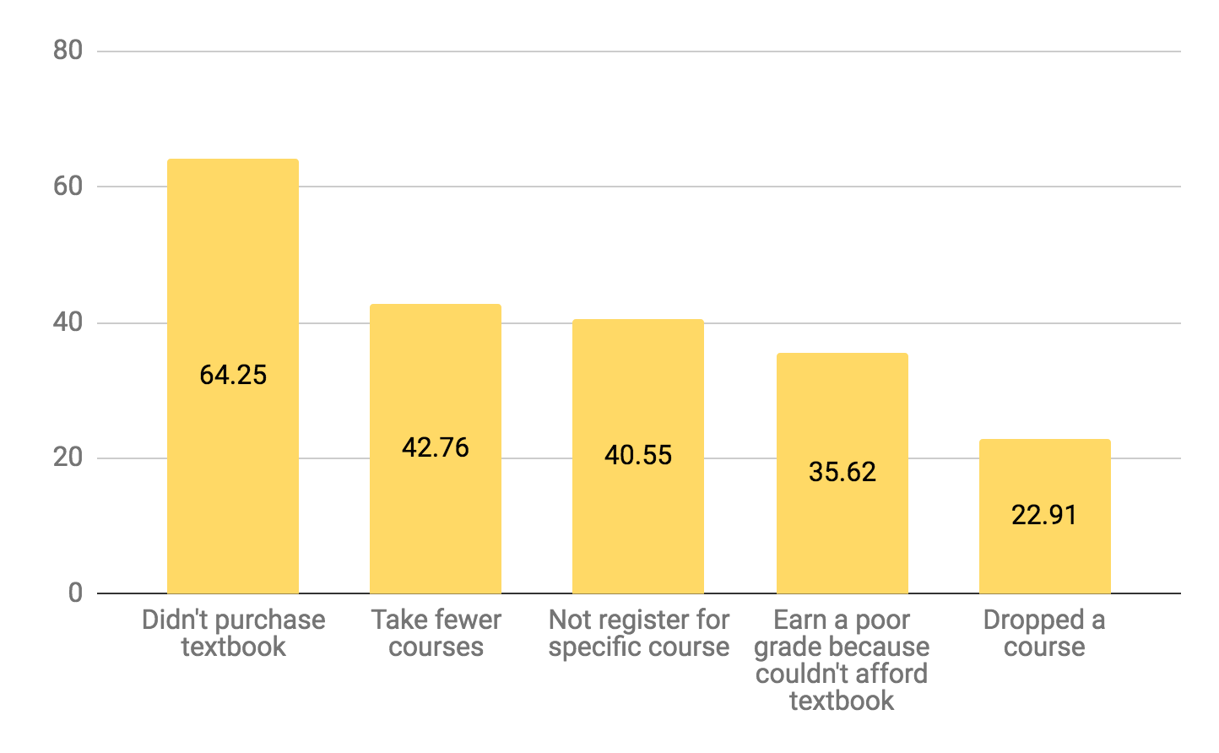
You Can’t Learn From a Resource You Can’t Get
“I need to pick up two extra shifts in order to afford my books…”
“I couldn’t pay all of my bills because of the cost of textbooks.”
“I couldn’t go last semester...because I couldn’t find any money to borrow.”

Slide 8
OER: Academic Freedom and Equity
Beyond cost, OER gives faculty academic freedom to find, adapt, and create materials that engage students in more meaningful and effective learning experiences.
Notes:
https://www.mentimeter.com/app (I used the ASCCC login)
Link to share during presentation: https://www.menti.com/474hzq438z (code: 3742 9612)
25 min
- 5 min for interactivity
- 10 min for definitions
- 10 min for examples

Slide 9
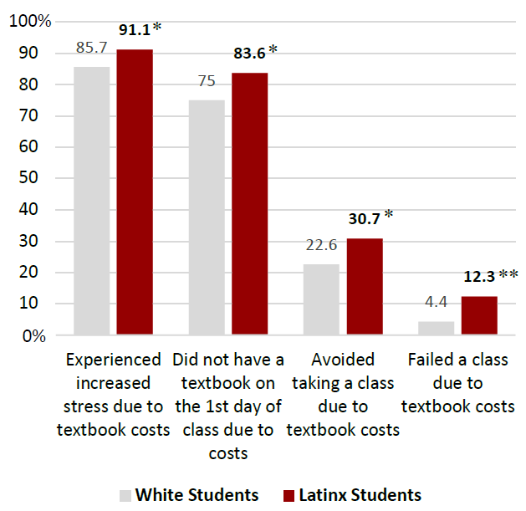
CSUCI Study
Notes:
CSU Channel Islands’ openCI initiative recently completed a campus-wide study of over 700 undergraduate students. This is a unique study because it focuses on exploring the impact of textbook costs specifically on historically underserved populations. Statistical analysis revealed textbook prices to be a significant educational barrier for all students, with a disproportionately negative effect among minoritized students, low-income students, and first-generation college students.

Slide 10
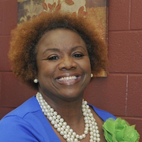
Instant Access 🡪 Removing Barriers
“Students have their textbook and faculty are able to teach instantaneously.
This removes barriers to access thus contributing to equitable outcomes in order to achieve equity in our education system.”
Source: "COVID-19 Reflection: How OER contributes to our equitable education system" by Tonja Conerly is licensed under CC BY 4.0

Slide 11
OER and IDEA
IDEA stands for Inclusion, Diversity, Equity, Anti-Racism
“Open” allows you to modify anything…
“CIS gender, White men from Western countries make up about 20 percent of the global population and yet they are writing 80 percent about the world.”
- Siko Bourterse
Notes:
Dave
Explain IDEA as it is a newer acronym.
Dave/Shagun[Slides: 17-20; Time: 8 mins]
2:48 - 2:56

Slide 12
OER and Academic Freedom
“Academic freedom establishes a faculty member’s right to remain true to his or her pedagogical philosophy and intellectual commitments. It preserves the intellectual integrity of our educational system and thus serves the public good.”
When OER are truly “open”, they can be modified in whatever way a faculty member chooses.
Teach the course the way you want to teach it, not the way a publisher dictates...… and do what it best for your students.
Notes:
“Defining Academic Freedom”; Inside Higher Education, December 2020, https://www.insidehighered.com/views/2010/12/21/defining-academic-freedom.

Slide 13
OER – The Ultimate in Academic Freedom
Adapting OER for for you and your students’ needs - allows for customization, improvement and perfection
Improve explanations and descriptions
Update research, scenarios, case studies
Collaborate with colleagues
Address biases
Modify language, images, examples
Add emphases
Enhance accessibility and useability
Introduce new ways of thinking
Notes:
Julie

Slide 14
From Access to Representation
Many textbooks are not inclusive
Challenges commonly arise in terminology, image selection, historical figures, references, etc.
OER can be written (or revised) to be more representative and inclusive
This should be a continuous process
Aided through peer-reviewing and collecting feedback (that includes students)
Source: " "We believe textbooks should be diverse and inclusive. Here's what we're doing about it." by Anthony Palmiotto and Symphonie Swift is licensed under CC BY 4.0

Slide 15
IDEA
Inclusion, Diversity, Equity, Anti-Racism
Improvements can vary from small to large
Biology text: Updating images and case studies to reflect our student body; including current understanding of sex and gender; adding diverse scientists.
Spanish text: Modifications of gender pronouns
Pyschology text: Presenting gender as a non-binary concept
Statistics for Social Justice Studies
Collaborations
Notes:
Shagun
Small to large - and more to be done…. Complete revision of a text to be more inclusive… Statistics for SJS.
Maybe list projects large to small so people can better understand what can be done and effort taken for each.

Slide 16
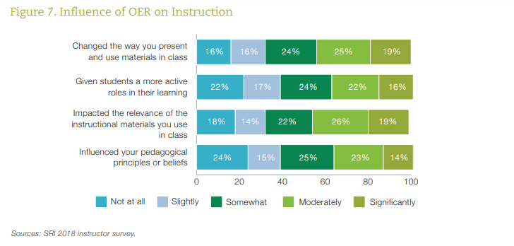
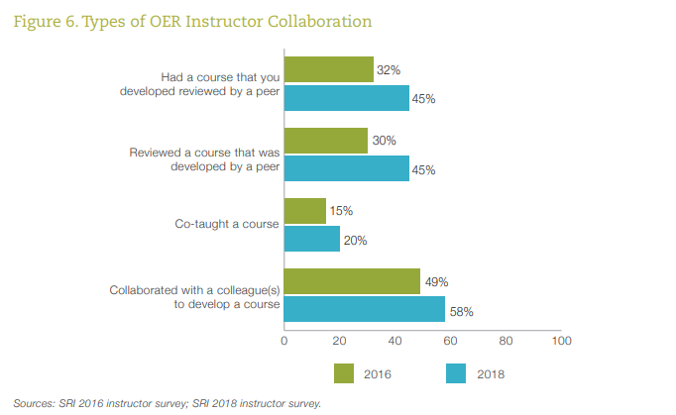
Achieving the Dream - Instructor Attitude, Academic Freedom, Collaboration….
Notes:
Griffiths, R., Mislevy, J., Wang, S., Ball, A., Shear, L., Desrochers, D. (2020). OER at Scale: The Academic and Economic Outcomes of Achieving the Dream’s OER Degree Initiative. Menlo Park, CA: SRI International

Slide 17
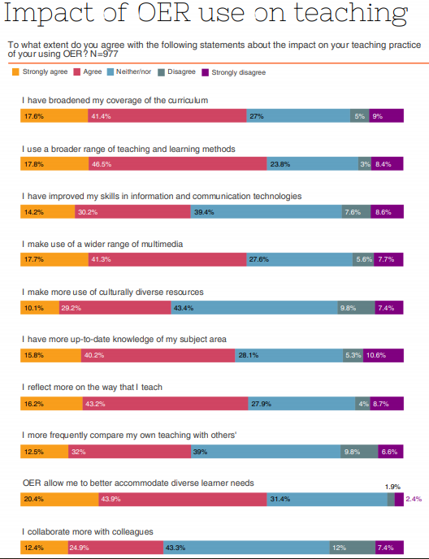
Source: https://www.slideshare.net/OER_Hub/oerrh-data-report-20132015-educators

Slide 18
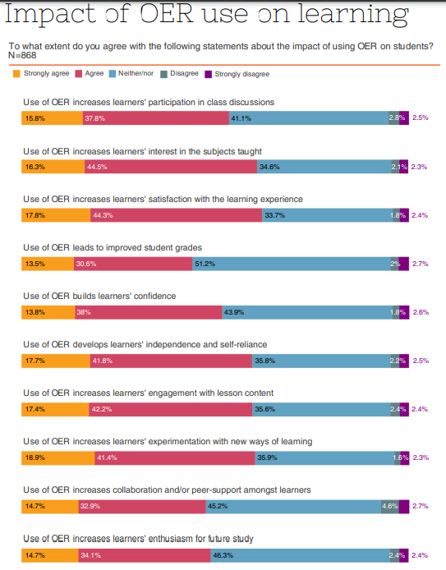
Source: https://www.slideshare.net/OER_Hub/oerrh-data-report-20132015-educators

Slide 19
Articulation & C-ID
Responses from UC and CSU system articulation leadership:
“For UC, it’s fine to use assembled materials or Open Educational Resources, so long as they’re as stable and publicly available as published textbooks (and not a list of links). “ Nancy Purcille Transfer Articulation Coordinator University of California, Office of the President | “Same for the CSU.” Ken O’Donnell Senior Director, Student Engagement and Academic Initiatives and Partnerships CSU Office of the Chancellor

Slide 20
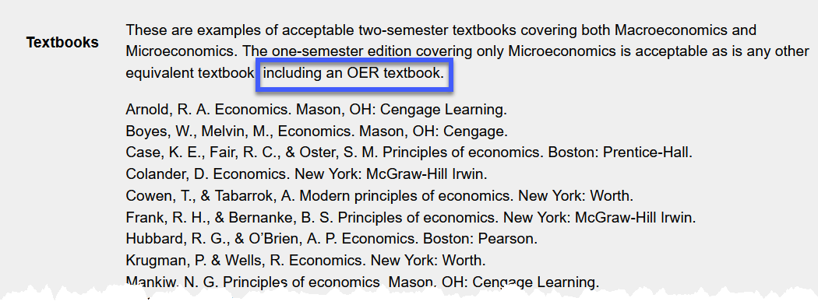
Articulation & C-ID
Example: Economics C-ID Descriptor

Slide 21
Open Pedagogy
Open Educational Practices (OEP)
What words come to mind when you hear the terms:
Open Educational Practices (OEP)
Open Pedagogy
Notes:
https://www.mentimeter.com/app (I used the ASCCC login)
Link to share during presentation: https://www.menti.com/474hzq438z (code: 3742 9612)
25 min
- 5 min for interactivity
- 10 min for definitions
- 10 min for examples

Slide 22
OER-enabled Pedagogy
A set of teaching and learning practices only possible or practical when you have permission to engage in the 5R activities.
Disposable v. Renewable Assignments
Authentic Assessments
Wiley & Hilton; 2018 and David Wiley; 2013
Paper Projects by JerzyGorecki pixabay license
Adapted from Creative Commons Certificate licensed CC-BY 4.0
Notes:
Disposable assignments

Slide 23
Open Pedagogy
An access-oriented commitment to learner-driven education and a process of designing architectures and using tools for learning that enable learners to shape the public knowledge commons of which they are a part.
Year of Open
Open Pedagogy Notebook
Together we Create; public domain
Adapted from CC Certificate; CC-BY 4.0
Notes:
Students helping to create course content - example, writing test bank questions (will discuss more)
Open Pedagogy Notebook has lots of great examples! - Go there

Slide 24
Open Educational Practices
Use / reuse / creation of OER and collaborative, pedagogical practices employing social and participatory technologies for interaction, peer-learning, knowledge creation
and sharing, and empowerment of learners.
Cronin’s 2018 Open Edu Global presentation
Adapted from CC Certificate; CC-BY 4.0
Adapted from www globe and social media; pixabay license
Notes:
Similar to Open Pedagogy but I prefer this b/c “pedagogy” & b/c acronym
And really underlines the connections

Slide 25
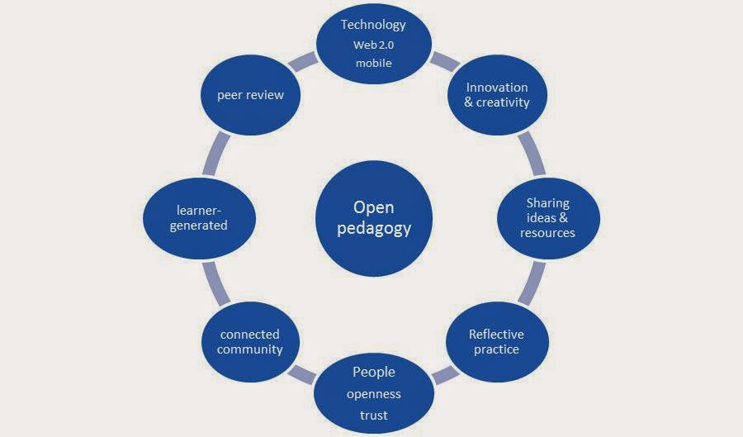
Eight attributes of Open Pedagogy
Bronwyn Hegarty
Attributes of Open Pedagogy by Bronwyn Hegarty based on Conole (2013) licensed CC-BY 3.0
Notes:
“Models that are developed to describe Open Education Practice must include the concept of openness in learning and teaching”
technology that is participatory (Web 2.0 and mobile) - includes social media and applications used by mobile devices;
innovation and creativity – involves spontaneity and a willingness to adopt another view and different approaches;
sharing of ideas and resources freely so that knowledge and materials can be disseminated;
opportunities for reflective practice – initiated by participation in critical analysis of practices, professional learning and connection with others’ perspectives
people who have trust in others’ work, are confident and demonstrate openness;
connected community so that practitioners can network and become part of a community of practice;
learner-generatedness – facilitating learners’ contributions by enabling and encouraging them to create and share information, resources and ideas;
peer review – the open critique of others’ work and scholarship.

Slide 26
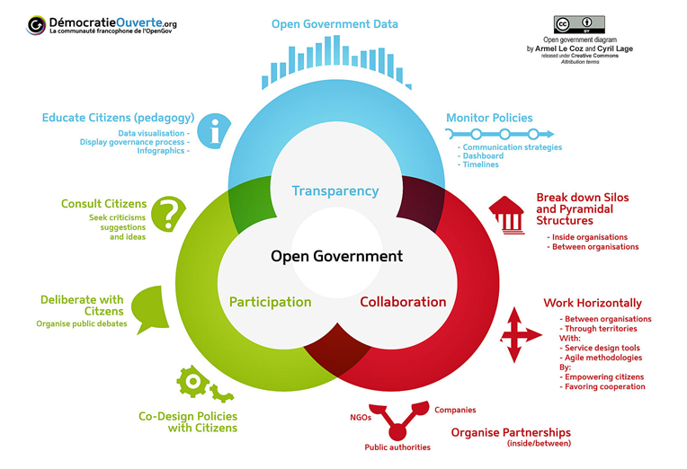
Open Government
Democratie Ouverte by Armel Le Coz and Cyril Lage [CC BY 3.0]
Notes:
I think Open Pedagogy makes most sense when compared to Open Government
Transparency - students always know WHAT & WHY they are learning and HOW they will be graded
clear rubrics
Participation - students are actively part of the class (not just passively absorbing information)
beyond lecturing
Collaboration - students are brought “back stage” in the learning process
create rubrics with students

Slide 27
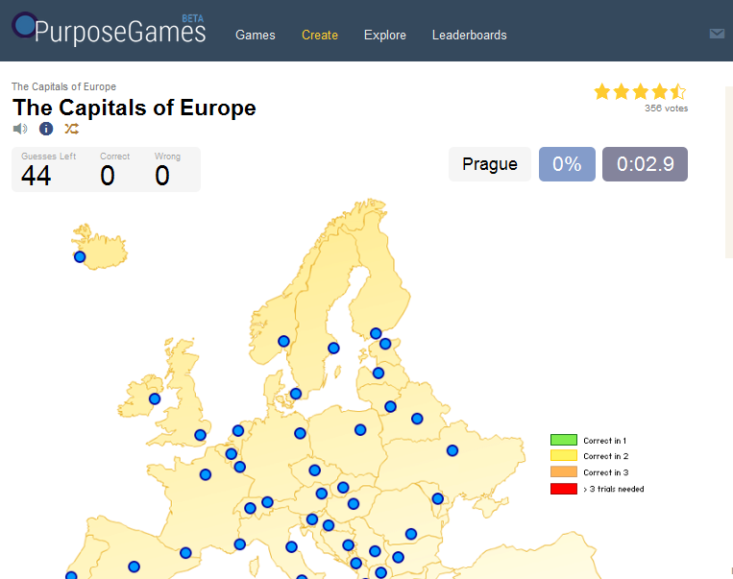
Start Small
Helping each other study
Test banks
with feeling! I mean, feedback.
Study Resources
flashcards
games
Roola: Review of Online Learning Aids
Notes:
Start small - things for your class
Feedback is key - what are misconceptions others may have and how can I clarify that
Study resources - lots of great places for students to build stuff - quizlet, purpose games, etc.
Roola

Slide 28
Helping each other learn
Sharing links
Creating videos
Creating lessons
Recording an audio book
Notes:
Diigo - shared bookmarks
Adobe Spark, Animation programs

Slide 29
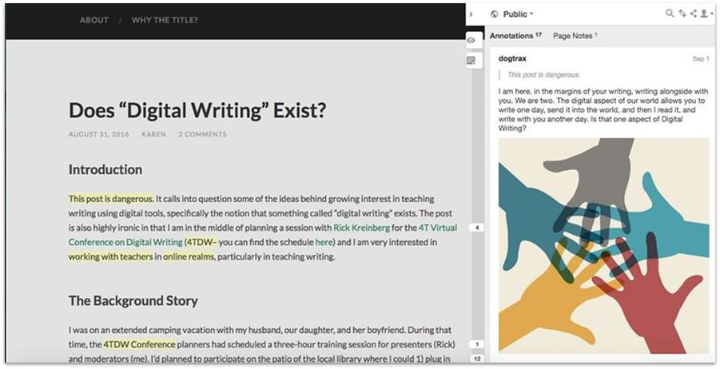
Learning together
Digital Writing, in the margins by Kevin Hodgson [CC BY 2.0] via Flickr.
Notes:
Annotate - hypothes.is
Study Guides - Google Docs

Slide 30
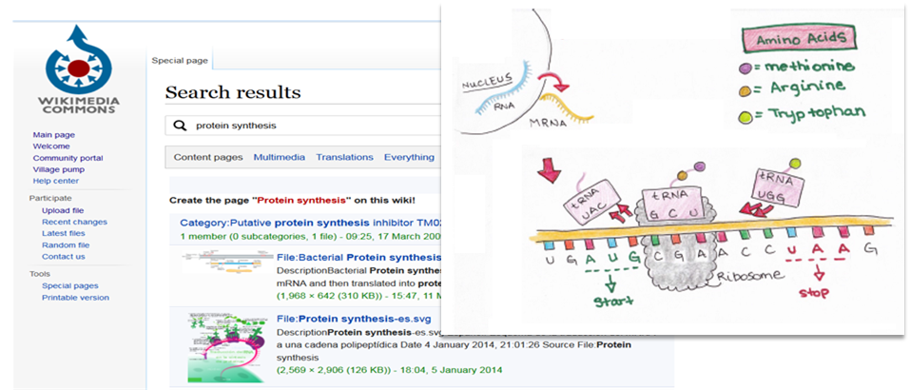
Encourage students to share

Slide 31
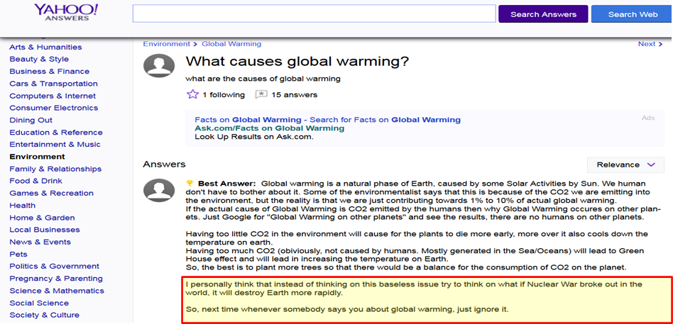
Public Service

Slide 32
Update the textbook
Customize the book
what do they think is important?
Are they reflected in the book
Case studies
locally relevant
student guided
Image: Water Technology Dept, College of Canyons OER Textbooks, CC-BY

Slide 33
Class Textbook
Anthology of Early American Literature
The story
My Slipper Floated Away
Biology: Outline of process
Outlining Topics
Finding Sources and Samples
Writing the First Draft
Adding images and applications
Editing
Building Study Tools

Slide 34
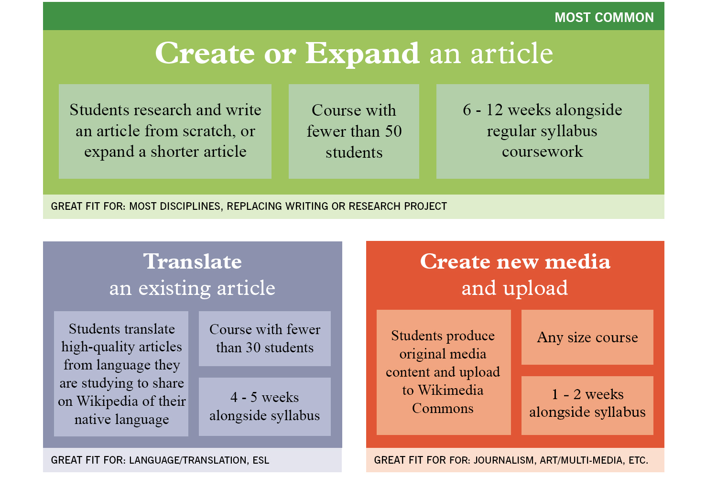
Edit Wikipedia - wikiedu.org

Slide 35
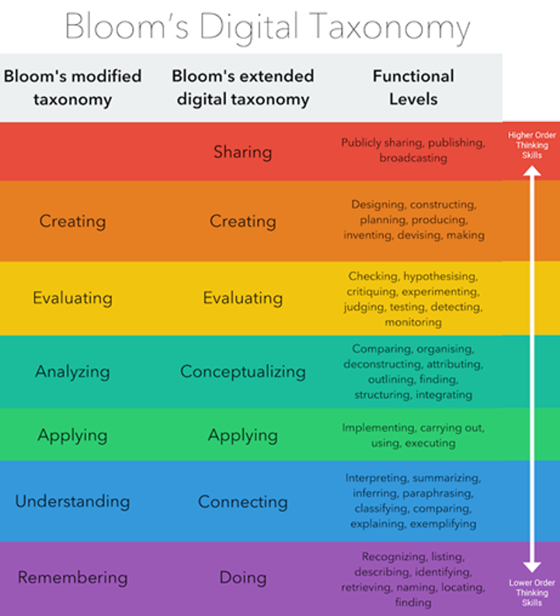
Stepping up Bloom’s!
Cropped from Bloom's Digital Taxonomy, by Fractus Learning, CC BY SA

Slide 36
Evidence that OER and OEP have additional benefits
Let’s look at some quantitative and qualitative data on both OER and OEP
We’ll examine data on impact, efficacy, and satisfaction
From both faculty and student perspectives

Slide 37
Benefits Beyonds Savings from OER
Not only does OER save students money
It changes their ability to be successful
And even more remarkably, it benefits our disproportionately impacted student populations the most
Let’s look at some data
Computer Problems by CollegeDegrees360 is licensed under CC BY-SA 2.0

Slide 38
University of Georgia
Population | Change in Grade | Change in DFW*
All Students | +8.6% | -2.68%
Non-Pell Eligible | +7.4% | -2%
Pell Eligible | +12.3% | -4.4%
Non-White | +13% | -5%
Part-Time | +28% | -10%
Total Students: 21,822 *DFW= Drop, Fail, Withdraw
Source: AAC&U, University of Georgia The Impact of Open Educational Resources on Various Student Success Metrics, in International Journal of Teaching and Learning in Higher Education, 2018
Notes:
The Impact of Open Educational Resources on Various Student Success Metrics. OERs improve end-of-course grades and decrease DFW (D, F, and Withdrawal letter grades) rates for all students and at greater rates for Pell recipient students, part-time students, and populations historically underserved by higher education.

Slide 39
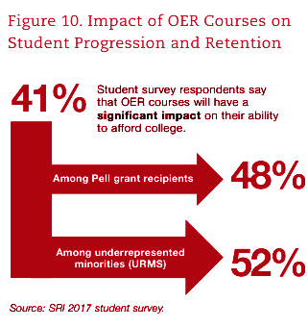
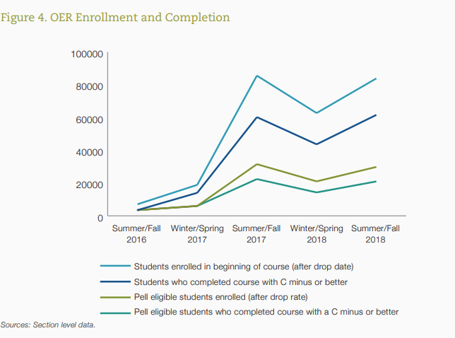
Achieving the Dream Stats
28% of students surveyed reported that they would use the money they saved with OER to take additional courses
Notes:
OER project involving a total of 38 community colleges across 13 states, four grant partners, and five funding organizations [Feb 2020]
Achieving the dream: Students are maintaining their GPAs despite taking more courses, on average.

Slide 40
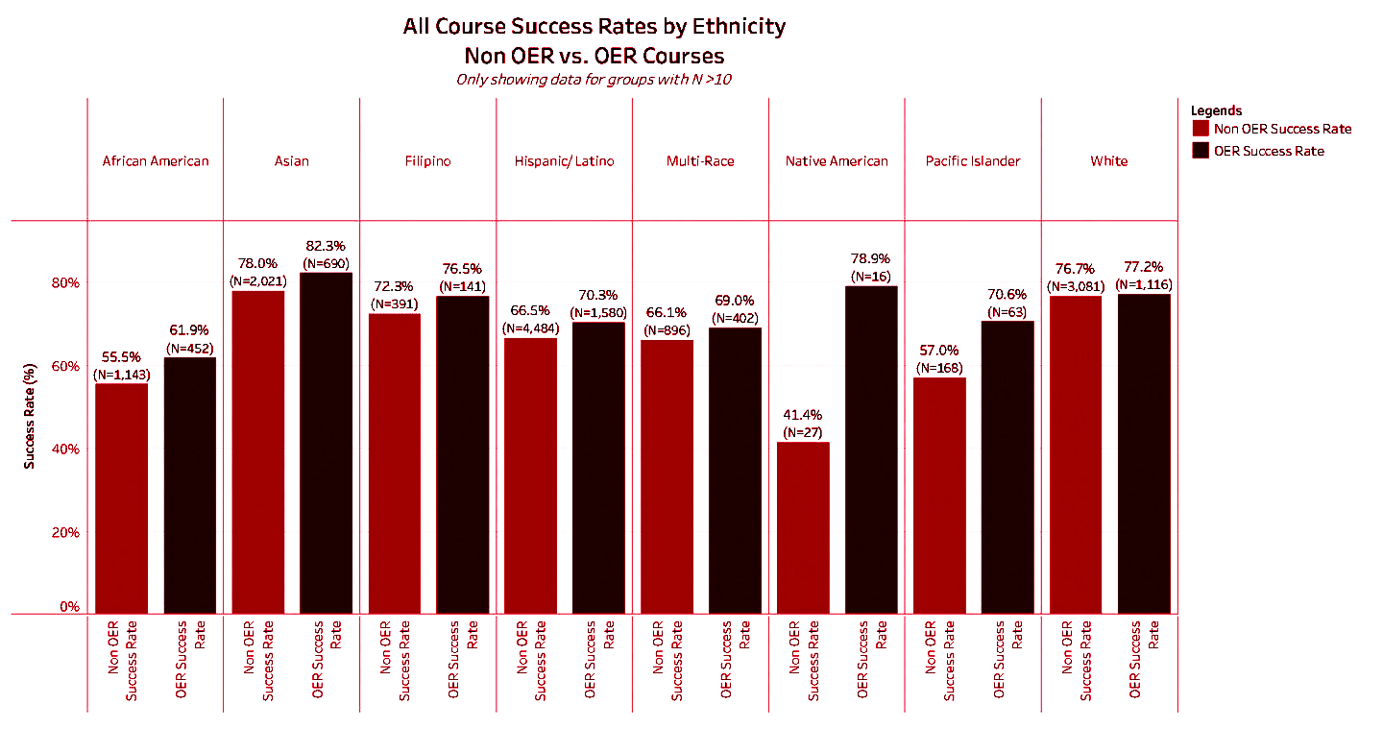
One CCC: Sacramento City College Study
Source: Sample Course Success Rates by Ethnicity
Notes:
The success rates are higher for all groups when using OER than when not using OER. [Sally 1 min]

Slide 41
Another CCC: Pasadena City College
Student Population | Success/Retention | Increase in OER/ZTC over Corresponding Non-OER/ZTC
Overall | Retention | 2%
 | Success | 12%
Veterans | Retention | 5%
 | Success | 16%
Low Income | Retention | 6%
 | Success | 13%
Foster Youth | Retention | 9%
 | Success | 14%

Slide 42
CCC ZTC Grantee Success Data
Grades for pell recipients: +7.6%
Grades of A: +7.3%
Grades of D: -15.6%
Grades of F: -11.2%
Results from:
179,050 letter graded outcomes
ZTC course = 37.475 (21%)
Non-ZTC course = 141, 575 (79%)
Notes:
Note: ZTC includes, but is not limited to OER

Slide 43
Sample of Further Research
Students enrolled in a course that had adopted an OER compared to being enrolled in the same course where a traditional/commercial textbook was adopted
had better performance on exams,
had higher final grades,
were more likely to stay enrolled in a class
were more likely to meet other course learning outcomes
Sources: https://www.tandfonline.com/doi/abs/10.1080/02680513.2012.716657; https://www.tandfonline.com/doi/abs/ 10.1080/02680513.2018.1486184; https://www.semanticscholar.org/paper/Do-Open-Educational- Resources-and-Cloud-Classroom-Tsai-Shen/42c6cc84a96c7dbb702b5b779cb22d1b56401d62#paper-header

Slide 44
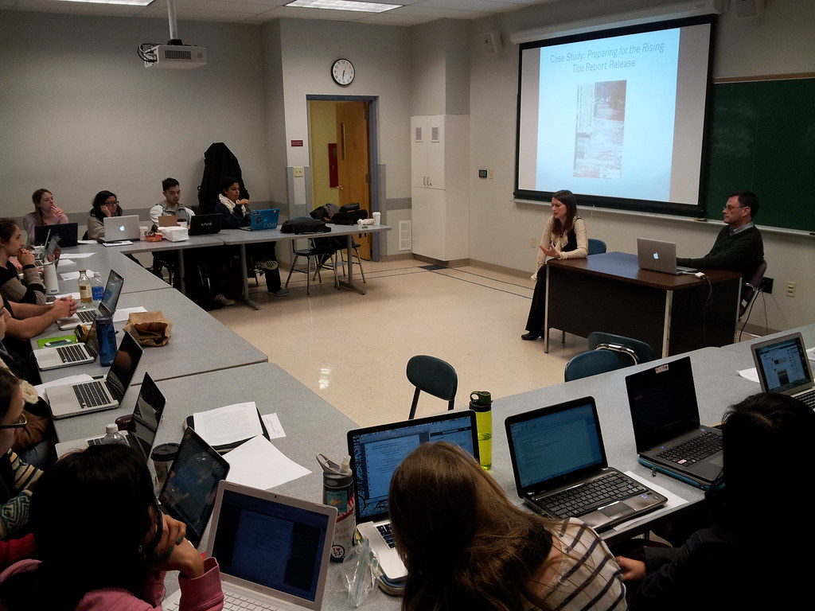
How Do Faculty and Students Feel About OER?
Let’s briefly delve into how faculty and students perceive OER
The Modern College Classroom by Todd Van Hoosear is licensed under CC BY-SA 2.0

Slide 45
Research on Faculty Perspective and Experiences
Faculty members also report that OER afford greater freedom when designing courses and learning materials, as OER can be adapted and revised as needed
Petrides et al., 2011; Pitt, 2015; Rolfe, 2017
60% of instructors stated their students were equally prepared when OER replaced traditional texts and 30 percent said their students were more prepared
Bliss et al., 2013

Slide 46
More Research on Faculty Perspectives
Nearly every instructor rated the OER as being either equal (40%), a little more useful (23%), or much more useful (34%) than materials they had previously used
Abromovich & McBride, 2018
Open Textbook library reviews generally give high ratings (median of 4.5/5 overall ratings)
Fischer, Ernst, & Mason, 2017
Sources of research on this and previous slide:
Paskevicius, M. and Irvine, V., 2019. Open Education and Learning Design: Open Pedagogy in Praxis. Journal of Interactive Media in Education, 2019(1), p.10. DOI: http://doi.org/10.5334/jime.512
https://openedgroup.org/review

Slide 47
CCC Faculty Support of OER:
Saddleback College
Overwhelmingly, faculty surveyed (83%) agreed that ZTC was effective in their courses.
Among non-adopters, 89% said that they either would (15%) or might (74%) use ZTC in the next 3 years.
Source: https://www.cccoer.org/case-studies/start-and-finish-college-without-purchasing-a-textbook/

Slide 48
Faculty Perspectives
Converting my course to OER was a revelation. I had previously thought of the print textbook as a security blanket. What I came to realize was that it had become a straightjacket which told me what to teach, when to teach it and how to teach it.
I now feel a sense of liberation and freedom to build courses in a way that meets our desired student learning outcomes and to use a much wider variety or resources to meet those outcomes.
The commitment to use OER in classes takes some preparation and involves some searching to find materials, but I am able to mix-and-match different parts of books, videos, website and other materials that are much more interesting to my students and to me as a teacher.
Source: https://www.westga.edu/~distance/ojdla/summer212/pina_moran212.html

Slide 49
Student Support of OER
One study of 662 students
86% rated OER as either as useful or more useful
Only 6% of students stated that the open textbooks rarely or never helped them meet their course objectives
Abramovich and McBride, 2018
CA college students support OER
100% in study wanted to use OER in future and would recommend to friends
The California OER Council, 2016
Source: https://openedgroup.org/review

Slide 50
Example of Student Perspective
Compared to students who had not taken an OER course, 311 students who took OER courses with trained faculty
were more satisfied with the cost of their courses
judged the free/open materials in their courses to be equal to or higher in quality than the commercial materials used in their other courses.
would recommend their courses to others
Source: https://www.westga.edu/~distance/ojdla/summer212/pina_moran212.html

Slide 51
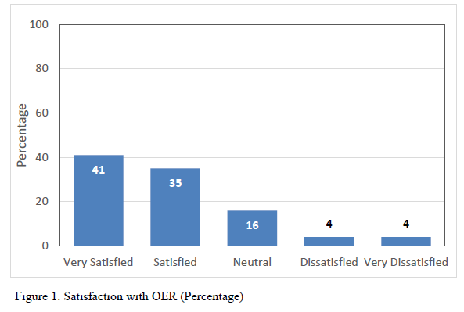
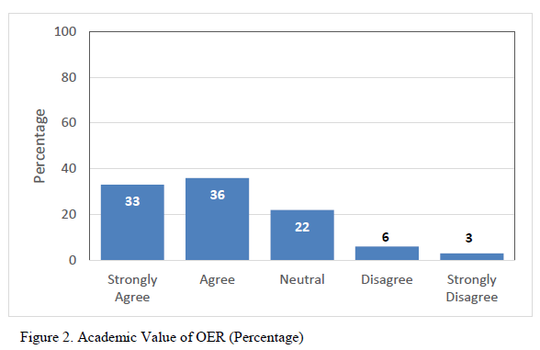
Sample CCC Student Satisfaction with and Academic Value of OER: College of the Canyons
92%
91%
Source: OER Student Survey Spring 2016 from College of the Canyons

Slide 52
Student Experiences with OER
...the OER book is overall less overwhelming and simpler to read. The non-OER book had a lot of extra reading in the side bars and extra bubbles of information that was honestly just too much information for me to take in at once. Reading the OER was straightforward and factual. There was not a moment where I felt like the information was just there to fill the page -- it was all relevant. I also really enjoyed the examples provided for specific theories, showing how they are implemented in our world.
I liked that all the reading material was given to me on my computer. I feel that this is a great resource for those of us that can’t afford to purchase a book. It’s better for the planet, too...
Source: https://www.cccoer.org/case-studies/opening-doors-to-equitable-student-outcomes-and-meaningful-career-pathways/
Open education textbooks were very beneficial. I liked being able to have my textbook with me wherever I was. I think that the online textbook was very good.
Source: COC ECE Student
Survey 2018

Slide 53
Summary of Research on Faculty and Student Perspectives and Experiences by Open Ed Group
Several thousand students and faculty members in more than a dozen studies that have focused on perceptions of OER.
In no instance did a majority of students or teachers report that the OER were of inferior quality
Roughly half of teachers and students find OER to be comparable to traditional resources
a sizeable minority believe they are superior
a smaller minority find them inferior
Source: https://openedgroup.org/review

Slide 54
What About Open Pedagogy?
There isn’t as much research on open pedagogy
We can take a look at
How at how faculty feel open pedagogy has changed their teaching practices
Results from an Open Pedagogy powered course
A student experience with open pedagogy

Slide 55
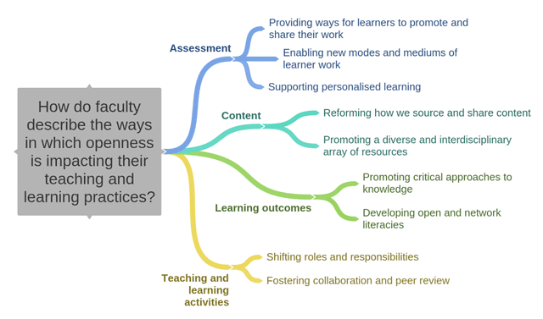
Impact of Open Pedagogy on Teaching Practices
Source: Paskevicius, M. and Irvine, V., 2019. Open Education and Learning Design: Open Pedagogy in Praxis. Journal of Interactive Media in Education, 2019(1), p.10. DOI: http://doi.org/10.5334/jime.512

Slide 56
Student Feedback from Robin DeRosa’s Open Pedagogy Powered First Year Seminar
The course evaluations were very positive.
4.4/5 for overall value
4.6/5 for contributing to the students’ intellectual growth.
4.9/5 for overall effectiveness of instructor
Comments from the evals
We discussed what we all thought, as a group, was the most valuable to learn through this course. We worked through these skills all through the course and it helped very much being a first year student and new to this environment. We used new technology to learn. which made it fun and educational.
I thought the work was extremely helpful and I will be able to carry what I learned from this class with me in the real world. I wish more classes were set up like this!
Source: http://robinderosa.net/higher-ed/extreme-makeover-pedagogy-edition/

Slide 57
A Student’s Experience with Open Pedagogy
“Without taking an open pedagogy class I would never have realized this about myself. I now approach information, and the way I learn and teach, in an entirely new fashion. I found that I have changed my approach in other classes that I’m taking this semester and it has benefited me greatly. I now see the world a bit differently, and find myself constantly connecting everything I do/come across. I find myself thinking a lot more about the world that I am in and what I have to gain from it. Information is no longer something that is given and received but is something that is shared.”
Source: https://thechcexplored.wordpress.com/2017/04/26/what-an-open-pedagogy-class-taught-me-about-myself/

Slide 58
Questions?
Shagun Kaur: kaurshagun@fhda.edu
Jennifer Paris: Jennifer.Paris@canyons.edu
Suzanne Wakim: wakimsu@butte.edu
ASCCC OERI: oeri@asccc.org

