Slide 1
Transfer Pathways Advocacy July 9 | 9:00-10:15
Notes:
Ginni

Slide 2
Presenters
Session Description
With nearly a decade since the introduction of Associate Degrees for Transfer and the recent introduction of the University of California Transfer Pathways, it would seem that transfer between the California systems of public higher education would be easier than ever. Students still continue​ to face barriers and obstacles to successfully transfer if that is a part of their educational goals. Join this session to discuss how college and system stakeholders can assist students in reaching their self-determined transfer goals, and consider changes that would better ensure students are well served by both the processes in place and subsequent proposals around transfer.
Ginni May
ASCCC Vice President
Michelle Plug
ASCCC Curriculum
Committee, Citrus College
Eric Wada
ASCCC C-ID Director, Folsom Lake College
Notes:
Ginni

Slide 3
Overview
Who are you?
Associate Degree for Transfer (ADT)
University of California Transfer Pathway (UCTP)
Googledoc:
Barriers or Obstacles to Transfer
Advocacy:
Solutions and Opportunities
Student Self-Agency
Notes:
Ginni

Slide 4
In the Pathable Chat…
Your name
Your college or organization
Your role
One ”thing” you hope to learn or take away from this session…
Share with us…
Notes:
Ginni

Slide 5
The Associate Degree for Transfer
Past | Present | Future
What is it?
How did it start?
How is it different from any other associate degree?
Where are we now with the ADT?
Where are we going with the ADT?
ADT

Slide 6
ADT: Past
AB 440 (Beall, 2009) – Transfer Degree as introduced 2/24/09
SB 1440 (Padilla, 2010) – California Community Colleges: student transfer
Student Transfer Achievement Reform Act
CCCs required to offer an ADT
SB 440 (Padilla, 2013) – Public Post Secondary Education: Student Transfer Achievement Reform Act
CCCs required to offer an ADT if colleges offer a local degree and there is an approved Transfer Model Curriculum (TMC)
Stay tuned for the Future…
AB 928 (Berman, 2021) – Transfer Achievement Reform Act of 2021: Associate Degree for Transfer Implementation Committee
Notes:
Ginni
2009 died after being gutted and amended as a bill on alcoholic beverages

Slide 7
ADT: Past
What about C-ID?
Course Identification Numbering System (C-ID) – go to C-ID.net
Response to SB 1415 (Brulte, 2004) – Postsecondary education: Donahoe Higher Education Act: common course numbering system.
In 2007, C-ID, the Course Identification Numbering System initiated by the ASCCC
Supranumbering system similar to CAN but far more detail
Learn more: https://c-id.net/about-us
C-ID and TMC
C-ID has been used to develop descriptors for all (or as many as possible) courses in each Transfer Model Curriculum
Notes:
Ginni

Slide 8
ADT: Present
Guarantee of admission*, and 60 unit caps for the CCC and CSU
The “cap” means a student must have a path to a degree with the 60+60 model, and in some disciplines it assumes the student is ready for certain courses (e.g. Calculus)
*Admission guarantee is to the CSU system, not to a specific campus or major.
CSU campus departments use the Transfer Model Curriculum (TMC) to make a determination of similar.
Students would have sufficient lower-division prep and could complete all degree requirements post-transfer within 60 units.
Notes:
Eric

Slide 9
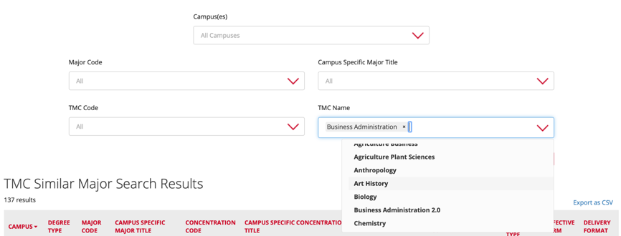
ADT: Present Determination of Similar
CSU resource for counselors and AOs:
https://www2.calstate.edu/attend/degrees-certificates-credentials/Pages/TMC-Search.aspx
Notes:
Eric

Slide 10
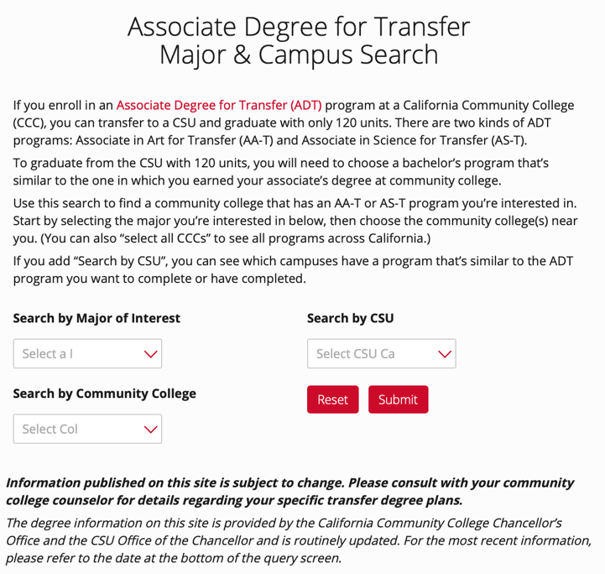
ADT: Present
CSU Determinations of Similar for Students:
https://www2.calstate.edu/apply/transfer/Pages/associate-degree-for-transfer-major-and-campus-search.aspx
Notes:
Eric

Slide 11
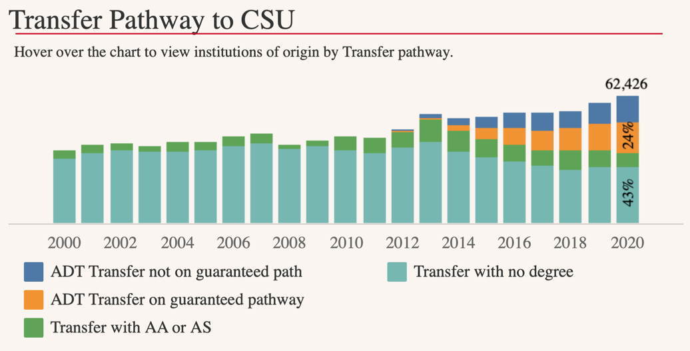
ADT: Present
ADT popular increasing as a transfer pathway to CSU: https://tableau.calstate.edu/views/FirstTimeFreshmanandCollegeTransfers/SummaryView?iframeSizedToWindow=true&:embed=y&:render=true&:showAppBanner=false&:display_count=no&:showVizHome=no
Notes:
Eric

Slide 12
ADT: Present
Other transfer situations:
ADT transfer but not on a guaranteed path
Transfer with AA or AS (local associate degrees, could be transfer bound)
Transfer with no degree
Other?
Questions:
What are the characteristics of students are falling into the above categories?
What opportunities and challenge arise for students in these categories?
Notes:
Eric

Slide 13
ADT: Future?
What is needed? More designations of similar degree in the CSU
AB 928 (Berman, 2021) – Transfer Achievement Reform Act of 2021: Associate Degree for Transfer Implementation Committee
In Senate, amendments still being considered…
Bill would possibly:
Establish the Associate Degree for Transfer Intersegmental Implementation Committee for oversight.
Require singular lower division general education pathway
Examine STEM degree pathway of the 60-unit framework. Any recommendation of change to be more than six units.
Require colleges to place students with a goal of transfer on an ADT pathway if one exists for their stated major. Students would have to opt out to choose a different pathway
Notes:
Ginni

Slide 14
University of California Transfer Pathway
Past | Present | Future
What is it?
How did it start?
How is it different from any other associate degree or pathway?
Is it an associate degree?
Where are we now with the UCTP?
Where are we going with the UCTP?
UCTP
Notes:
Ginni

Slide 15
UCTP: Past
A University of California Transfer Pathway is a standardized major preparation plan for a transfer student who intends to major in one of the 20 most popular majors
First 10 pathways approved in 2015
Now there are 20 approved pathways
Pathway is a recommendation – degree attainment is not a requirement for admission to UC
Notes:
Ginni
https://asccc.org/content/uc-transfer-admission-pathways
https://asccc.org/content/streamlining-transfer-pathways-educational-equity-or-equality

Slide 16
UCTP: Past
ASCCC 2017 Fall Plenary Session, Resolution F17 15.01—Aligning Transfer Pathways for the CSU and UC Systems
Streamline as much as possible to remove barriers for transfer and eliminate duplication of efforts
Fall 2018 – Intersegmental Committee of Academic Senates (ICAS) began discussion
2019-20 – Intersegmental Curriculum Workgroup (ICW) and the C-ID Advisory Committee began Transfer Alignment Project:
examined TMCs from seven disciplines to consider TMC and UCTP alignment
UCTP Degree Pilot in Chemistry or Physics
Notes:
Ginni

Slide 17
UCTP: Present UCTP Degree (Pilot) – Chemistry/Physics
The University of California (UC) Degree for Chemistry/Physics provides students a basis for understanding the physical concepts and skills required for attainment of upper division status as a Chemistry/Physics major.
Students completing the degree and transferring to the UC, will be expected to complete two more courses in IGETC Area 3 and two more courses in IGETC Area 4 to fulfill UC general education requirements.
Successful completion of the UC Transfer Pathway Chemistry/Physics degree with a minimum GPA of 3.5 guarantees the student admission into the University of California system (but does not guarantee acceptance to a particular campus).
Students who do not reach the 3.5 GPA threshold will still be competitive at several UC campuses and are still encouraged to apply.
Notes:
Michelle

Slide 18
UC Transfer Admissions Agreement (TAG)
Create an account for the UC via the Transfer Admission Planner
Complete the TAG application and review it with your community college counselor and/or UC campus TAG adviser. (Submit Sept. 1-30 for Fall)
Fulfill all coursework and GPA requirements in your TAG agreement.
In addition to the TAG agreement, students must also fill out the application for admission to UC and submit it Nov. 1–30.
Students can only apply only apply for a TAG at one campus.
The TAG matrix provides a list of participating campuses and campus-specific requirements to qualify and is updated every year.
Six UC campuses offer the Transfer Admission Guarantee (TAG) program for California community college students who meet specific requirements:
Davis
Irvine
Merced
Riverside
Santa Barbara
Santa Cruz
Notes:
Michelle

Slide 19
UCTP: Future?
UCTP | TAG | ADT
Notes:
Ginni

Slide 20
Googledoc
Link: https://docs.google.com/document/d/1sSNZwId9BkrBMYWsbWKh0Pd-5qphoY0a/edit
Notes:
Ginni
https://docs.google.com/document/d/1sSNZwId9BkrBMYWsbWKh0Pd-5qphoY0a/edit

Slide 21
Barriers or Obstacles to Transfer
Undecided on Career/Program Goals
The push for students to complete their degree in 2 years
Economic Barriers
Class Scheduling
ADT’s – CSU’s change similar majors for ADTs without notification, not enough similar majors
Increased impaction at the CSU's and UC's making it difficult for students to transfer
Lack of consistent policies from CSU/UC system
Reciprocity between colleges (acceptance of courses and units)
Students using pathway map in place of counselor
Pathway is not a one size fits all: does not address the multiple goals a student may have
Legislative demands that do not align with student needs
Notes:
Michelle

Slide 22
Advocacy: Solutions and Opportunities
Identify local stakeholders:
Discipline faculty
Counselors
Articulation Officers
Degree auditors
Consider reviewing the C-ID resources page
ADT Substitutions (and reciprocity) documents:
https://c-id.net/page/1
Notes:
Eric

Slide 23
Advocacy: Solutions and Opportunities
Where students face a pathway that exceeds 60 units:
Above all, equity must be our focus.
Think of ways to keep students engaged and motivated to persist.
Cross-disciplinary discussions (e.g. in STEM) to recruit and retain students.
Coordinate efforts with local transfer institutions
Notes:
Eric

Slide 24
Advocacy: Student Self-Agency
Clear and accurate information on pathways so students can make informed choices
Student Focus Groups: Broad representation
Faculty and Staff sign up for college: try entering the college, registering for classes, choosing a major, considering a transfer institution
Notes:
Ginni

Slide 25
Resources and Thank You!
Davison, D., V. May. Streamlining Transfer Pathways: Educational Equity or Equality. ASCCC Rostrum April 2021.
Bruno, J., J. Freitas, V. May. The UC Transfer Admission Pathways. ASCCC Rostrum November 2015.
C-ID – Course Identification Numbering System: https://www.c-id.net
ASSIST – Official course transfer and articulation system for California’s public colleges and universities: https://assist.org
For more information, email info@asccc.org
ASCCC 2021 Academic Academy, October 7-9 (virtual)
Notes:
Ginni

