Slide 1
College and Career Readiness: Noncredit Pathways
Notes:
Randy

Slide 2
Description
This presentation will highlight the many paths noncredit offers to credit college and career readiness. Presenters will discuss working with credit faculty and industry partners to create an innovative curriculum that facilitates student success in the classroom and in employment as well as the need for counseling support to address the unique needs of the noncredit student. This presentation emphasizes integrative planning efforts, leveraging of resources, the flexibility of noncredit delivery models, and strengthening the credit/noncredit relationship to enhance student success.
Notes:
Randy

Slide 3
Your Presenters
Randy Beach, ASCCC Curriculum Committee, Southwestern College
Wendy Brill-Wynkoop, ASCCC Noncredit Committee and FACCC President, College of the Canyons
Emma Diaz, ASCCC Noncredit Committee, San Bernardino Valley College
Notes:
Randy

Slide 4
Noncredit Essentials
Important contributor to “open access” for students with diverse backgrounds
Tuition free
Can be a first point of entry
Transition point from “wherever” to credit instruction and the workforce
Courses focus on skill attainment, not grades or units (aka competency-based)
Flexible course scheduling
Can be a driver behind more equitable outcomes
Notes:
Randy

Slide 5
Noncredit Essentials
Noncredit courses are approved by districts and “chaptered” by CCCCO via the CO Curriculum Inventory (COCI)
Ten Noncredit Instructional Categories
English as a Second Language*
Short-term Vocational*
Workforce Preparation*
Elementary and Secondary Basic Skills*
Immigrant Education
Health and Safety
Substantial Disabilities
Parenting
Home Economics
Older Adults
*A noncredit instructional category eligible to be sequenced to lead to a Career Development and College Preparation (CDCP) (“enhanced funding”) certificate program, pursuant to Ed Code § 84760.5.
Notes:
Randy
Noncredit course categories that are eligible for State apportionment, per EDC section 84757 (9 categories defined in EDC; 10th category (workforce preparation) defined in Title 5 section 55151)
Underlined categories are CDCP enhanced funding (EDC 84760.5(b); Title 5 section 55151 – CDCP)

Slide 6
Noncredit Programs (Title 5 section 55155)
Career Development and College Preparation
Certificates of Competency (Elementary and Secondary; ESL)
Certificate of Completion (Short-term Vocational with high employment potential)
Adult High School Diploma
Noncredit Pre-apprenticeship
Important to remember to design programs and courses with noncredit students in mind
Noncredit students come for a variety of reasons
Most vulnerable; multiple challenges
Noncredit students are credit students/credit students are noncredit students
Communicate expectations and opportunities
Innovate with urgency of eliminating equity gaps and achieving full student equity
Notes:
Randy

Slide 7
Noncredit Support Courses
These courses are designed together with credit faculty to support students who are currently enrolled or are preparing to enroll in credit courses. Some options include:
Modularized support courses
Intensive review courses
Mirrored courses (more on this on the next slide)
Corequisite support courses
Courses that build bridges between credit and noncredit can be a way to introduce noncredit offerings to faculty that typically teach credit courses. Some crucial areas of support include:
Career and academic counseling
Financial aid services
Academic support including tutoring
Supportive Services such as CalWORKs, CAEP, EOPS and DSPS
Partnerships between credit and noncredit faculty
Notes:
Randy

Slide 8
English and Math Support
AB 705 and Guided Pathways prompted many colleges to rethink how noncredit can support students as they onboard into credit coursework
Corequisite noncredit courses can provide concurrent support in Math and English supporting the pathway from noncredit to credit to transfer
Benefits for students:
Build foundational level skills
Focus on skill attainment, not grades or units
Meet the students where they are
Provide low-cost educational opportunities
Individualize Instruction and Tutoring
Work at your own pace
Provide a Stress-Free Learning Environment
Notes:
Randy

Slide 9
English and Math Support
Strengths
Students can enroll for free
Students do not accumulate excessive units
Flexibility of course scheduling (open entry/open exit)
No repeatability limits
Challenges
Course not counted for financial aid
Basic skills restrictions
College enrollment cannot be required
Different instructors for credit/noncredit courses
No enhanced funding
Longer approval process
Difficulty navigating enrollments
2021 ASCCC Curriculum Institute 9
Notes:
Randy

Slide 10
Mirrored Credit and Noncredit Courses
Credit and noncredit course with identical course outline of record.
Usually seen in ESL and short-term vocational classes.
Creates pathways for the adult noncredit learners.
Courses are scheduled at the same time with one instructor teaching all students.
Sections are typically crossed listed with a specified amount of seats in the credit and noncredit sections.
Noncredit students attend all class sessions and complete the same work as the credit students.
Noncredit students cannot earn units for successfully completing the course, but they can earn a certificate.
Notes:
Randy

Slide 11
Mirrored Credit and Noncredit Courses
Helpful for students that are transitioning from noncredit to credit.
Low-stakes option for students who want to:
attempt a course
need extra time mastering the content
don’t qualify for financial aid
Provides a unique opportunity for students to explore the rigor and expectation of credit courses without the pressure of
tuition fees
failing grade
repeatability restrictions
Credit for Prior Learning (CPL) can be used to earn units at a later time.
Notes:
Randy

Slide 12
California Adult Education Program (CAEP) Legislated Objectives
(1) An evaluation of current levels and types of adult education programs within its region, including education for adults in correctional facilities; credit, noncredit, and enhanced noncredit adult education coursework; and programs funded through Title II of the federal Workforce Investment Act of 1998, known as the Adult Education and Family Literacy Act (Public Law 105-220).
(2) An evaluation of current needs for adult education programs within its region.
(3) Plans for parties that make up the consortium to integrate their existing programs and create seamless transitions into postsecondary education or the workforce.
Notes:
Emma

Slide 13
Consortium Structure
Notes:
Emma

Slide 14
Transition Pathway
Dedicated on site counseling/advisement
Awareness of non-traditional students
Step-by-step guidance and support for enrollment process
Support post transition (FYE, EOPS, Summer Bridge, SDEV etc.)
Notes:
Emma

Slide 15
Awareness Of Non-traditional Students and Their Barriers
ESL student
Single parent
Working adult
Re-entry student
College-educated immigrants
Undocumented
International students
Students with disabilities
Older adults
Notes:
Emma

Slide 16
Dedicated Counseling/Advisement
Dedicate a minimum of a full day to each site (college information and academic advisement)
Provide workshops (Enrollment, Financial Aid, Orientation, and Credit ESL)
Classroom visits
College field trips
Serve as consortium and college representation
Notes:
Emma

Slide 17
Virtual Dedicated Counseling/Advisement
Virtual Step-by-step Guidance and Support for Enrollment Process
Remote office hours (phone, email, Zoom, Cranium Café)
Flexible schedule for appointments (outside traditional office hours)
Provide virtual workshops and recordings (Enrollment, Financial Aid, Orientation, and Credit ESL)
Virtual classroom visits (informational videos)
Notes:
Emma

Slide 18
Virtual Support Post-transition
Continue with referrals to other college programs.
Invitations to trainings/tutorials to help them with distance learning.
Access to college transition counselor/advisor via virtual meetings (Zoom/Cranium Café), phone or email.
Free Chromebooks and hotspots check out for students.
Serve as consortium and college representation (virtual).
Notes:
Emma

Slide 19
Additional Students' Barriers During Pandemic
Added intersectionality
All students are now facing multiple barriers
Low Computer/Digital Literacy
ESL, re-entry student
Older adults
Students with Disabilities
Managing own and children's virtual learning
Single parent
Working adult
Notes:
Emma

Slide 20
Additional Students' Barriers During Pandemic
Work/House insecurity
Entire student population at risk
Internet access
Across the board risk (Faculty, Staff, Students)
Balance family, work and education
Across the board risk (Faculty, Staff, Students)
Adults working non-consistent schedules
Difficulties finding a routine
Notes:
Emma

Slide 21
Step-by-step Guidance & Support For Enrollment Process
College Application
Financial Aid
Orientation (online or in person)
Placement
Education Plan
Registration
Notes:
Emma

Slide 22
Support Post-transition
Referrals to other college campus programs i.e. FYE, EOPS, Summer Bridge, SDEV, etc.
Dedicated college campus office for adult school students.
Dual Enrollment (SB 554)
Notes:
Emma

Slide 23
Pathways To College
Credit Programs
NonCredit Programs
Notes:
Emma

Slide 24
Noncredit Programs
Similar perks to the credit Program
ALL students can participate for FREE
Can reinforce the material offered at the Adult School
Prepare students to enter the workforce or school
Help bridge learning gaps
Students can earn a noncredit certificate
Phlebotomy
Diesel
Business
Notes:
Emma

Slide 25
Credit Programs
Take college level courses while working on Adult School Program
Credit bearing classes can help with program completion
Exposure to college
MOST will participate with financial aid or at no cost
Access to college Student Support Services
Notes:
Emma

Slide 26
Notes:
Emma

Slide 27
Noncredit Programs at College of the Canyons
Programs to support student success
College Skills
College Success Skills
Computer Applications
Math/English Skills
ESL
Citizenship
GED Prep
Programs serving our business partners
Career Skills
Human Resources
Commercial Sexual Exploitation of Children Identification Training
CBEST Prep
Personal Training
Spanish for Healthcare workers
Notes:
Wendy

Slide 28
Notes:
Wendy

Slide 29
COC Career Skills Program
NC.CSKL 001 - Time Management
NC.CSKL 002 - Business Writing in the Technology Age.
NC.CSKL 003 - Critical Thinking, Problem Solving, and Decision Making
NC.CSKL 004 - Customer Service
NC.CSKL 005 - Negotiation
NC.CSKL 006 - Personality Styles
NC.CSKL 007 - Successfully Managing and Developing People
NC.CSKL 008 - Workplace Communication Strategies
NC.CSKL 009 - Personalized Career Planning
NC.CSKL 010 - Strategic Job Search
NC.CSKL 011 - LinkedIn for Business
NC.CSKL 012 - Job Shadowing
NC.CSKL 015 - Adaptability
NC.CSKL 016 - Digital Fluency
NC.CSKL 017 - Empathy
NC.CSKL 018 - Entrepreneurial Mindset
NC.CSKL 019 - Resilience
NC.CSKL 020 - Self-Awareness
NC.CSKL 021 - Social/Diversity-Awareness
Notes:
Wendy

Slide 30
College of the Canyons Career Skills 019 – Resilience
Examines skills needed to have a healthy relationship with failure and remain competitive in the modern workplace. Emphasis is placed on embracing momentary failure, taking time for reflection and corrective action, and exploring techniques to learn from setbacks and continue to move forward.
Notes:
Wendy

Slide 31
Why Do Students Take Online Courses?
Top three reasons* students take an online class:
Convenient schedule (83%)
Helps with work/life balance (62%)
Comfort with technology (46%)
*As reported by College of the Canyons students.
Notes:
Wendy

Slide 32
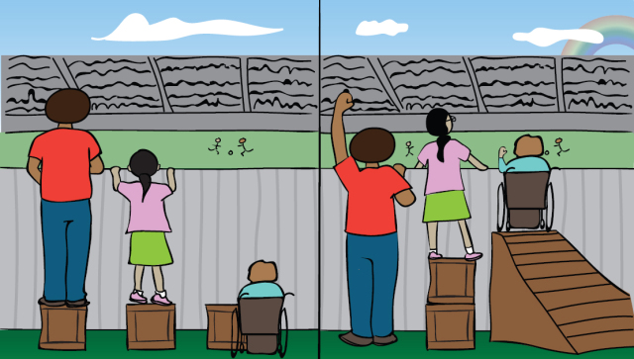
Strategies For Quality Online Teaching In Noncredit
Apply equitable methods to promote student access and success while acknowledging institutional obstacles.
Call students ahead of time
Open courses ahead of time with a 0 module
Use culturally aware course content and assessment
Incorporate Open Educational Resources (OER)
Announce resources available at the college
Ensure accessibility (508 compliance)
Keep it simple!
Notes:
Wendy

Slide 33
Strategies For Regular And Effective Interaction
Utilize multiple tools to support instructor-to-student and student-to-student interaction
Announcements
Canvas messaging
Participate on discussion boards
Ensure students notifications are on!
Personalized videos
Screencasts or other instructor’s video recording (ex: Zoom)
Grade promptly and leave feedback
Teach netiquette
2021 ASCCC Curriculum Institute 33
Notes:
Wendy

Slide 34
Strategies For Quality Online Teaching In Noncredit
Develop plans for improving courses each time they are taught
End of course surveys
Instructor feedback
Use formative and summative assessment and course analytics to guide changes
Notes:
Wendy

Slide 35
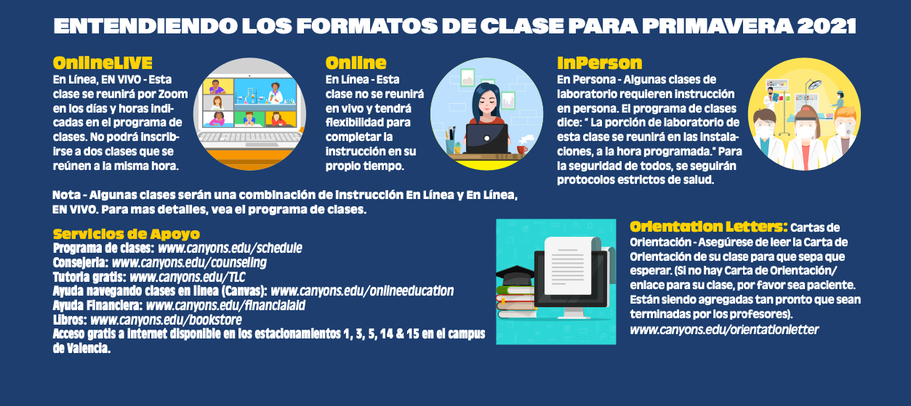
Notes:
Wendy

Slide 36
info@asccc.org
Notes:
Randy

