Slide 1
ASCCC COUNSELING IN A STATE OF EMERGENCY
Counseling Faculty Self-Care, Healthy Thinking, Grief & Loss During COVID 19 Pandemic

Slide 2
Presenters: LaTonya Parker Ed.D. ASCCC Area D Representative Bertha Hale Ed.D. CEO of Solutions 2 Etc. LLC

Slide 3
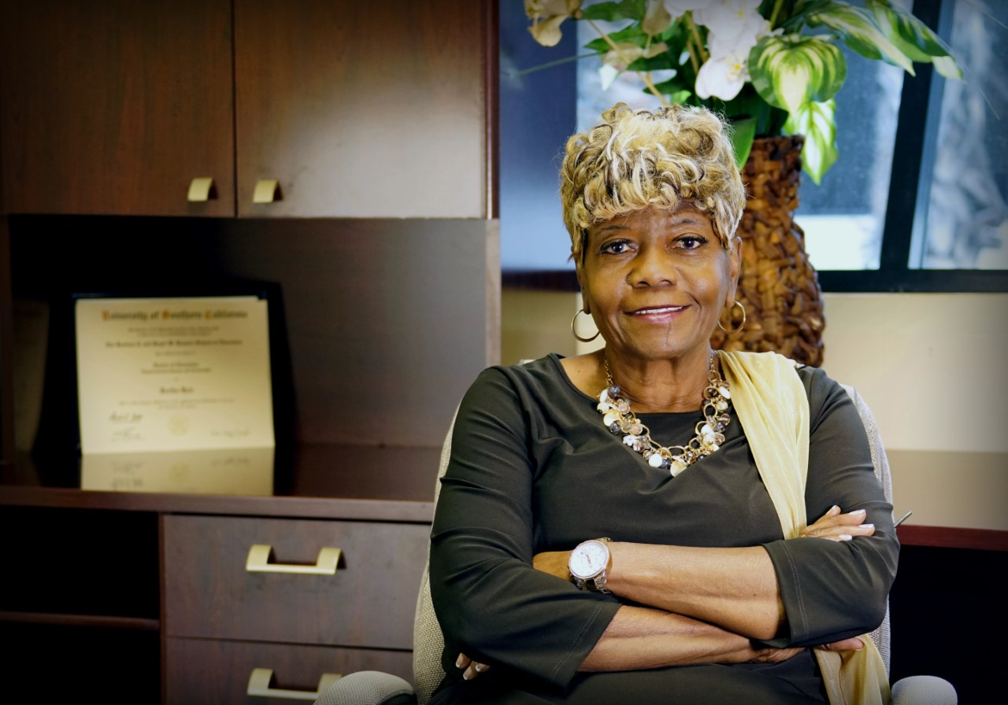
Dr. Bertha Hale, is founder and CEO of Solutions 2 Etc. LLC and provides numerous services for children and families ordered by the courts for Anger Management, Parent Education, Domestic Violence Intervention, Supervised Visitation or other related services. Dr. Hale received a Bachelor of Arts degree in Psychology and Social Relations from the University of California, Riverside. A Master of Arts degree in Education from California State University, San Bernardino, and a Doctorate Degree in Education from the University of Southern California. Dr. Hale is also the author of two books “Passage Through The Night!” Coping with Grief and Loss also authored and continues to develop “The CORE Model Family Support.”

Slide 4
“Almost everything will work again if you unplug it for a few minutes, including you.” -Anne Lamott

Slide 5
Balancing Personal Responsibilities
Self/
Counseling Faculty
New Work Place Culture
Physical
Health
Personal Financial Security
Distance Education Instruction
Mental
Well-being
Social /Relationship Self-Care

Slide 6
Responding To An Uninvited Transition
Healthy Thinking
Rest
Mental Well Being
Exercise
Healthy Eating

Slide 7
Healthy Thinking
Intermittent Social Media/TV
Watching
Know Your Standards of Survival
Know You Are Going to Survive
Find the Good

Slide 8
Calm Yourself Within
Reach Out to Others
Notes of Gratitude
Book Club
Be Creative
Drink Tea
Center Yourself

Slide 9
Q & A

Slide 10
THANK YOU!

