Slide 1
Equity Minded Leadership and Faculty Diversification
ASCCC Faculty Leadership Institute
Virtual Conference
Thursday, June 18, 2020
9:00am-10:30am General Session III

Slide 2
Presenters:
LaTonya L. Parker, ASCCC Area D Representative
Robert L. Stewart, Jr., ASCCC Area C Representative
Faculty diversification has been adopted as one of the priority areas for ASCCC. Diversification begins with a full understanding and appreciation for individuals with different perspectives, backgrounds, characteristics and qualities of who belong. To advance faculty diversification, local academic senates are asked to establish an AAA local academic model. This model includes acknowledgement, accountability and action oriented strategic planning with intentional agenda development.
During this session academic senate leaders will discuss achieving common ground and educational benefits of faulty diversity in the California community college system.

Slide 3
TODAY’S AGENDA: -Welcome and Introductions -Workforce Diversity Defined -Faculty Diversity (FD) Discussion -FD Moving From an Organization Value to Practice Through Institutional Strategies
Equitable (Ethnic and Racial Diversity) Approaches to Increase Student Success

Slide 4
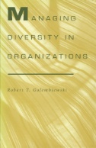
“Workforce diversity means a workforce made up of people with different human qualities or who belong.”
Golembiewski, R. T. (1995). Managing diversity in organizations. Tuscaloosa, Ala: University of Alabama Press.
http://www.worldcat.org/oclc/44956061

Slide 5
Why is it Important for Faculty and Administrators to Dialogue and Align Goals to Hire for Diversity? Share Activity

Slide 6
Educational Benefits of Faculty Diversity
According to the California Community Colleges Chancellor’s Office 2016 Equal Opportunity Employment & Diversity Best Practices Handbook there has been an increase in underrepresented students in California community colleges in recent years.
Data shows that the student population in the community colleges has become increasingly more diverse, whereas all ranks of the workforce have not reflected this increase in diversity. According to data submitted by the districts, for the past 10 years, approximately 20 percent of full-time faculty members are from underrepresented communities.
See chart in next slide:
6

Slide 7
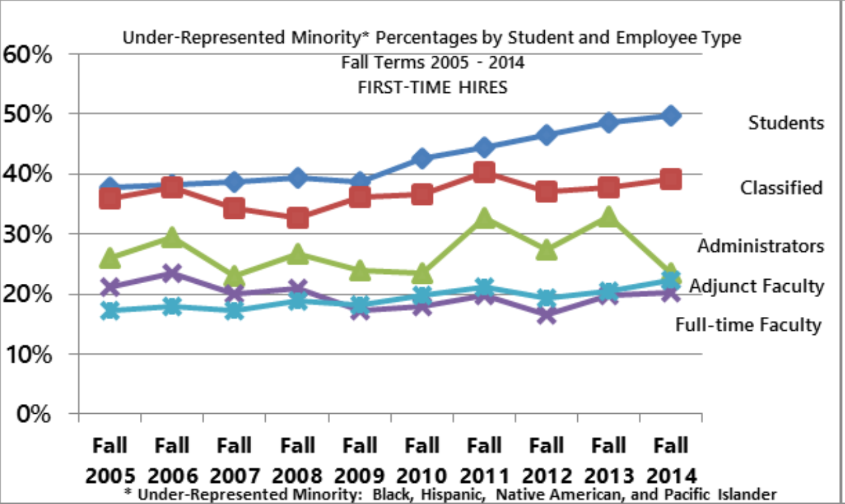
Under-Represented Minority Percentages by Student and Employee Type

Slide 8
Additional Benefits of Faculty Diversity
Improving Faculty Diversity Improves the Quality of Instruction
Diversity in the workplace adds to the diversity of ideas and attitudes within an organization.
Improving Faculty Diversity will Protect Districts Against Liability
Both the Civil Rights Act of 1964 and the California Fair Employment and Housing Act prohibit employers from discriminating against employees based on a number of protected characteristics, including race, gender, religion, sexual orientation and national origin.
8

Slide 9
What are Best Collaborative Practices for Faculty and Administrators to Hire for Diversity?
9

Slide 10
Achieving Common Ground Through Developing and Maintaining Institutional Commitment to Faculty Diversity
Data Informed Decisions
Has your organization reviewed the current hiring processes?
Does your organization make available under-represented students and employees data?
Bring Awareness
Identify Potential Barriers
Communicate Challenges
Data Driven Decisions
Create an Achieving Common Ground Plan
Develop a Metric
Include the Faculty, Staff and Administrators in the Communication Plan
Sustain Momentum
10

Slide 11
TAKEAWAY!
Collaborative strategies to increase diversity hiring to increase students’ success in California community colleges
11

Slide 12
THANK YOU
LaTonya Parker: latonya.parker@mvc.edu or latonya@asccc.org
Robert L. Stewart, Jr.: STEWARRL@LASC.EDU
Email
Academic Senate for California Community Colleges: submit I inquiries to info@asccc.org

Slide 13
Resources:
https://asccc.org/sites/default/files/publications/FacultyHiring_0.pdf
https://californiacommunitycolleges.cccco.edu/Portals/0/Reports/2016-EEO-and-Diversity-Handbook-ADA.pdf
https://extranet.cccco.edu/Portals/1/Legal/EEO/2018-Longitudinal-Data-Guide.WEB.pdf

