Slide 1
Equity, Diversity, and Inclusion in Budget Reduction Considerations
ASCCC Presentation
Dr. Isabel O’Connor
Dr. Ashanti Hands
Lorenze Legaspi

Slide 2
Agenda
Institutional Commitment and Culture
Resource Allocation Process
Schedule and FTEF Reductions
Scholarships Equity Review
COVID-19 Relief Funding
Quick Tangibles

Slide 3
ASK AROUND

Slide 4
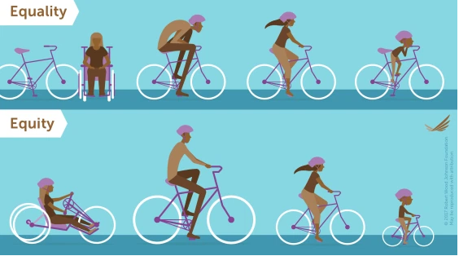
Mesa College’s Definition of Equity
At Mesa, equity is a student-centered approach to fostering a culture of success for historically marginalized students. In our roles as faculty members, student services practitioners, staff, and administrators, we pursue equity through principles of inquiry and data-informed decision
making principles of inquiry and data-informed decision making. We will achieve equity when we see parity in outcomes across racial/ethnic groups and all disproportionately impacted groups within higher education. We work within integrated and equity-minded systems to ensure that everyone has what they need to succeed during their time at Mesa College.

Slide 5
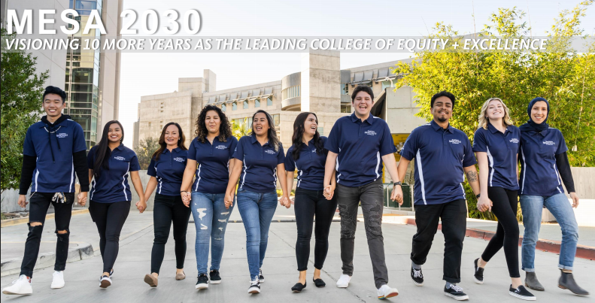
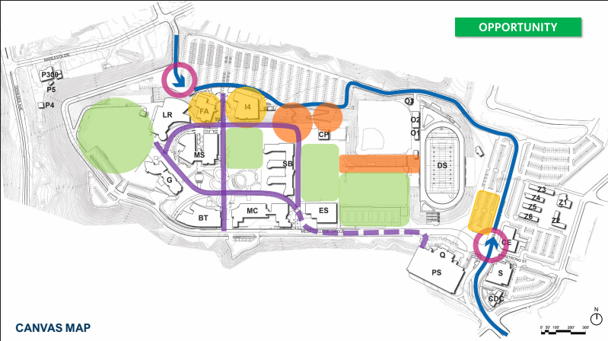
Educational and Facilities Master Planning
Guiding Principle

Slide 6
Resource Allocation
Budget Allocation Process
Budget Allocation Recommendation Committee
Include Diversity, Equity, and Inclusion in Rubric
Position Prioritization
Faculty & Classified
Hiring/Screening Process

Slide 7
Scheduling and FTEF Reductions

Slide 8
The Challenge: FTEF Reductions
 | Proportion of FTES Target by College | 20/21 Targeted FTES | 20/21 Targeted FTEF | 19/20 Actual FTEF | FTEF to Reduce | Estimated Sections to Reduce in 20/21
 |  |  | Productivity set at 15.0
City College | 24.5% | 8,994 | 600 | 673 | 73 | 365
Mesa College | 37.5% | 13,767 | 918 | 992 | 75 | 373
Miramar College | 20.5% | 7,526 | 502 | 520 | 18 | 91
Continuing Educ. | 17.5% | 6,424 | 428 | 443 | 15 | 73
Total | 100% | 36,711 | 2,447 | 2,628 | 181 | 903

Slide 9
The Process: Late Spring 2020
Reduced 43 FTEF in Summer 2020 (COVID)
How about the remaining 32 FTEF to cut?
Parameters:
Budget cuts
Historically, the SDCCD had pursued growth
Planning mainly based on FTES, not FTEF
Significant cultural shift
District Goal: Increase efficiency (FTEF allocated based on 17.5)
And of course, COVID-19

Slide 10
The Reduction Process: Equity and Fairness
Started with per school percentage of college FTEF allocation and applied it to the reduced annual allocation
Deans and chairs discussion and shared parameters:
Size of programs: Reduction impact on smaller programs
Student needs: Program completion and class rotation
Evening classes: Catch 22
Should we offer CCAP? Honors?
Cancel Intersession? Who enrolls in Intersession?
New programs: Schedule if low enrolled?
What to cancel: Below 70% of cap?

Slide 11
The Considerations
Themes running through planning:
Tension between budget and student completion and success
Effects of cuts to programs that enroll significant numbers of disproportionately impacted students
Preserve high demand large programs? How about smaller programs, such as Chicano Studies and Black Studies?
No winners and losers

Slide 12
Equity and Humanity in FTEF Allocation
Not a purely mathematical formula:
To develop the schedule or
To manage enrollment
Deans and chairs have the big picture
Everyone uses the same enrollment data by school and program (no secrets)
No winners and losers. We are all in this together.
Biggest lessons learned:
Collaboration between VPI, Deans and Chairs
Don’t avoid the difficult meeting/conversations
Build shared interests
Transparency

Slide 13
Scholarship Equity Review

Slide 14
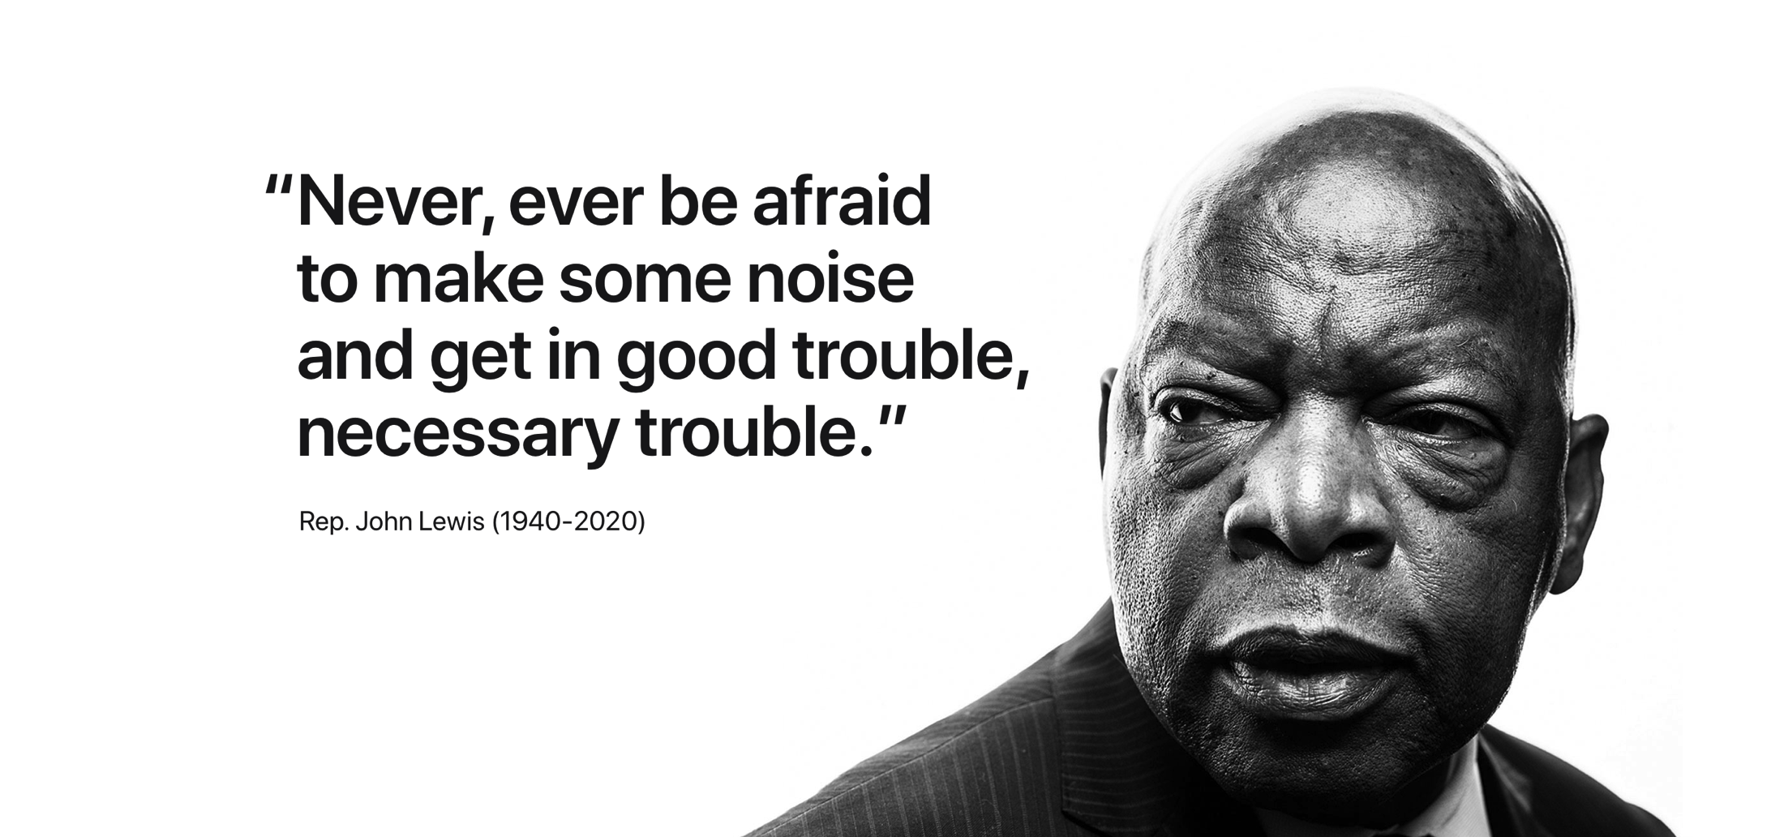

Slide 15
Scholarship Equity Analysis
2018-2019
Lessons Learned
2019-2020
Data Informed Action
2020-2021
Outcomes|Lessons Learned

Slide 16
RACE/ETHNICITY
2018-2019
Lessons Learned
Part 1
White = lowest application rate, but highest award rate
African American and Latinx = lowest award rate
Asian = biggest gap bet. application rate and award rate
1ST-GENERATION (FG)
On avg, non-FG received more scholarship money than FG
Latinx was the only group that had both the lowest application rate and lowest award rate
FG Latinx was the largest group among drafted applicants
Primary Language is Not English (PLINE)
PLINE Asians = high application rate but lowest award rate
PLINE Latinx = largest group among drafted applicants

Slide 17
AMOUNT
2018-2019
Lessons Learned
Part 2
Compared to males, females received fewer awards per headcount, lower amount per award, and lower amount per headcount.
Compared to other ethnicities, White students received highest amount per award
Compared to other ethnicities, African American students received lowest amount per award and lowest amount per headcount
GPA & UNITS
Higher GPA & higher units = greater chance of receiving scholarships
Lower GPA & lower units = drafted, less likely to submit, lower winning chance

Slide 18
Overview
2018-2019
Lessons Learned
2019-2020
Data Informed Action
2020-2021
Outcomes|Lessons Learned

Slide 19
2019-2020: Data Informed Action
WORKSHOPS
CLASSROOM PRESENTATIONS
COLLABORATION WITH INSTRUCTORS
LANGUAGE TO INCLUDE ON SYLLABI
CANVAS SLIDES
PUBLICITY/ SOCIAL MEDIA
HOW TO STEPS ONLINE

Slide 20
2019-2020: Data Informed Action
Removing Barriers
Community Service" expanded to include service
to church, family and friends
Emphasized "All GPAs welcome to apply"
Removed required references
Removed minimum unit requirement (select scholarship)
Flexible with part time/ full-time status

Slide 21
2019-2020: Data Informed Action
Equity Lens - Reviewer’s Workshop
Review of data
Questions asked
Discussion on intent of the scholarship
Understanding the purpose of the scholarship

Slide 22
Scholarship - Equity Analysis
2018-2019
Lessons Learned
2019-2020
Data Informed Action
2020-2021
Lessons Learned

Slide 23
Outcomes|Lessons Learned
from 2019-2020
RACE/ETHNICITY - more diverse
More African American, Asian, Latinx
Representation of Native American
GENDER
Average per headcount for females were higher than for males
Representation of non-binary category
AMOUNT
Higher amount for African American, Asian, Filipino
Lower amount for White and Latinx (but Latinx was still the biggest group in terms of total amount received and total headcount)

Slide 24
Outcomes|Lessons Learned
from 2019-2020
Inspect what you expect
Interrogate your data with an equity lens
Be intentional about creating space for equitable outcomes with allocation of resources
Start where you are with what you have
Repeat

Slide 25
COVID-19 Relief Funding
CARES Act
Direct Aid
Institutional Funds
MSI Funds
COVID-19 Block Grant
State Federal
Fund Raising

Slide 26
Quick Tangibles
Faculty Voice and Input
The 10+1
10. Processes for institutional planning and budget development
Ask, ask, challenge
True Budget Reduction
Keep focused on the students
Review and use data in decision makings
Honor the student experience

