Slide 1
Civil Discourse: Engaging with Colleagues Who May Not Like You
LaTonya Parker, ASCCC Area D Representative
Carrie Roberson, ASCCC North Representative
Stephanie Curry, ASCCC North Representative
Notes:
SC AND CR

Slide 2
Who’s in the Room?
Notes:
SC and CR

Slide 3
IN A TIME OF GREAT CHANGE…
Student Centered Funding Formula (SCFF)
AB 705
Vision for Success
OER
Guided Pathways
Strong Workforce
Accreditation
CA Online Community College
Notes:
SC and CR

Slide 4
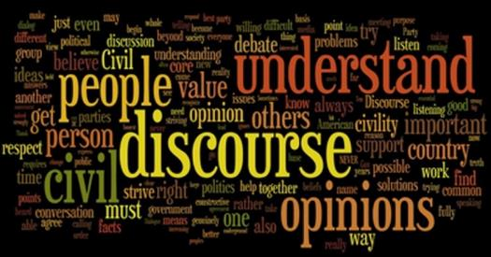
One way to navigate the changing environment…
Notes:
SC and CR

Slide 5
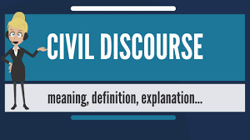
How would you define Civil Discourse?
Notes:
LTP

Slide 6
Civil Discourse Defined
Civil discourse is engagement in discourse intended to enhance understanding.
Kenneth J. Gergen| PhD | Swarthmore College, PENNSYLVANIA | Department of Psychology-- described civil discourse as "the language of dispassionate objectivity“
“the exercise of patience, integrity, humility and mutual respect in civil conversation even with those whom we disagree”– James Calvin Davis
Notes:
LTP

Slide 7
Quote:
“ Show respect even to people who don’t deserve it, not as a reflection of their character, but as a reflection of yours”
---Dave Willis

Slide 8
Civil Discourse is not always easy…
It Involves a commitment to an informed, frank exchange of
ideas and an understanding of complexity and ambiguity.
One should not expect civil discourse to create a feeling
of comfort.
It is difficult for people to address challenges to deeply
held beliefs and opinions
Both sides must be willing to alter positions based on convincing
arguments and evidence.
Notes:
SC

Slide 9
Be proactive when dealing with conflict
What is at issue?
What are the interests?
Who should be consulted?
What policies, procedures or processes may affect resolution or management?
What is the conflict culture?
Notes:
SC

Slide 10
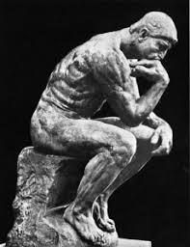
SMART Self Guidance to Civil Discourse
S Be thoughtful and specific about the personal area you would like to focus on
Notes:
LTP

Slide 11
SMART Self Guidance to Civil Discourse
M Make sure you self-assess through continually monitoring/measuring your progress
Notes:
LTP

Slide 12
SMART Self Guidance to Civil Discourse
A envision the achievable successful outcome
Notes:
LTP

Slide 13
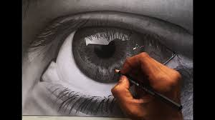
SMART Self Guidance to Civil Discourse
R Be realistic about the desired civil discourse outcome.
Think about the personal adjusted behavior that will affect your leadership role and engagement with others.
Notes:
LTP

Slide 14
SMART Self Guidance to Civil Discourse
T Identify end time for the desired results to help you stay the course.
Notes:
LTP

Slide 15
Good Practices to Avert, Manage, or Resolve Conflict
Take nothing personally.
Guide all participants to do the same.
Fall on your sword, if necessary.
Is this the hill you are going to die on?
Resist the urge to pursue or claim personal victories over others.
Keep the interests of the students and the college overall in the forefront of your mind.
Find agreement where you can
Take breaks
Notes:
CR

Slide 16
SCENARIO—Discuss in Small Groups
How would you navigate a discussion on the role of counselors and faculty in advising students?
What are the points of contention?
Who needs to be included in the discussion?
What questions need to be asked to understand each other's roles?
how do we engage to understand?
How can you use the SMART tools to help in this discussion?

Slide 17
Questions?
Notes:
CR

Slide 18
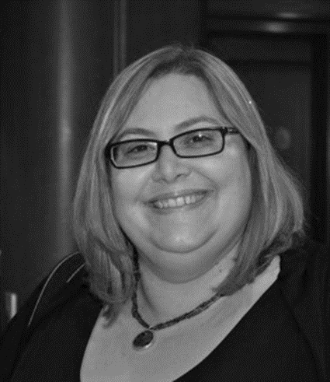
latonya.parker@mvc.edu
robersonca@butte.edu
stephanie.curry@reedleycollege.edu
Notes:
CR

