Slide 1
Local Budget
Rebecca Eikey, Area C Representative
Ginni May, Area A Representative
Faculty Leadership Institute, June 16, 2017, Sacramento Sheraton

Slide 2
Overview
What is the role of the local Academic Senate in the local budget development process?
How does the local budget affect instructional programs and student services?
What aspects of the state budget should academic senate leadership consider as they engage in local budget discussions?
Questions and Comments…

Slide 3
Acronyms
ASCCC – Academic Senate for California Community Colleges
CCCCO – California Community Colleges Chancellor’s Office
AB – Assembly Bill
IEPI – Institutional Effectiveness Partnership Initiative
PRT – Partnership Resource Team
MOO – Menu of Options
IE Plan – Innovation and Effectiveness Plan
FTES – Full Time Equivalent Student
WSCH – Weekly Student Contact Hour
FTE – Full Time Equivalent
FON – Faculty Obligation Number
CCR – California Code of Regulations (Title 5)

Slide 4
Role of the Local Academic Senate with the Budget

Slide 5
Title 5 §53200 – The “10+1”
(c) “Academic and professional matters” means the following policy development and implementation matters:
(1) thru (9)
(10) processes for institutional planning and budget development; and
(11)
(d) “Consult collegially” means that the district governing board shall develop policies on academic and professional matters through either or both of the following methods, according to its own discretion:
(1) relying primarily upon the advice and judgment of the academic senate; or
(2) agreeing that the district governing board, or such representatives as it may designate, and the representatives of the academic senate shall have the obligation to reach mutual agreement by written resolution, regulation, or policy of the governing board effectuating such recommendations.

Slide 6
From Local Senates Handbook
Secure Resources to Ensure Senate Success
Work with the local administration to identify the types of budget resources, such as reassigned time or travel, available to the senate.

Slide 7
From Local Senates Handbook
Secure Resources to Ensure Senate Success
Work with the administration to put in writing any budget agreements to fund the senate. Informal agreements have a habit of disappearing with rapidly shifting administration members.

Slide 8
From Local Senates Handbook
Secure Resources to Ensure Senate Success
Justify to the college administration why inadequate resources may harm students, accreditation, campus climate, and effective participatory governance in order to convince the college to increase resources.

Slide 9
ASCCC Resolutions
Resolution 17.01 Spring 2017 – Academic Senate Involvement in and Sign-off on Grants and Initiative Plans
Resolution 6.05 Fall 2016 – Direct Strong Workforce Funding to Districts (not through regional consortium)
Resolution 11.02 Spring 1999 – Use of Technology Money (sign-off by the local academic senate president)
Resolution 12.04 Spring 1996 – Staff Diversity Funds (local senate president sign off on reports to CCCCO)
More…

Slide 10
Budget on Instructional Programs and Student Services

Slide 11
Committees and Documents
Budget Committee (College/District) – many different structures…
2017-19 Integrated Plan:
Student Equity
Student Success and Support Program
Basic Skills Initiative
Submission Deadline: December 1, 2017
Budget Allocations reflect 2017-18, with annual reports
Requires Academic Senate President’s Signature
Other Plans with Budget Implications…

Slide 12
Grants and Initiatives
Many do not request Academic Senate President to sign, but some do…
Basic Skills and Student Outcomes Transformation Program – AB 770 (2015, Irwin) (grants)
Strong Workforce Program – Doing What Matters
*IEPI PRT (Innovation and Effectiveness Plan)
California Apprenticeship Initiative (two grants)
California Guided Pathways
Others…
*senate president signature if MOO or IE Plan include any “10+1”

Slide 13
Curriculum Considerations
Feasibility
Facilities
Supplies
Others…

Slide 14
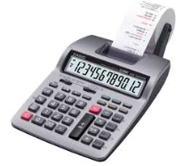
Course Offerings
FTES
2 Semesters or 3 Quarters
1 FTES = (15 contact hours/week)x(2x17.5 weeks)
= (15 contact hours/week)x(3x11.67 weeks)*
= 525 contact hours
WSCH = (# of contact hours/week) x (# of students enrolled)
Productivity = WSCH/FTE

Slide 15
Nuts and Bolts
Local Budget Development:
Restricted vs. Unrestricted
Funding Priorities
Documented Process in place
Funding Sources
Apportionment and General Funds
Perkins and other CTE funds
Other Categorical funds
Lottery
Deferred maintenance
Grants
Others…

Slide 16
Budget Considerations: A Primer for Senate Leaders, Fall 2009
College or District Preliminary or Tentative Budget must be adopted by the local governing board by July 1.
Note: the state budget is not adopted until June 30…
Specific budget numbers in excess of 10% of last year’s actual budget
Year end actual balance exceeds 15% of proposed budget – reserves are required but excessive reserves suggest over-budgeting and under-spending
Large changes between the budgeted and actual amounts

Slide 17
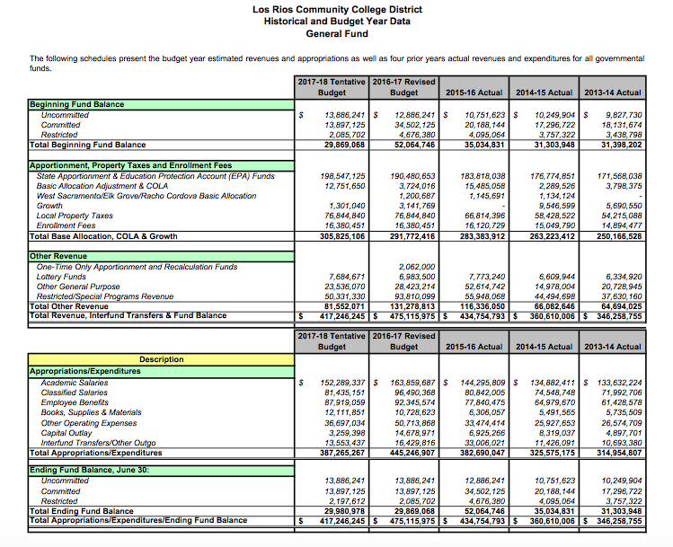
Budget Spreadsheet

Slide 18
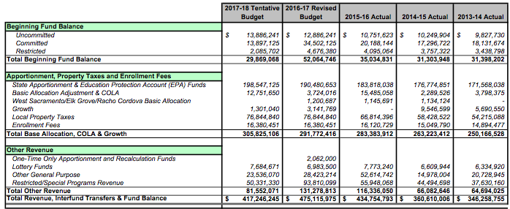
Budget Spreadsheet

Slide 19
Budget Spreadsheet

Slide 20
Budget Considerations: A Primer for Senate Leaders, Fall 2009
College or District Final Budget must be adopted by the local governing board by September 15.
CCFS-311 Annual Community College Financial Status Report
CCFS-320 Apportionment Attendance Report
Annual Audit Report
FON (Faculty Obligation Number)
50% Law - Ed Code §84362(d)
75:25 - Title 5 §51025, Ed Code only requires that the BoG establish minimum standards for hours of credit instruction taught by full time faculty

Slide 21
The FON, 50% Law, and 75:25
FON (1989) – Fulltime Faculty Obligation Number
Ed Code §87482.6 and CCR Title 5 §51025 requires districts to increase the number of full time faculty over the prior year in proportion to the amount of growth in funded credit FTES.
Based on credit funded FTES
Baseline Compliance established based on local FON in 1988-89
50% Law (1961) – Ed Code §84362(d) requires that 50% of district’s current expense of education be for salaries of classroom instructors
75:25 – AB 1725 (Vasconcellos,1988) Established a goal that 75% of instructional hours be taught by full time faculty.

Slide 22
Aspects of the State Budget

Slide 23
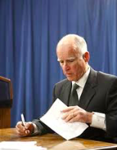
State Funding
January 10 Governor’s Budget Proposal
May Revise
Assembly, Senate consider – Conference Committee resolves differences
2/3 vote in each house to pass, June 15 is deadline
To Governor to sign (or veto)

Slide 24
State Funding
Prop 98 – General Fund
Essentially received 10.93% “fair share” in each of last three budget years (2015-16, 2016-17, 2017-18)
Categorical Funds (Restricted)
CCCCO Grants
EOPS
DSPS
More…

Slide 25
Questions and Comments
Contact:
Rebecca Eikey rebecca.eikey@canyons.edu
Ginni May mayv@scc.losrios.edu

Slide 26
References
Budget Primer: http://asccc.org/sites/default/files/publications/Budget-Fall09_0.pdf
Local Senates Handbook: http://www.asccc.org/sites/default/files/local_senates_handbook2015-web.pdf
FON: http://extranet.cccco.edu/Divisions/FinanceFacilities/FiscalStandardsandAccountibilityUnit/FiscalStandards/FullTimeFacultyObligation.aspx#Fall_2016_and_Fall_2017
CCCCO Budget page: http://extranet.cccco.edu/Divisions/FinanceFacilities/FiscalServicesUnit/BudgetNews.aspx

