Slide 1
Local $Budget$ 101
Ginni May, ASCCC Treasurer
Carrie Roberson, ASCCC North Representative
Craig Rutan, ASCCC Secretary
Faculty Leadership Institute, June 14, 2018, Sheraton San Diego
Notes:
CARRIE

Slide 2
OVERVIEW
What is the role of the local Academic Senate in the local budget development process?
How does the local budget affect instructional programs and student services?
What aspects of the state budget should academic senate leadership consider as they engage in local budget discussions?
Questions and Comments…
Notes:
CARRIE

Slide 3
Role of the Local Academic Senate with the $ Budget $
Notes:
CARRIE

Slide 4
Title 5 §53200 – The “10+1”
(c) “Academic and professional matters” means the following policy development and implementation matters:
(1) thru (9)
(10) processes for institutional planning and budget development; and
(11)
(d) “Consult collegially” means that the district governing board shall develop policies on academic and professional matters through either or both of the following methods, according to its own discretion:
(1) relying primarily upon the advice and judgment of the academic senate; or
(2) agreeing that the district governing board, or such representatives as it may designate, and the representatives of the academic senate shall have the obligation to reach mutual agreement by written resolution, regulation, or policy of the governing board effectuating such recommendations.
Notes:
CARRIE

Slide 5
From Local Senates Handbook
Secure Resources to Ensure Senate Success
Work with the local administration to identify the types of budget resources, (reassigned time, travel, materials, events, other) that is available for the senate.
Notes:
CARRIE

Slide 6
From Local Senates Handbook
Secure Resources to Ensure Senate Success
Work with the administration to put in writing any budget agreements to fund the senate.
Notes:
CARRIE: Informal agreements have a habit of disappearing with rapidly shifting administration members.

Slide 7
From Local Senates Handbook
Secure Resources to Ensure Senate Success
Provide college administration rationale of how adequate resources supports students, accreditation, campus climate, and effective participatory governance in order to justify to the college to maintain/ increase resources.
Notes:
CARRIE

Slide 8
ASCCC Resolutions
Resolution 17.01 Spring 2017 – Academic Senate Involvement in and Sign-off on Grants and Initiative Plans
Resolution 6.05 Fall 2016 – Direct Strong Workforce Funding to Districts (not through regional consortium)
Resolution 11.02 Spring 1999 – Use of Technology Money (sign-off by the local academic senate president)
Resolution 12.04 Spring 1996 – Staff Diversity Funds (local senate president sign off on reports to CCCCO)
More…
Notes:
CARRIE

Slide 9
Budget on Instructional Programs and Student Services
Notes:
GINNI and Craig

Slide 10
Committees and Documents
Budget Committee (College/District)
MANY different structures…
2017-19 Integrated Plan:
Student Equity
Student Success and Support Program
Basic Skills Initiative
*Requires Academic Senate President’s Signature
Guided Pathways
Self Assessment
Submission deadline: (December 2017)
Integrated Work Plan:
Submission deadline: (March 2018)
*Required Academic Senate President’s Signature
Other committees/documents or local college initiatives with budget implications for Academic Senate consideration?
Notes:
GINNI and all

Slide 11
Grants and Initiatives
Many plans do not request Academic Senate President to sign, but some do…
Basic Skills and Student Outcomes Transformation Program – AB 770 (2015, Irwin) (grants)
Strong Workforce Program – Doing What Matters
*IEPI PRT (Innovation and Effectiveness Plan)
California Apprenticeship Initiative (two grants)
Others…?
*Senate president signature if MOO or IE Plan include any “10+1”
Notes:
GINNI

Slide 12
Curriculum Considerations
Feasibility
Facilities
Supplies
Others…?
Notes:
GINNI and Craig

Slide 13
Nuts and Bolts
Local Budget Development:
Restricted vs. Unrestricted
Funding Priorities
Documented process in place
Funding Sources
Apportionment/General Funds
Perkins and other CTE funds
Other Categorical funds
Lottery
Deferred maintenance
Grants
Others…?
Notes:
GINNI and Craig: what to look for when analyzing a college/district budget

Slide 14
Budget Considerations: A Primer for Senate Leaders, Fall 2009
College or District Preliminary or Tentative Budget must be adopted by the local governing board by July 1.
*Note: the California state budget is not adopted until June 30…
Specific budget numbers in excess of 10% of last year’s actual budget
Year end actual balance exceeds 15% of proposed budget – reserves are required but excessive reserves suggest over-budgeting and under-spending
Large changes between the budgeted and actual amounts
Notes:
GINNI and Craig

Slide 15
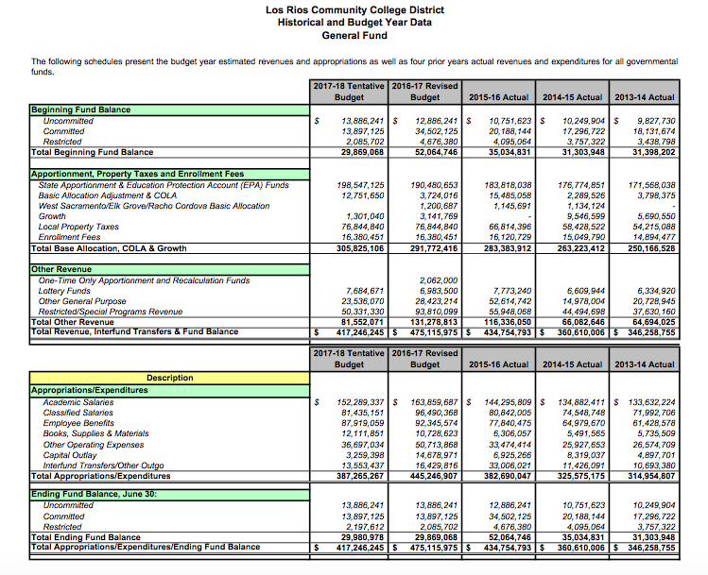
Budget Spreadsheet
Notes:
GINNI

Slide 16
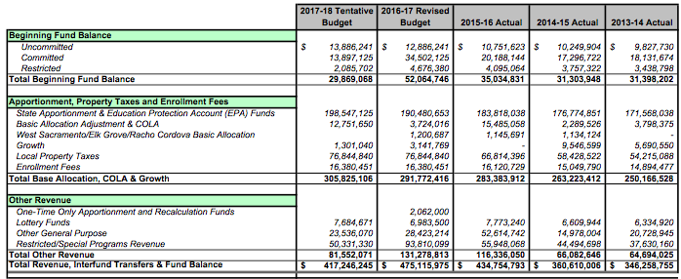
Budget Spreadsheet
Notes:
GINNI

Slide 17
Budget Spreadsheet
Notes:
GINNI

Slide 18
Budget Considerations: A Primer for Senate Leaders, Fall 2009
College or District Final Budget must be adopted by the local governing board by September 15.
CCFS-311 Annual Community College Financial Status Report
CCFS-320 Apportionment Attendance Report
Annual Audit Report
FON (Faculty Obligation Number)
50% Law - Ed Code §84362(d)
75:25 - Title 5 §51025, Ed Code only requires that the BoG establish minimum standards for hours of credit instruction taught by full time faculty
Notes:
GINNI and Craig: what to look for when analyzing a college/district budget

Slide 19
The FON, 50% Law, and 75:25
FON (1989) – Fulltime Faculty Obligation Number
Ed Code §87482.6 and CCR Title 5 §51025 requires districts to increase the number of full time faculty over the prior year in proportion to the amount of growth in funded credit FTES.
Based on credit funded FTES
Baseline Compliance established based on local FON in 1988-89
50% Law (1961) – Ed Code §84362(d) requires that 50% of district’s current expense of education be for salaries of classroom instructors
75:25 – AB 1725 (Vasconcellos,1988) Established a goal that 75% of instructional hours be taught by full time faculty.
Notes:
GINNI and Craig

Slide 20
Aspects of the State Budget
Notes:
CRAIG

Slide 21
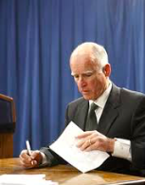
State Funding
January 10 Governor’s Budget Proposal
May Revise
Assembly/Senate consider Conference Committee resolves differences
2/3 vote in each house to pass, June 15 is deadline
To Governor to sign (or veto)
Notes:
CRAIG and Ginni

Slide 22
State Funding
Prop 98 – General Fund
Essentially received 10.93% “fair share” in each of last three budget years (2015-16, 2016-17, 2017-18)
How will this change for 2018-19…?
Categorical Funds (Restricted)
CCCCO Grants
EOPS
DSPS
More…
Where are we now…?
Notes:
CRAIG and Ginni

Slide 23
Questions and Comments
Contact:
info@asccc.org
Notes:
ALL

Slide 24
References
Budget Primer: http://asccc.org/sites/default/files/publications/Budget-Fall09_0.pdf
Local Senates Handbook: http://www.asccc.org/sites/default/files/local_senates_handbook2015-web.pdf
FON: http://extranet.cccco.edu/Divisions/FinanceFacilities/FiscalStandardsandAccountibilityUnit/FiscalStandards/FullTimeFacultyObligation.aspx#Fall_2016_and_Fall_2017
CCCCO Budget page: http://extranet.cccco.edu/Divisions/FinanceFacilities/FiscalServicesUnit/BudgetNews.aspx
Notes:
ALL

