Slide 1
Local and State Budgets and the Future Mayra Cruz , ASCCC Treasurer Mario Rodriguez, Los Rios Community College District, Vice Chancellor of Finance and Administration
Notes:
Local and Statewide Budgets and the Future
This year’s California Community College budget proposals contain elements to address COVID-19 and Californians, and students’ fundamental needs of the time. What is being proposed and what is changing? How do we mitigate the disruption to instruction and services without compromising the system’s focus on equity? In order to better understand the current budget climate, and to ensure budgetary decisions are made to best serve students, faculty leaders should understand how the budget works at the state and at the local level. During this session, the presenters will talk about the impact of the budget reductions and what faculty leaders should watch for.
1

Slide 2
Session Outcomes
Relentless focus on equity
Review how the State Budget works
Learn the 2020-21 California Community College budget proposal impact
Understand how the Student-Centered Funding Formula is calculated
Discuss how to empower faculty leaders to better understand the current budget climate to ensure budgetary decisions are student centered and equity minded
2
Notes:
Last point-Discuss how faculty leaders must be empowered to better understand the current budget climate to ensure budgetary decisions are made to best serve students, faculty leaders should understand how the budget works at the state and at the local level
2

Slide 3
Our Why?
Applying an equity and empowerment lens
3
Notes:
Retrieve from https://multco.us/diversity-equity/equity-and-empowerment-lens
The equity and empowerment Lens (with a racial justice focus) improves planning, decision-making, and resource allocation leading to more racially equitable policies and programs. At its core, it is a set of principles, reflective questions, and processes that focuses at the individual, institutional, and systemic levels by:
deconstructing what is not working around racial equity;
reconstructing and supporting what is working;
shifting the way we make decisions and think about this work; and
healing and transforming our structures, our environments, and ourselves.
3

Slide 4
4
Notes:
4

Slide 5
Calls for Action
Make a tentative agenda now that includes a discussion of anti-racism/no-hate education. Remember, you do not have to have an answer to start a conversation.
Prioritize culturally responsive curricular redesign with your curriculum committee.
Acknowledge, without assigning blame, that the structure of the college houses the biases and prejudices of its founding time. Those biases have privileged some and disadvantaged others, particularly African-American and LatinX communities.
Prioritize the evaluation of hiring and evaluation processes.
Request services from the ASCCC about any of these topics.
Evaluate your academic senate and find the voices among your faculty missing in governance. Find ways to empower those voices.
Work with your administration and students to find constructive ways students can express themselves about these deaths and the structural and historical biases that exist.

Slide 6
Why?
1. Who are the racial/ethnic and student groups affected? What is the potential impact of the resource allocation and strategic investment to these student groups?
2. Does the decision being made ignore or worsen existing disparities or produce other unintended consequences? What is the impact on eliminating the opportunity gap?
3. How does the investment or resource allocation advance opportunities for students not historically served well?
4. What are the barriers to more equitable outcomes? (e.g. mandated, financial, programmatic, managerial or institutional)
6
Notes:
6

Slide 7
Why?
5. How have you intentionally involved stakeholders who are also members of the communities affected by the strategic investment or resource allocation? How do you validate your assessment in (1), (2) and (3)?
6. How will you modify or enhance your strategies to ensure each learner and communities’ individual and cultural needs are met?
7. How are you collecting data on race, ethnicity, and other key data that addresses the "why"?
8. What is the commitment to professional learning for equity? What resources are you allocating for training in culturally responsive instruction and services?
7

Slide 8
About the College Budget
A budget reflects the priorities of the institution.
Priorities are set based on the Educational Master Plan or Strategic Plan and broad goals established by the local board of trustees.
Collegial consultation is the process for the effective participation of faculty.
These priorities must be aligned to the Vision for Success Goals.
8

Slide 9
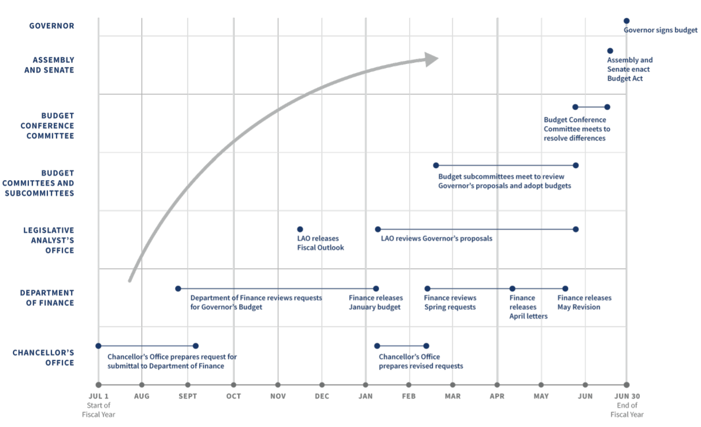
Budget Process
9

Slide 10
20-21 Proposed Budget Proposal and Impact
$54 billion budget shortfall
State Assembly and Senate have reached an agreement on the California Budget
System of deferrals proposed by the legislature vs. a cut to base apportionment
Hardship on districts will be cashflow and may require a system of loans.
10
Notes:
Deferrals vs cut to base apportionment- Those deferrals will be a challenge for districts but seem better than a permanent reduction to apportionment rates.
Note for Mario: Outcome of the conference committee between the legislature and the administration to be conclude by June 15.
10

Slide 11
Student Centered Funding Formula (SCFF)
Replaced “Program-Based Funding Model” or Senate Bill 361
70% based on students served and funding for your site
20% based on the number of financially needy and Assembly Bill 540 students served
10% based on outcomes of students
11

Slide 12
SCFF Calculation - Site
12

Slide 13
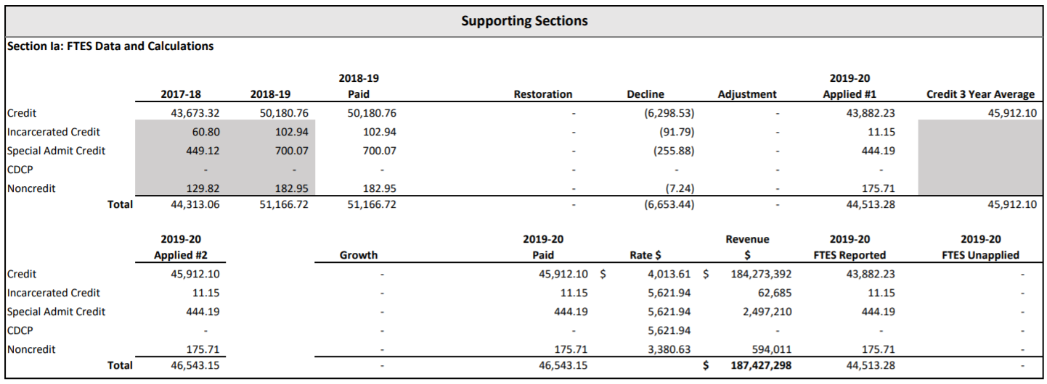
SCFF Calculation - FTES
13

Slide 14
SCFF Calculation - Supplemental
14

Slide 15
SCFF Calculation – Success (All)
15

Slide 16
SCFF Calculation – Success (Pell and Promise)
16

Slide 17
Important Terminology
Stability: “Guaranteed” funding for 1 year. By end of the subsequent year, college must achieve original Full Time Equivalent Students(FTES) goal or lose funding.
Restoration: Entitled to restore base funded FTES during three years following year of initial decrease.
Hold Harmless: The amount of funding recived in 2017-18, grown by the Cost of Living Adjustment (COLA) until 2021-22. (Note: 2020-21 budget will likely extend until 2023-24)
17

Slide 18
Faculty Obligation Number (FON)
Title 5 §§ 51025 and 53311
AB1725 (passed in 1988) established a goal to reach 75% of instructional hours to be taught by full-time faculty
Includes all tenured and tenure track positions (instructional and non-instructional)
Does not matter the funding source (unrestricted general fund, restricted funds, etc.)
Compliance based on each CCDs FON in 1988-1989
Increased proportionally with funded credit FTES
Compliance FON is the lower of Advance FON or P2 FON
18

Slide 19
50% Law
Education Code § 84362
Only the Unrestricted General Fund
Numerator
Full-time and part-time instructors salaries and benefits; Instructional aides salaries and benefits
Denominator
Non-instructional salaries and benefits; Supplies and materials; Other operating expenses
Exclusions
Instructional staff-retirees’ benefits and retirement incentives; Student health services above amount collected; Student transportation; Non-instructional staff-retirees’ benefits and retirement incentives; Rents and leases; Lottery expenditures; Capital expenditures
19

Slide 20
Local Budget: Empowering Faculty
Aligning budget priorities with the college mission and goals
Affirming institutional equity goals
Ensuring that educational integrity and campus needs for serving a diverse student body are understood.
20
Notes:
20

Slide 21
Local Budgets: Empowering Faculty
Education Code Section 70902 (b)7 requires boards to ensure the right of faculty to participate effectively in district and college governance
Title 5 §53203 requires that “the governing board or its designees will consult collegially with the academic senate when adopting policies and procedures on academic and professional matters.”
Academic and professional matters are defined in Title 5 §53200 and specifically provide for faculty roles in processes for institutional planning and budget development
21

Slide 22
Faculty Role in Budget Processes
College and district budget committees: Assure that faculty appointments to all governance committees, including committees that deal with planning and budget, are made by the academic senate in a manner that ensures an equitable representation of faculty.
Evaluate all processes for program review, prioritization of needs, and budgeting and widely distribute the results of program review and prioritization processes.
Engage in the assessment of budget processes, applying an equity lens.
22
Notes:
22

Slide 23
Faculty Role in Budget Processes
Academic Senate President Signature on statewide grants and initiatives:
Guided Pathways
Student Equity and Achievement (SEA) Program
Others
Curriculum Implications
Student Centered Funding Formula—Performance-based Funding:
New degrees and certificates must meet needs of students and community
AB 705 Implementation:
Watch enrollment trends,
Monitor student success and persistence
23

Slide 24
From Local Senates Handbook
Secure Resources to Ensure Senate Success
Work with the local administration to identify the types of budget resources, such as reassigned time or travel, available to the senate.
Notes:
There may be other budget items that senates are responsible for such as clerical staff, equipment and supplies – not all colleges have this.
24

Slide 25
From Local Senates Handbook
Secure Resources to Ensure Senate Success
Work with the administration to put in writing any budget agreements to fund the senate. Informal agreements have a habit of disappearing with rapidly shifting administration members.
Notes:
And academic senate leaders – documenting agreements is crucial
25

Slide 26
From Local Senates Handbook
Secure Resources to Ensure Senate Success
Justify to the college administration why inadequate resources may harm students, accreditation, campus climate, and effective participatory governance in order to convince the college to increase resources.
Notes:
Reassigned time, travel funds, professional development funds, supplies, funds to host events, and such
26

Slide 27
Resources
ASCCC Budget Processes and the Faculty Role https://asccc.org/sites/default/files/BudgetProcess_FacultyRole.pdf
ASCCC Local Senates Handbook (2020)
https://asccc.org/sites/default/files/ASCCC_Local-Senates-Handbook_2020_Apub.pdf
CCCCO Student Centered Funding Formula
https://www.cccco.edu/About-Us/Chancellors-Office/Divisions/College-Finance-and-Facilities-Planning/Student-Centered-Funding-Formula
27

Slide 28
For more information contact:
info@asccc.org
28

