Slide 1
Resolution Writing 102: Master Class in Resolution Writing
ASCCC Resolutions Committee Members:
Geoffrey Dyer, Area A Representative Conan McKay, Area B Representative Sam Foster, Area D Representative
Faculty Leadership Institute, June 14, 2018, Sheraton San Diego Hotel and Marina

Slide 2
Session Outcomes
Consider and discuss how local resolutions processes vary
Brainstorm ways to foster greater faculty engagement in resolutions processes
Use Resolutions Page on ASCCC Website to check already adopted resolutions
Review specific passages of Resolutions Handbook
Develop/Fine-tune Resolutions for Saturday’s Mock Plenary

Slide 3
By 6:00pm Tonight
email your mock resolution to resolutions@asccc.org
secure the signature of four conference attendees as seconders on the resolution form and submit to any member of the Resolutions Committee (Geoffrey Dyer, Rebecca Eikey, Sam Foster, or Conan McKay)
IF you want your Mock Resolution to be debated in Mock Plenary

Slide 4
Introductions

Slide 5
Why Use Resolutions?
Why use them at statewide level?
Why use them locally?

Slide 6
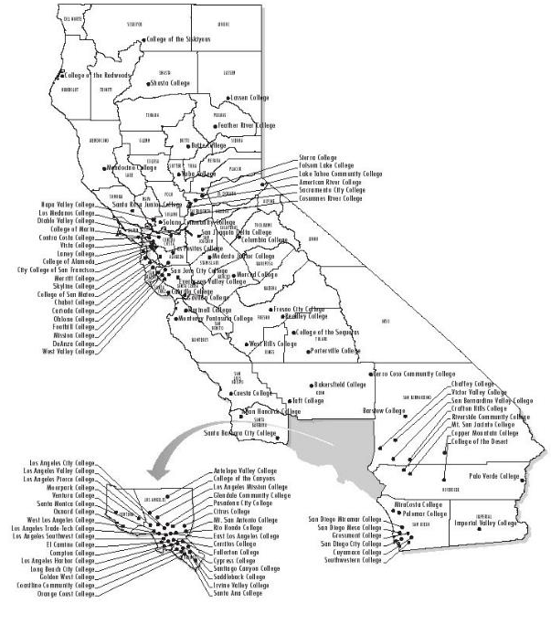
LOCAL SENATES
RESOLUTIONS
PROCESSES

Slide 7
Resolutions Processes of Local Academic Senates
Does your local senate have a clearly documented, broadly understood local resolutions process?
Can any faculty member write a resolution and submit it to your academic senate?
Does the resolution need to adhere to certain guidelines (seconders, formatting, review by officers, etc.) to advance to the senate for a vote?
Does your local AS require multiple readings of resolutions?
Does your senate have a rule about the amount of votes required to adopt a resolution that reverses a previous position?
Notes:
Don’t Linger . . .

Slide 8
The ASCCC Local Senates Handbook Recommends . . .
“The Academic Senate for California Community Colleges conducts its business using the resolutions process (see the ASCCC Resolutions Handbook) and recommends that local senates do likewise; many senates, however, reserve resolutions only for the most urgent of their statements and recommendations.” (ASCCC Local Senates Handbook)
How are the processes different?

Slide 9
Faculty Involvement in Resolutions
How involved are the faculty on your campus in writing, discussing, and voting on local resolutions?
On ASCCC resolutions?
WHO’S GOT SOMETHING THAT WORKS?

Slide 10
Fine-Tuning Your Resolution

Slide 11
Mock Resolution from Last Session
Is the draft complete?
Does it have at least one Whereas statement, and at least on Resolved statement?
Four is the limit.
Let’s check it against some of the guidelines in the Resolutions Handbook
Feel free to edit as we go!

Slide 12
From ASCCC Resolutions Handbook:
“Homework: The Academic Senate has hundreds of resolutions, and they are accessible for review on its website, asccc.org. It is possible that a resolution already exists for the position you wish to take. Please review the existing resolutions first so that duplication can be avoided.”
“It is strongly advised not to introduce resolutions to reaffirm existing positions because of the confusion that may ensure if such resolutions fail.”

Slide 13
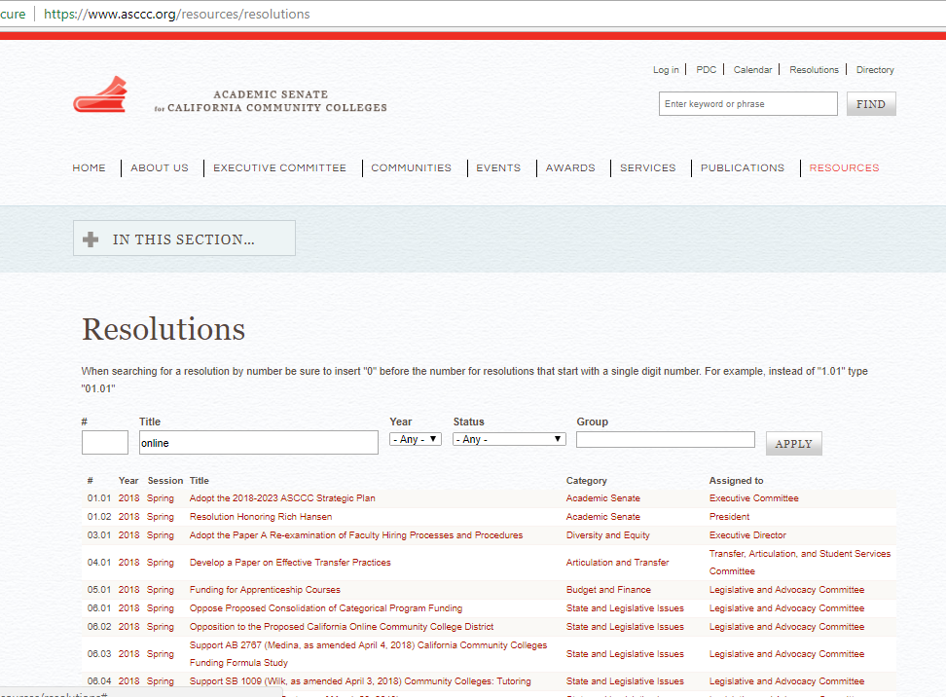
Check Previous ASCCC Resolutions
Notes:
*Searching in Title is not a full-text search . . .

Slide 14
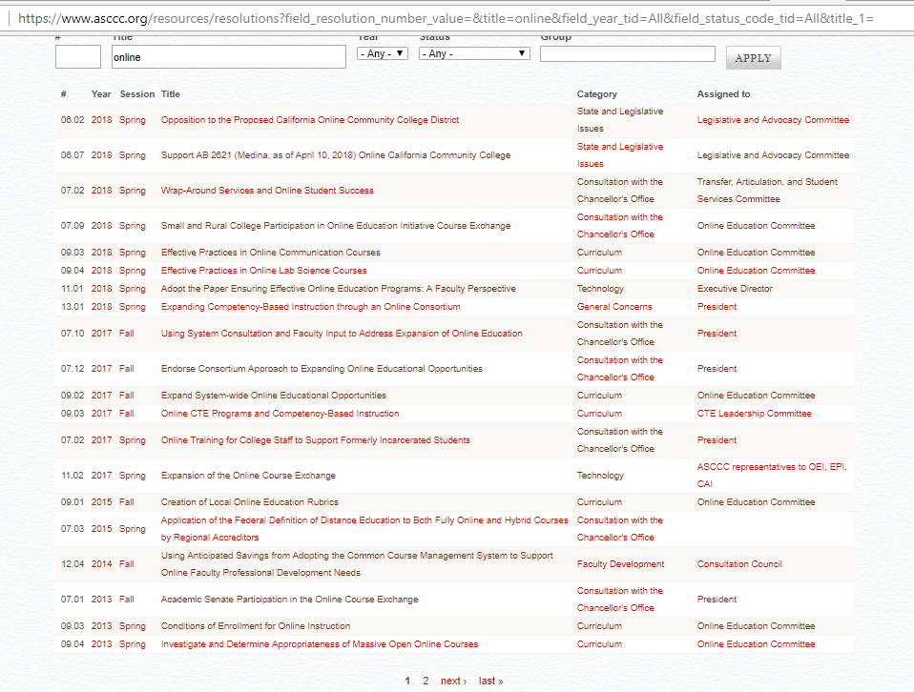

Slide 15
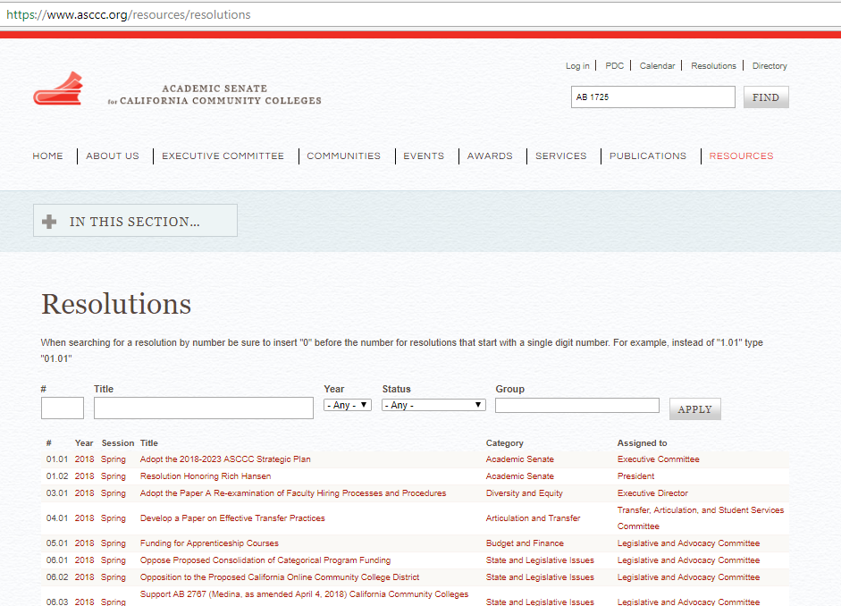
Use Advanced Search for Comprehensive Results

Slide 16
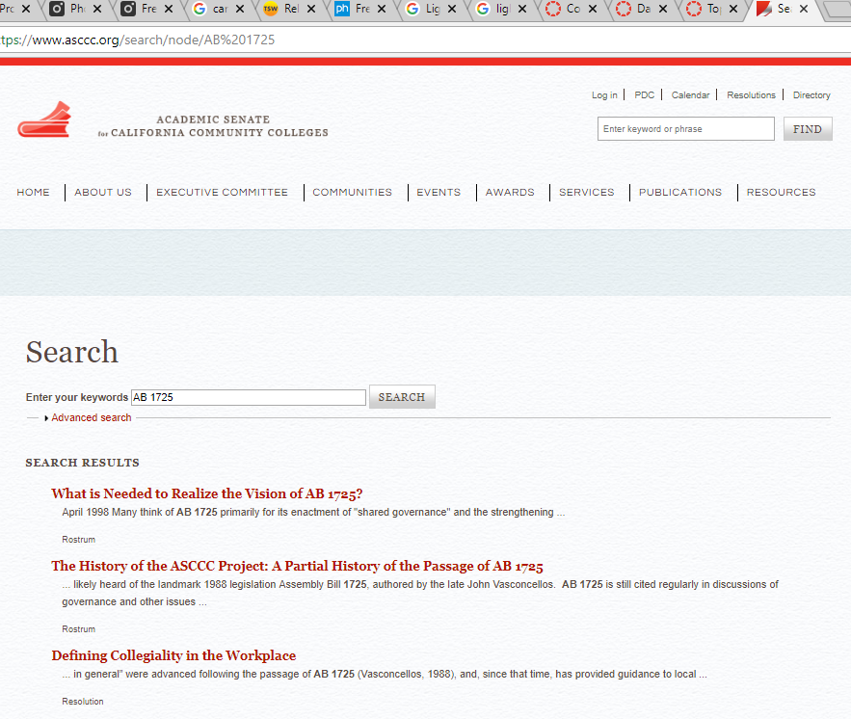

Slide 17
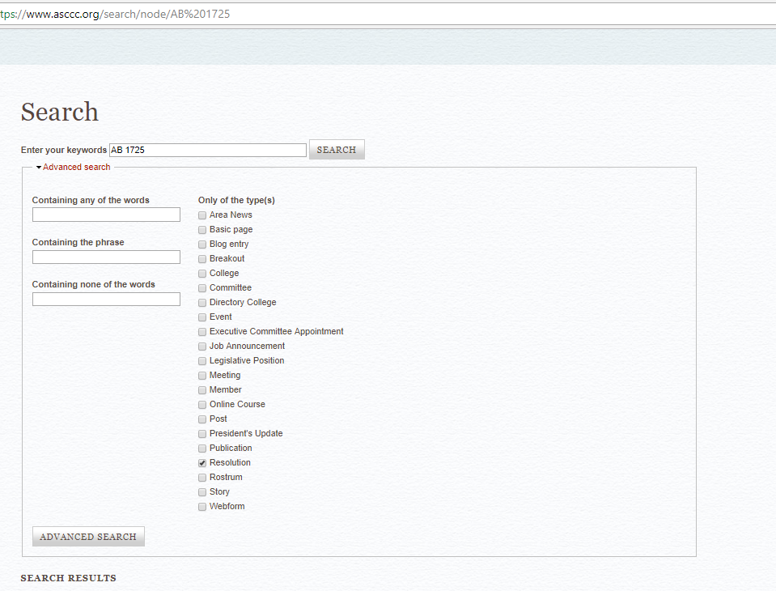

Slide 18
ASCCC Resolutions Do Not/Should Not . . .
Typically reaffirm existing positions (because of the conflict that can ensue if they fail)
Recommend action outside the 10 + 1
Deal with strictly local concerns
Contain more than four Whereas or Resolved statements
Use inflammatory tone or contain personal insults or language that may be perceived as such

Slide 19
Professionalism Preferred
“Avoid personal attacks or insults of any person or group, even subtle ones. No matter how justified the statement or how offensive the target, such attacks will almost inevitably draw opposition from some members of the voting body.”

Slide 20
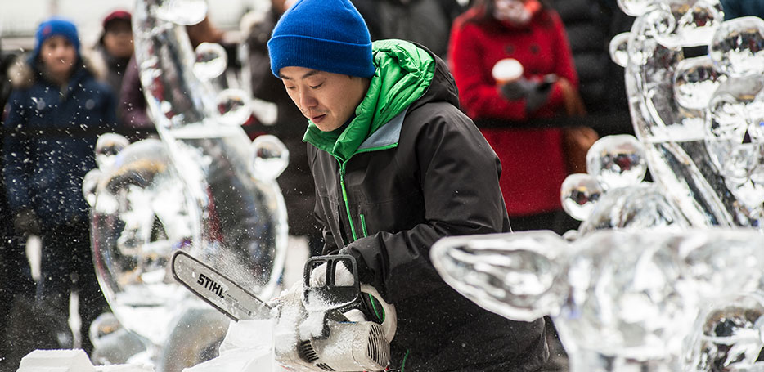
Professionalism Preferred

Slide 21
ASCCC Resolutions Do/Should
be direct & clear
contain factual Whereas statements
include references
write out full names of groups/organizations in first use
avoid lumping (one reason per Whereas)
only direct the academic senate to act (we can request to or recommend of other entities)
include title
be actionable:
“work with [other body] to ensure” vs. “ensure”
“oppose” vs. “prevent”

Slide 22
First Whereas
“Consider using the first ‘whereas’ as an introduction, outlining the situation in general or providing background and indicating the people or groups involved before justifying your resolutions in the other ‘whereas’ statements”

Slide 23
Citing Legislation
Cite last name of author and year passed or date of most recent proposed legislation or regulations included in legislation.
For example, AB 1725 (Vasconcellos, 1988), AB 705 (Irwin, 2017), AB 1805 (Irwin, as of May 29, 2018)
Include hyperlink in footnote¹
¹https://www.asccc.org/papers/resolution-handbook

Slide 24
Full Names of Organizations /Acronyms
Write out the names of groups or organizations in your first reference to the within your resolution. The name may be followed by a parenthetical abbreviation, which may then be used for future references. It is unnecessary to note an acronym if the group or organization is not referenced again in the resolution.
Ex: California Community Colleges Chancellor’s Office (instead of “Chancellor’s Office”)

Slide 25
Actionable Language
Urge
Research
Develop (a position, materials, a paper, etc.)
Distribute
Oppose
Publish
Survey
Encourage
Conclude
Adopt
Request
Express
Form
Collect
Communicate
Recognize

Slide 26
Advice on Wording
Recommend: Directed to a body with specific authority over issue in question? Within ASCCC purview to recommend?
Ensure: Does ASCCC have power to fulfil goal? If not, consider “work with”
Assert or Affirm: Have ASCCC already researched and developed position on issue? No? Consider using “explore” so field can discuss to build foundation.
Work with: Often followed by another direction to accomplish something

Slide 27
Sample Resolution
What do you notice about the resolution?

Slide 28
Activity
Swap resolutions with someone, without telling them what your resolution addresses or speaking to them.
Read your colleague’s mock resolution, without asking them questions or speaking to them.
Take turns summarizing what you read to its author, without looking at it.
Authors: Did your reader tell you what you thought you wrote? Does this let you know if you’ve communicated successfully?
Readers: Do you have advice for your authors, based on what we’ve discussed today?

Slide 29
By 6:00pm Tonight
email your mock resolution to resolutions@asccc.org
secure the signature of four conference attendees as seconders on the resolution form and submit to any member of the Resolutions Committee (Geoffrey Dyer, Rebecca Eikey, Sam Foster, or Conan McKay)
IF you want your Mock Resolution to be debated in Mock Plenary

Slide 30
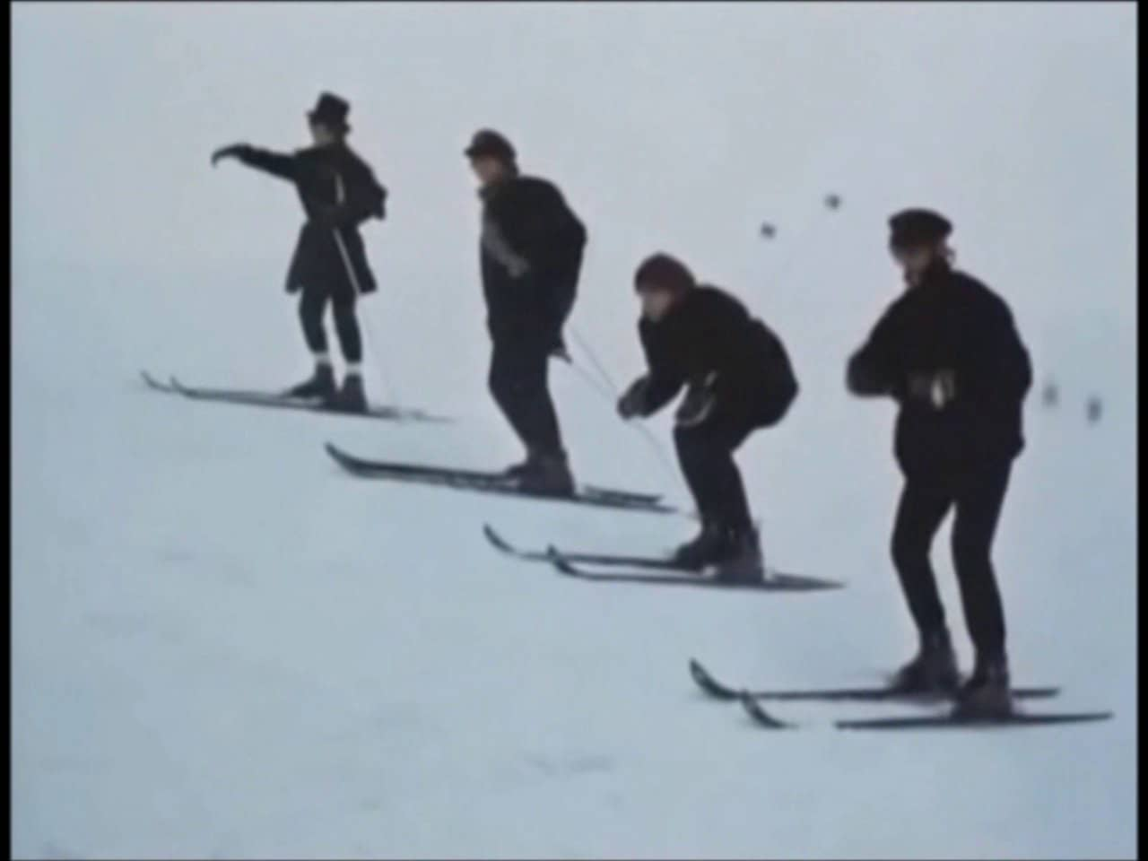
How Can We Help?
gdyer@taftcollege.edu
sfoster@fullcoll.edu
cmckay@mendocino.edu

