Slide 1
Resolution Amendment Writing
Rebecca Eikey, Area C Representative
Ginni May, Area A Representative
Faculty Leadership Institute, June 16, 2017, Sacramento Sheraton

Slide 2
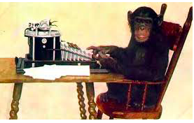
Overview
Nuts and Bolts
Your Turn…Write an Amendment!

Slide 3
Nuts and Bolts
Amendments:
Added to help clarify intent and/or expand scope
Use underscores and strikethroughs, not track changes
Review the title after adding an amendment, and amend if necessary
Make sure amendments don’t result in inconsistencies within a resolution or reverse the intent of the resolution (better to vote the resolution down)
Include contacts for each amendment

Slide 4
Nuts and Bolts
You can:
Amend a resolved or whereas
Add a resolved or whereas
Strike a resolved or whereas
More…
All resolutions and amendments are to be submitted electronically to resolutions@asccc.org
Signature pages are to be submitted during session to the Resolutions Committee Chair

Slide 5
Nuts and Bolts
Format:
No more than four “whereas” and four “resolved” statements:
Sample
Amend Resolution 3.14
Amend the first whereas:
Whereas, Blah, blah de dah blip; and
Add a second resolved:
Resolved, that the Academic Senate for California Community Colleges…
Contact: Qwerty Tipe, Kee Bord College

Slide 6
Nuts and Bolts
Must check the following:
Duplication of Position
Reversal of Position
Clarity, Readability, Understanding, Intent
Senate Purview

Slide 7
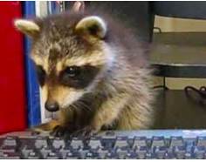
Your Turn…
Write an Amendment with colleagues…
Amendments are due: Today, June 16, 5:30 pm!
Mock Plenary Session: Saturday, June 17, 10:00 am!
Email Amendments to resolutions@asccc.org

