Slide 1

Resolution Writing: 101
Resolution Writing Made Easy
Geoffrey Dyer, Area A Representative
Rebecca Eikey, Area C Representative
The ASCCC expresses its official position on issues, legislation, and ideas through the resolution process.
Faculty Leadership Institute, June 14, 2018, Sheraton San Diego Hotel and Marina

Slide 2

Overview
Introduction
Resolutions Handbook
Process
Using Resolutions Locally
Nuts and Bolts
Your Turn…Write a Resolution!

Slide 3
Introduction
Resolutions…
Identify and record the will of the academic senates of the California community colleges
Set direction for the ASCCC as a whole
Direct members of the Executive Committee and ASCCC Committees to take action in response
Are borne out of issues important to faculty and often identified by:
  the ASCCC Executive Committee
  ASCCC Committees/Taskforces
  Local Senates
  Individuals

Slide 4

Introduction
Resolutions…
Are debated by the body at the fall and spring plenary sessions
Are voted on by the delegates of the local senates
Are bottom up, grass roots democracy
Are used for:
  Adopting Papers
  Disciplines List
  Positions on Pending Legislation
  Affect Change
  Address Conflict

Slide 5
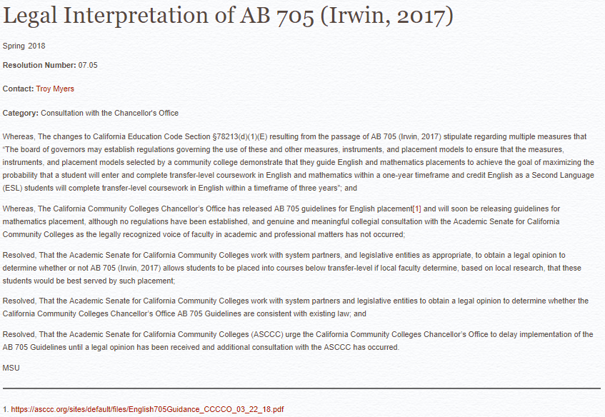
Sample Resolution
What do you notice about the resolution?
“Whereas” statements are factual
“Resolved”s are actionable
Notes:
Ask audience to point out features of Res

Slide 6


Think, Pair, Share: Idea for a Mock Resolution
Take a couple of minutes to consider statewide issues in education that are important to you, or something silly that you think other Leadership Institute attendees might appreciate. (Silly resolutions can only be directed at the ASCCC President!)
While some Mock Plenary resolutions have evolved into the basis for resolutions submitted to actual Plenary (13.03 F17—Robert L Stewart), others have been nonsensical or even directed a past ASCCC President to take his hair out of a ponytail.
After brainstorming privately, share your idea with people at your table.

Slide 7

Resolutions Handbook
Adopted in Fall 2014
Updated Fall 2016/Spring 2017
Details Process and Procedures
Defines the roles of the Executive Committee and the Resolutions Committee

Slide 8
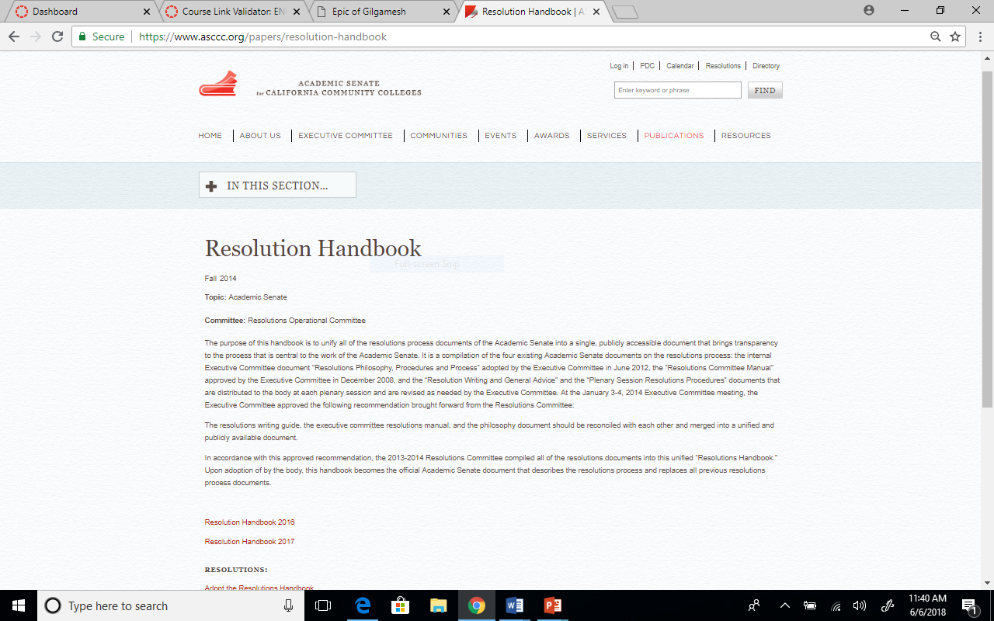
Resolutions Handbook
Publications→ Papers
→ Use most current!

Slide 9


RESOLUTIONS PROCESS
OVERVIEW
Notes:
Geoffrey/Oleg

Slide 10

Process
Resolution:
Pre-plenary review
Executive Committee
Resolutions Committee
Area Meetings
Plenary Breakouts and Office Hours
New resolutions and amendments require four signatures
Debate and Voting – Parliamentary Process

Slide 11
Resolutions & Amendments Timeline
Resolutions can be pulled from consent until 8:20 on Saturday of Plenary

Slide 12
Required
All resolutions and amendments are to be submitted electronically to resolutions@asccc.org
Signature pages are to be submitted during session to the Resolutions Committee Chair – with signatures from four (4) delegates
Contacts must attend afternoon sessions at plenary to address conflicts

Slide 13
Consent Calendar
Resolutions are placed on consent calendar if:
  Deemed non-controversial
  Do not reverse a previous position
  Do not compete with another proposed resolution
Items on consent will be voted on together
Resolutions and amendments submitted
last day of plenary will not be placed
on consent calendar
Marked in packets with an asterisk

Slide 14
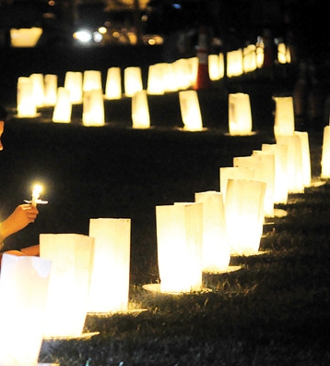
After Plenary Session
Resolutions assigned to committee or individual
Resolutions tracked on ASCCC website
Action included in annual reporting

Slide 15

Using Resolutions Locally
ASCCC resolutions useful for supporting change at your local campus
Local senates may see a local issue that has statewide implications
Concerns and ideas often begin locally where legislation and regulation implementation rubber hits the road

Slide 16

Nuts and Bolts
Must check the following:
Duplication of Position
Reversal of Position
Clarity, Readability, Understanding, Intent
Senate Purview
Not a Strictly Local Concern

Slide 17
Nuts and Bolts
Format:
No more than four “whereas” and four “resolved” statements:
Sample
Whereas, Blah, blah de dah; and
Whereas, Ho may hum;
Resolved, That the Academic Senate for California Community Colleges diddly to the doodly bop.
Contact: Elemeno Pea, ABC College

Slide 18
Nuts and Bolts
Format:
No more than four “whereas” and four “resolved” statements
“Resolved” statements should “stand alone” in case divided
Consider using first “whereas” as an introduction
Write out names in first reference with acronym in parenthesis, then use acronym for subsequent reference
Be as direct as possible
Limit “whereas” statement to one reason in support or defense of the “resolved” statements
Be sure the title of the resolution accurately reflects the content and intent of the resolution

Slide 19
Nuts and Bolts
Amendments (tomorrow afternoon):
Added to help clarify intent and/or expand scope
Use underscores and strikethroughs, not track changes
Review the title after adding an amendment, and amend if necessary
Make sure amendments don’t result in inconsistencies within a resolution or reverse the intent of the resolution (better to vote the resolution down)
Include contacts for each amendment

Slide 20
Nuts and Bolts
Carefully Consider:
Word Choice – Use qualifiers such as any, every, all, never, none, etc. very carefully.
“Recommend” – Be clear about what is being recommended.
“Ensure” or “Require” (Is it within ASCCC power?)
“Assert” or “Affirm” implies a position
“Support” (but not the $$ kind)
“Work with” (collaborate with system partners)

Slide 21

Your Turn…
Write a Resolution with colleagues…
Resolutions are due: Thursday, June 14, 6:00 pm!
All resolutions and amendments are to be submitted electronically to resolutions@asccc.org
Resolutions will be printed and ready for you on Friday.
Amendments are due: Friday, June 15, 6:00 pm!
Mock Plenary Session: Saturday, June 16, 10:15 am!
WE
GOT
THIS!

Slide 22

Questions and Comments
Contact:
Geoffrey Dyer: gdyer@taftcollege.edu
Rebecca Eikey rebecca.eikey@canyons.edu

