Slide 1
Addressing Anti-Blackness in the California Community Colleges: Meet the Summer Special Rostrum Faculty Authors: Session Introduction-LaTonya Parker Ed.D. Area D Representative
Want to know more about the authors behind your favorite summer 2020 Rostrum? Tune into this session to discover the methods of – and inspiration behind the articles on Addressing Anti-Blackness from some of the California community colleges most exciting faculty members

Slide 2
Panel Discussion Intro-Mayra Cruz ASCCC Secretary
“Our actions will demonstrate our purpose—and the message will be clear, consistent, and credible.”
~Erick O. Bell, Las Positas College

Slide 3
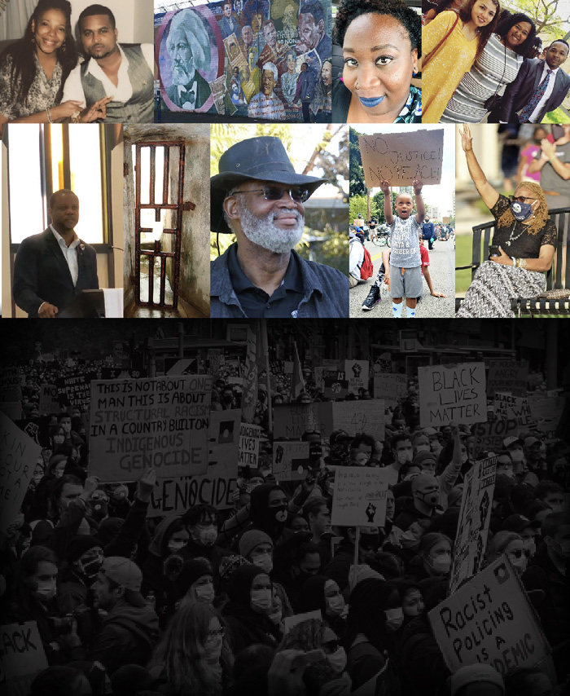
Addressing Anti-Blackness in the California Community Colleges: Meet the Summer Special Rostrum Faculty Authors: Paper Overview: Michelle Bean At-Large Representative

Slide 4
Panel Discussion
1. Can you briefly share why the decision to write an article for the summer Rostrum?

Slide 5
Panel Discussion
2. What was your personal mindset like when you were writing the article?

Slide 6
Panel Discussion
3. What would the author want others to take away from what they wrote?

Slide 7
Thank You!

