Slide 1
Humanizing Online Teaching & Learning: An Equity-Minded Approach
Kandace Knudson, Sacramento City College
Julie Oliver, ASCCC Area A Representative
Michelle Pacansky-Brock, CVC-OEI/@ONE
Robert L. Stewart, Jr., ASCCC Area C Representative
Humanizing Online Teaching & Learning: An Equity-Minded Approach Michelle Pacansky-Brock, CVC-OEI/@ONE Julie Oliver, ASCCC Area A Representative Kandace Knudson, Sacramento City College Robert L. Stewart, Jr., ASCCC Area C Representative

Slide 2
Outline for this session...
We are falling short
Student engagement in DE
Humanizing to increase engagement
How it works: Nuts and bolts of digital Humanness

Slide 3
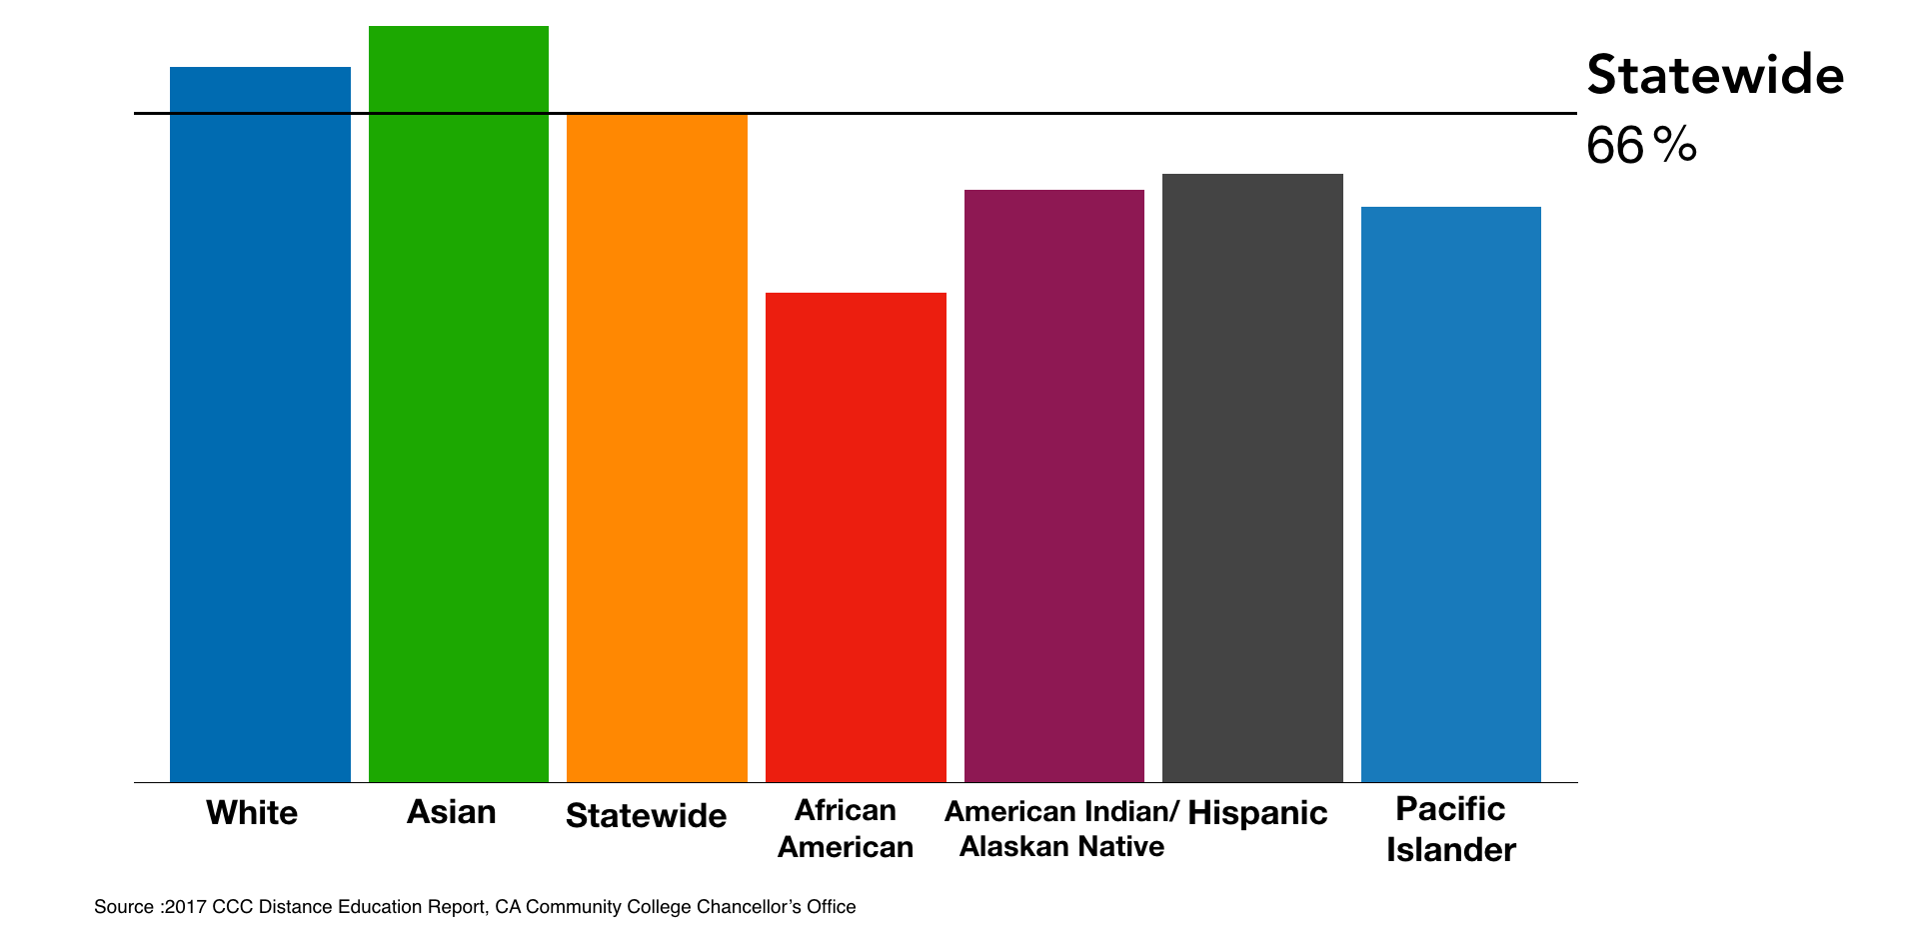
Why we’re here: Disaggregated 2016-17 Online Course Success Rates
California Community Colleges (CCCs)

Slide 4
Increasing Engagement
Literature suggests that increasing success increases engagement
Pedagogical commitment
Institutional commitment

Slide 5
Humanizing Instruction
Vibrant
Welcoming
Vacant
Pedagogical training, commitment to student engagement
Sterile

Slide 6
Students were asked...
If you sense that your online instructor cares about your learning how does it affect you?
What do you think their answers were?

Slide 7
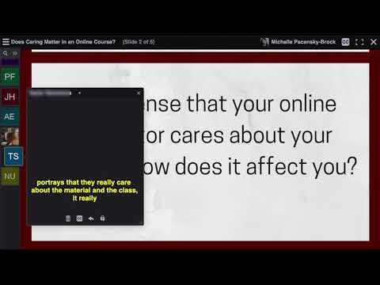
Here’s what they had to say...
What stands out for you as you listen to students answer the question?
Please add your thoughts to the Pathable chat.

Slide 8
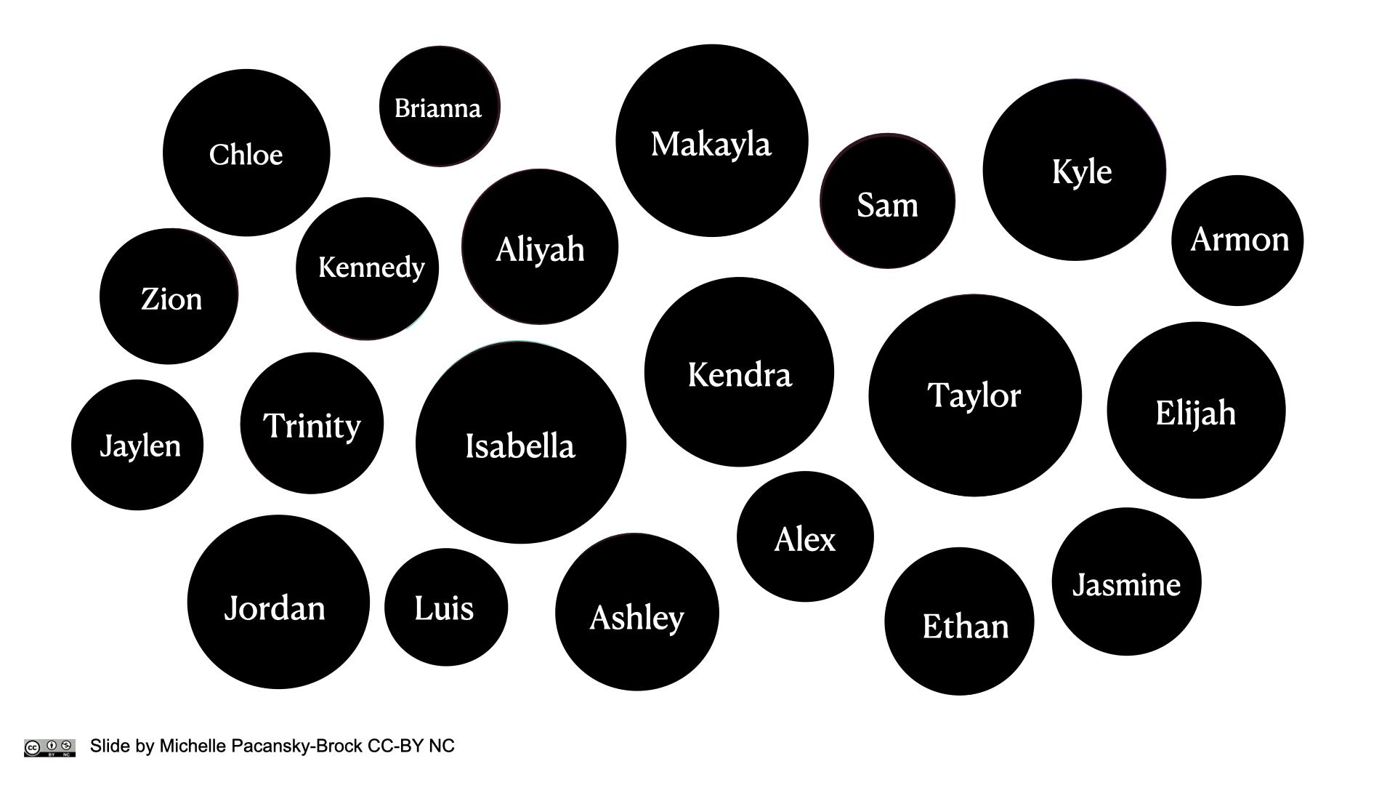
Slide by Michelle Pacansky-Brock, CC-BY-NC

Slide 10
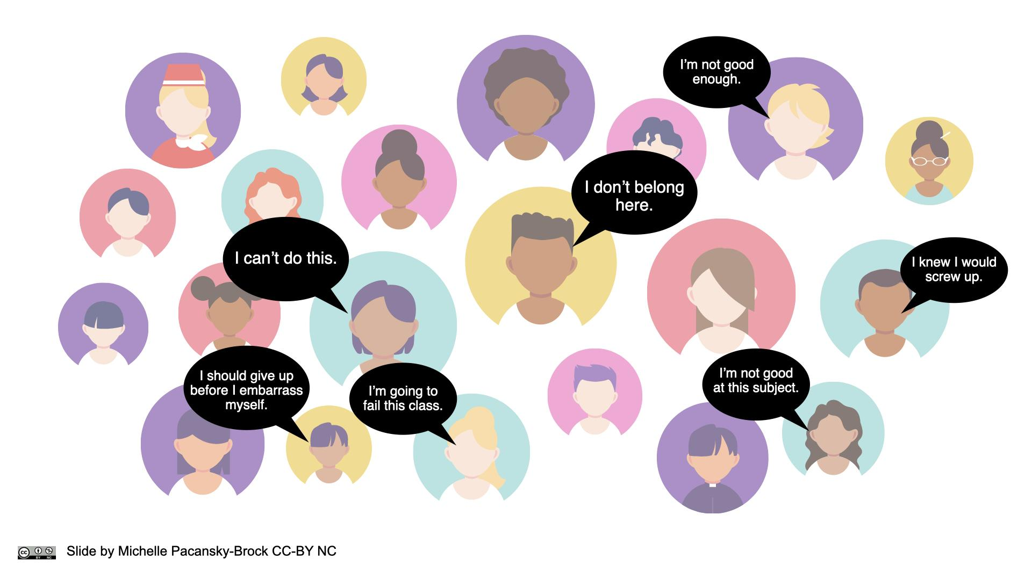
Slide by Michelle Pacansky-Brock, CC-BY-NC

Slide 11
Equality = Equity

Slide 12
Equality: Treat all students the same

Slide 13
Equity: ensure all students have what they need to succeed

Slide 14
Engagement starts with you.
Slide by Michelle Pacansky-Brock, CC-BY-NC

Slide 15
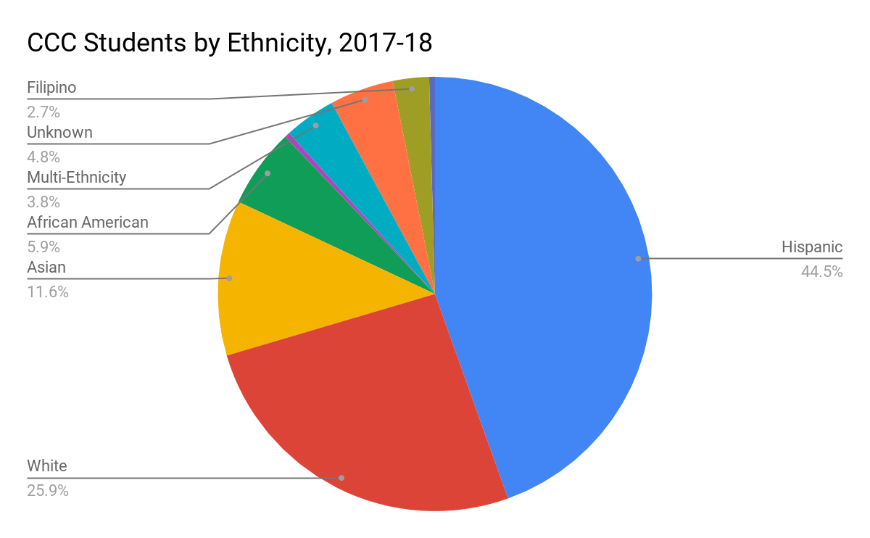
CCCCO.edu, Fact Sheet

Slide 16
Disaggregated 2016-17 Online Course Success Rates
California Community Colleges (CCCs)

Slide 17
Human connection emerges from trust.
Many students enter a course from a place of distrust.
Establishing trust is our responsibility.
Slide by Michelle Pacansky-Brock, CC-BY-NC

Slide 18
Validating Black Male Students
Black males in the U. S. exist within perceptions of:
Distrust - Assumptions of criminality
Shadow of suspicion and hyper-surveilled/monitored for wrong doing
Disdain - Pathologizing culture
History of being talked down to by educators; assumed to be low-income, come from fatherless homes/unengaged parents
Disregard - Ascriptions of intelligence
Educators less likely to praise them for academic success, excellence is second-guessed as cheating
Wood, J. L., & Harris, F., III. (2017). Supporting men of color in the community college: A guidebook. San Diego, CA: Lawndale Hill.
Slide by Michelle Pacansky-Brock, CC-BY-NC

Slide 19
Belonging Uncertainty
Belonging uncertainty in college is triggered by:
lack of social connectedness (which can be exacerbated by online courses)
macro and microaggressions
negative stereotypes in and out of the classroom
Research shows: When White and Black students are exposed to the same threats of social connectedness, Black students are more negatively impacted (Walton & Cohen, 2007)
Walton, G. M., & Cohen, G. L. (2007). A question of belonging: Race, social fit, and achievement. Journal of Personality and Social Psychology, 92(1), 82.
Slide by Michelle Pacansky-Brock, CC-BY-NC

Slide 20
“Students who feel invisible and unimportant” need to be “seen” and “valued” by educators.
Wood & Harris III, 2017, p. 41.
Wood, J. L., & Harris, F., III. (2017). Supporting men of color in the community college: A guidebook. San Diego, CA: Lawndale Hill.
Rendón, L. (1994). Validating culturally diverse students: Toward a new model of learning and student development, Innovative Higher Education, 19, 33-51.
Slide by Michelle Pacansky-Brock, CC-BY-NC

Slide 21
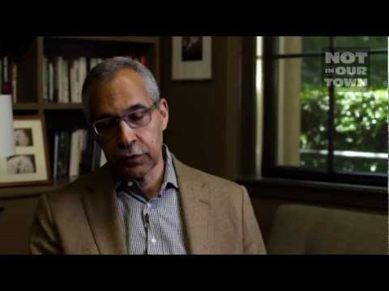
Stereotype Threat (Steele & Aronson, 1995)
A person feels at risk of confirming a negative stereotype about one’s identity
Triggered by situations, words.
Negative stereotypes about intelligence are more likely to trigger stereotype threat in college students who are Black, Indigenous, and people of color and women in STEM courses.
Consequences: disengagement, underachievement on exams and other academic tasks, sudden course withdrawal
Dr. Claude Steele, Stanford University
View 5:50 - 8:15
Steele, Claude M., and Joshua Aronson. "Stereotype Threat and the Intellectual Test Performance of African Americans." Journal of Personality and Social Psychology 69, no. 5 (1995): 797-811.

Slide 22
Culture Informs Teaching and Learning
Photo by Nikita Taparia on Unsplash

Slide 23
Low Context & High Context Cultures
Lower Context Cultures
Higher Context Cultures
Task-based
Logic & facts are emphasized
Verbal over non-verbal
Relationships are plentiful, short-term
Relationship-based
Intuition is valued
Non-verbal over verbal
Relationships are fewer, long-term
Halverson, C. B. (1993). Cultural-context Inventory: The Effects of Culture on Behavior and Work Style. In Pfeiffer, J. W. (ed.)., Annual: Developing Human Resources, Pfeiffer and Company, San Diego, CA.
Slide by Michelle Pacansky-Brock, CC-BY-NC

Slide 24
Culturally Responsive Teaching ensures there is no mismatch.
Photo by Nikita Taparia on Unsplash

Slide 25
Question...
What are some ways an instructor might humanize their online course?
Add your thoughts to the chat or unmute yourself and share your ideas with the group.

Slide 26
Ideas for Humanizing Online Classes
Three ideas to consider...
Create a web-based liquid syllabus to welcome your students and to share some basic information.
Learn more about your students in the first week with a getting to know you survey.
Let your students see and hear you. Create videos!

Slide 27
Provide a Liquid Syllabus
Before Your Course Begins
“I trust you. I am here for you.”
Example by Katie Wittman-Conklin
Pacansky-Brock, (2017, 2014) and Pacansky-Brock, Smedshammer, Vincent-Layton, (2020)
Slide by Michelle Pacansky-Brock, CC-BY-NC

Slide 28
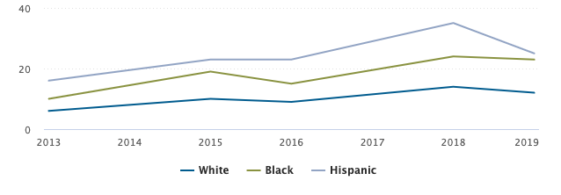
Phone-friendly learning environments are anti-racist
% of U.S. adults who do not use broadband at home but own smartphones, by race
Pew Research Center, (2019). Mobile Fact Sheet.

Slide 29
In Your Course: Use a Getting to Know You Survey
Identify your high opportunity students.
What are your preferred pronouns?
I will leave you feedback in video format. Does that work for you?
Yes, sounds great.
No, thanks. I prefer written feedback.
In one word, describe how you are feeling about this class.
Please share one thing that may interfere with your success in this class.
See a Google Forms sample: brocansky.com/humanizing/student-info
Import from the Canvas Commons: Search for #HumanizingSTEM

Slide 30
Thank you & Questions
info@asccc.org

Slide 31
Resources
Pacansky-Brock, M., Smedshammer, M., & Vincent-Layton, K. (2020). Humanizing Online Teaching to Equitize Higher Education. Current Issues in Education, 21(2).
How to create a Liquid Syllabus. Public resource by Michelle Pacansky-Brock and CVC-OEI/@ONE.
How to create a brief, imperfect welcome video. Public resource by Michelle Pacansky-Brock and CVC-OEI/@ONE.
@ONE CVC-OEI Humanizing Challenge - an archive of a 3-day event
Michelle Pacansky-Brock’s Humanizing Webpage
Humanizing Online Teaching & Learning PocketPD Guide by Michelle Pacansky-Brock and CVC-OEI/@ONE.

Slide 32
References
Halverson, C. B. (1993). Cultural-context Inventory: The Effects of Culture on Behavior and Work Style. In Pfeiffer, J. W. (ed.)., Annual: Developing Human Resources, Pfeiffer and Company, San Diego, CA.
Jaggars, S. S. & Xu, D. (2016). How do online course design features influence student performance? Computers & Education, 95, April 2016, 270-284.
Pacansky-Brock, M. (2017). Best practices for teaching with emerging technologies (2nd ed.). New York, NY: Routledge.
Pacansky-Brock, M. (2014, August 13). The Liquid Syllabus: Are you ready?, [blog post].
Pacansky-Brock, M., Smedshammer, M., & Vincent-Layton, K. (2020). Humanizing Online Teaching to Equitize Higher Education. Current Issues in Education, 21(2).
Rendón, L. (1994). Validating culturally diverse students: Toward a new model of learning and student development. Innovative Higher Education, 19, 33-51.
Walton, G. M., & Cohen, G. L. (2007). A question of belonging: Race, social fit, and achievement. Journal of Personality and Social Psychology, 92(1), 82.
Wood, J. L. (2019). Black Minds Matter: Realizing the Brilliance, Dignity, and Morality of Black Males in Education. San Diego, CA: Montezuma Publishing.
Wood, J. L., & Harris, F., III. (2017). Supporting men of color in the community college: A guidebook. San Diego, CA: Lawndale Hill.

