Slide 1
The Institutional Effectiveness Partnership Initiative (IEPI) and You!
Ginni May, North Representative, ASCCC
Wheeler North, San Diego Miramar College
Michelle Pilati, Rio Hondo College
Spring 2017 Plenary Session
San Mateo Marriott, April 20, 2017

Slide 2
The Institutional Effectiveness Partnership Initiative (IEPI) is in its third year of existence…
What is IEPI?
What is the Professional Learning Network (PLN)?
What are the Applied Solution Kits (ASKs)?
Is this for faculty?
…And how did we get here???

Slide 3
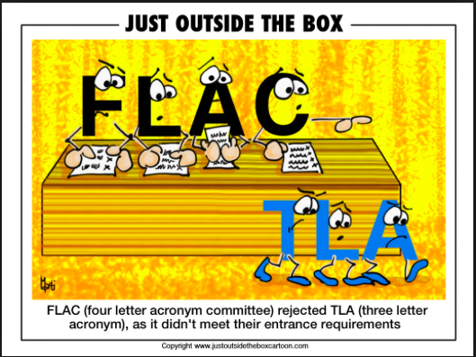
Humor…

Slide 4
What is IEPI?
Institutional Partnership Effectiveness Initiative (IEPI):
Initiative funded by the Legislature
$2.5 million for Year One (2014-15)
$17.5 million for Year Two (2015-16)
$27.5 million for Year Three (2016-17)
Administered by the California Community Colleges Chancellor’s Office (CCCCO)

Slide 5
IEPI Goals
Advance the California Community Colleges as the most effective and innovative system of higher education in the world,
Help colleges enhance student access, success, and equity,
Help colleges avoid accreditation sanctions and audit findings,
Support colleges in implementing emerging initiatives

Slide 6
IEPI Three Major Components
Develop and implement a framework of indicators and college/district goals—student performance and outcomes, fiscal viability, accreditation, …
Make technical assistance teams (called Partnership Resource Teams, or PRTs) available to institutions that express interest in receiving assistance—PRT…
Enhance professional development opportunities for colleges and districts through the IEPI Specialized Training program—Professional Learning Network (PLN), regional workshops, …

Slide 7
Partnership Resource Team (PRT)
Letter of Interest (LOI) submitted by CEO
A Partnership Resource Team (PRT) of peers is formed – typically 3 visits
Grants of up to $200K in seed money for institutions to accelerate Innovation and Effectiveness Plans
Areas of Focus:
Integrated Planning
Enrollment Management
SLO and SAO Assessment
Evidence based decision-making
Governance and communication
Delineation of function between college and district
Fiscal Management and Strategies

Slide 8
IEPI Structure
Composition of Partnership
CCC Chancellor’s Office
College of the Canyons
Academic Senate for CCC
Foothill College
Chabot-Las Positas CCD
Representatives from 22 Statewide Organizations
Success Center for California Community Colleges
IEPI
Executive Committee
IEPI
Advisory Committee
Policy, Procedures, Practice Workgroup
Framework of Indicators Workgroup
Technical Assistance Workgroup
Professional Development Workgroup
Policy, Practice, Procedure Workgroup

Slide 9
What is the Professional Learning Network (PLN)?
https://prolearningnetwork.cccco.edu/

Slide 10
Resources
IEPI products
Initiative products
CAI, EPI, OEI
Organizational products
CCCCO, ASCCC,
Your effective/promising practices, policies, models
Select “Share” on Homepage
Reviewed
Why?

Slide 11
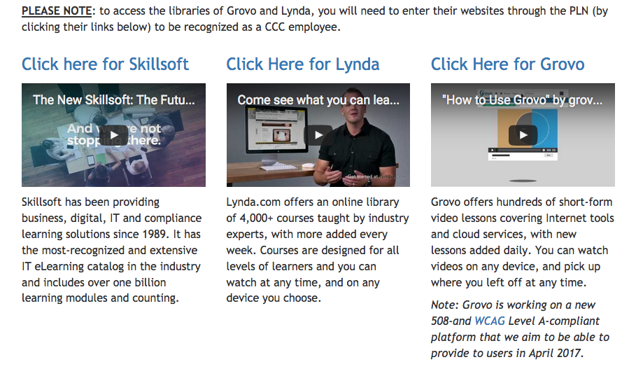
Learn
Vendor-provide training opportunities
Lynda.com
Skillsoft
Grovo

Slide 12
What are the Applied Solution Kits (ASKs)?
Fall 2015, the IEPI Policy, Practice, Procedure (P3) Workgroup envisioned a Framework Tool that would of best or effective practices in areas where colleges had requested assistance in their Letters of Interest requesting a Partnership Resource Team. Tools such as a
check list,
rubric,
descriptions,
links or video talks of supporting best practices in focus areas
Primarily from California Community Colleges, may include ideas from across the country
Tool used during IEPI Partnership Resource Team training to provide a standardized discussion tool for college Institutional Effectiveness efforts that are being supported by IEPI

Slide 13
What are the Applied Solution Kits (ASKs)?
Tool shared by PRT members as appropriate on their visits to support college Institutional Improvement Plans
Tool may highlight the colleges that have implemented the best or effective practices so that other colleges might follow up for more information.
Tool that is OPTIONAL to use – not intended to become a requirement!
Other names…Effective Practices Resource Toolkit (EPRT) – didn’t pass muster…

Slide 14
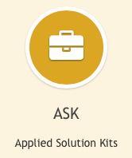
What are the Applied Solution Kits (ASKs)?
Initial Areas:
Integrated Planning
Disaggregation of Data
(Strategic) Enrollment Management
Resource Allocation
Governance
Others?... Change Management/Leadership and Guided Pathways
Venues for feedback:
ASCCC Events
ACCCA Conference
RP Group Conference
CSSO Conference
CIO Conference
Convenings across the state…

Slide 15
IEPI Integrated Planning Workgroup
Workgroup was formed March 2016 to develop planning resources for colleges.
Currently has about ten members to include researchers and two faculty.
Workgroup has been holding convenings across the state at colleges and various events.
Focus of resources are on facilitating the development of integrated planning.

Slide 16
IEPI Integrated Planning Workgroup
Resources are disseminated via the convenings and the PLN.
The PLN ASK (Applied Solution Kit) on integrated planning went live early Spring 2017 and is a development in progress.
https://prolearningnetwork.cccco.edu/ask/integrated-planning/

Slide 17
IEPI Integrated Planning Workgroup
VETTING??????
What does it mean when we post a resource on a CCCCO sponsored website?
What do the labels “Best, or Promising Practices” mean and how do they influence usage?
Who/What is the vetting process and how does that tie to a specific label or brand?
Are there more appropriate labels?

Slide 18
IEPI Integrated Planning Workgroup
To date the Workgroup has relied on:
Internal review and evaluation.
Review by external groups – such as 3CSN, RP Group and Career Ladders.
Reliance on existing literature reviews.
Formal and informal evaluation by convening attendees.

Slide 19
Vetting Rubric

Slide 20
Accreditation Crosswalk - Example

Slide 21
IEPI Integrated Planning Workgroup
What resources do we need, specific to:
Governance and 10+1
Institutional Planning
Program review
Resource management
Integration
Enrollment planning
Accreditation
Evidence gathering
Self studies and annual reporting

Slide 22
Is this for faculty?... YOU BET!!!
Title 5 §53200
“Academic and professional matters” means the following policy development and implementation matters:
curriculum, including establishing prerequisites and placing courses within disciplines;
degree and certificate requirements;
grading policies;
educational program development;
standards or policies regarding student preparation and success;
district and college governance structures, as related to faculty roles;
faculty roles and involvement in accreditation processes, including self-study and annual reports;
policies for faculty professional development activities;
processes for program review;
processes for institutional planning and budget development; and
other academic and professional matters as are mutually agreed upon between the governing board and the academic senate.

Slide 23
…And how did we get here???
Where did this IEPI concept come from?
What are the faculty and college goals regarding IEPI?
Why are you here?

Slide 24
Thank You!

