Slide 1
The Infrastructure of Accreditation:
The Department of Education and The Regional Accreditors

Slide 2
Breakout Outcome I
Attendees will explore the role of the Higher Education Act and the U.S. Department of Education in community college accreditation.

Slide 3
What is Accreditation?
Quality assurance process by which colleges and universities are evaluated
Self-evaluation and peer review process coordinated by non-profit accreditation commissions (not the federal or state government)
Used by the U.S. Department of Education to determine eligibility for Higher Education Act programs

Slide 4
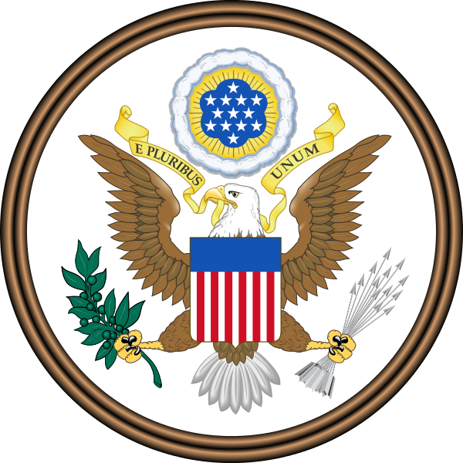
How is Federal Funding Tied to Accreditation?
To receive federal financial assistance
(including student grants and loans):
A college or university must be accredited by an organization recognized by the US Department of Education (USDE)
As changes are made to federal law, accreditors update their standards to ensure continuing USDE recognition
Notes:
Among the changes was the requirement to assess student learning. Some people think the ACCJC came up with SLO assessment.

Slide 5
All USDE-recognized Accreditors Require Compliance with Federal Regulations
For example:
ACCJC:
Manual for Institutional Self Evaluation, Appendix H
Selected Evaluation Team Responsibilities for Compliance with
U.S. Department of Education Regulations
WSCUC:*
Review Under WSCUC’s Standards and Federal Compliance
Worksheet
*WASC Senior College and University Commission
Notes:
Appendix H of ACCJC’s Manual calls out federal regulations. Similarly, WSCUC provides a worksheet at http://www.wascsenior.org/content/review-under-wscuc-standards-and-compliance-federal-requirements

Slide 6
Hierarchy of Accreditation Authorities (Part I: Voluntary, Peer-Based)
Council for Higher Education Accreditation (CHEA) Established 1996 after other, similar, organizations were dissolved
The only non-governmental higher education organization in the US that scrutinizes quality of accrediting organizations
Periodically reviews how well member accrediting organizations meet its Recognition Standards
Both WSCUC and ACCJC are members of CHEA
CHEA recognition is not required for Federal aid
CHEA.org website
Notes:
Like the USDE, CHEA recognizes accreditors other than the regional accreditors.
The Northwest Commission on Colleges and Universities no longer seeks CHEA recognition.

Slide 7
Hierarchy of Accreditation Authorities
(Part II: Governmental)
USDE*--guided by
NACIQI,⁺ applying C.F.R.^{w} reflecting
HEA and other US law--
recognizes accrediting agencies and associations.
*The US Department of Education
+National Advisory Committee on Institutional Quality
wCode of Federal Regulations
Notes:
These are the ones that really concern us now. This is an overview; we will go over each element.

Slide 8
Department of Education (USDE)
USDE Function: “to establish policy for, administer and coordinate most federal assistance to education, collect data on US schools, and to enforce federal education laws regarding privacy and civil rights.”
Department of Education Organization Act, 1979
The Secretary of Education makes decisions for the USDE.

Slide 9
National Advisory Committee on Institutional Quality and Integrity (NACIQI) Established in 1992 via HEA
Provides recommendations to the Secretary of Education on
matters related to accreditation
the eligibility and certification process for colleges and universities
Accrediting organizations must demonstrate compliance with USDE criteria for recognition.
NACIQI conducts regular, periodic reviews of each USDE-recognized accreditor.
NACIQI page on the U.S. Department of Education Website
Notes:
NACIQI is part of the Department of Education (USDE)

Slide 10
Higher Education Act (HEA)
Higher Education Act is designed to:
strengthen the educational resources at colleges and universities
provide financial assistance for students in post-secondary and higher education
From the Long Title of HEA
The HEA is a key source of Federal Regulations that impact all USDE-recognized accreditors’ standards.
Notes:
Other federal regulations impact accreditation; that’s why we get federal changes between renewals of the HEA.

Slide 11
Summing Up: “Accrediting” Accreditors
Accrediting commissions are voluntary associations of peers, most founded well before the HEA.
Both the USDE’s NACIQI and CHEA recognize accreditors.
USDE-recognized accreditation is required for federal programs, including financial aid.
An accrediting entity does not need to be a member of CHEA to keep USDE recognition.
Notes:
Accreditors are not themselves accredited; USDE and CHEA (and other bodies) recognize accreditors.

Slide 12
“
QUESTIONS?

Slide 13
Breakout Outcome II
Attendees will explore the steps to become accredited by a regional accrediting agency.

Slide 14
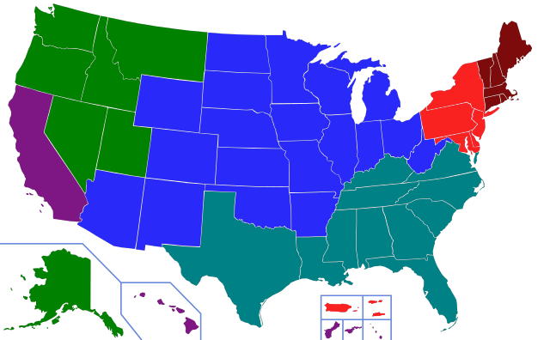
The Regional Accreditors (with year of founding)
New England Association of
Colleges and Schools (1885)
Northwest Commission
on Colleges and
Universities
(1917)
Western Association of
Schools and Colleges:
(1962)
WASC Senior College and
University Commission
&
Accrediting Commission for
Community and Junior Colleges
Middle States Association of
Colleges and Schools (1919)
Higher Learning Commission (1919)
Southern Association of
Colleges and Schools (1895)
Notes:
Each regional accreditor is “responsible for a specific geographic area.” (CHEA, NCCU)

Slide 15
Who May Apply For WSCUC Accreditation?
“Postsecondary institutions … that offer one or more programs leading to the baccalaureate or higher degree may apply to the Commission for eligibility.”
http://www.wascsenior.org/content/How-to-Become

Slide 16
How to Become Accredited by WSCUC
“The Commission has established formal procedures by which institutions can move through the required stages that lead to accreditation. These stages include:
Eligibility
Initial Accreditation (If Initial Accreditation is not achieved after the Seeking Accreditation, Visit 1, Candidacy may be granted)
Each stage has specific criteria, processes, and time frames…. The time frame may take several years depending on the maturity of institutional development.”
http://www.wascsenior.org/resources/eligibility
Notes:
This is a direct quote from the WSCUC web page cited.

Slide 17
Is Change in the Air?
The January 22, 2016 DRAFT Accreditation Implementation Task Force Report to Chancellor Brice Harris proposes a new process for CCCs to transition to a new accreditor:
Each college presents the report next due to the new accreditor, but uses the ACCJC standards.
The new accreditor reviews the college using the ACCJC standards.
The new accreditor provides a crosswalk of its standards to ACCJC’s.
The new accreditor specifies when the college will be reviewed according to the new accreditor’s standards.
Notes:
CCCCO’s Consultation Digest, Jan. 18, 2016: Task Force on Accreditation

Slide 18
Changing Accreditors
It takes years for an institution to switch accreditors.
The WASC Senior College and University Commission (WSCUC) process includes full reports and campus visits.
www.wascsenior.org/resources/eligibility
The CCCO’s Accreditation Implementation Task Force has drafted an innovative proposal to manage a transition away from ACCJC.
Notes:
The proposal from the Accreditation Task Force is so innovative that is it probably premature to think about how the CCCs might transition to another accreditor

Slide 19
“
QUESTIONS?

Slide 20
Citations
No Love, But No Alternative (Accreditation Will Change, But Survive)
https://www.insidehighered.com/news/2015/09/01/accreditation-will-change-survive
Higher Ed Overhaul Unlikely in 2016
https://www.insidehighered.com/news/2016/02/02/higher-education-act-overhaul-long-shot-election-year
Education Dept. Adds Requirements for Educators
https://www.insidehighered.com/quicktakes/2016/02/05/education-dept-adds-requirements-accreditors
United States Department of Education (USDE)
http://www.ed.gov/
National Advisory Committee on Institutional Quality and Integrity (NACIQI)
http://www2.ed.gov/about/bdscomm/list/naciqi.html
Council for Higher Education Accreditation
http://www.chea.org/
WASC Senior College and University Commission
http://www.wascsenior.org/

