Slide 1

Hearts,
Brains, and
Growing Pains
Creating Sustainable Change During Turbulent Times
May 4, 2018
ASCCC Career and Noncredit Education Institute

Slide 2
Topics
Understanding, Surviving, and Managing Change
Capitalizing on Opportunities
Using Influence and Advocacy
Moving Forward
Leadership is a choice, not a position.
- Stephen Covey

Slide 3
Our Current Environment
Turbulent Times and Transformational Change

Slide 4
New Funding Formula
Regional Consortia
DACA
Accountability Measures
Strong Workforce Program
Adult Ed Block Grants
Self Supporting
CDCP
Performance Based Funding
Public Criticism
Enrollment Decline
FLOW

Slide 5


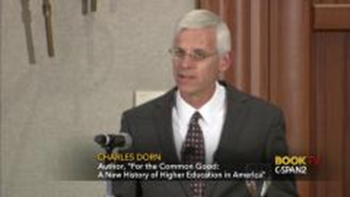
https://www.c-span.org/video/?438461-1/for-common-good
https://www.youtube.com/watch?v=AoAA1WDE354

Slide 6





Sound Familiar?
College really isn’t worth it…too much debt and not enough return
We don’t need colleges anymore…everything can be taught online
Colleges are teaching irrelevant courses that don’t lead to jobs
There is too much focus on STEM…we’re losing the value of a liberal arts education

Slide 7
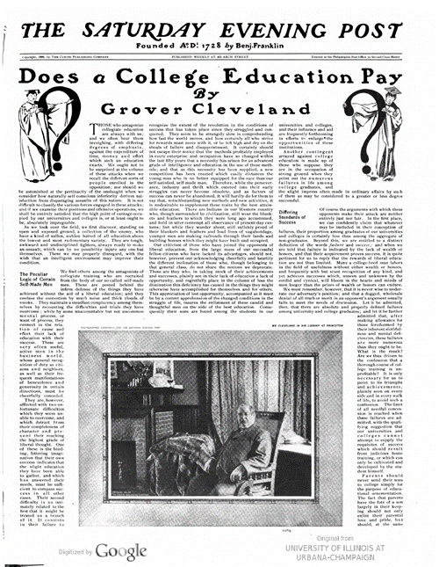
Saturday Evening Post
May 1900
Myth of “self-made men”
Rewards of liberal education
Dangers of insularity and elitism

Slide 8
Higher Education Transformation
Forces
Recession
Political and social unrest
Demographics – communities and students served
Public policy and accountability
Characteristics
Arguments over academic freedom
Criticisms about access, affordability, relevance
Conflict, debate, experimentation
Evolution of existing and creation of new institutions

Slide 9
Understanding, Surviving, & Managing Change

Slide 10
What Is Change Management?
Personal Change: Intentional, purposeful adoption of new thoughts & behaviors
Organizational Change: Adoption of new ideas or behavior by an organization in response to opportunities or threats

Slide 11









Typical Phases
Denial
Commitment
Awareness
Action
Resistance

Slide 12


Develop a Vision
Where do you want your organization to be in 5 years?
What would success look like?
What differences do you want to make in the world?

Slide 13
Confront Fear
  Fear of the unknown
    Loss of power, turf
  Fear of the known
    Changes in work volume or process
  Fear of failure

Slide 14
Learn from Experimentation, Innovation, & Mistakes
Leaders are visionaries with a poorly developed sense of fear and no idea of the odds against them.
– Robert Jarvick,
creator of the artificial heart
Anyone who has never made a mistake has never tried anything new.
― Albert Einstein

Slide 15

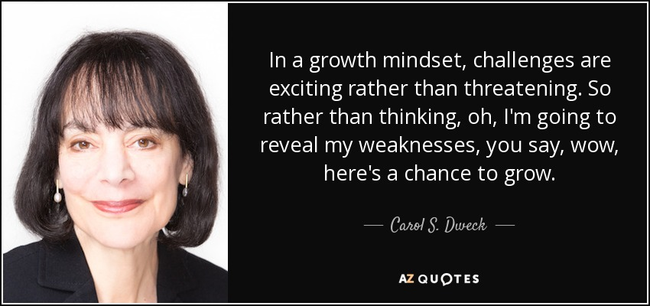
Develop a Growth Mindset

Slide 16
