Slide 1
Celebrate Your Resiliency

Slide 2
Be Courageous

Slide 3
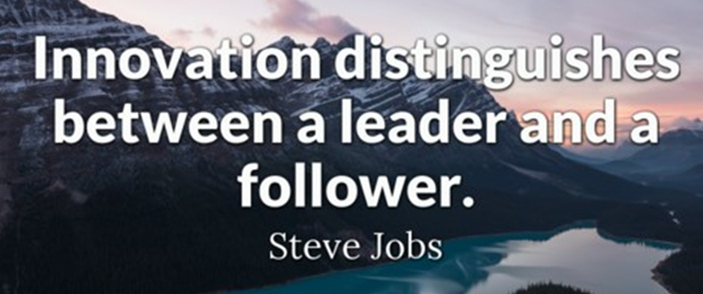
Capitalizing on Opportunities
Leveraging Your Strengths

Slide 4
Collective Impact
Collective Impact Models include AEBG and Regional Consortia
Liaisons to the community
Impact on families and communities
Leveraging resources

Slide 5
Student Scenario AEBG
Jane Re-Careers

Slide 6
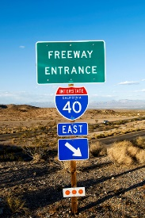
Guided Pathways
Entry point for gazillions
Wholistic approach to students

Slide 7
Online Education
On the ground partner for face-to-face support or services
Advocacy for changing the funding formula for noncredit online programs
Hybrid models

Slide 8
Demonstrate Your Innovative Spirit
Responsive and Quick and Flexible and Adaptable
This Photo by Unknown Author is licensed under CC BY-NC

Slide 9
Influence and Advocacy

Slide 10
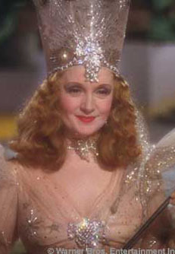
Influencing Your CEO
Show me the data
Contribute to major goals – enrollment, equity, revenue, student achievement, etc.
Ask for help
Follow through

Slide 11
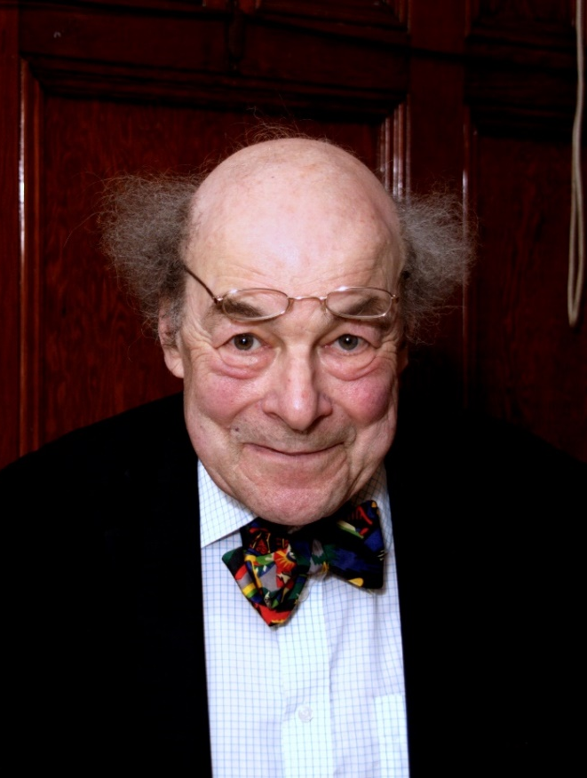
Influencing the “transfer” Side of the House
Seek out a partner – it only takes one
Share Business, Industry, and Community Partners
Contribute to enrollment
Provide prepared students

Slide 12
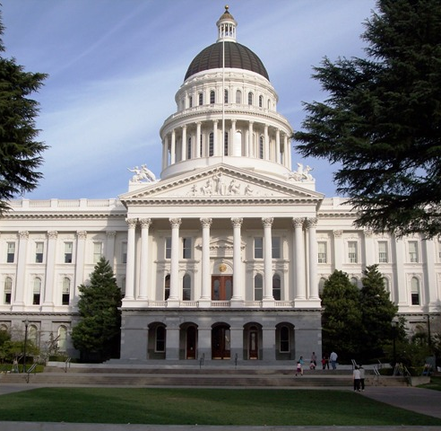
Use Political Muscle
Politically Savvy vs Politically Driven
Formal Advocacy
Legislative and Code changes

Slide 13
A Few Final Thoughts

Slide 15
Apply the 3 Day Rule
You drag it around like a ball and chain You wallow in the guilt; you wallow in the pain You wave it like a flag, you wear it like a crown Got your mind in the gutter, bringin' everybody down
Get over it, Get over it All this whinin' and cryin' and pitchin' a fit Get over it, Get over it

Slide 16
Celebrate Who You Are
Celebrate successes
Celebrate others
Surround yourself with great people

Slide 17
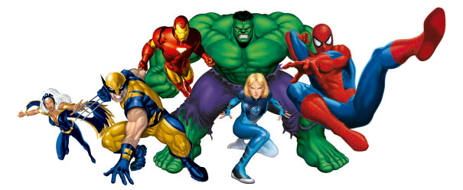
Continue to be Superheroes
Your voice does matter
Your future is bright
This Photo by Unknown Author is licensed under CC BY

Slide 18
Student Scenario ESL
Jilla

Slide 19
Thank You!!!

