Slide 1
LIBRARY SERVICES DURING A STATE OF EMERGENCY
Dan Crump, Council of Chief Librarians
Stephanie Curry, ASCCC North Representative
Notes:
Stephanie

Slide 2
Zoom Menu Bar Controls
Mute/Unmute Microphone
Stop/Start Video
Chat Feature

Slide 3
If your computer does not have a microphone you can call into the meeting to access audio. Please mute your computer and only use the telephone for audio in order to avoid feedback between the two devices.

Slide 4
Where we are….
Closures
Staffing
Online Accessibility
Consortium Renewals (May 29th)
Focus on supporting students and faculty and ensuring instructional continuity.
Notes:
Stephanie
Dan---most all are closed, some are lending location for laptops, hotspots, etc.
Dan---staff, most are totally remote, might be some that are checking out laptops, very few are coming in (like once a week) to check on things
Dan---all the databases, etc
Dan---message from James Wiser (CCL/CCLC Consortium) about Spring deadline until end of May

Slide 5
Librarians are Awesome!
Notes:
Stephanie Importance and effectiveness of the library community. Resources, listservs and support
Dan---we are used to using online sources, so not as big a stretch as for some of our classroom colleagues..

Slide 6
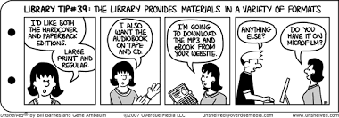
Library Remote Resources
Library Platform
Databases
E-books
Audiobooks
Videos
Notes:
Stephanie and Dan
Dan---still waiting for quotes
Dan---databases from Consortium (and on own), mostly full-text
Dan---e book collections---Ebsco and Proquest
Dan---videos---Kanopy, Films on Demand

Slide 7
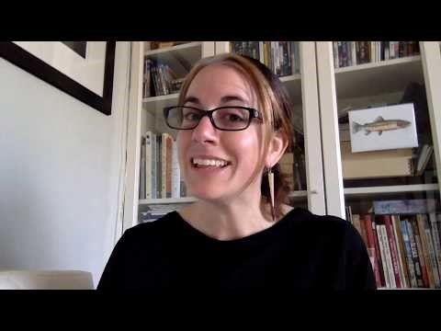
100% Online Library Series by Elizabeth Horan form Coastline College
Notes:
Stephanie

Slide 8
Accessibility of Library Resources
Closed Captions
Readable PDF
HTML Versions
ALT-Text Images
Text Reading
Notes:
Dan
Dan---databases are accessible

Slide 9
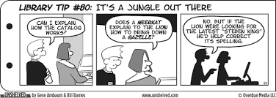
Information Competency
Courses
Videos
LibGuides
Library Orientations
Zoom options
You Tube
Synchronous and Asynchronous
Embedded Librarian
Notes:
Dan
Orientations---Zoom (synchronous) and YouTube (asyncronous)

Slide 10
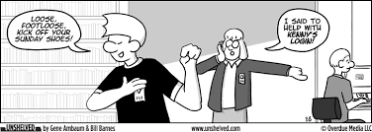
Supporting Students
Resources
Loaning
Suspending Fines etc.
Technology
Embed in Canvas
Reserve Textbooks – Publishers
Notes:
Dan
Dan---loaning of library laptops and location for distribution of college laptops (mass purchase of Chromebooks).
Dan---loaning of books extended; suspension of fines
Dan---embedding in Canvas pages of classroom faculty
Dan---reference---phone, chat (LibAnwers, LibaryH3LP)
Dan---research appointments---using Google Voice
Dan---reserves---VitalSource and RedShelf, and others; scanning of textbooks (emergency considerations for copyright/fair use)

Slide 11
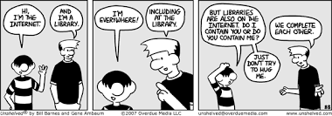
Supporting Faculty
Reach out to your Faculty (all faculty)
Help finding resources
Assistance in embedding resources into online courses
Providing accessible resources
Tutorials
Notes:
Dan

Slide 12
What are you doing to support Instruction?
Notes:
Stephanie and Dan

Slide 13
Silver Lining
What we learn now will help improve our services to students in the now and in the future.
Notes:
Stephanie

Slide 14
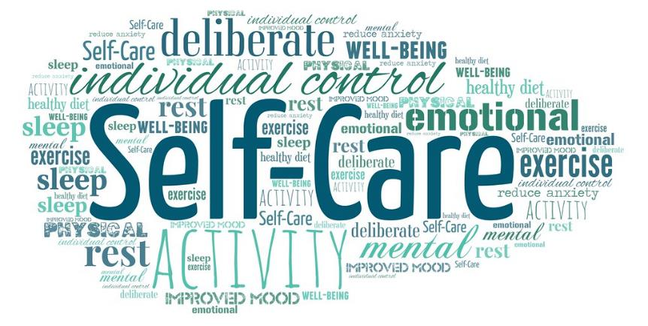
Take care of yourself!
Notes:
Stephanie

Slide 15
Resources
Coronavirus-Impacted Libraries Get Unlimited Access to Ebook Central Holdings--- https://www.proquest.com/blog/pqblog/2020/Coronavirus-Impacted-Libraries-Get-Unlimited-Access-to-Ebook-Central.html (3/26, 10:59am)
DSM-V (one month free trial)(3/24, 6:41am)
The Internet Archive has launched a new public library with 1.4 million books. The National Emergency Library is meant to help universities and colleges. The books are made available through a new interpretation of 'fair use' 3/27, 3:43pm
Vendor Love in the Time of COVID-19---https://docs.google.com/document/u/2/d/e/2PACX-1vT3pF6oX93Ok0GqSvQuqOhQRTVF7lgxzq5GS3alUZsWyz2Q6SS3fl3wyMc1-XBhcjMQFoOXGhRZzGRT/pub (3/15, 1:22pm);
HeinOnline---https://mailchi.mp/wshein/free-remote-access-to-heinonline-academic?e=726e97b8bc (3/23, 10:53am)
Taylor & Francis---https://view.email.taylorandfrancis.com/?qs=95b7f0ea7c9236ad2a0ba7338206ca48054d975fad88d91226a92e9890fc2ef97a8e294d00a731bf901574917ebc1aabc0ca04a3c00b42fcfbeadb73f520b56fdc5b0a27ebd66d5d0939b4b9446aa437 (3/23, 8:50am)
Graphing Calculators---Texas Instrument---https://docs.google.com/document/u/2/d/e/2PACX-1vT3pF6oX93Ok0GqSvQuqOhQRTVF7lgxzq5GS3alUZsWyz2Q6SS3fl3wyMc1-XBhcjMQFoOXGhRZzGRT/pub (3/26, 9:00am)
Videos---Kanopy, Films on Demand, Swank, https://tubitv.com/home (3/25, 11:51am), 3/25, 10:20am,
Notes:
Dan

Slide 16
Communications
CCCCO COVID-19 Page
ASCCC COVID-19 Resources Page
ALA Executive Board Recommends Closing of Libraries to Public---http://www.ala.org/news/press-releases/2020/03/ala-executive-board-recommends-closing-libraries-public
Academic Libraries and COVID-19 (ACRL Insider)--- https://www.acrl.ala.org/acrlinsider/archives/19351 (also 3/13, 9:58am)
Keeping up with…COVID-19 (ACRL)--- https://ala.informz.net/informzdataservice/onlineversion/ind/bWFpbGluZ2luc3RhbmNlaWQ9OTIyMTQwNiZzdWJzY3JpYmVyaWQ9MTA2NDY3NDI2MA==
Notes:
Dan

Slide 17
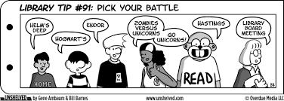
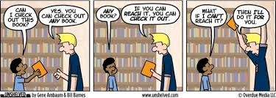
Q and A

