Slide 1
Student Equity, The California Community Colleges and OER: The Present and Future of OER in the CCCs
Spring 2018 ASCCC OER Regional Meetings
February 9 (Rio Hondo)
February 10 (American River)

Slide 2
Overview
Welcome and Introduction
OER, Equity, and Open Access
OER in the CCCs Today
College Textbook Affordability Act of 2015 (AB 798)
ZTC Program (SB 1359, 2016)
OER in the CCCs Tomorrow
ASCCC OER Task Force
ZTC-Related Needs Assessment
OER and You

Slide 3
OER Equity, OER and
The Promise of Open Access
James Glapa-Grossklag
Dean, Educational Technology, Learning Resources and Distance Learning
College of the Canyons
Co-Technical Assistance Provider, CCC ZTC Grant
ASCCC OER Regional Meeting
Rio Hondo College
February 9, 2018
Unless otherwise indicated, this presentation is licensed CC-BY 4.0

Slide 4
"Open Access Buttons" by h_pampel is licensed under CC BY-SA 2.0

Slide 5
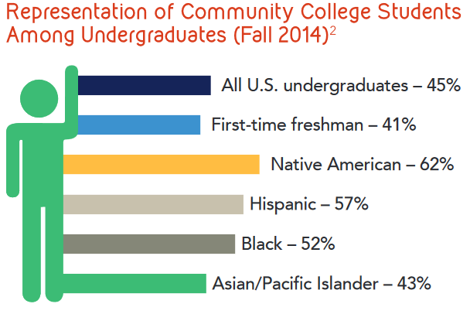
AACC 2016 Fact Sheet

Slide 6
AACC 2016 Fact Sheet

Slide 7
Housing Insecure 50%
Homeless
14%
Food Insecure 55%
Hungry
36%
33,000 students at 70 community colleges in 24 states

Slide 8
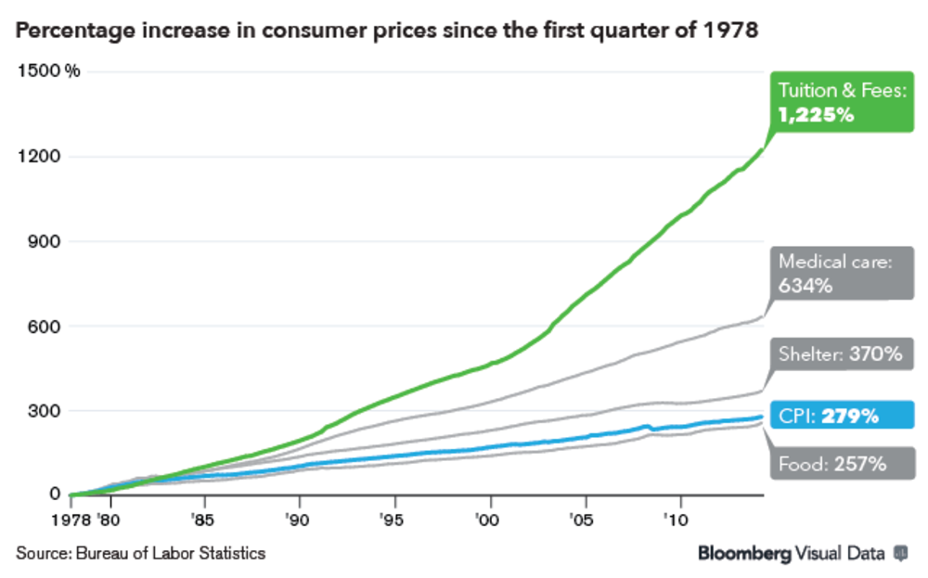
https://www.bloomberg.com/news/articles/2014-08-18/college-tuition-costs-soar-chart-of-the-day

Slide 9
The Economist, 8/16/14 http://econ.st/2CPMkTR

Slide 10
1/2 take fewer or different classes
2/3 choose to not buy textbook
9.5/10 concerned about grades
Survey of 2039 students at 156 campuses across 33 states
Source: Fixing the Broken Textbook Market, 2014

Slide 11
Not bought required textbook
57%
Concerned about grades
67%
Influences enrollment
70%
Source: Open Educational Resources Student Survey Spring 2016 Report #303

Slide 12
Access to materials on first day of class
Free online, low-cost print option
Relevant and current content
Faculty control of content

Slide 13
Faculty should steal intellectual property and place themselves in legal jeopardy, while subjecting students to penalties for not understanding plagiarism
Faculty should have
full legal rights to customize, copy, and contextualize learning materials to fit the needs of their students

Slide 14
Open Educational Resources (OER)
OERs are freely available learning materials that can be
copied, edited and shared
to better serve all students

Slide 15
open licensing system
www.creativecommons.org

Slide 17
“Zero Textbook Cost (ZTC) Degrees”
… community college associate degrees or career technical education certificates earned entirely by completing courses that eliminate conventional textbook costs by using alternative instructional materials and methodologies, including open educational resources ...
CA Education Code Section 78052(a)

Slide 18
Current ZTC grantees
Alameda
Allan Hancock
Butte
Canyons
Glendale
Grossmont
LA Valley
Lake Tahoe
Los Medanos
Marin
‪MiraCosta
Orange Coast
Pasadena
Reedley
San Bernardino Valley
San Diego Continuing Ed
San Jose City College
Santa Ana
Santa Monica
Skyline
Taft
West Hills Coalinga
‪West Hills College Lemoore

Slide 19
What Can You Do?
Talk to students about costs
Tell students about OER
Include OER in plans
Connect with the community
Learn more

Slide 20
www.cccoer.org

Slide 22
ASCCC OER Task Force
Began in March, 2016
Make recommendations to ASCCC
Support
Needs Assessment
Regional Workshops
Listen and dialogue with CCC faculty
Discipline Survey
Collaborate with ASCCC, CO, TAP

Slide 23
Fall Sabbatical Project
Collaborated with counseling faculty from 6 CCC’s
Curated, co-authored, edited three College Success OER
Was supported by Grossmont College, mentors, Open Education Community
Piloting Spring ‘18
Official Release Summer ‘18

Slide 24
The Value of Time: Going on Sabbatical? Try OER
https://www.asccc.org/content/value-time-going-sabbatical-try-oer

Slide 25
A Note on Academic Freedom
Faculty have more freedom to identify and utilize content that specifically fits their courses.
Students have the freedom to access their content wherever they are, whenever they want, however they learn.

Slide 26
Student Content Freedom
Wherever they want
Different formats for different devices and situations
Share on social networks and public forums
Share in blended learning environments
Whenever they want
Instant, unlimited access
Permanent access, they own the content forever
However they learn
Use content in their work legally
Make videos/class assignments legally
Put into a format that meets their study habits

Slide 27
Access to materials on first day of class
Free online, low-cost print option
Relevant and current content
Faculty control of content

Slide 28
Post-Course Access to Content Matters
Courses that span multiple semesters
Retaking the course
Reference for advanced courses
Studying for higher education entrance exams & certification exams
Changing careers
Any of the above could mean a student needs to purchase another access code or rent the content again
Notes:
Re: digital access codes, rentals ,and subscriptions for content

Slide 29
This work is licensed under a Creative Commons Attribution-ShareAlike 3.0 Unported License.

Slide 30
“Let us remember: One book, one pen, one child, and one teacher can change the world.”
- Malala Yousafzai

Slide 31
ASCCC OER Task Force
Contributions
ASCCC OER Listserv
asccc.org
Resources – Subscribe to listserv
Butte College: Online OER Course for Faculty

Slide 32
Introduction to OER Course
Workshops | Fridays 12 – 2 pm via Zoom
March 9 | What is OER and why does it matter? Open Access, Libraries, And Publishing
April 6 | Introduction to licensing Search Strategies
April 13 | Universal Design & Accessibility
May 4 | Curation using Pressbooks Open Pedagogy
For more information: Wakimsu@butte.edu

Slide 33
In Preparation for CA-OER Council…
ASCCC Survey – Spring 2013
471 Respondents
95, 20%, reported using OER in lieu of – or in addition to – an assigned text
Just 32 faculty indicated they were using OER in lieu of a text.

Slide 34
Have you ever considering using OER for one or more of your courses?
Yes – 103 (27%)
No – 26 (12%)
I don’t know enough about OER to have seriously considered its use – 227 (60%)

Slide 35
ASCCC OER Task Force - Listserv
asccc.org
“Subscribe to Listservs” (bottom right of home page)
Select “ASCCC OER Task Force”
While you’re there – sign-up for your discipline’s listserv.
“These are distribution list servers only, they serve only to disseminate information, recipients may not reply. Those interested many sign up below.”

Slide 36
ASCCC OER Taskforce
Initiated discipline-based needs assessment to inform the development of a comprehensive plan to “make OER ubiquitous
Initial disciplines – English, math, Communication Studies, Psychology, and Sociology

Slide 37
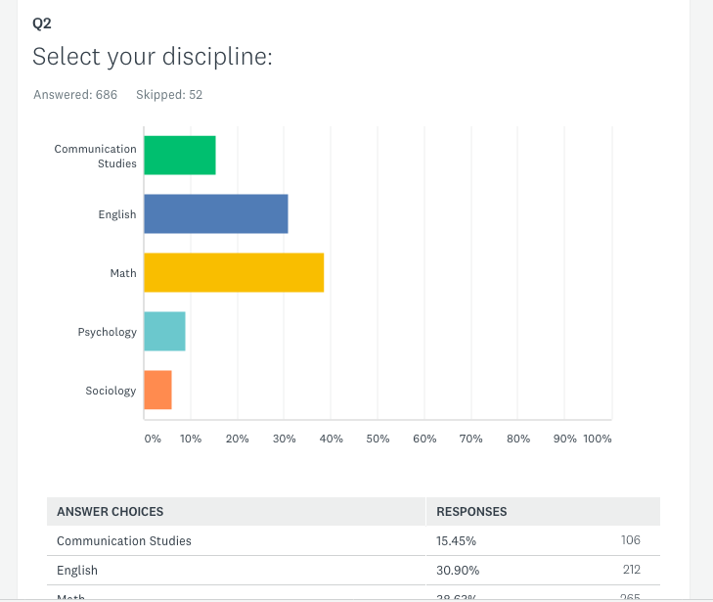
ASCCC OER Survey 2017
Over 700 respondents

Slide 38
Mainly experienced faculty…

Slide 41
Notes:
Yes – 103 (27%)
No – 26 (12%)
I don’t know enough about OER to have seriously considered its use – 227 (60%)

Slide 42
Comments
I believe people value what they pay for. Tuition wouldn't be rising at twice the rate of inflation if the feds hadn't gotten involved in the student loan business, guaranteeing loans for college students. It has created a bubble in higher education, and it isn't sustainable. Pushing for free textbooks is a band-aid for this problem; if someone has a good one I certainly might consider it, but so far what I have seen is a lot of books which are fair-to-middlin', and some might well have been rejected by mainstream publishers because they were not good.
Too much work right now. I'm a new professor. I need my resources handed to me on a silver platter or I simply don't have time.
OER are generally poor quality. OER also does not offer online homework like Pearson, WileyPlus, or WebAssign.
Just through completing this survey, I am more interested in OER and I would like to learn more to see if it is a good fit for my courses.

Slide 43
A few more…
I'd like students to be able to access their text in class WITHOUT using their phone, tablet, or computer.
I don't like it. I also don't appreciate that colleagues are paid $1000 to adopt OER and those of us who have thoughtfully assessed what is available and used what we see as better textbooks get nothing. not just.
Online HW capacity was not even close enough to providing the support our students need.
OER does not measure up to traditional textbooks.

Slide 44
OER in the CCCs Tomorrow
At present, no effort is underway to:
systematically identify and address barriers to OER adoption,
support local OER implementation efforts, and
leverage the expertise in the CCC system to create a sustainable OER ecosystem.
Notes:
SYSTEMATIC AND SUSTAINABLE = key words in discussing difference between previous bills and funding versus what we need “tomorrow”
Diversity of CCC’s: Some colleges/faculty have different OER needs (i.e. - some need unique discipline OER development (i.e. water systems technology), some need ancillary development (my open math), some need funding for positions of support (OER librarian, instructional design, OER coordinator)…

Slide 45
ASCCC Proposal - California Community College OER Initiative - CCCOERI
ASCCC is seeking support for a 5-year project (~1.2 million/per year) to implement OER systemwide coordinating state level activities to increase OER availability and supporting local OER implementation.
At the end of the initial project period, the structure and accomplishments of the CCCOERI would be evaluated and future funding needs identified.
Notes:
MP

Slide 46
Goals
Ensure OER availability for at least 70% of all C-ID courses by the end of the 5-year term.
Significantly reduce costs for students in at least 50% of the most highly enrolled courses.
Develop systems to replace high-cost homework systems such as "My Math Lab” and other ancillary materials that facilitate faculty OER adoption.
Notes:
MP - Increase adoption of OER, thus allowing more students access to material and giving them greater opportunity to be successful.

Slide 47
Goals
Establish a network of OER Liaisons to serve as local OER champions.
Develop OER resources for selected CTE areas.
Leverage prior related work.
Facilitate achieving the goals of AB 705 and other legislation/initiatives.
Notes:
Increase adoption of OER, thus allowing more students access to material and giving them greater opportunity to be successful.

Slide 48
Activities
Identify OER needs and determine how best to meet them.
Create discipline faculty teams with leaders to facilitate resource identification and development.
Establish an RFP process to fund the development of high-cost homework systems and other resources.

Slide 49
Activities
Provide expertise with respect to copyright, accessibility, and technology/instructional design to facilitate local and statewide OER efforts.
Build on the accomplishments of other state-funded OER efforts and leverage the work and resources of existing grants and initiatives.

