Slide 1
Making the Case for Investing in OER
ASCCC 2020 Curriculum Institute Friday, July 10, 2020 2:45 – 4:00 pm
Notes:
AT

Slide 2
Session Description
While Open Educational Resources (OER) are free, institutionalizing OER requires an investment. What evidence is there to support the need for OER? What evidence is there that OER impact student success? This workshop will discuss research studies that demonstrate how the cost of textbooks affects student success and retention. We will focus specifically on research that demonstrates the effects on students from underserved populations such as ethnic minorities, low-income students, and first-generation students.

Slide 3
Presenters
Shagun Kaur, DeAnza
Jennifer Paris, College of the Canyons
Amanda Taintor, Reedley
Suzanne Wakim, Butte

Slide 4
Overview
Evidence of the Need for OER
Evidence of the Impact of OER
OER and Equity
OER and Academic Freedom
Why OER?
Notes:
AT

Slide 5
Evidence of the Need for OER
While the cost of going to a CCC is free or low, California is expensive.
California has the third-highest cost of living index, only Hawaii and DC are more expensive. (Cost Of Living Index By State 2020)
Notes:
https://worldpopulationreview.com/state-rankings/cost-of-living-index-by-state
California has the third-highest cost of living index of 151.7. Aside from Hawaii, California has the highest transportation index of 138.9, thanks to notoriously high gas prices (the highest in the country). The housing index is 227.3 with a two-bedroom apartment running at $2,495 and even higher in cities like Los Angeles and San Francisco.

Slide 6
#RealLCollege Survey Cover
Notes:
https://hope4college.com/wp-content/uploads/2019/03/RealCollege-CCCCO-Report.pdf

Slide 7
#RealCollegeSurvey - Overview
60% were housing insecure in the previous year.
50% of respondents were food insecure in the prior 30 days.
19% were homeless in the previous year.
Seven in 10 experienced food insecurity or housing insecurity or homelessness during the previous year.
Notes:
https://hope4college.com/wp-content/uploads/2019/03/RealCollege-CCCCO-Report.pdf
ALMOST 40,000 STUDENTS AT 57 CALIFORNIA COMMUNITY COLLEGES PARTICIPATED.
The data in this report come from an electronic survey fielded to students. This system-wide report includes data from 57 schools in the system. Colleges distributed the electronic survey to all enrolled students, yielding an estimated response rate of 5%, resulting in almost 40,000 total students participating in the survey.

Slide 8
#RealCollegeSurvey – Special Populations
Rates of basic needs insecurity are higher for marginalized students, including African Americans, students identifying as LGBTQ, and students considered independent from their parents or guardians for financial aid purposes.
Students who have served in the military, former foster youth, and formerly incarcerated students are all at greater risk of basic needs insecurity.
Notes:
https://hope4college.com/wp-content/uploads/2019/03/RealCollege-CCCCO-Report.pdf
ALMOST 40,000 STUDENTS AT 57 CALIFORNIA COMMUNITY COLLEGES PARTICIPATED.

Slide 9
Less Affordable
Notes:
http://www.aei.org/publication/chart-of-the-day-or-century/
Seven of those goods and services have increased more than average inflation, led by hospital services (+211%), college tuition (+183.8%), and college textbooks (+183.6%). Average wages have also increased more than average inflation since January 1998, by 80.2%, indicating an increase in real wages over the last several decades.

Slide 10
More affordable…
Notes:
http://www.aei.org/publication/chart-of-the-day-or-century/
The other seven price series have declined since January 1998, led by TVs (-97%), toys (-74%), software (-68%) and cell phone service (-53%). The CPI series for new cars, household furnishings (furniture, appliances, window coverings, lamps, dishes, etc.) and clothing have remained relatively flat for the last 21 years while average prices have increased by 56% and wages increased 80.2%.

Slide 11
The Cost of Textbooks (2016)
Five publishers control 80% of the market
Students have no choice over the textbook
50% of CC students use financial aid to buy their books
Students using loans pay $34.72 for a $150 book
$3,150,000,000 of financial aid is spent on textbooks/year
If every student had just one textbook replaced with OER it would save students over $1,000,000,000/year
Source: "Covering the Cost: Why We Can No Longer Afford to Ignore High Textbook Prices" by Ethan Senack and Robert Donoghue, Student PIRGs is licensed under CC BY 4.0
Notes:
If every student had just one textbook replaced with OER it would save students over $1,000,000,000/year.

Slide 12
If every student had just one textbook replaced with OER it would save students over $1,000,000,000/year.

Slide 13
Costs >> Debt
High cost of living leads to:
hard choices..
debt..
Challenges only exacerbated by COVID-19.

Slide 14
Student Debt - US
The US has 45 million students who collectively owe more than $1.5 trillion in student loan debt.
CA, TX, FL, and NY represent more than 20% of all US student debt at $340 billion.
Student loan debt is now the second highest consumer debt category - behind only mortgage debt - and higher than both credit cards and auto loans.
Data from The Institute for College Access and Success (TICAS). 14th Annual Student Debt Report, 2018
Notes:
Data from The Institute for College Access and Success (TICAS). 14th Annual Student Debt Report, 2018

Slide 15
Student Debt - California
3.9 millions students owe $111.7 billion dollars.
Average Student debt: $22,585
Percentage of Graduates with debt: 49%
Photo by Damir Spanic on Unsplash
Notes:
Data from The Institute for College Access and Success (TICAS). 14th Annual Student Debt Report, 2018

Slide 16
Racial Inequity in Student Debt
A 2018 study in the journal Sociology of Race and Ethnicity found that
Black students held as much as 85.8% more debt than white students.
15 years after graduation, black students held 186% more debt than white students.
A 2019 paper by public policy organization Dēmos found that
Black students, male and female, held over 110% of the original balance
Native American students close to 100%.
Latino students fared slightly better, though female students held more debt (86%) than males (79%).
Notes:
Houle, J.N., Addo, Fenaba R. 2018. “Racial Disparities in Student Debt and the Reproduction of the Fragile Black Middle Class”. Journal of Sociology of Race and Ethnicity. American Sociological Association:1–16.

Slide 17
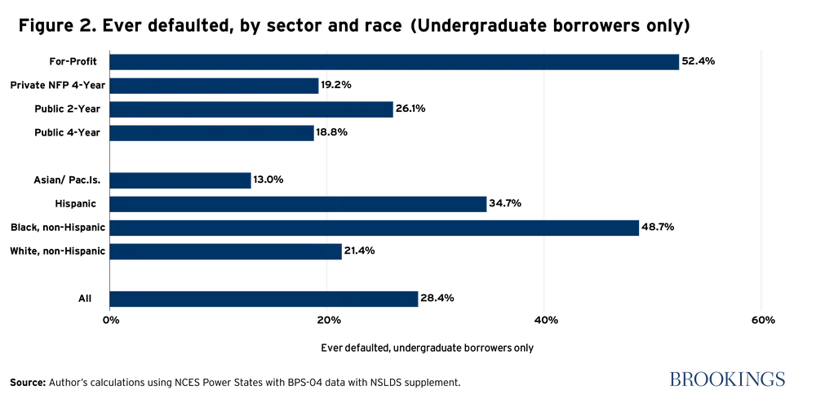
Default Rates on Student Loans
Source: Judith Clayton for Brookings based on data by National Center for Education Statistics, 2016.

Slide 18
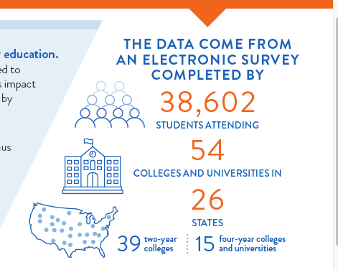
Impact of Pandemic?
National survey - April 20 - May 15

Slide 19
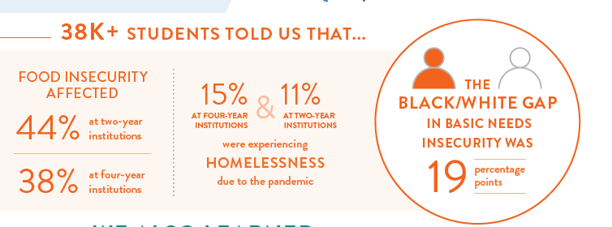
hope4college.com/realcollege-during-the-pandemic

Slide 20
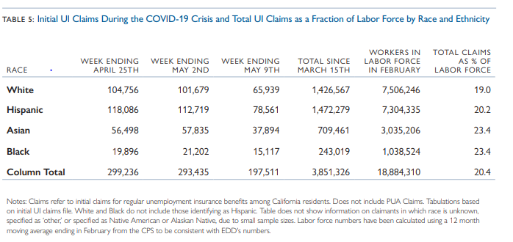
Initial Unemployment Insurance Claims During COVID by Race and Ethnicity
Notes:
Hedin, T.J. Schnorr, G. Wachter, T(May 21, 2020) .Policy Brief: An analysis of Unemployment Insurance Claims in California During COVID-19 Pandemic. California Policy Lab.

Slide 21
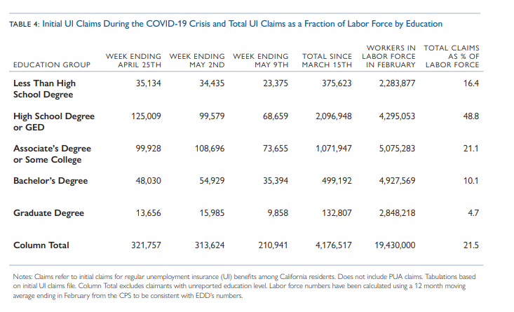
Initial Unemployment Insurance Claims During COVID-19 By Education
Notes:
Hedin, T.J. Schnorr, G. Wachter, T(May 21,, 2020) .Policy Brief: An analysis of Unemployment Insurance Claims in California During COVID-19 Pandemic. California Policy Lab.

Slide 22
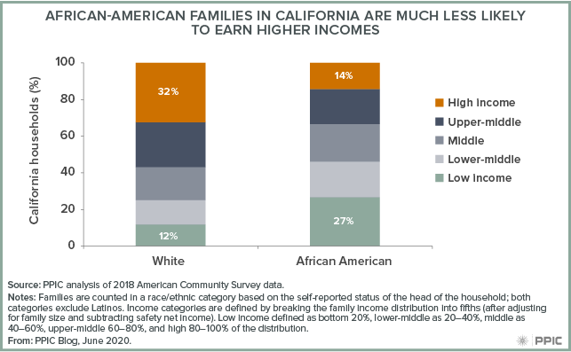
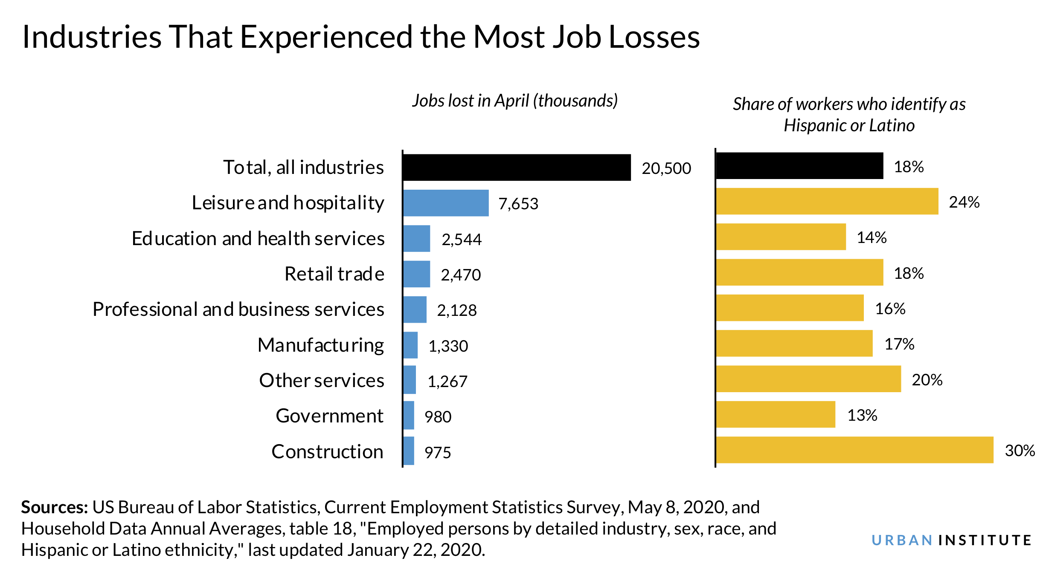
Racial Disparities Are Widespread in California
Notes:
Bohn et al. Racial Disparities Are Widespread in California. Public Policy Institute of California. June 3, 2020
https://www.urban.org/urban-wire/latinx-unemployment-highest-all-racial-and-ethnic-groups-first-time-record

Slide 23
How do we transition from costs to student success?
Photo by Sharon McCutcheon on Unsplash
Photo by Christine von Raesfeld on Unsplash
Notes:
How do we transition from costs to student success?

Slide 24
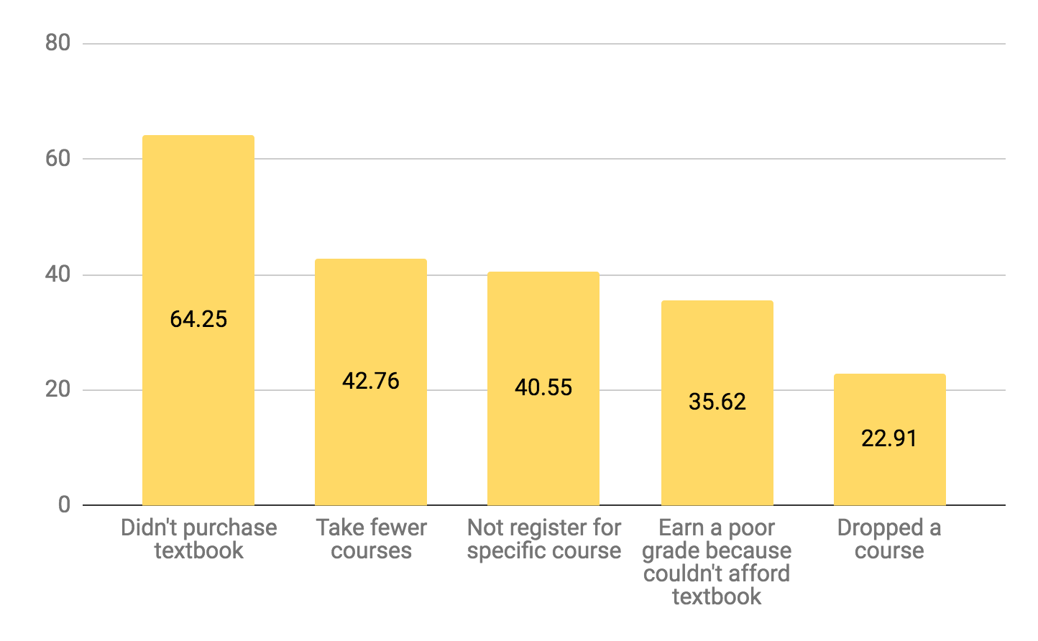
You can’t learn from a resource you can’t get
2018 Student Textbook and Course Materials Survey Executive Summary, https://dlss.flvc.org/colleges-and-universities/research/textbooks

Slide 25
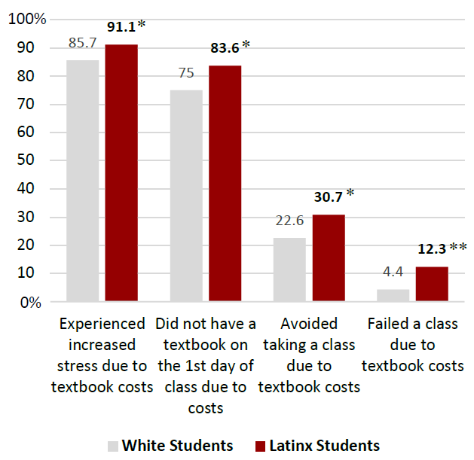
CSU Channel Islands
Notes:
CSU Channel Islands’ openCI initiative recently completed a campus-wide study of over 700 undergraduate students. This is a unique study because it focuses on exploring the impact of textbook costs specifically on historically underserved populations. Statistical analysis revealed textbook prices to be a significant educational barrier for all students, with a disproportionately negative effect among minoritized students, low-income students, and first-generation college students.

Slide 26
CSU CI – Impact of Textbook Prices
n=700 undergraduate studentsduate students
Textbook prices are a significant educational barrier for all students
Textbook prices are an even greater barrier for historically underserved students
It is our responsibility as staff, faculty, and administrators to "remove any unnecessary financial barriers to academic success, and to ensure that our students’ learning potential is never limited by their purchasing power."
Notes:
"Textbook Affordability and Student Success for Historically Underserved Populations at CSUCI" by J. Jacob Jenkins, Jaime Hannans, Luis Sanchez, and Jill Leafstedt for openCI is licensed under CC BY 4.0
CSU Channel Islands’ openCI initiative recently completed a campus-wide study of over 700 undergraduate students. This is a unique study because it focuses on exploring the impact of textbook costs specifically on historically underserved populations. Statistical analysis revealed textbook prices to be a significant educational barrier for all students, with a disproportionately negative effect among minoritized students, low-income students, and first-generation college students.

Slide 27
University of Georgia, 2018
Population | Change in Grade | Change in DFW*
All Students | +8.6% | -2.68%
Non-Pell Eligible | +7.4% | -2%
Pell Eligible | +12.3% | -4.4%
Non-White | +13% | -5%
Part-Time | +28% | -10%
Total Students: 21,822 *DFW= Drop, Fail, Withdraw
Source: AAC&U, University of Georgia The Impact of Open Educational Resources on Various Student Success Metrics, in International Journal of Teaching and Learning in Higher Education, 2018

Slide 28
Research indicates..
OER are associated with increases in student success.
And the positive effects may be even greater for our students who often struggle the most.

Slide 29
OER > Successful Completion of More Units
Courses with open textbooks have a lower withdrawal rate
Community college students taking multiple OER courses earned more credits and similar grades than students who took no OER courses and reported high engagement with course materials
Notes:
Reference?

Slide 30
Largest Benefits Seen With Centralized Efforts
Estimates suggest a modest 3 percent institutional return on investment after the initial OER course development period and enrollment increases.
An average of $1.03 in gross revenue was generated for every dollar spent (program and additional delivery costs)—a modest 3 percent institutional return on investment that reflects an average net financial benefit of $38,000 [This assumes colleges spent money on OER efforts - benefits are most pronounced when institution has an intentional, concerted effort]
Notes:
Reference??

Slide 31
Bring the goodness into the light
Let students know about no-cost course sections
No Cost + Promise = free not just freemium
No Cost + Pathways = filling in potholes

Slide 32
Looking Closer at Equity
Principle of fairness in education
Inequities occur when biased or unfair policies, programs, practices, or situations contribute to a lack of equality in educational performance, results, and outcomes
Source: National Alliance for Partnerships for Equity Education Foundation
Source: "How OER can Support Student Equity and Diversity" by CCCOER is licensed under CC BY 4.0
Notes:
We’ve already discussed the financial needs or students and we’ve seen some of the data about how data can be even more beneficial to students that are disportionately impacted, but there is another way that we can look at equity and use OER to be more inclusive and representative. My apologies for the text heavy and imageless slides coming at you. I prefer to be more visual, but I wanted to share direct quotes of influential voices in OER work.

Slide 33
Being Equity-Minded
“Dr. J. Luke Wood started by defining equity as ‘a heightened focus on groups experiencing disproportionate impact in order to remediate disparities in their experiences and outcomes’.”
“Equity means recognizing that some students will need different interventions to be successful.”
Source: "Reaching Underserved Students through Culturally Responsive Teaching and Learning Overview of Dr. J. Luke’s keynote at the Online Teaching Conference 2018 " by Una Daly is licensed under CC BY 4.0
Photo: "Dr-j-luke-wood.jpg" by Karankjain is licensed under CC BY-SA 4.0

Slide 34
OER and Equity
“OER is about opening up the world of knowledge to as many people as possible”
One way this can be accomplished is through diversity, equity, and inclusion
Removing barriers
Representation
Customization
Authenticity
Universal Design
Source of quote: "Hurry Up and Slow Down By Rose Roberts, Educational Development Specialist (Indigenous Engagement and Education)" by Rose Roberts, Heather M. Ross is licensed under CC BY 4.0

Slide 35
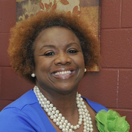
Instant Access - Removing Barriers
“Students have their textbook and faculty are able to teach instantaneously. This removes barriers to access thus contributing to equitable outcomes but in order to achieve equity in our education system.”
Source: "COVID-19 Reflection: How OER contributes to our equitable education system" by Tonja Conerly is licensed under CC BY 4.0

Slide 36
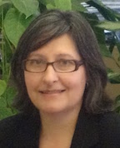
From Access to Representation
“Equity is about more than making education affordable. OERs are changing how students learn and how faculty teach.”
“Equity in our OER work is not just ensuring that all of our students have quality course materials available to them on the first day of class, it is also about ensuring that our students see themselves in their course materials and know that they CAN be successful in college.”
Source: "Taking OER Off-Campus: Equity Is About More Than Saving Money " by Ursula Pike is licensed under CC BY 4.0

Slide 37
More Representative Textbooks
Many textbooks are not inclusive
Challenges commonly arise in terminology, image selection, historical figures, references, etc.
OER can be written (or revised) to be more representative and inclusive
This should be a continuous process
Aided through peer-reviewing and collecting feedback (that includes students)
Source: " "We believe textbooks should be diverse and inclusive. Here's what we're doing about it." by Anthony Palmiotto and Symphonie Swift is licensed under CC BY 4.0

Slide 38
Customization to Student Population
“Not only does OER save students (or K-12 school districts) money, they can be completely customized to reflect each institution’s student population leading to a more equitable and inclusive learning experience for all.”
Who is not represented in your current books?
Source: "New America Blog Series: Leveraging Open Educational Resources for Queer Students Summary " by Kelsey Smith is licensed under CC BY 4.0

Slide 39
Importance of Authenticity
Be cautious of unintentional “othering”
You cannot learn about other ways through the lens of the dominant culture or group
It isn’t about inserting pieces of appropriate diverse information o images within the book
Authenticity is the result of diverse contributions at every step of the work
Source: "Hurry Up and Slow Down By Rose Roberts, Educational Development Specialist (Indigenous Engagement and Education)" by Rose Roberts, Heather M. Ross is licensed under CC BY 4.0

Slide 40
Reflecting on the Social Messages of our Chosen Textbooks
“Teaching is never a neutral act. The texts we bring into our classrooms have messages about social continuity and social change, whether we acknowledge these messages or not.” – Shantel Ivits
Source: "Teaching is not Neutral" by Lauri Aesoph is licensed under CC BY 4.0
Image: "ivits_shantel_15_0056_bw" is licensed under CC BY 4.0

Slide 41
Committing to Inclusivity
“…a commitment to challenging explicit and implicit racism, sexism, classism, ableism, homophobia, transphobia, xenophobia, and other forms of structural oppression or hegemony in OER and the wider world. It is a commitment to anti-racism, and considering the potential global audience of your OER. Whether or not it’s intentional, an open textbook that only points to cis, white, upper middle-class anecdotes in its “Examples” section is reinforcing white supremacy and constructing barriers to access and positive user experiences for people of color, trans people, working-class people, and other marginalized peoples.”
Source: "Improving the Digital Accessibility of OER: A Reflective Guide" by Katy Anastasi, openoregon is licensed under CC BY 4.0
Image: "Image" by BMCC is licensed under CC BY-NC 4.0

Slide 42
Importance of Accessibility
Many commercial textbooks are not fully accessible
OER can fall into the trap of replicating those issues, without caution and intention
“Ideally, all electronic instructional materials should be made accessible to all students, including those with disabilities. All students have different functional abilities and learning styles.”
Source of quote: "Accessibility of Information in Electronic Textbooks for All Students" by Texas School for the Blind and Visually Impaired is licensed under CC BY-NC 4.0

Slide 43
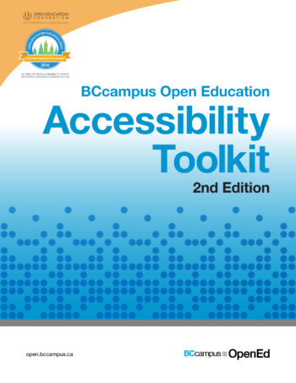
Accessibility through Universal Design
“Universal Design is the process of creating products...that are usable by people with the widest possible range of abilities, operating within the widest possible range of situations (environments, conditions, and circumstances).”
“Rather than a single, one-size-fits-all solution, it offers a flexible approach that can be customized and adjusted for individual needs.”
There are many resources to help create (or revise) OER to be accessible
Source: "Accessibility Toolkit - 2nd Edition" by Amanda Coolidge, Sue Doner, Tara Robertson, and Josie Gray is licensed under CC BY 4.0

Slide 44
How OER Can Change Messages
“Dominant practices are benefiting some individuals but harming others. We need open because whiteness is real and discrimination is pervasive, because “born digital, born accessible” is not the norm. We need open because textbook costs have outstripped inflation and students are going without.”
“Ultimately, we need open because we deserve access in the true sense. We deserve access for all of us.”
Source: "Minimizing Barriers Through Open Practices" by Kaela Parks is licensed under CC BY 4.0

Slide 45
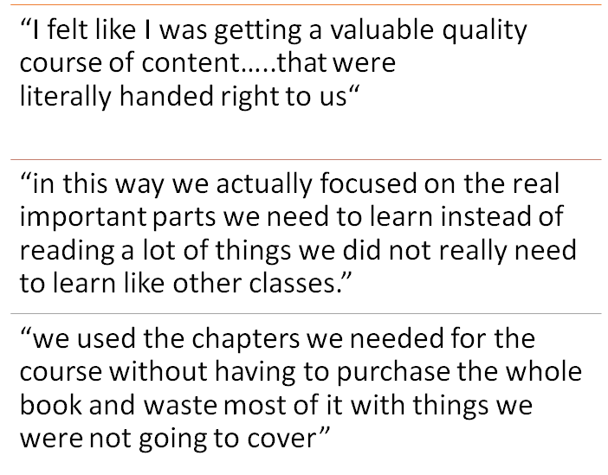
OER and Academic Freedom

Slide 46
OER and Academic Freedom

Slide 47
Why not OER?

Slide 48
Questions?
Photo by Camylla Battani on Unsplash

Slide 49
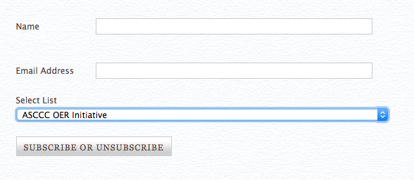
Resources
ASCCC OERI Website (asccc-oeri.org)
ASCCC OERI E-Mail (oeri@asccc.org)
ASCCC OERI Canvas site (tinyurl.com/ASCCC-OpenEd)
Sign up for OERI list-serv (https://www.asccc.org/signup-newsletters)

