Slide 1
ASCCC Accreditation Institute:
Faculty Engagement and ALO Partnership
This Photo by Unknown Author is licensed under CC BY-NC
This Photo by Unknown Author is licensed under CC BY-NC
Notes:
NOTE:
To change the image on this slide, select the picture and delete it. Then click the Pictures icon in the placeholder to insert your own image.
Sheri to Introduce

Slide 2
How Do We Create Teamwork?
Notes:
Sheri

Slide 3
Presentation Objectives:
Discuss the role of faculty in the accreditation process.
Discuss the role of the Academic Senate in the accreditation process.
Discuss how accreditation fits into participatory governance.
Notes:
Sheri

Slide 4
Answer the WHY!
Why accreditation?
Notes:
Sheri
Participation and engagement are CHOICES.
We want faculty to CHOOSE to participate in the accreditation process.
Therefore, we want faculty to understand WHY accreditation is important and HOW it can affect them.

Slide 5
How can a campus encourage faculty to participate in the accreditation process?
What leadership roles are available to faculty in regards to accreditation?
How can a faculty member help to inspire others in regards to accreditation?
How can a faculty member engage the campus in the idea of continuous improvement?
Notes:
Yvonne

Slide 6
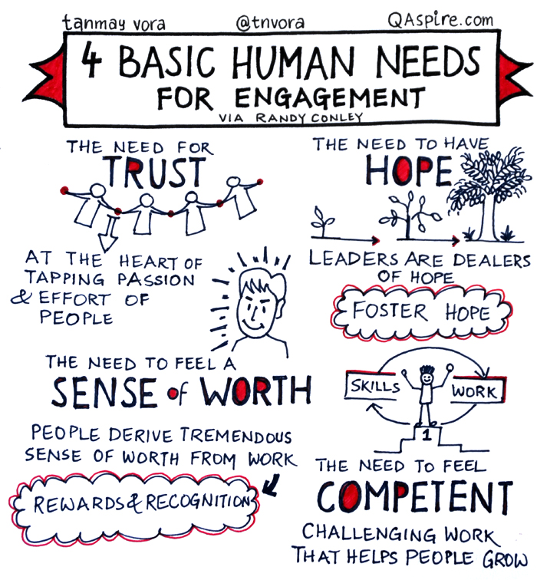
What is a Faculty Accreditation Coordinator?
Los Angeles Pierce College developed a reassigned time position for a Faculty Accreditation Coordinator (FAC): In collaboration with the ALO, the FAC provides college-wide leadership and promotes broad participation and engagement in college decision-making and the integrated planning and resource allocation process.
This Photo by Unknown Author is licensed under CC BY
Notes:
Yvonne

Slide 7
Responsibilities of the Faculty Accreditation Coordinator (FAC)
Works with the ALO to write and edit the Midterm Report as well as the ISER.
Works with the ALO to educate the campus community regarding accreditation and organize events.
Works with the ALO to co-chair the Accreditation Steering Committee.
Works with the ALO to coordinate with the chairs of participatory governance and academic senate committees to ensure accreditation-related goals are regularly monitored and evaluated.
Works with the ALO to provide the campus with reports at appropriate campus committees.
Works with the ALO to identify strategies and make recommendations to promote campus dialogue regarding accreditation.
Works with the ALO to stay current on all accreditation processes and attends events/conferences related to the accreditation.
Notes:
Yvonne

Slide 8
Questions to Consider:
Does your campus have a position similar to a Faculty Accreditation Coordinator (sometimes called faculty co-chair)? What is this position called on your campus?
What are the responsibilities of the Faculty Accreditation Coordinator or co-chair?
Is this an ongoing position?
Notes:
Yvonne

Slide 9
What if Your College Does Not Have a Faculty Accreditation Coordinator?
How can a campus create an “accreditation” leadership role for a faculty member?
How can a faculty member work with the campus’ ALO (with or without release time)?
What are some specific responsibilities that a faculty member can take on in order to promote continuous improvement?
Notes:
Yvonne

Slide 10
Notes:
Yvonne

Slide 11
What is the Academic Senate’s role in facilitating a faculty role in accreditation?
ASCCC created a handbook, “Effective Practices in Accreditation: A Guide for Faculty,” in fall 2015.
“The Accreditation Standards begin with the message, ‘The primary purpose of the ACCJC-accredited institution is to foster student learning and student achievement.’ That is, obviously, impossible without faculty involvement” (3).
ALL faculty (and staff!) are encouraged to participate in the accreditation process. “The most visible sign of faculty involvement in accreditation is within the committee structures a college adopts in regards to a college’s accreditation or institutional effectiveness efforts” (3).
Notes:
Sam

Slide 12
Notes:
Sam

Slide 13
ASCCC Advice:
Each college, ideally, should have an accreditation oversight committee that is an ongoing or standing committee.
Because faculty roles and involvement in accreditation processes, including self study and annual reports, is a designated 10 + 1 function, it is recommended that a faculty member chair or co-chair any standing accreditation committee.
Faculty can provide continuity and institutional memory in a committee like an oversight committee.
The faculty chair or co-chair can then work with the Academic Senate to ensure broad campus participation.
Working with the Academic Senate, the committee’s chair/co-chair will provide frequent updates to allow for faculty inclusion and involvement in the accreditation process.
Notes:
Sam

Slide 14
The Role of Senate Committees in Accreditation Oversight
The Academic Senate, and its standing committees, and other key committees at the college should work toward the development and continuous monitoring of particular standards.
Again, committees provide a wonderful space for faculty involvement.
A faculty chair/co-chair of an accreditation oversight committee can become a leader to disturbing information and championing the attention to various standards; therefore, “cross-pollinating committee structures with the standing accreditation committee” (6) is imperative.
Notes:
Sam

Slide 15
Planning Ahead
As part of the 10 +1 agreement, local senates should have a formal position regarding the faculty’s role in accreditation.
The local senate should work to:
Integrate accreditation questions regarding the standards into program review, which will help make data easily accessible when writing a self-evaluation for the Commission.
Collect evidence for the new cycle shortly after an action letter and/or recommendations are sent to the college, and if sanctions are imposed.
Plan committee chair orientations to include their responsibilities for the committee as well as how they can work with accreditation in mind, including where to find supporting data.
Notes:
Sam

Slide 16
Planning Ahead (Cont’d)
Assist in preparing a keyword searchable website linking divisions, committees, program reviews, and other accreditation-related materials for easy access to data, reports and documents for any administrator or faculty to access. This should include updates and timelines for the accreditation process.
Encourage the senate president or designee to work with the strategic planning committee to ensure faculty engagement in integrated planning efforts.
Formulate clear planning cycles and communicate them to the committees, department chairs and faculty at large with the goal of the college being more systematic in its approach to accreditation.
Notes:
Sam

Slide 17
Notes:
Sam

Slide 18
Questions to Consider:
Does your campus have an accreditation oversight committee?
Does a faculty member chair or co-chair that committee?
How often does a faculty member report on the accreditation processes to the Academic Senate, its standing committees, and other committees on campus?
How is your campus working together with faculty and administration to put the accreditation puzzle pieces together?
Notes:
Sam

Slide 19
How does Accreditation Fit into Participatory Government?
A quick reminder of the 10 + 1:
Because faculty are directly involved in participatory governance matters, per AB 1725, these matters are categorized into the 11 areas of responsibilities that faculty have. Faculty agrees to participate in the 11 agreed-upon matters as part of their faculty obligations.
7. Faculty roles and involvement in accreditation processes.
Notes:
Yvonne

Slide 20
Overview:
Faculty needs to participate in the accreditation process.
Leadership opportunities for faculty exist!
Campuses should use their committee structures to facilitate continuous improvement in regards to accreditation.
The ALO and a faculty member can create a fruitful partnership to champion accreditation.
Notes:
Sheri

Slide 21
Notes:
Sheri

Slide 22
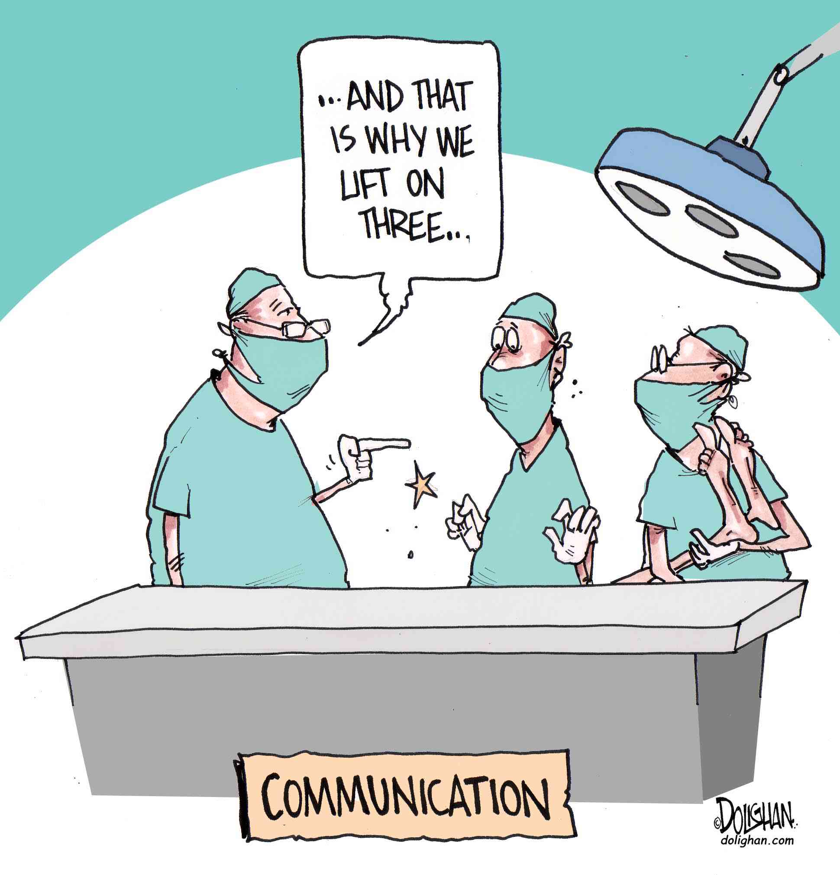
Notes:
Sheri

Slide 23
ASCCC Accreditation Institute: Faculty Engagement and Alo partnership
Presented by:
Sheri Berger, Vice President of Academic Affairs, Los Angeles Pierce College (LAPC)
Sam Foster, ASCCC South Representative
Yvonne Grigg, Professor of English and Faculty Accreditation Coordinator (LAPC)

