Slide 1
From the Classroom to the Community:
Bridging Culturally Responsive Practices with Counseling and Student Support Services

Slide 2
Facilitators/Presenters
Facilitators:
Manuel J. Vélez - ASCCC South Representative
LaTonya Parker - ASCCC Area D Representative
Presenters:
Paul Alexander - English Professor, San Diego City College
Maria Figueroa - English Professor, MiraCosta College
Gertrude López - Umoja Coordinator, Moreno Valley College

Slide 3
Goals/Outcomes for this Session
To understand Culturally Responsive Teaching and why it’s important
To learn about specific projects that successfully utilized Culturally Responsive Practices
To learn about groups such as Puente and Umoja and how to introduce them in your college
To identify culturally responsive practices that faculty can introduce in their own classrooms

Slide 4
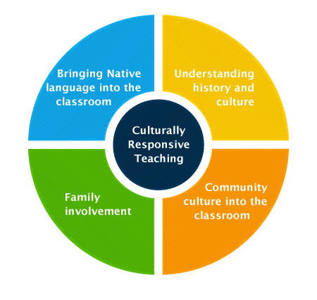
Culturally Responsive Teaching:
What is it?
“Culturally Responsive Teaching can be defined as using the cultural knowledge, prior experiences, frames of reference, and performance styles of ethnically diverse students to make learning encounters more effective and relevant to them.”
Geneva Gay, Culturally Responsive Teaching: Theory, Research, and Practice

Slide 5
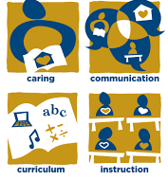
Culturally Responsive Teaching:
Why is it important?
Culturally Responsive Teaching means…
Developing a cultural diversity knowledge base
Designing culturally relevant curricula
Nurturing cross-cultural communication
Creating cultural congruity in the classroom
Demonstrating cultural caring and building a Learning Community

Slide 6

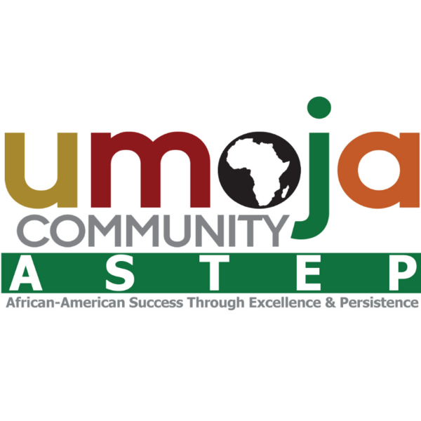
Culturally Relevant Learning Communities
The Puente Project is a national award-winning program that has improved the college-going rate of tens of thousands of California's educationally underrepresented students since 1981. Its mission is to increase the number of educationally disadvantaged students who enroll in four-year colleges and universities, earn college degrees and return to the community as mentors and leaders to future generations. The program is interdisciplinary in approach, with writing, counseling and mentoring components.
Umoja is a community of educators and learners committed to the academic success, personal growth and self-actualization of African American and other students. The Umoja Community seeks to educate the whole student–body, mind and spirit. Informed by an ethic of love and its vital power, the Umoja Community will deliberately engage students as full participants in the construction of knowledge and critical thought.

Slide 7
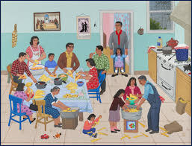
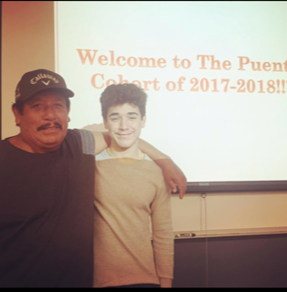
Pedagogy of Cariño in the PUENTE Classroom
I shed tears of anguish
as I see my children disappear
behind the shroud of mediocrity
never to look back to remember me
I am Joaquin
I have endured in the rugged mountains
of our country.
I have survived the toils and slavery
of the fields.
I have existed
In the barrios of the city
in the suburbs of bigotry
in the mines of social snobbery,
in the prisons of dejection,
in the muck of exploitation
and
in the fierce heat of racial hatred…
I am the masses of my people and
I refuse to be absorbed.
I am Joaquin
The odds are great
But my spirit is strong
My faith unbreakable
I

Slide 8
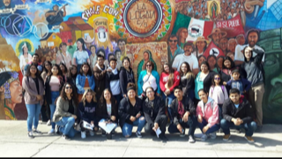
InLak’Ech: As a framework for decolonial teaching and learning
In Lak/Ech/ Tu eres mi otro yo/ You are my other me
If I do harm to you/ I do harm to myself
If I love you / I love myself
LA CULTURA CURA

Slide 9
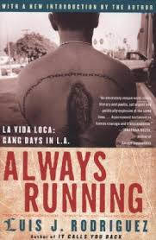
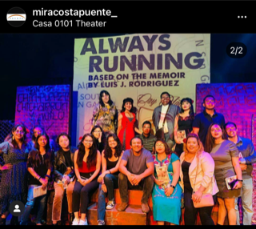
InLak’Ech: Decolonizing the classroom
The classroom as a sacred place of learning
Students’ Cultural Capital* is centered
Co-creators of knowledge*
Community / Family

Slide 10
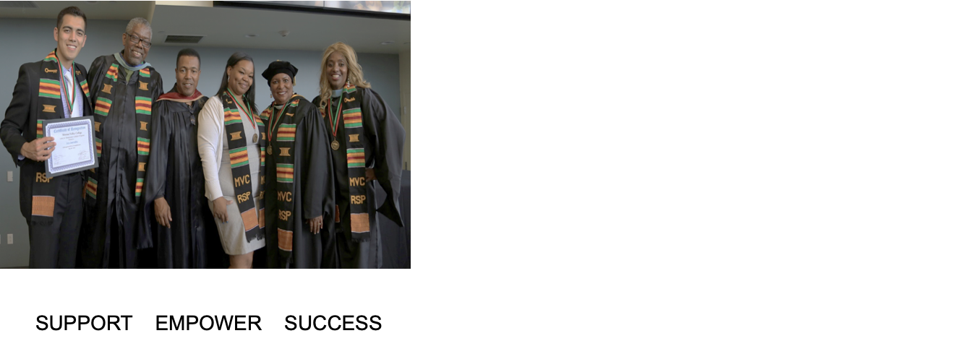
Moreno Valley College Umoja Community
The Moreno Valley College Umoja Community is dedicated to increase the number of educationally underserved students who enroll in our college, transfer to a four-year college or university, and return to the community as leaders and members for future generation. MVC Umoja Community also takes a proactive approach American males, and other at-risk students in higher education

Slide 11
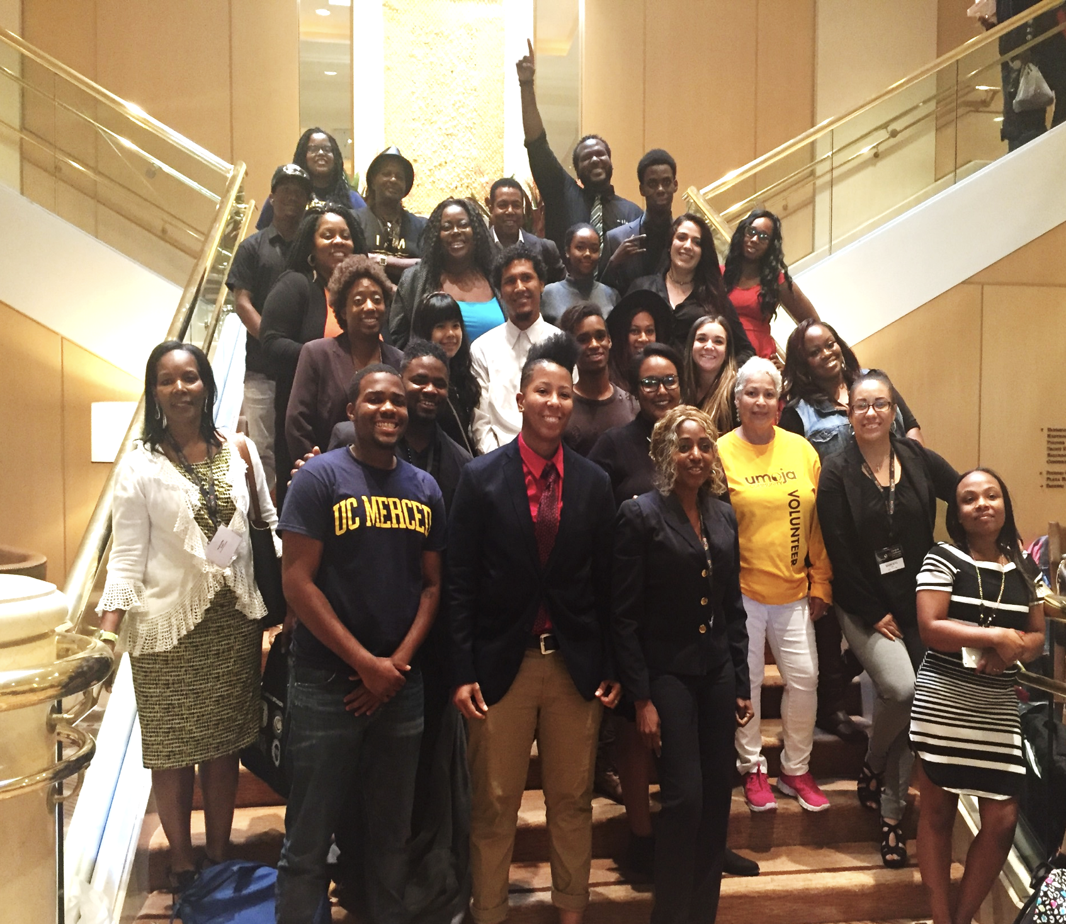
Moreno Valley College Umoja Community
Umoja Summer Bridge Program College Promise
Umoja Practices Practice’s relating to " If I were your Teacher" Workshop
Umoja Priority Registration James Baldwin
A2Mend Male Mentoring Program/club charter 1. Raising Intentional & Deliberate
Umoja Club//Community servicer Beach clean-up 2. Mentoring
Business Mixer Partnership 3. Mattering
Job Placement Program Partnership 4, Community Building
MVC Umoja Mentor/Mentee Program
Transfer Partnership with Historically Black Colleges and Universities Campus Tours/Leadership Conferences
Transfer Partnerships with UC’s,CSU’s Systems and private institutions
Study Vibes evening touring /online touring support services
Learning Community/Streamline Success transfer Path
Umoja Student Workshops/ Self Development Training
Book Lending Library/extra book support/class code support
Umoja Specialized Counselors/Online support
Transfer assistants/ Transfer guarantee
Umoja Swag, book bags, folder, USB Ports, chrome books, hot spots, Umoja beanies, scarves, tee shirts, cups coffee, snacks , food vouchers ,gas cards and much, much more.

Slide 12
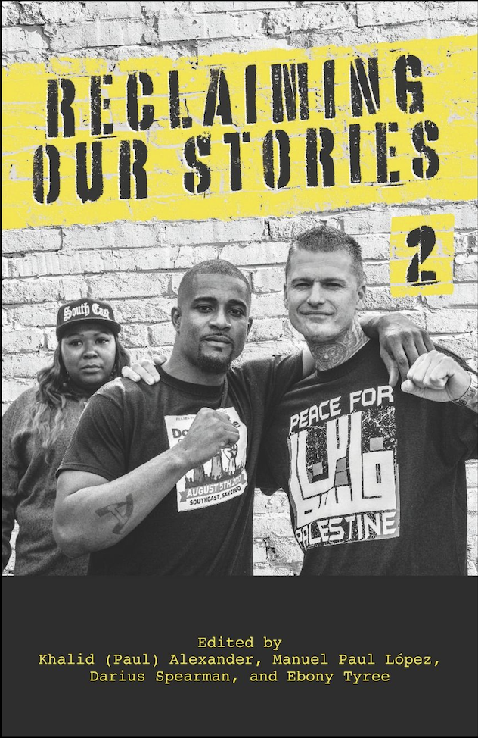
Bringing the College to the Community and the Community to the College
For Black folks teaching—educating—was fundamentally political because it was rooted in anti racist struggle. Indeed, my all black grade school became the location where I experienced learning as revolution.
-bell hooks

Slide 13
Umoja Principles and “Mattering”
umojacommunity.org
Mattering is intersectional-cultural, social, political, civic, spiritual. Given the years of institutionalized educational inertia, which often includes potent doses of failure and disaffection, we are being asked to create learning experiences that reclaim mattering and give agency to our students as matters. It matters what we teach; we must take a risk to include content that fuses suffering, identity and freedom. Mattering increases context while making choices about what is urgent.

Slide 14
Padlet Exercise
Click on the link below to access our Padlet board and share at least one idea or practice that you intend to implement in your classroom or in your interactions with your students. Please feel free to also “like” and comment on other posts.
Link to Padlet: https://padlet.com/1_manuel/culturallyresponsivepractices
Password: antiracism

Slide 15
Information on
Puente and Umoja
To learn more about how to bring Puente to your college visit their website at: https://www.thepuenteproject.org
To learn more about how to bring Umoja to your college visit their website at: https://umojacommunity.org

Slide 16
Resources
Gay, Geneva. "Preparing for culturally responsive teaching. (2001 AACTE Outstanding Writing Award Recipient)." Journal of Teacher Education, vol. 53, no. 2, 2002, p. 106+. Gale Academic OneFile, https://link.gale.com/apps/doc/A83732906/AONE?u=san28139&sid=AONE&xid=2dce48d0. Accessed 31 Oct. 2020.
Zaretta Hammond "Culturally Responsive Teaching" at the San Francisco Public Library
Stembridge, A. (2020). Culturally Responsive Education in the Classroom. New York: Routledge, https://doi.org/10.4324/9780429441080
What Does The Puente Project Mean To You?
Umoja Community Success

