Slide 1
Grow Your Own Faculty- How to Encourage our Students
to Become Community College Instructors
Notes:
Icebreaker: Name and college and your leadership position (Mayra)
Session date and time: November 5th from 3:00 to 4:00PM
One of the most important characteristics of the California community colleges is our unique and dynamic relationships with the students and communities we serve. In fact, for many of these students the impact of this relationship is so strong, that they return after their studies to rejoin our community in various capacities including instructors. In this session we’ll explore the importance of cultivating and encouraging our students to consider careers as community college professors and learn from former and current students about their own experiences in the community college. We’ll also place emphasis on programs such as SDICCCA and Project Match and their role in helping students consider a career as community college instructors.

Slide 2
Presenters/Facilitators
Facilitators
Manuel Velez - ASCCC Executive Committee South Representative
Mayra Cruz - ASCC Executive Committee Treasurer
Presenters
Elmida Baghdaserians, CTELC member, Los Angeles Valley College
Angelica Campos, SSCCC, City College of San Francisco
Steven Moreno-Terrill, College of the Desert
Rasheed Aden - San Diego City College
Notes:
1 minute

Slide 3
Session Outcomes and Goals
To learn more about the “Grow Your Own” movement
To share stories about the pathway from student to the professoriate
To identify practices/tips/strategies for developing mentor/mentee relationships
To introduce research and data related to mentor/mentee relationships
To learn more about faculty development/mentorship programs such as SDICCCA and Project Match and how they can positively impact faculty diversification
To identify practices that would promote a “Culture of Mentorship” at your college
Notes:
2 minutes

Slide 4
Grow Your Own (GYO)
Educator Programs
GYO programs help address teacher shortages, retention issues and teacher diversity by engaging in a variety of strategies that aim to recruit teachers from local communities in hopes that the pool of candidates will increase in diversity and will be more likely to stay teaching in the community.
Benefits of GYO Programs include:
Can help to address the underrepresentation of faculty of color in community colleges and public schools
Can help to create stronger connections with the communities we serve
Creation of pathways into the teaching profession through partnerships

Slide 5
Poll: Mentorship at your college
Please choose the response that most closely resembles your response:
How does your college encourage students to consider a career in community colleges and teaching as a profession?
We’ve established “GYO” mentorship programs on our campus/district
We have partnerships with other academic/community organizations to encourage mentorship
We have no formal mentorship program or partnership but encourage mentoring through student organizations
Mentorships are informal and at the discretion of our individual instructors
Please take a moment to participate in our poll on the Pathable site
Notes:
1 minute

Slide 6
A Student’s Perspective
Angelica Campos
Student Senate for California Community Colleges,
Student at City College of San Francisco
Notes:
5 minutes

Slide 7
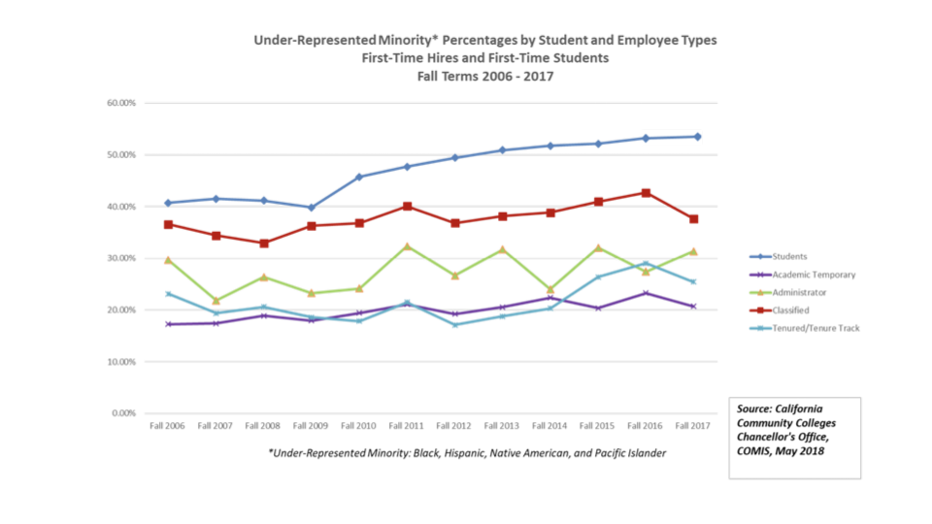

Slide 8
What does the research say?
When mentors and instructors reflect community college students’ own backgrounds and experiences, students benefit (Fairlie, Hoffman, & Oreopoulos, 2014).
Mentoring networks are particularly significant to women and diverse faculty, but they are less likely to access and develop mentoring relationships and networks (Mott, 2002; Zellers et al., 2008; Pololi & Knight, 2005; Van Emmerik, 2004; Chesler, Single, & Mikic, 2003; Chesler & Chesler, 2002; Bickel, 2014).
Notes:
5 minutes
Steven’s slide

Slide 9
What does the research say?
Mentoring enhances
teaching effectiveness (Williams, 1991)
faculty retention, recruitment, productivity and satisfaction (Columbia University, 2016)
Faculty Diversity Internship Programs (FDIP) provide the benefits of mentorship, professional development, and networking (Sirihekaphong, 2016)

Slide 10
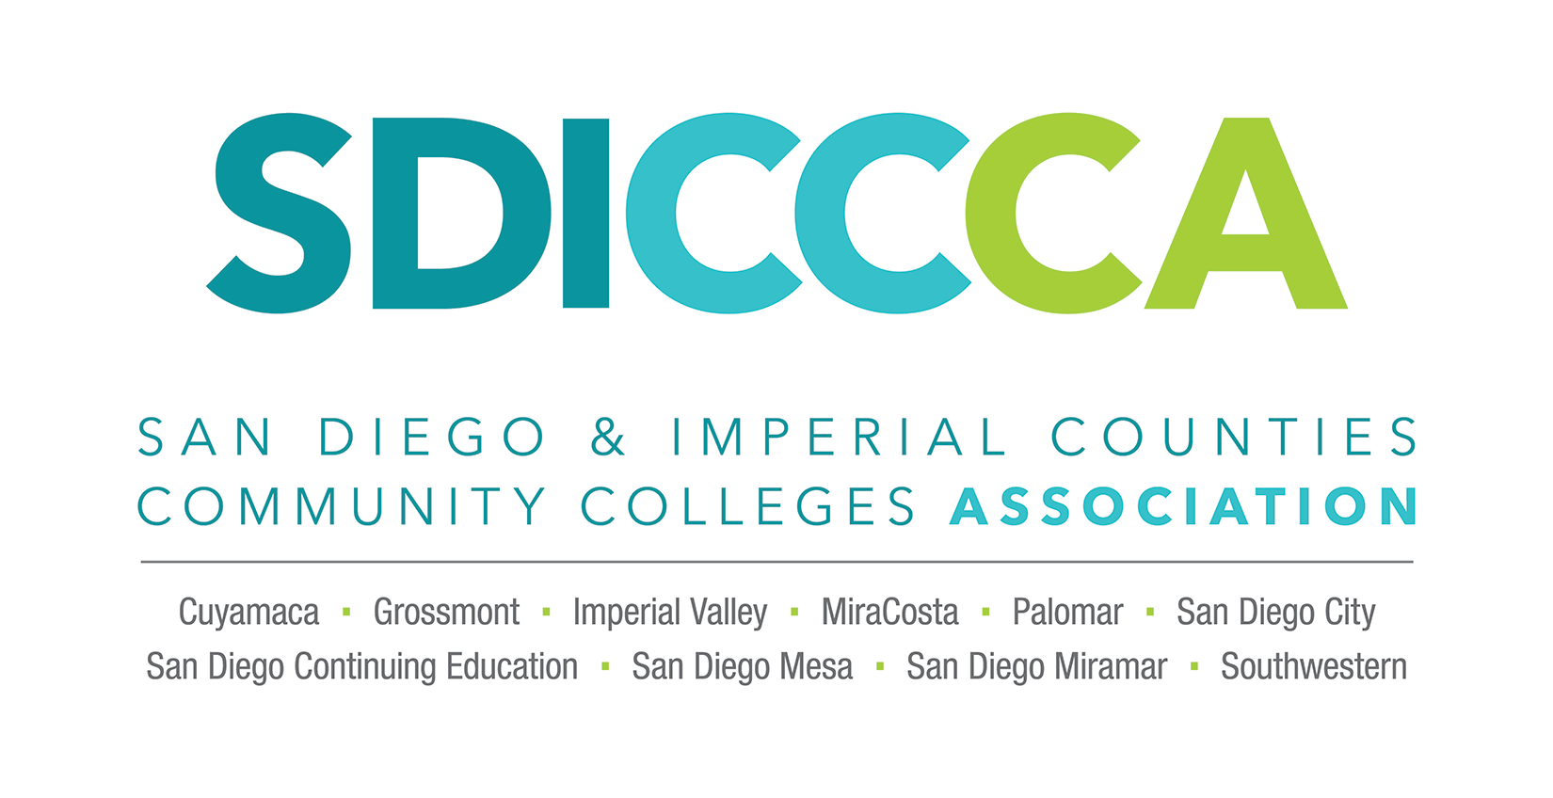
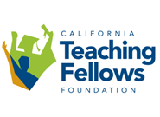
Formal Mentorship Programs
The SDICCCA Regional Fellowship Program is a major cooperative initiative between the San Diego/Imperial County Community College Association (SDICCCA) and San Diego State University (SDSU). The purpose of the program is to identify, recruit, train, and support prospective community college educators including classroom, library, and counseling faculty in their pursuit of part-time and full-time faculty positions within community colleges in the region.
The Teaching Fellows Scholarship program recruits high school seniors (who maintain a 3.5 GPA) and provides a four year, enriched cohort experience for the Teaching Fellows as they complete degrees and credentials. Teaching Fellows are placed 15 hours per week as teaching assistants in low income schools and receive financial assistance and personalized support through a counselor and staff in the Teaching Fellows office. Twenty-five students are selected for the program each year.
The Los Angeles Community College District (LACCD), comprised of nine area community colleges, offers Project MATCH as a program to prepare and recruit a diverse community college faculty who are sensitive to the needs of the students and community it serves. The goals of the program are to (1) improve the diversity of the faculty pool in the District, (2) mentor participants to serve as role models reflecting that diversity within the District, and (3) better reflect the diversity of the communities within the largest community college district in the nation.
Notes:
4 minutes

Slide 11
Formal Mentorship Programs
Hermanos Unidos/Brothers United (HUBU) is committed to helping students succeed by informing, motivating, and preparing them for success both academically and personally. The HUBU mission is to increase faculty and student interaction; promote community, cultural, and gender identity development, and encourage peer-to-peer interaction between students.
The GYOC is a collective of practitioners, educators, union members, policy makers, researchers and allies focused on creating a national model for recruiting & retaining diverse, community- grounded teachers of color. We believe increasing attention should be given to community-based efforts committed to recruiting, preparing, and retaining teachers of color. We are committed to creating safe spaces for students and educators of color. We are a cross-collaborative network that aligns programs and University models towards developing best practices for the Grow-Your-Own Collaborative.
AACTE’s Networked Improvement Community (NIC) was created as a pathway to examine and act upon the overwhelming absence of teachers of color in our public schools. In spring 2013, AACTE established its first NIC with the specified aim of increasing the diversity of our nation’s teacher candidate pool by focusing on the recruitment of Black and Hispanic/Latino men into EPPs.

Slide 12
A Former Student’s Perspective:
Steven Moreno-Terrill
That “aha” moment
Mystified process
SDICCCA and Mesa College Department of Chicana/o Studies
Notes:
5 minutes

Slide 13
The Importance of Nurturing Mentor/Mentee Relationships
Win-Win and win some more……
7 Reasons Why Mentors are Important in Every Field:
1. Important skills and knowledge are passed on from mentor to mentee.
2. Supportive long-term relationships are formed.
3. Mentors give objective advice and constructive criticism.
Notes:
3-4 minutes- Hi all, I thought it might help us organize our thoughts about why mentors are key in every field … feel free to leave it in or take it out..

Slide 14
4. Mentors help with setting reasonable and reachable goals.
5. Mentors become the mentee’s cheerleader and confidence-booster.
6. Mentors are usually well connected within the arena they operate in.
7. The mentorship becomes mutually beneficial and personally rewarding for both parties.
“A mentor is someone who allows you to see the hope inside yourself”. Oprah Winfrey

Slide 15
How Can You Secure a Mentor?
Connect with faculty/leaders who know you and believe in your work
Follow up with e-mail and in person when possible
Make an effort to meet your future mentor, attend their lectures and/or presentations
Ask questions, if the person is where you want to be one day ask them how they got there
Do not reinvent the wheel, each of us has a unique journey that can help others
Network, there is learning in every opportunity!
Notes:
I will discuss this in my five minute presentation. Is it possible to include it? Elmida
Yes!

Slide 16
A Personal Narrative: Elmida
Education: AA-Child Development, BA-Human Development, MA-Counseling & Psychology, Ed.D.-Organizational Leadership
Experience: 10 years experience working with children, 21 years in HE/Professor, Chair and Academic Advisor
Committees/Professional Membership: ASCCC-CTEL, PEACH, ACCCTTP, CCCECE
Research Interest: DEI, Leadership, Mentoring, Advocacy, PD
Notes:
5 minutes

Slide 17
Personal Narrative
Ahmed Aden
Counselor, Assistant Professor
Coordinator, Hispanics Unidos Brothers United (HUBU)
San Diego City College
Notes:
5 minutes

Slide 18
Breakout Activity: Becoming a Mentor
After listening to the personal narratives of our panelists and learning more about the role and need for “Grow Your Own” programs, use your breakout room to engage in a conversation with your peers about how your faculty and college could encourage our students to pursue a career as community college faculty. The following questions can be used to guide your conversation:
In what ways can faculty “informally” serve as mentors or support their students?
What department-wide measures can be taken to encourage students to consider careers in community college?
How can the college or district contribute to nurturing faculty/student mentorships?
Notes:
15 minutes

Slide 19
ASCCC Information and Contact Information
For more information on the ASCCC please visit our website at ASCCC.org
Or send us a message via e-mail at info@asccc.org

Slide 20
Thank you!

