Slide 1
Mindfulness for Leaders: Staying Grounded in a Vortex of Chaos

Slide 2
Presenters
Manuel Vélez - ASCCC Executive Committee South Representative
Julie Oliver - ASCCC Executive Committee Area A Representative
Angela Echeverri - Los Angeles Community College District

Slide 3
Our Focus for this Session...
Focus on strategies to keep yourself grounded as well creating an environment of mindfulness at your college
How to consider mindfulness as a leader
Considering mindfulness through the lens of equity and diversity
Notes:
2-3 minutes
Manuel

Slide 4
Opening Poll
Pathable Poll: After nearly eight months of remote operations, where is your stress level lately? (Please answer in the Pathable platform.)
Stress, what’s stress?
Everything is great! I can handle it.
Some days are tough, some days are great.
Every day is an uphill climb.
Very overwhelmed. Barely coping.
Losing my mind!
Notes:
Julie 2-3 minutes

Slide 5
Beginning With The Self
Notes:
Angela
10 minutes - presentation
5 minutes - activity

Slide 6
How Have Our Lives Changed?
Increased workload
Working from home
Zoom and Canvas fatigue
Childcare responsibilities
Social and physical isolation
COVID-19 and health concerns
Uncertainty, stress, and anxiety
Financial hardship
Loss and grief
Social unrest and upheaval
Limited travel and recreation opportunities

Slide 7
Take a Moment
Breathe and Relax

Slide 9
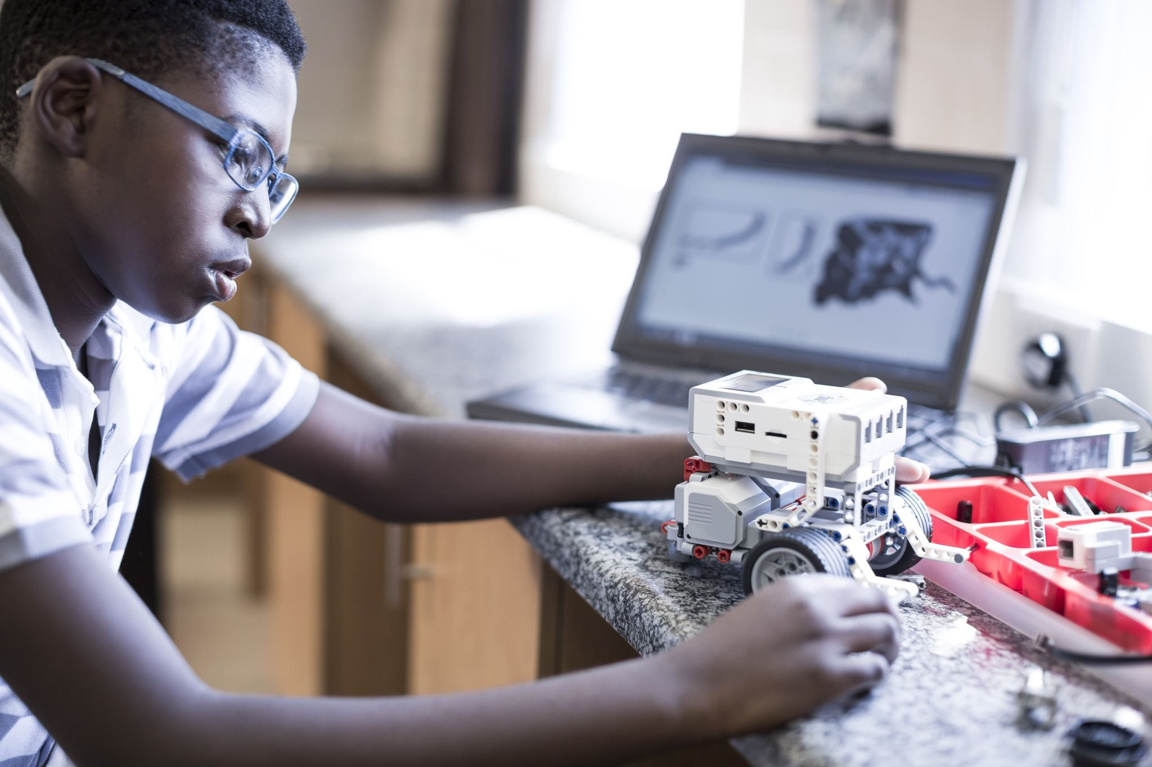
Transitioning From Crisis Mode to Long-Term Change
Adjust to new our reality and working conditions
Settling in for the long haul
From weeks to months or longer
Prevent burnout and fatigue
Find joy and purpose
Focus on the positive
Opportunity for innovation and learning
Gratitude
What we can control?
How can we make a difference?
Practice self care and wellness

Slide 10
Self Care is Essential
Meditation and mindfulness
Workspace
Professional development and learning
Disconnecting from work, news, media
Physical activity
Healthy diet, hydration, and habits
New routines
Journal
Hobbies
Connecting with others and nature
Ask for help
Be kind to yourself and others
Other: Pets, art therapy, reading

Slide 11
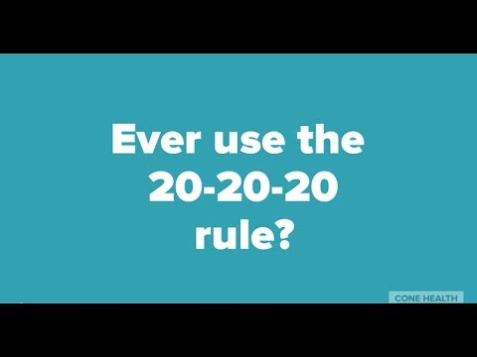
Optimizing Your Working Conditions
Desk
Computer and accessories
Comfortable chair
Lighting
Prevent eye strain
Internet
Supplies
Instructional props
Privacy
Hydration
Taking breaks
Other considerations

Slide 12
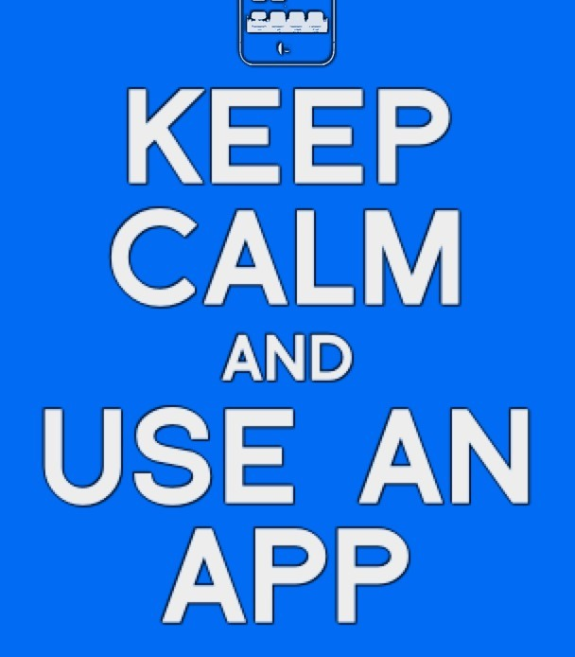
Wellness and Mindfulness Apps
Meditation
Work break reminder
Eye care
Hydration
Exercise
Other

Slide 13
Breathing Exercise

Slide 14
What Strategies are Helping You Cope?

Slide 15
Word Cloud: How are you?
Add a word or short phrase to the cloud describing a strategy you’re using to help you stay grounded (reading, hobbies, spending time with loved ones)
Notes:
2-3 minutes

Slide 16
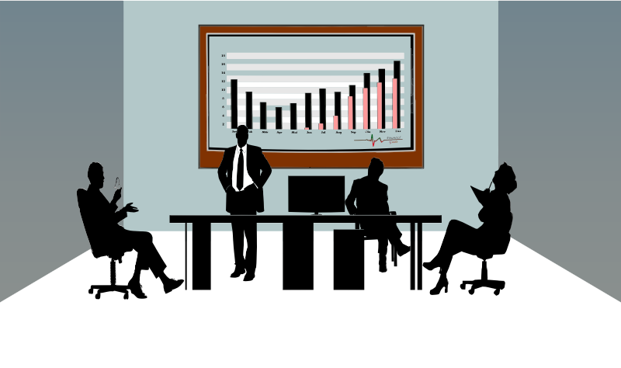
MINDFULNESS IN RELATIONSHIP BUILDING
Notes:
Julie
10 minutes - presentation
5 minutes - activity

Slide 17
MINDFULNESS IN RELATIONSHIP BUILDING
Notes:
Julie
10 minutes - presentation
5 minutes - activity

Slide 18
EFFECTIVE STRATEGIES for RELATIONSHIP BUILDING
Mutual understanding of roles/responsibilities and genuine respect
Inclusivity, transparency, diplomacy
Think about what makes your relationship with this person important.
Seek the source of the disagreement and points of common purpose (Is this a hill to die on?)
Stay responsible for your feelings
Identify unconscious biases (conversation filters)
Be mindful of personal power and privilege
Engage in dialogue including clarifying values/checking personal perception
Pay attention to what has heart and meaning
Speak the truth without blame or judgment
Be open to outcome, not attached to outcome
Allow for mistakes to happen!
Notes:
Julie

Slide 19
Setting the Tone as Senate President
The senate president can set the tone by:
Creating a vision & strategy
Recognizing leadership styles and how to use them
Being proactive
Setting direction
Raising expectations
Asking lots of questions
Listening for understanding
Notes:
Julie

Slide 20
Provide Leadership for Faculty
Conduct senate orientations for faculty
Foster connections with the faculty beyond the senate
Create an orientation for new senators on participatory governance
Model leadership
Assume good intentions
Build connections with the ASCCC by promoting institutes, area meetings, plenary sessions and other ASCCC events
Notes:
Julie

Slide 21
ASCCC Call to Action
Special Message from ASCCC President John Stanskas June 2020
Make a tentative agenda now that includes a discussion of anti-racism/no-hate education. Remember, you do not have to have an answer to start a conversation.
Prioritize culturally responsive curricular redesign with your curriculum committee.
Acknowledge, without assigning blame, that the structure of the college houses the biases and prejudices of its founding time. Those biases have privileged some and disadvantaged others, particularly African-American and LatinX communities.
Prioritize the evaluation of hiring and evaluation processes.
Request services from the ASCCC about any of these topics..
Evaluate your academic senate and find the voices among your faculty missing in governance. Find ways to empower those voices.
Work with your administration and students to find constructive ways students can express themselves about these deaths and the structural and historical biases that exist.
Notes:
Julie

Slide 22
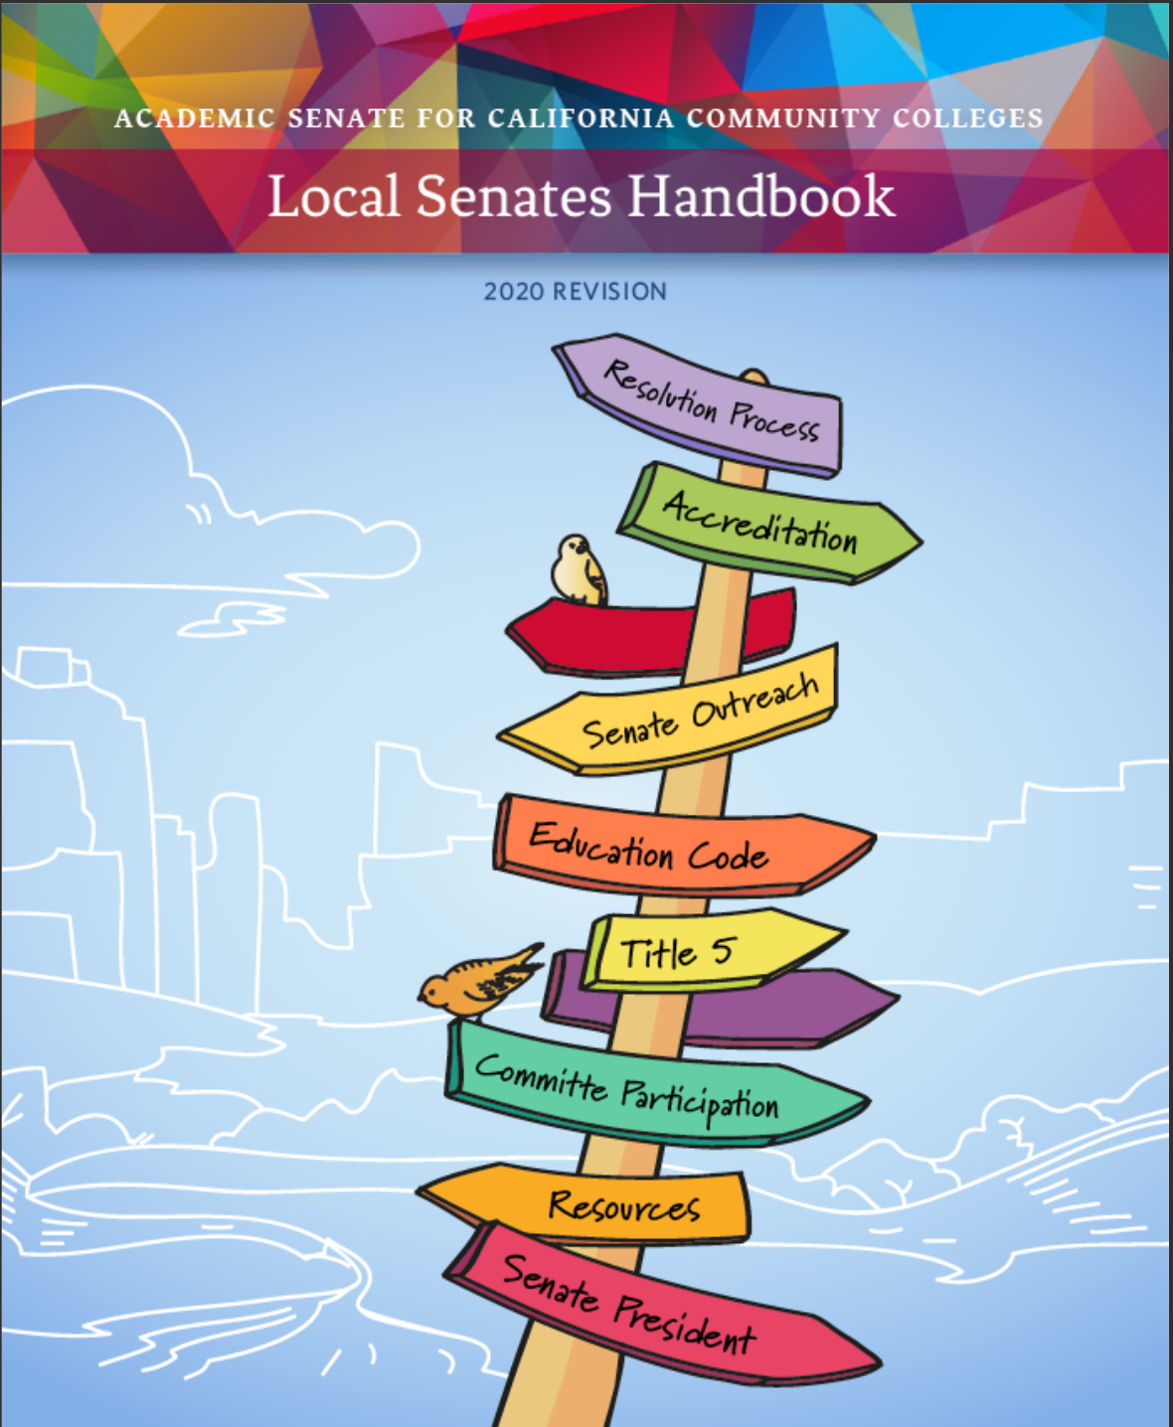
Utilize ASCCC Resources such as
https://indd.adobe.com/view/7f4e2df0-a2c8-42cd-8a88-bb92cfc68ed3
Notes:
Julie

Slide 23
How are you being a mindful leader while working remotely?
Take a moment to use the GoogleDoc link found in the Pathable chat to share your ideas.
https://docs.google.com/document/d/1sPsOwDO5CLn-DFWff52nHFsWNxzMi7gCHVWMXSfW7TI/edit?usp=sharing
Notes:
Julie

Slide 24
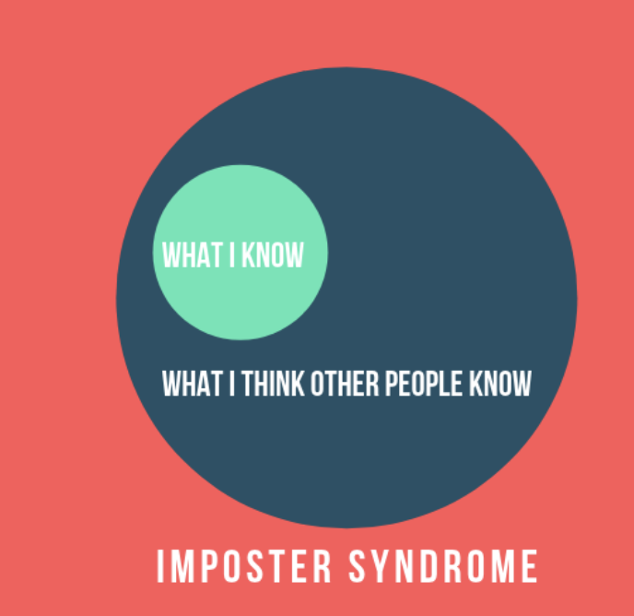
Mindfulness Through an Equity Lens: The Imposter Syndrome
First described by psychologists Suzanne Imes, PhD, and Pauline Rose Clance, PhD, impostor phenomenon occurs among high achievers who are unable to internalize and accept their success. They often attribute their accomplishments to luck rather than to ability, and fear that others will eventually unmask them as a fraud.
While all of us suffer from “imposter syndrome” at some point in our lives, it is most commonly felt by members of “marginalized” communities
Negative Effects of Imposter Syndrome
Tends to discourage participation in meetings/projects
Creates a sense of “not-belonging” and a need to conform in order to “fit in”
Results in increased feelings of stress and anxiety for those struggling with Imposter Syndrome
Can result in virtual disconnects from the college community
Can work to maintain white patriarchal systems of power
Notes:
Manuel
10 minutes
5 minutes

Slide 25
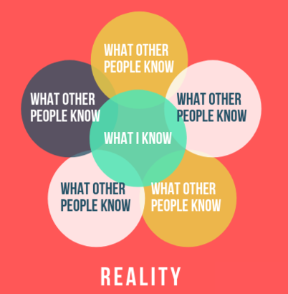
Mindfulness Through an Equity Lens: Addressing The Imposter Syndrome
As faculty leaders it’s important to be aware of how our structures and culture may encourage Imposter Syndrome. Faculty leaders can help to create an atmosphere of confidence and inclusion:
Openly acknowledge that Imposter Syndrome is a reality that many faculty face and commit to addressing it.
Do not force anyone to speak who doesn’t want to, but also make sure to create an atmosphere where dialogue is encouraged for all
Create spaces for new and underrepresented faculty to showcase and discuss their works within academic settings.
Encourage professional development that focuses on works of scholars from underrepresented communities
Ensure that committee memberships reflect the diverse identities of your faculty
Encourage leadership positions for faculty from underrepresented communities.

Slide 26
Mindfulness Through an Equity Lens:
Stereotype Threat
This term, coined by Claude Steele and Joshua Aaronson, refers to a social-psychological predicament in which someone feels that their own characteristics or actions may “confirm” a negative stereotype in the eyes of others or even in themselves. Consequences can include:
Underachievement and decreased performance by those stigmatized
Increased use of self-defeating strategies
Disengagement and disidentification
Altered professional identities and aspirations

Slide 27
Mindfulness Through an Equity Lens:
Combating Stereotype Threat
Because Stereotype Threat functions similarly to Imposter Syndrome, in many ways they can also be addressed similarly. Here are some other things for faculty leaders to consider in regards to Stereotype Threat:
Organize professional development activities centered around recognizing and addressing Stereotype Threat.
Encourage and empower your faculty to speak up when they feel they’ve been stereotyped.
Before meetings, affirm that everyone is welcome regardless of cultural, linguistic, and other identities.
Encourage a setting that represents the cultural diversity of your faculty and college community.

Slide 28
Mindfulness Through an Equity Lens: Racial Battle Fatigue
Racial Battle Fatigue is used to describe the psychophysiological symptoms—from high blood pressure to anxiety, frustration, shock, anger and depression—people of color may experience living in and navigating historically white spaces. For faculty of color Racial Battle Fatigue often leaves them disillusioned, disempowered and disconnected.
Make sure to recognise the service and accomplishments of faculty of color
Commit to a culture of equity for your faculty where effort is made to support faculty of color at the college
Create an environment that encourages and empowers faculty to speak out, when they feel victimized by microaggressions
Make sure to include faculty of color representation in important committees and task-forces

Slide 29
Mindfulness Through an Equity Lens:
Padlet Activity
Using the link below (also found on the Pathable chat), log onto Padlet and write down a brief idea on how your college can address any one (or all) of the three equity issues we discussed today.
https://padlet.com/1_manuel/equitymindfulness
Password: antiracism

Slide 30
Thank You & Questions
For more information on the ASCCC please visit our website at ASCCC.org
Or send us a message via e-mail at info@asccc.org

Slide 31
Resources
Calm app
Edwards, C. W. (2019). “Overcoming Imposter Syndrome and Stereotype Threat: Reconceptualizing the Definition of a Scholar”. Taboo: The Journal of Culture and Education, 18 (1). https://doi.org/10.31390/ taboo.18.1.03
Inzlicht, M., & Schmader, T. (Eds.). (2012). Stereotype threat: Theory, process, and application. Oxford University Press.
TED. (2018, December 11). Implicit Bias, Stereotype Threat and Higher Ed | Russell McClain | TEDxUniversityofMarylandBaltimore [Video File]. Retrieved from https://youtu.be/yiZQaE0q9BY
Hartlep, Nicholas D, and Daisy Ball. Racial Battle Fatigue in Faculty: Perspectives and Lessons from Higher Education. , 2020. Internet resource.

