Slide 1
Program Review and Integrated Planning: A Conversation About Data
Barry Gribbons, Deputy Chancellor, College of the Canyons
John Stanskas, ASCCC Vice President
ASCCC Accreditation Institute 2017

Slide 2
Overview
What do the ACCJC Standards say about using data for program review and integrated planning?
What needs to be integrated?
What data is readily available?
How is data incorporated in college processes?

Slide 3
What do the ACCJC Standards Say?

Slide 4
I. Mission
Using analysis of quantitative and qualitative data, the institution continuously and systematically evaluates, plans, implements, and improves the quality of its educational programs and services.

Slide 5
IB. Mission
IB1. The institution demonstrates a sustained, substantive and collegial dialog about student outcomes, student equity, academic quality, institutional effectiveness, and continuous improvement of student learning and achievement.

Slide 6
IB. Mission
IB3. The institution establishes institution-set standards for student achievement, appropriate to its mission, assesses how well it is achieving them in pursuit of continuous improvement, and publishes this information. (ER 11)

Slide 7
IB. Mission
IB4. The institution uses assessment data and organizes its institutional processes to support student learning and student achievement.

Slide 8
IB. Mission
IB5. The institution assesses accomplishment of its mission through program review and evaluation of goals and objectives, student learning outcomes, and student achievement. Quantitative and qualitative data are disaggregated for analysis by program type and mode of delivery.

Slide 9
IB. Mission
1B6. The institution disaggregates and analyzes learning outcomes and achievement for subpopulations of students. When the institution identifies performance gaps, it implements strategies, which may include allocation or reallocation of human, fiscal and other resources, to mitigate those gaps and evaluates the efficacy of those strategies.

Slide 10
III. Resources
IIID. The institution’s mission and goals are the foundation for financial planning, and financial planning is integrated with and supports all institutional planning. The institution has policies and procedures to ensure sound financial practices and financial stability. Appropriate financial information is disseminated throughout the institution in a timely manner.

Slide 11
IV. Leadership and Governance
IVB3. ensuring that educational planning is integrated with resource planning and allocation to support student achievement and learning;
IVD5. District/system planning and evaluation are integrated with college planning and evaluation to improve student learning and achievement and institutional effectiveness.

Slide 12
What Needs to be Integrated?
Program Review
Resource Allocation
Staffing (Academic and Classified)
Strategic Plan
Master Plan
Technology Plan
Initiatives
Student Equity
SSSP
Adult Education Block Grant
Strong Workforce
Guided Pathways
California Assessment Initiative
Open Educational Resources
California Career Pathways Trust Grant
Basic Skills Outcomes Transformation Grant

Slide 13
Resources Commonly Available
IEPI Indicators
SSSP
Student Equity
CTE Data Unlocked/SWP
Data Mart
Launchboard

Slide 14
IEPI Indicators
Student Outcomes
Accreditation Status
Completion Rate Prepared Unprepared Overall
Number of Degrees
Accreditation Status
Number of Certificates
Number of Transfers
Transfer-level Completion Rate
Math Year 1
Math Year 2
English Year 1
English Year 2
Fiscal Viability
Number of Low-unit certificates
Salary and Benefits
Cash Balance
OPEB Liability
District Participation Rate
Fund Balance
Annual Operating Excess/Deficiency
FTES (college)
Number of CDCP Awards
CTE Completion Rate
Remedial Rate Math English
ESL
Course Completion Rate
State & Federal Compliance
Fiscal Audit • State Compliance
Federal Awards
CTE Skills Builder
Median Time to Degree
Other
Optional College Choice ( -- only if an indicator is identified by the college)
Required College Choice • (Basic Skills)
Optional College Choice (Noncredit)

Slide 15
Scorecard

Slide 16
Launchboard

Slide 17
Launchboard

Slide 18
Datamart

Slide 19
Student Equity and SSSP
Student Equity Plans and SSSP Plans can be used to help meet standards IA, IB and IIC
IA- Mission
IB- Academic Quality and Institutional Effectiveness
IIC- Student Support Services

Slide 20
SSSSP and Student Equity Plan
Data Components
Three major areas:
Specific sections on institutional research, monitoring and evaluation.
Equity Plan Goals and Priorities for closing Achievement Gaps in Key Indicators link Student Services and Instruction.
Budgets that reflect linkages to Student Success and Equity.

Slide 21
What do the plans tell us…
Provided disaggregated data on student success
Created opportunities to dialog about student success and equity
Required us to assess our student services in the areas of assessment, orientation, counseling services and at risk students
Created plans that link student success data and goals to resource allocation

Slide 22
CTE Data Unlocked and SWP
Provides data on workforce needs in the area and current community college capacity
More detailed completion data
Demographic data on CTE programs

Slide 23
So Now What?
What do we do with all this data and how is it incorporated into your college processes of integrated planning and program review?
Document, document, document

Slide 24
Getting Data Into Program Review

Slide 25
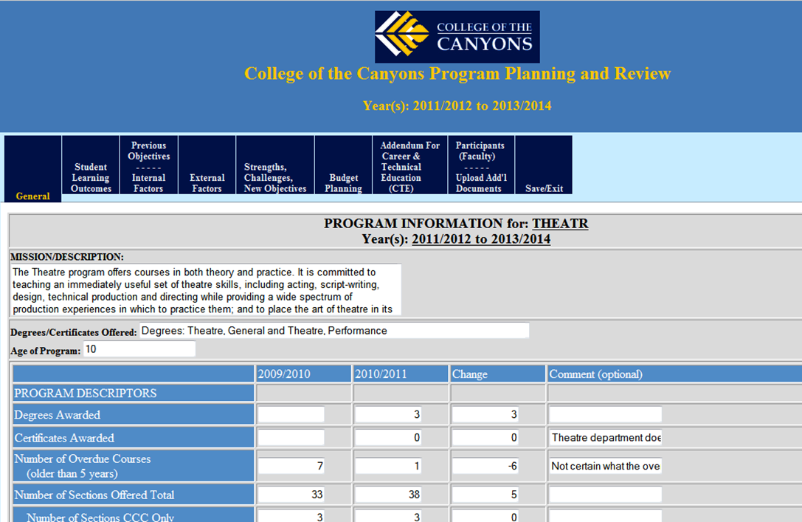
An Example

Slide 26
Integrating With Program Review Example
Drawn exclusively from program review

Slide 27
Student Learning Outcomes-
Programs

Slide 28
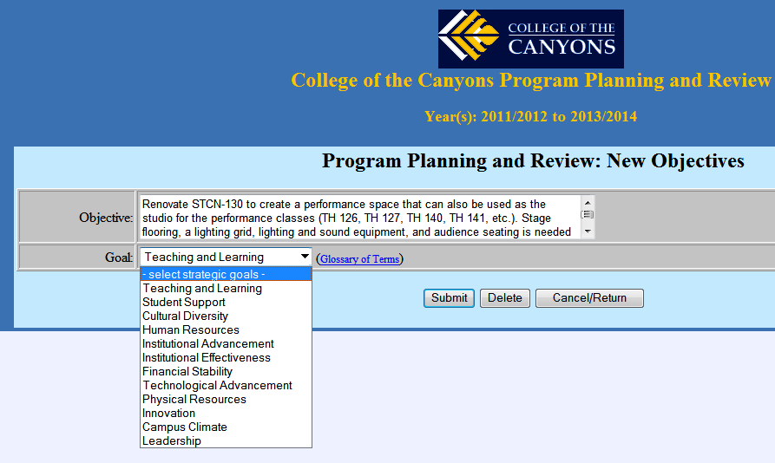
Previous Objectives –
Internal Factors (continued)

Slide 29
Budget Planning (continued)
Budget Connected to Department Objectives

Slide 30
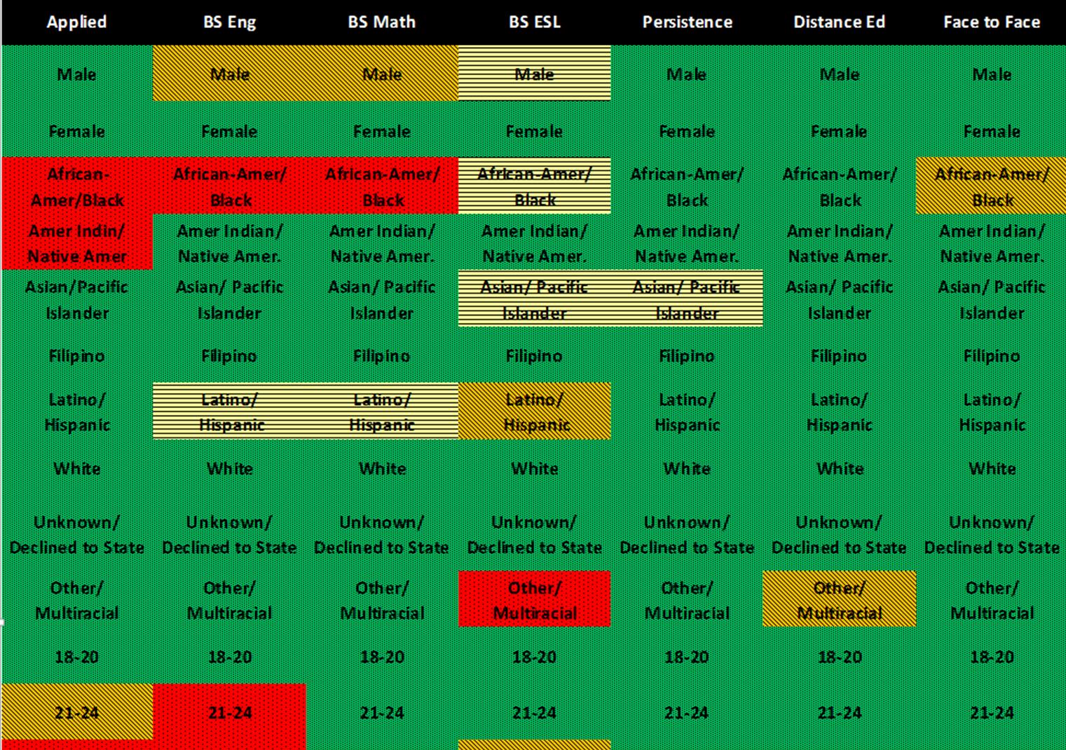
Sample View of College of Canyons’ “Student Equity Heat Map”
Legend: | Red
 | Orange
 | Yellow
 | Green

Slide 31
Tableau Example

Slide 32
What Makes It Work?
Big Ideas from Departments Drive Planning!!!
Dialog within and Across Area
Ensure Ideas are Clearly Articulated Where they Should Be

Slide 33
Integrated and Inclusive Process
Inclusive
Institutional Effectiveness & Inclusive Excellence
Student Government
Business & Education Alliance
Enrollment Management
Performance Indicators
SLOs
Planning Retreats
Program Review
Academic Senate
Business Services and PAC-B
Classified Senate
College-Wide Planning Team
Improved communication, collaboration & integrated planning
Improved coordination of research, evaluation and development of plans pertaining to student success
Review progress on indicators relative to goals, establish new goals, review strategies for achieving goals within Equity, Basic Skills, SSSP and other efforts, as well as discuss unmet needs and ways to meet those needs
Developing an inventory of all activities supporting student outcome and institutional goals
Streamlining processes through utilization of a common solution form

Slide 34
How Does Your College Approach Integrated Planning?
Summits?
Uber-committees?
Technology Solutions?
Other Ideas?

