Slide 1
Regardless of Location or Means of Delivery: Meeting the Standards for Every Student
Stephanie Curry—Reedley College
Alice Taylor—West Los Angeles College

Slide 2
Breakout Outcome
Attendees will understand the expectations for addressing non-traditional student populations and instructional locations and discuss strategies for addressing those standards.

Slide 3
One College Example
2 Educational Centers
40 Miles from main campus
70 Miles from main campus
Online Classes
Middle College High School
Dual Enrollment (60 sections with 12 school districts)
Other Considerations
Sites
Community Campuses
Prison Program
Notes:
Not sure of the thought behind this slide.

Slide 4
“Regardless of location or means of delivery”
II.A.1-instructional programs
II.B.16-evaluates and improves
II.B.1-providing learning support services
II.C.1-evaluating student support services
II.C.3-equitable access to appropriate,
comprehensive and reliable services

Slide 5
ALL the standards apply to everything the college does—no matter where.
for example,
serving your “intended student population” (I.A.1)
assessing SLOs “for all instructional programs and student and learning support services” (I.B.2)
using delivery modes “that reflect the diverse and changing needs of its students, in support of equity in success for all students” (II.A.7)

Slide 6
SLOs
Document that SLO’s and ILO’s are being assessed at all locations and online
Should be broad discussion of outcomes between faculty members from all locations
May want to disaggregate data by location or means of delivery
Dual enrollment classes must assess the same course SLOs as on campus classes

Slide 7
Distance Education
Definition: “a formal interaction which uses one or more technologies to deliver instruction to students who are separated from the instructor and which supports regular and substantive interaction between the student and the instructor either synchronously or asynchronously”
Notes:
From the ACCJC Guide to Evaluating Distance Education and Correspondence Education

Slide 8
Distance Education
Proper training for faculty teaching online students
Need to document that all online students and faculty have equitable access to resources and services

Slide 9
Substantive Change Proposal
Required when 50% or more of the classes for any degree or certificate (including GE) are offered as distance education or at an off-campus location
Must demonstrate:
control of the site sufficient to assure quality of programs and services
appropriate services and learning resources
safety, security, facilities and equipment (Standard III.B and III.C)
fiscal stability and planning (Standard III.D)
Another Substantive Change Proposal is required to close a location.

Slide 10
Educational Centers and Sites
Center--An off-campus site administered by a parent college that offers programs leading to certificates or degrees that are conferred by the parent institution.
Notes:
I’d omit this—the ASCCC definition does not seem to have an impact on ACCJC’s treatment, which depends on the

Slide 11
Dual Enrollment
Dual Enrollment = Concurrent Enrollment
For accreditation purposes, high school students enrolled in our classes, “regardless of location,” are our students
AB 288—
expands opportunities for high school students to be concurrently enrolled at community college pursuant to a agreement by the respective local governing boards
College and Career Access Pathways partnerships: high school students may take college courses only in designated college or career access pathways with the goal of developing a seamless transition from high school to community college
Dual Enrollment agreements can be used for Accreditation Evidence

Slide 12
Middle College and Early College High Schools
MCHS are secondary schools located on a college campus. These schools offer challenging academic programs designed to serve high-potential, high-risk students. MCHS feature effective support services, small class size, and the opportunity for students to concurrently take some college classes at typically minor cost to the student.
ECHS are designed for students who are underrepresented in postsecondary education, including: students who have not had access to the academic preparation needed to meet college readiness standards, students for whom the cost of college is prohibitive, students of color, first generation college-goers, and English learners.
They are designed so that all students can achieve two years of college credit at the same time they are earning a high school diploma (within four to five years of entering grade nine).

Slide 13
Planning
Planning documents can be evidence that you meet Standards for all locations:
Distance Education Plans
Strategic Plans
Facilites Plans
Educational Master Plans

Slide 14
Program Review
Questions that ask for evaluation of DE or off-campus programs can show you meet the standards at all locations
This is an opportunity to disaggregate
by program type an mode of delivery (I.B.5)
by subpopulations of students (I.B.6)

Slide 15
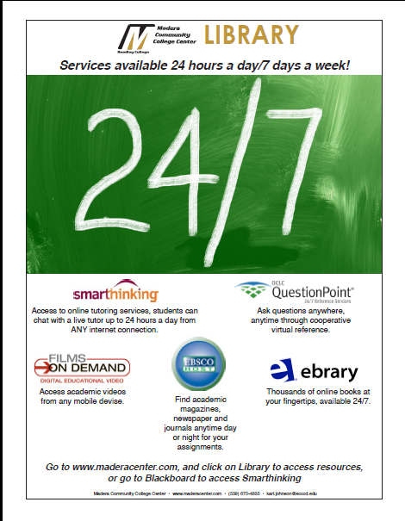
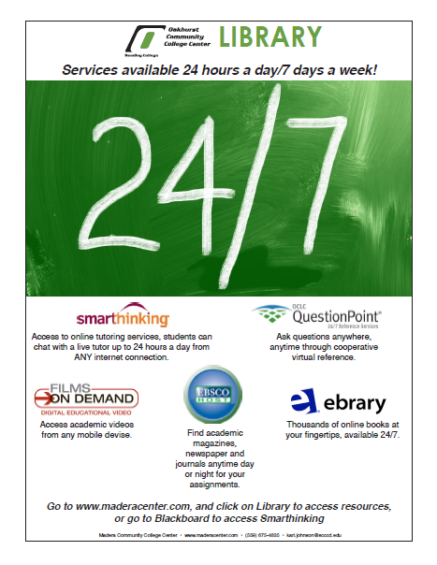
Publicizing Services

Slide 16
Outsourcing Services
IIB 4--When the institution relies on or collaborates with other institutions or other sources for library and other learning support services for its instructional programs, it documents that formal agreements exist and that such resources and services are adequate for the institution’s intended purposes, are easily accessible and utilized. The institution takes responsibility for and assures the security, maintenance, and reliability of services provided either directly or through contractual arrangement. The institution regularly evaluates these services to ensure their effectiveness

Slide 17
“
Questions?

