Slide 1


Regional Consortia Planning

Slide 2
Session Overview
Of the $200 million in Strong Workforce funding, 40% is allocated to regions to invest in coordinated efforts to increase CTE enrollments and improve the quality of their CTE programs. This session will provide an overview of regional planning efforts, as well as regional structures.

Slide 3
Your Presenters
Gustavo Chamorro, LAOCRC, OC Director
Julie Pehkonen, Chair, Inland Empire/Desert Regional Consortium

Slide 4
Learning Outcome
As a result of your participation in this session, we hope you will …
be inspired to learn more about your own region’s Strong Workforce Program plan, and you will be motivated to engage in the process.

Slide 5
SWP 101
Notes:
Regional structure

Slide 6
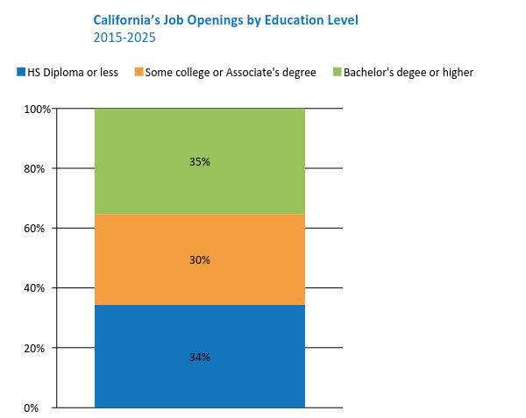
California needs
1 million more
AA, certificates, or industry-valued credentials.
The Goal
1.9 million job openings will require some college or an Associate's degree
Data source: Georgetown University Center on Education and the Workforce, "Recover: Job Growth and Education Requirements Through 2020," State Report, June 2013.
Analysis: Collaborative Economics
Notes:
1 M more middle skill credentials – more than a high school degree but less than a BA. A.k.a., subbaccalaureate: AA, certificates and industry-valued credentials.

Slide 7
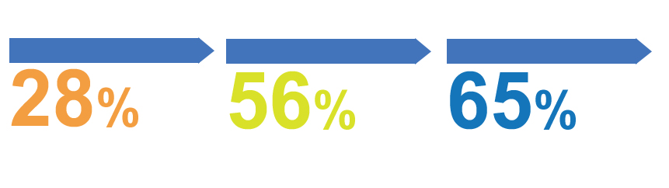
“Some College” is the New Gateway Into The Workforce
IN THE 1970s
IN 1992
BY 2020
of jobs required more than a high school education.
of jobs required more training.
of job openings in the U.S. will require some postsecondary education or training-though not necessarily a four-year degree.
Source: Georgetown Center on Education and the Workforce analysis
Notes:
Van:
- “Some College” has become the new gateway for employment. 65% of jobs openings require an AA, certificate, industry-recognized credential or more.

Slide 8

Career Technical Education: The Path Out of Poverty
$60,771
($29.22/hour)
2-parent with
one working adult, 2-child
Source: CA Budget Project
$66,000
AA – Career Technical Education
5-years later
Source: Salary Surfer, 112 CA Community Colleges
$38,500
AA - General Education
5-years later
Source: Salary Surfer, 112 CA Community Colleges
Notes:
Van:
- Our Career Technical Education (CTE) programs have strong earning power, esp given current concerns re: student debt. Actual avg student earnings from our CTE programs 5 years after leaving us is $66K…. Supports a family of 4 to live in CA.

Slide 9













Sunny Cooke (Chair)
Chief Executive Officer
Lynn Shaw (Vice-Chair)
Faculty - CTE
Craig Justice
Chief Instructional Officer
Mollie Smith
CTE Dean
Bill Scroggins
Chief Executive Officer
Julie Bruno
Faculty – General Education
Ricardo Navarette
Chief Student Svcs Officer
Rachel Mullin
Student/Veteran
Carole Goldsmith
Chief Executive Officer
Toni Parsons
Faculty – Basic Education
Kuldeep Kaur
Chief Business Officer
Linda Wah
Trustee
Lynell Wiggins
Faculty - Counselor
Notes:
- 26 members: ½ of whom are reps of internal constituency groups; ½ are stakeholder groups that depend on the community colleges for workforce training

Slide 10













Tim Rainey (Vice Chair)
CA Workforce Development Board
Nicole Rice
CA Manufacturers & Tech Assn
John Brauer
CA Labor Federation
Abdi Soltani
ACLU Northern CA
Patricia de Cos
CA State Board of Education
Cathy Martin
CA Hospital Assn
Darin Chidsey
So CA Assn of Govts
Brian Burrell
Year Up – Bay Area
Kari Decker
JP Morgan Chase
Allan Zaremberg
CA Chamber of Commerce
Jim Mayer
CAFWD
Mike Dozier
Partnership for San Joaquin Valley
Barbara Baran
CA EDGE Coalition

Slide 11
25
Notes:
Regional structure

Slide 12
The number of recommendations identified by the Strong Workforce Task Force
Notes:
What does the legislation say about planning?

Slide 13
Student Success (2)
Workforce Data & Outcomes (3)
Curriculum (6)
Career Pathways (1)
CTE Faculty (4)
Regional Coordination (4)
Funding (5)

Slide 14
70
Notes:
Regional structure

Slide 15
How many times the word plan or planning is used in the Trailer Bill language.
Notes:
What does the legislation say about planning?

Slide 16
A regional plan, developed with input from regional stakeholders, updated yearly, renewed every 4 years.
Notes:
What does the legislation say about planning?

Slide 17
The regional plan should inform:
Regional (40%) Allocations
Local Campus (60%) Planning and Allocations
Notes:
What does the legislation say about planning?

Slide 18
Allocation Model

Slide 19
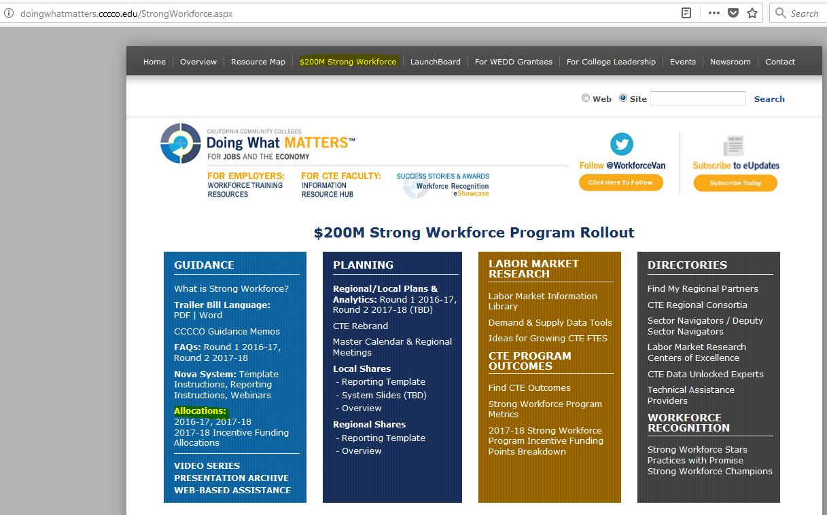

Slide 20
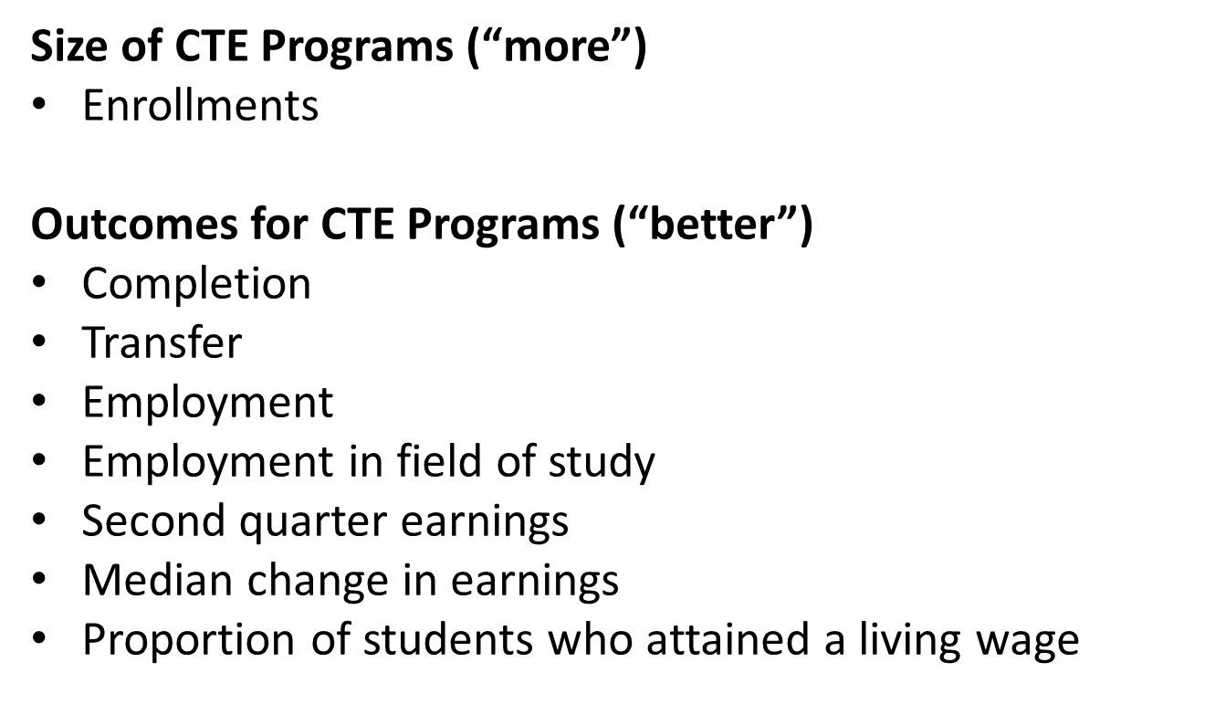
Strong Workforce Program Metrics

Slide 21
7

Slide 22








Slide 23
Decision Making

Slide 24

Notes:
Making lots of money after graduation

Slide 25
Governance structures in place in all 7 regions

Slide 26
Fiscal 101

Slide 27
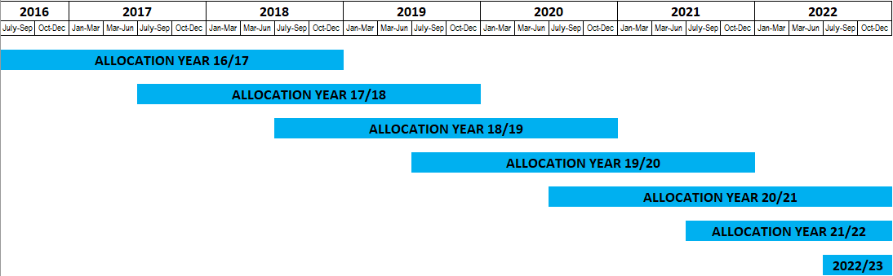
Not a grant – Ongoing Funding
Overlapping funding years
Flexible – Will expense produce More and Better CTE?
Local allocation – Regional allocation
83% allocation – 17% allocation
Notes:
Regional structure

Slide 28
All Things Strong Workforce
http://doingwhatmatters.cccco.edu/StrongWorkforce.aspx
Notes:
Look at the regional plan links and analytics

Slide 29
53

Slide 30
How many times consortia are referenced in the Trailer Bill language.

Slide 31
The Consortia Role in SWP
Collaboration
Coordination
Governance
Fiscal

Slide 32
How do regions plan and allocate resources?
Ongoing (timelines)
Gather data
Develop proposals (template)
Decisions (governance)
Implementation

Slide 33
184
Notes:
Regional structure

Slide 34
Plans by Region – Round 1
Bay - 70
Central / Mother Lode - 16
Inland Empire / Desert – 9
Los Angeles / Orange – 37
North / Far North - 22
San Diego – 5
South / Central Coast - 25

Slide 35
The Local Planning Process
Notes:
Regional structure

Slide 36

Notes:
(Susanne) Getting started on a career path in high school. Students may think life after high school will be all rainbows and butterflies. Articulation. Get focused, stay focused.
is not all rainbows and butterflies

Slide 37
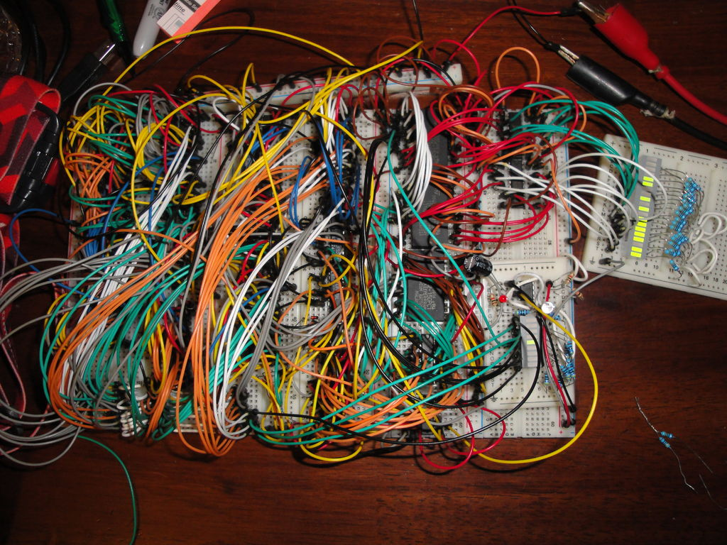
Notes:
It’s more like this … it’s not easy work

Slide 38
Faculty Engagement
Notes:
Regional structure

Slide 39

Choice
Notes:
It’s more like this …

Slide 40
Faculty Engagement
Bring your ideas and expertise to the planning table.
Can’t attend a meeting? Who is already at the regional planning table?
  Discuss your ideas with your CTE Dean
  Reach out to your CTE Liaisons
  Engage with your DSN and other regional faculty
Share with the region the gaps your employers/advisors are talking to you about?

Slide 41
When does the next round of planning begin?

Slide 42
Questions?

