Slide 1
Statewide Curriculum Updates
Curriculum Regional Meetings
October 21 & 22, 2016
Dolores Davison, ASCCC
Jackie Escajeda, CCCCO

Slide 2
Overview
Chancellor’s Office Curriculum Inventory (COCI)
Program and Course Approval Handbook (PCAH)
Statewide Curriculum Workgroup

Slide 3
Chancellor’s Office Curriculum Inventory (COCI)
Three Phase Migration:
December 2016
12 Pilot Colleges & any college brave enough to take a leap of faith
Testing and conversion
February 2017
Early adopters
March 2017 –
Final migration

Slide 4
COCI
Development for creating a new course are 87% developed with the remaining 13% being worked on right now. This will be completed by the end of the month and we will enter November with that section of the new application complete.
Development for creating a new Program is 100% complete.
Development for all components of submitting a new program proposal and amending an existing program is now at 87% complete with additional work happening now. This section will be 95% complete by the beginning of November.

Slide 5
COCI
The subproject of working with Governet on the data migration, including data for pilot testing, is underway.
The subproject for interacting with MIS is underway.
The workgroup for vendor integration is kicking off in the next week. This workgroup is comprised of pilot and advisory committee colleges and select colleges that responded to the COCI field survey during the month of October.

Slide 6
Important Reminders
The new COCI application is being designed to replace the current system. The application isn't being designed for use as the primary curriculum
management system at the local level.
The Chancellor’s Office is not requiring colleges to correct data issues prior to using the new application.
Courses and Programs that have validation errors will not change in status during migration.
Webinar Link: www.cccedplan.org

Slide 7
PCAH, 6th Edition
Standards and Guidelines
Implementation & Submission
Curriculum Inventory Manual

Slide 8
Timeline
PCAH
Submitted to the BoG in July 2016
Corrections (including inclusion of standalone (approved by the BoG in July) continuing
Intended release = December 2016 (in conjunction with the COCI)

Slide 9
Timeline
Submission Guidelines
Review scheduled for next week
Plan is to release version with PCAH if possible
Curriculum Inventory Technical Manual
Will be developed after COCI is fully rolled out and issues/concerns have been identified

Slide 10
PCAH – Noteworthy Changes
Credit hour calculations– major clarification for calculating credit
Grade of “P” OK for ADTs
Guidelines for double counting major and GE units in ADT submissions
Stand alone credit courses can be locally approved

Slide 11
PCAH – Noteworthy Changes
Program Goal classification for credit programs:
Transfer
ADT
IGETC/CSU GE Breadth Certificate
CTE (Must have CTE TOP Code)
Certificate of Achievement
Associate Degree (Some degrees may include programs with transfer preparation)
Local
Includes programs developed for transfer preparation that are not ADTs
Includes programs designed to address community need
May include transfer or local GE

Slide 12
PCAH – Noteworthy Changes
Documentation/justification for Transfer Prep degree submissions options:
Programmatic articulation agreements
ASSIST documentation – major articulation for majority of required courses
Table of program requirements from catalog of targeted transfer institution with crosswalk to CCC program requirements
Lower division major prep endorsed by professional bodies/program accreditors
Formal letters from targeted institution verifying program alignment

Slide 13
PCAH – Noteworthy Changes
Documentation/justification for Local community need (not transfer prep) degrees or certificates:
Letters of support
Surveys
Other evidence that program supports community needs

Slide 14
PCAH – Noteworthy Changes
Collaborative programs:
Where college(s) rely on other college(s) to offer all courses required for degree
Some more background information added
Ideal option for ADT or CTE
Written agreement (MOU)

Slide 15
Statewide Curriculum Workgroup
Members include ASCCC, CIOs, Curriculum Specialist, CO staff, CTE, Noncredit
First meeting – October 13
Purpose – to delve into curriculum processes and determine means by which to streamline

Slide 16
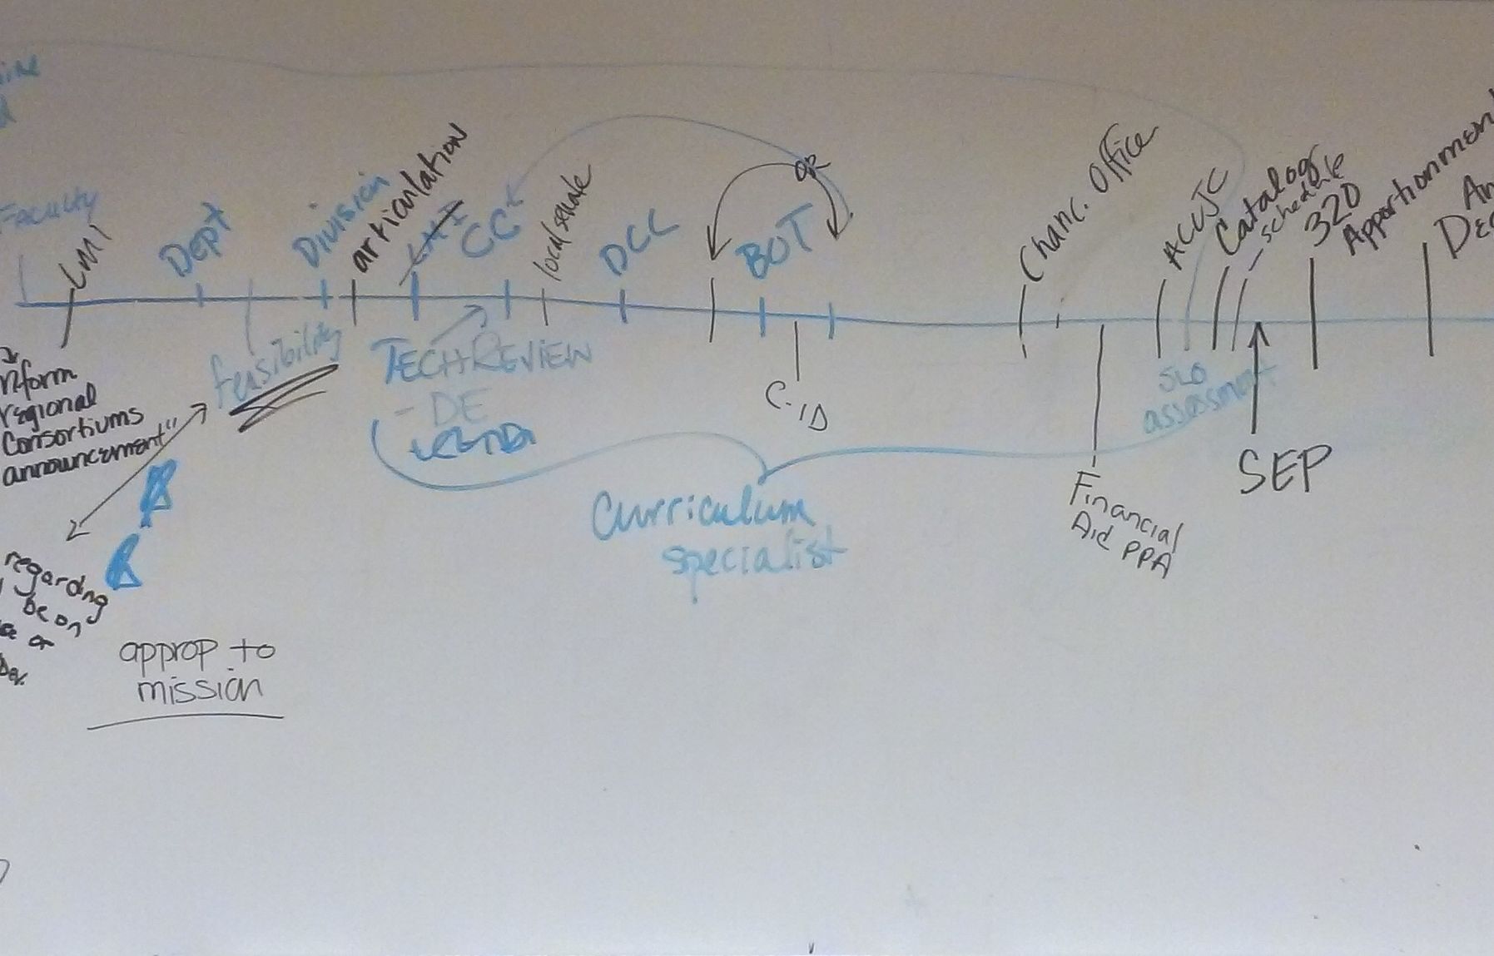
Statewide Curriculum Workgroup

Slide 17
Statewide Curriculum Workgroup
Local Processes
ASCCC Regional Workshops
Plan to roll out in December through winter/early spring
CCCCO Processes
What are legal obligations?
Changes on standalone and other approvals
Outside entities

Slide 18
Questions and Thank You!
Dolores Davison (davisondolores@foothill.edu)
Jackie Escajeda (jescajeda@CCCCO.edu)‎

