Slide 1
Reimagining our Model to Improve Student Completion: The Guided Pathways Approach
Dr. Darla M. Cooper
Director, Research and Evaluation
The RP Group
ASCCC Instructional Design and Innovation Institute
March 2017

Slide 2
Acknowledgements
This presentation includes content developed by:
Dr. Davis Jenkins (CCRC)
Dr. Rob Johnstone (NCII)
AACC Pathways Project
CA Guided Pathways Project

Slide 3
Building Urgency and the Case for Change

Slide 4
Lost in a Maze
4

Slide 5
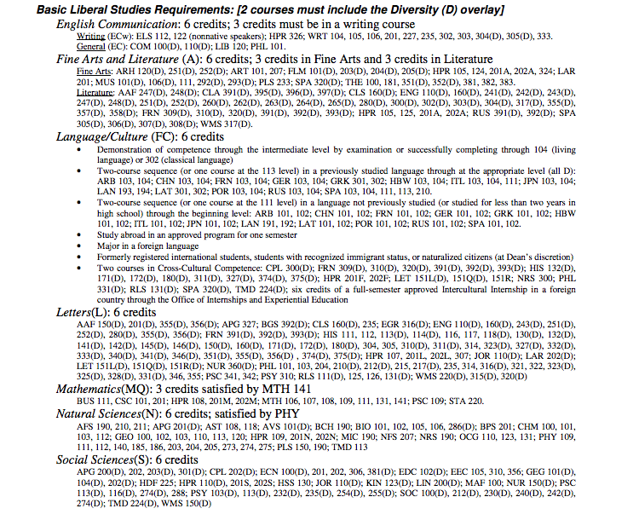
GENERAL EDUCATION REQUIREMENTS (Select 12 courses from this list of more than 300)

Slide 6
New Students Want to Know
What are my career options?
What are the education paths to those careers?
What will I need to take?
How long will it take and how much will it cost?
How much financial aid can I get?
Will my credits transfer?
6

Slide 7
Returning Students Ask
How far along am I toward completing my program? How much more will I have to pay?
What will I need to take next term and what will my scheduled be?
What if I want to change programs?
Will my credits transfer?
How can I get work experience in my field of interest?
7

Slide 8
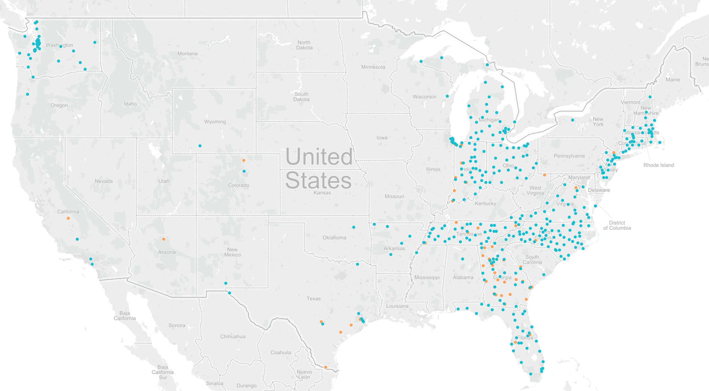
A National Movement
8

Slide 9
Defining the Pathways Model

Slide 10
What Is the “Pathways Model?”
An integrated, institution-wide approach to student success based on intentionally designed, clear, coherent and structured educational experiences, informed by available evidence, that guide each student effectively and efficiently from her/his point of entry through to attainment of high-quality postsecondary credentials and careers with value in the labor market.

Slide 11
11

Slide 12
Four Essential Practices of Pathways
Clarify paths to student end goals
Help students get on a pathway
Help students stay on path
Ensure that students are learning

Slide 13
Clarify Paths to Student End Goals: What Does It Look Like?
Features:
Detailed information on target career and transfer outcomes
Course sequences, critical courses, embedded credentials, and progress milestones
Math and other core coursework aligned to each program of study

Slide 14
Help Students Get on a Pathway: What Does It Look Like?
Features:
First-year experiences to help students explore the field and choose a major
Full program plans based on required career/college exploration
Contextualized, integrated academic support to help students pass program gateway courses
K-12 partnerships focused on career/college program exploration

Slide 15
Help Students Stay On Path: What Does It Look Like?
Features:
Ongoing, intrusive advising
Systems for students to easily track their progress
Systems/procedures to identify students at risk and provide needed supports
A structure to redirect students who are not progressing in a program to a more viable path

Slide 16
Ensure That Students Are Learning: What Does It Look Like?
Features:
Program-specific learning outcomes
Project-based, collaborative learning
Applied learning experience
Faculty-led improvement of teaching practices
Systems/procedures for the college and students to track mastery of learning outcomes

Slide 17
Six Success Factors

Slide 18
Six Success Factors
Directed: Students have a goal and know how to achieve it
Focused: Students stay on track—keeping their eyes on the prize
Nurtured: Students feel somebody wants them to succeed as a student and helps them succeed

Slide 19
Six Success Factors (cont.)
Connected: Students feel they are part of the college community
Engaged: Students actively listen and participate in class and are involved in extracurricular activities
Valued: Students’ skills, talents, abilities and experiences are recognized; they have opportunities to contribute on campus and feel their contributions are appreciated

Slide 20
Crosswalk: Success Factors and Guided Pathways
Clarify paths to student end goals
Directed
Help students choose and enter a pathway
Directed, Focused, Connected, Nurtured, Engaged
Help students stay on path
Directed, Focused, Connected, Nurtured
Ensure that students are learning
Directed, Focused, Engaged, Connected, Valued, Nurtured

Slide 21
Early Outcomes Data on Guided Pathways Reform
Tennessee Community College System

Slide 22
Community College Graduation Rates
1st yr - Did not attempt 9hrs in focus area
1st yr - Attempted 9hrs in focus area
1st yr - Earned 9hrs in focus area

Slide 23
Incoming Freshmen who successfully completed at least 9 hours in their focus
during their 1st Academic Year
56 % increase
123% increase

Slide 24
Demystifying Guided Pathways: Exploring Ten Commonly Asked Questions about Implementing Pathways

Slide 25
Demystifying Guided Pathways Paper By Rob Johnstone
Released in November 2015 by NCII
Companion to CCRC Pathways book
Designed to address questions NCII, CCRC, JFF, and Public Agenda have heard in hundreds of guided pathways sessions with faculty, student services professionals, and administrators
Not the defining word – just food for thought!

Slide 26
Top 10 FAQs – Redesigning for Completion
Q1 - Isn’t college a meritocracy, where the strong / smart succeed, and the weak / underprepared / unmotivated don’t succeed?
Model of higher education relatively unchanged
Notes:
Democratized access but didn’t change anything else

Slide 27
Top 10 FAQs – Redesigning for Completion
Q2 – Isn’t “free choice” the cornerstone of American higher education?
Behavioral economics and social psychology research on number of choices and rationality

Slide 28
Top 10 FAQs – Redesigning for Completion
Q3 – Won’t we sacrifice quality when we move to guided pathways?
Random assignment of GE package vs. “fit”
Notes:
Intelligent design, not random assignment
GE SLOs are what employers are looking for – not just AA grads it’s all college graduates at all levels

Slide 29
Top 10 FAQs – Redesigning for Completion
Q4 – Won’t we lose the heart of a liberal arts education when we make students’ journeys more structured?
Same number of humanities (or any other area) under guided pathways vs. cafeteria model
Notes:
Same requirements just put together into cohesive and customized and relevant package for students

Slide 30
Top 10 FAQs – Redesigning for Completion
Q5 – Won’t faculty lose control over what is taught in their discipline?
Ownership over what is taught in programs vs. individual courses
Notes:
May lose control of teaching what you want when you want
What do students need to take and when should we offer it
Dev ed math pathways decision is now focused on what math students need for their pathways and ultimate careers
Move from control of what is taught in discipline to control over what is taught in programs
Read paper response

Slide 31
Top 10 FAQs – Redesigning for Completion
Q6 – Won’t we lose enrollment at our college if we decrease swirl with increased structure or by making things mandatory?
Potential to increase units per student significantly
Notes:
Easier to drop out when not making progress
For every one that graduates with 95 units, there are 5 that don’t graduate at all
Enrollment management is about keeping ones you have and not getting new ones

Slide 32
Top 10 FAQs – Redesigning for Completion
Q7 – Isn’t all of this “hand-holding” going to create graduates that can’t navigate the workplace / real world?
Value of systems that those who work in higher education have trouble navigating

Slide 33
Top 10 FAQs – Redesigning for Completion
Q8 – Don’t students benefit when they “find themselves” by what looks like wandering to an observer?
Works for some who can afford to – not as often for low-income students and FTIC
Notes:
Student support redefined students didn’t say they want to wander, directed and focused were prioritized
Guided exploration, process of elimination to isolate what like and don’t like
Get students into careers instead of jobs

Slide 34
Top 10 FAQs – Redesigning for Completion
Q9 – How can students be expected to make career decisions at age 18?
Q10 – Don’t students change careers 4 to 7 times – why then guided pathways?
Guided pathways can focus attention on GE skills that will help students navigate careers and career changes
Notes:
Get students into careers, GE is important to supporting flexibility to change careers
Need to get into first career
Careful not tracking students into low income careers, historically done that, there are ways to avoid
Bridge programs to get college ready

Slide 35
Example of College Redesigning for Completion
Broward College

Slide 36
36

Slide 37
The AACC and CA Pathways Initiatives

Slide 38
AACC Pathways Project
National project focused on building capacity for community colleges to design and implement structured academic and career pathways for all of their students
30 community colleges from across the country will send teams to attend the six institutes in 2016-2018, where each institute focuses on a critical aspect of institutional change and pathway design/implementation

Slide 39
CA Guided Pathways Project
Will help 15-20 California community colleges implement an integrated, institution-wide approach to student success by creating structured educational experiences that support each student from point of entry to attainment of high-quality postsecondary credentials and careers
Following institute model of AACC Pathways Project
Applications were due February 28
NOT the same as the Pathways line item in Governor’s January budget

Slide 40
Final Thoughts

Slide 41
So What Does All This Mean?
You’re already doing a lot of work in the four essential pathways pillars and six success factors!
Pathways is not another initiative or project, it’s a comprehensive approach or framework that can bring disparate, disconnected efforts together into a coherence and cohesiveness
Need to explore how to build curricular and extracurricular pathways through the institution with students’ end goal in mind

Slide 42
Questions to Think About
Are students able to make informed decisions about what to study and how that decision links to their future goals?
Are we adequately preparing students to be successful after they leave us?
What pathways essential practices or six success factors may be missing from or could be strengthened at your college?

Slide 43
Conclusion
Guided pathways can be a strong lever for helping more students complete college and enter the workforce to achieve family security, personal growth, and professional advancement.
Excitement about the next five years
Can envision a future where this movement transforms our system of higher education nationally and in California improving millions of lives

Slide 44
References
Guided Pathways Demystified
http://www.inquiry2improvement.com/publications-resources
AACC Pathways Project
http://www.aacc.nche.edu/Resources/aaccprograms/pathways/Pages/default.aspx
CA Guided Pathways Project
https://www.caguidedpathways.org/

Slide 45
Q & A

Slide 46
Thank You!

