Slide 1
Promoting Culture Change at the Local Level: Faculty Diversity
ASCCC SPRING 2019 PLENARY
Silvester Henderson, ASCCC At-Large Representative Robert L. Stewart Jr., Los Angeles Southwest College LaTonya Parker, ASCCC South Representative

Slide 2
The Academic Senate for California Community Colleges is pleased to empower faculty at the local level with equitable practices to increase the diversity hiring of underrepresented minorities. This session will discuss achieving workplace diversity through relating job performance to skills and abilities of qualified candidates through intentional organizational practices. Join us for a session of deliberate dialogue of achieving common ground between faculty and administrators to align goals for diversification practical strategies with three practitioners dedicated to address potential institutional barriers to equal employment opportunities.
Presenters:
Silvester Henderson, ASCCC At-Large Representative
Robert L. Stewart Jr., Los Angeles Southwest College
LaTonya Parker, ASCCC South Representative

Slide 3
TODAY’S AGENDA: -Welcome and Introductions -Workforce Diversity Defined -Faculty Diversity (FD) Discussion -FD Moving From an Organization Value to Practice Through Institutional Strategies
Equitable (Ethnic and Racial Diversity) Approaches to Increase Student Success

Slide 4
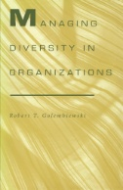
“Workforce diversity means a workforce made up of people with different human qualities or who belong.”
Golembiewski, R. T. (1995). Managing diversity in organizations. Tuscaloosa, Ala: University of Alabama Press.
http://www.worldcat.org/oclc/44956061

Slide 5
Why is it Important for Faculty and Administrators to Dialogue and Align Goals to Hire for Diversity? Pair & Share Activity

Slide 6
Educational Benefits of Faculty Diversity
According to the California Community Colleges Chancellor’s Office 2016 Equal Opportunity Employment & Diversity Best Practices Handbook there has been an increase in underrepresented students in California community colleges in recent years.
Data shows that the student population in the community colleges has become increasingly more diverse, whereas all ranks of the workforce have not reflected this increase in diversity. According to data submitted by the districts, for the past 10 years, approximately 20 percent of full-time faculty members are from underrepresented communities.
See chart in next slide:
6

Slide 7
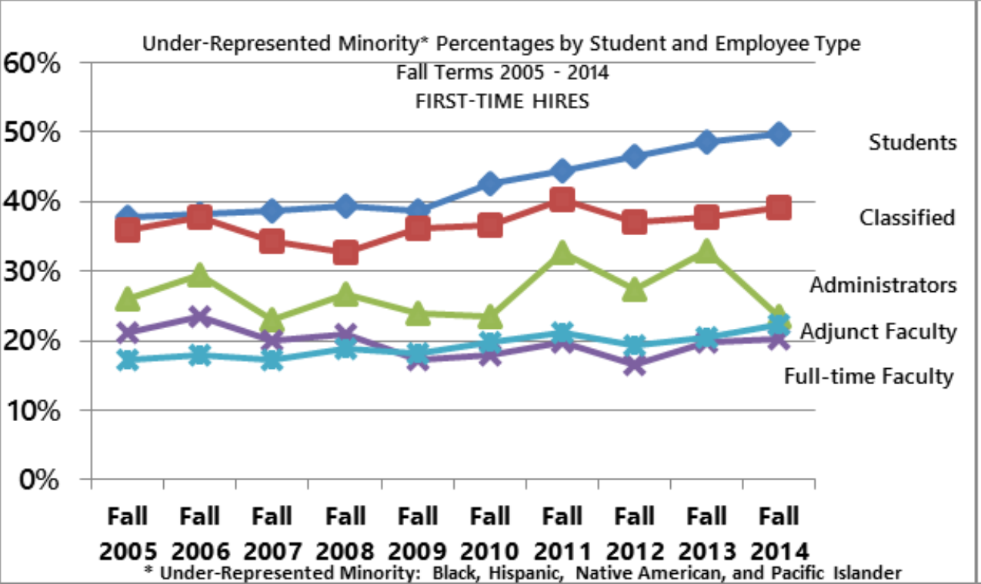
Under-Represented Minority Percentages by Student and Employee Type

Slide 8
What are Best Collaboration Practices for Faculty and Administrators to Hire for Diversity?
8

Slide 9
Achieving Common Ground Through Developing and Maintaining Institutional Commitment to Faculty Diversity
Putting the Institution Under a Microscope
Has your organization reviewed the current hiring processes?
Does your organization make available under-represented students and employees data?
Bring Awareness
Identify Potential Barriers
Communicate Challenges
Data Driven Decisions
Create an Achieving Common Ground Plan
Develop a Metric
Include the Students, Faculty, Staff and Administrators in the Communication Plan
Sustain Momentum
9

Slide 10
TAKEAWAY!
Collaborative strategies to increase diversity hiring to increase students’ success in California community colleges
10

Slide 11
THANK YOU
LaTonya Parker: latonya.parker@mvc.edu
Henderson, Silvester: SHenderson@losmedanos.edu
Robert L. Stewart Jr.,;
stewarrl@lasc.edu
Email
Academic Senate for California Community Colleges: submit inquiries to info@asccc.org

Slide 12
Resources:
https://asccc.org/sites/default/files/Hiring_Paper.pdf
https://californiacommunitycolleges.cccco.edu/Portals/0/Reports/2016-EEO-and-Diversity-Handbook-ADA.pdf

