Slide 1
Ujima: Looking Beyond Colonialistic Individualism
Towards a More Collaborative and Culturally
Responsive Model of Learning
Maria Figueroa, MiraCosta College
Manuel Velez, ASCCC South Representative

Slide 2
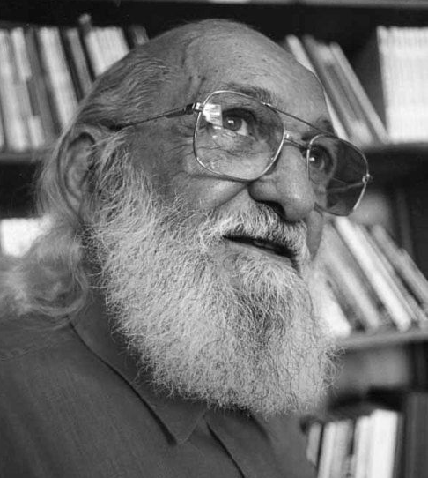
Welcome and Introduction to Session
In this session we’ll do the following:
Define colonialism and explore its history and legacy
Understand the role of colonialism in our current academic systems
Reflect collectively on how our own practices perpetuate the negative impacts of colonialism
Reimagine a classroom that engages the community it serves and works to “decolonize” education
To help facilitate our conversations, we’ll be using padlet during this session. You can access Padlet by clicking on the following link: https://padlet.com/ManuelJVelez/Ujima
There's no such thing as neutral education. Education either functions as an instrument to bring about conformity or freedom.

Slide 3
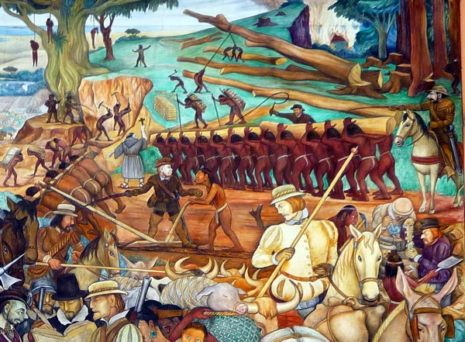
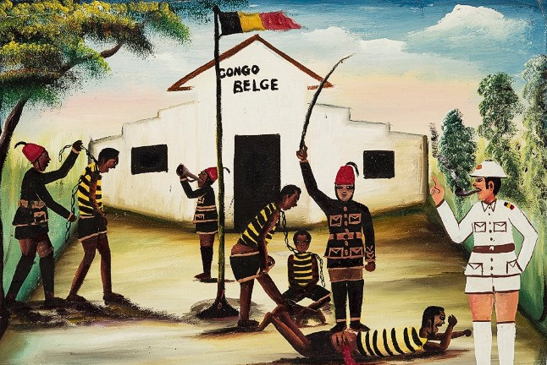
What is colonialism anyway and why does it matter?
Colonialism as a tool of conquest and control
Colonialism can be defined as a policy or system of control/power asserted by one group over another.
Historically, this manifested itself as nations dominating and controlling other nations in order to take and benefit from the resources of the colonizing nation.
Western Colonialism refers to a period (1760s - 1870s) whereby several European nations colonized large areas of the world including in Asia, Africa and the Americas.
Colonialism functions by replacing linguistic, cultural, religious, political, societal structures of the colonized with those of the colonizer in order to control the behaviors of the colonized.
Three main types of colonial structures: Traditional, Settler, and Neo-Colonialism
In the colonial context the settler only ends his work of breaking in the native when the latter admits loudly and intelligibly the supremacy of the white man's values.
― Frantz Fanon, The Wretched of the Earth

Slide 4
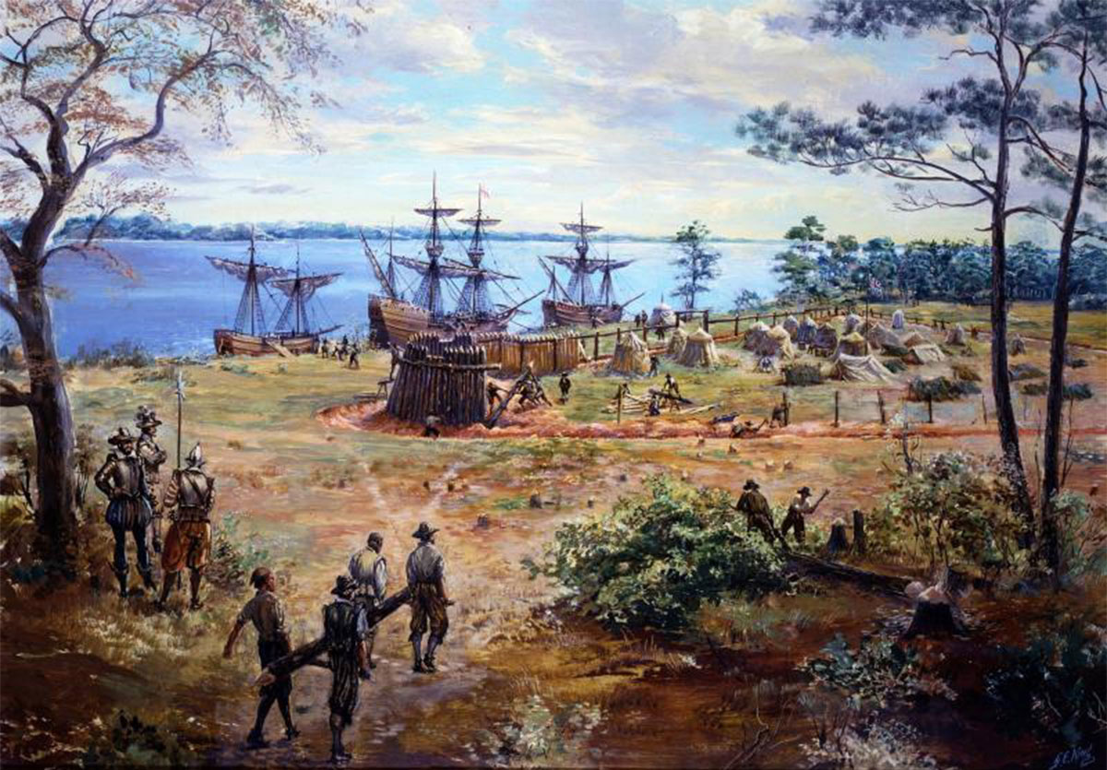
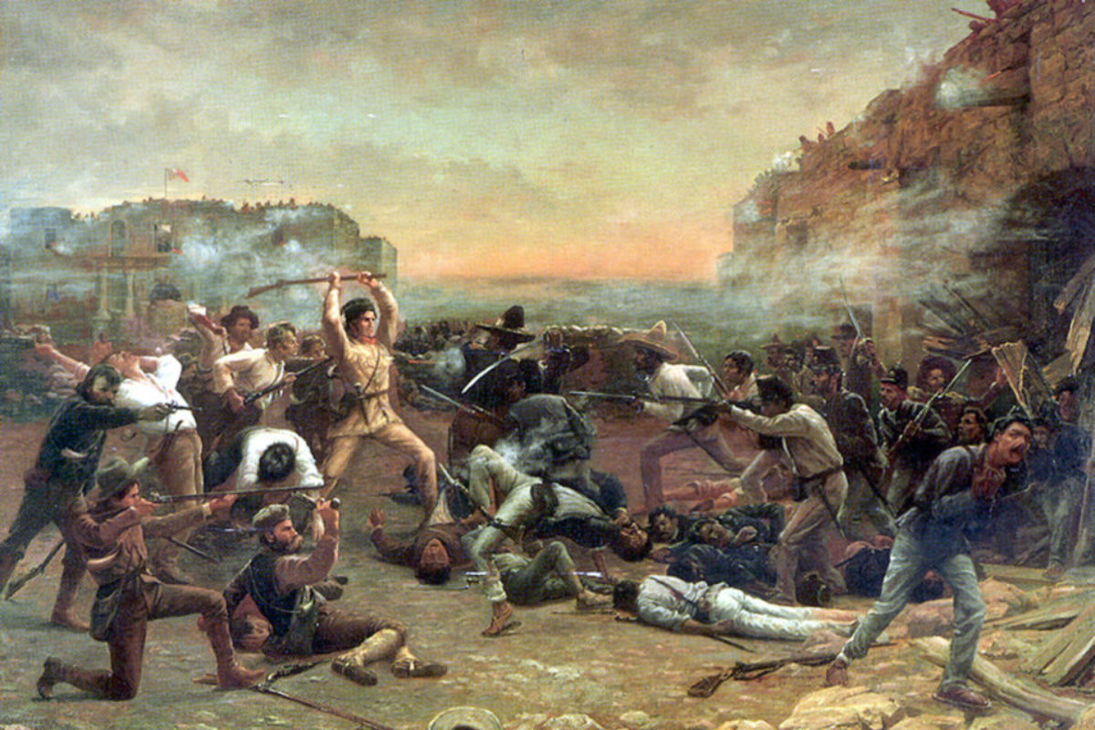
What is colonialism anyway and why does it matter?
Colonialism and Education
Because colonialism is a system to maintain dominance over a group of people, its primary tools become linguistic and cultural.
In the era of Western Colonialism where religion played a dominant role, literacy was taught to the colonized as a means of facilitating conversion to Christainity
As colonial states grew, education expanded in order to maintain control over a larger and growing colonized population.
In Settler Colonial nations, education was a way of establishing a sense of “placement” for the colonizer. For this reason, even when calling for political independence from their “home country”, the settler colonial nation still remains loyal to their linguistic and cultural structures.
Because the U.S. functions as both traditional and settler colonial powers, its educational system is designed to both create a sense of “eurocentric” placement that is different from the native cultures and to “indoctrinate” the colonized into the values of the colonial power.
Berlin of 1884 was effected through the sword and the bullet. But the night of the sword and the bullet was followed by the morning of the chalk and the blackboard…The bullet was the means of physical subjugation. Language was the means of spiritual subjugation.
— Ngugi Wa Thiong’o

Slide 5
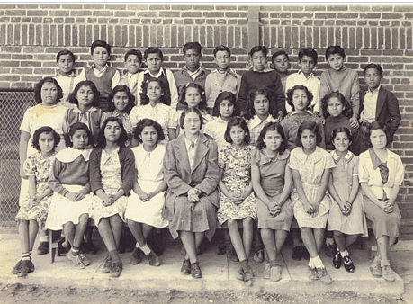
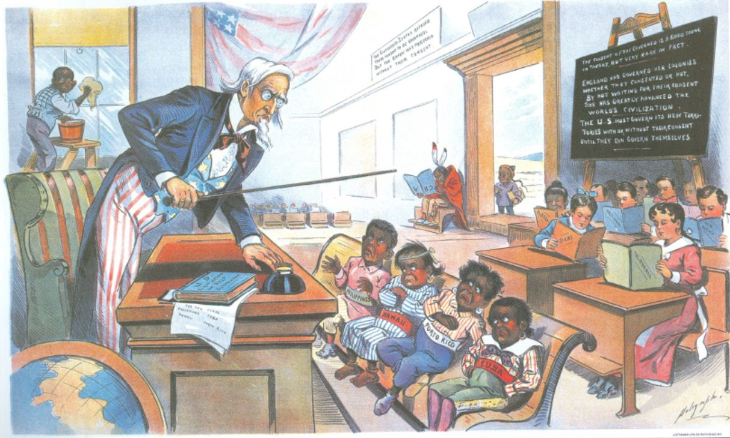
What is colonialism anyway and why does it matter?
The effects of colonialism on the classroom
While we can debate whether or not colonialism still exists or is a relic of the past, it’s clear that our educational system still relies very much on the colonial structures upon which it was founded. In U.S. classrooms, this reliance manifests itself in the following ways:
Segregation of students of color into “Americanization” schools
The absence of representations of communities of color in lesson plans
Reinforcement of negative stereotypes of students of color
Issues of self-esteem among students of color
A sense of not-belonging in the classroom
increased discipline issues
achievement gaps between white students and students of color
lack of responsiveness and connection to students of color in curriculum development
Every third-grade student in the United States is presented with the concept of Europeans discovering America as a "New World" with fertile soil, abundant gifts of nature, and glorious mountains and rivers. Only the most enlightened teachers will explain that this world certainly wasn't new to the millions of indigenous people who already lived here when Columbus arrived.”
-Wilma Mankiller

Slide 6
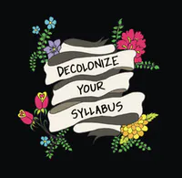
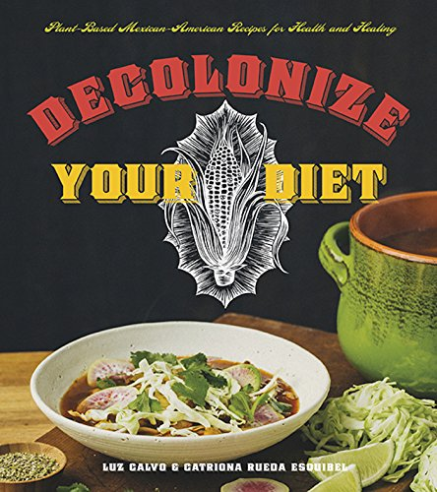
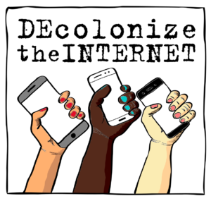
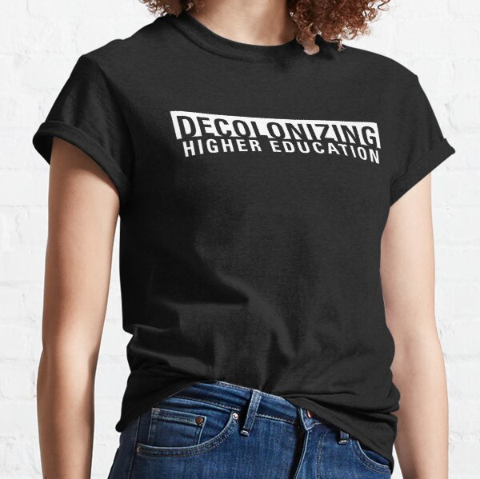
What is colonialism anyway and why does it matter?
The current discourse on colonialism
In the last several years discussion on colonization and how to address it has moved into the mainstream and become popular.
This discourse certainly is well intentioned and focuses on addressing colonialism through processes of “decolonization”
Scholars from various disciplines have published books focusing on the importance of decolonization.
Unfortunately, as with all theories that enter into the mainstream, the direction of the discourse tends to move in a way that may not directly address colonization at all or addresses it only superficially.
Because colonialism is embedded in the foundation of our society truly “decolonizing” society requires a reimagination and transformation of it wholly.
Those of us who have been forged in the crucibles of difference - those of us who are poor, who are lesbians, who are black, who are older - know that survival is not an academic skill...For the master's tools will not dismantle the master's house. They will never allow us to bring about genuine change.
― Audre Lorde

Slide 7
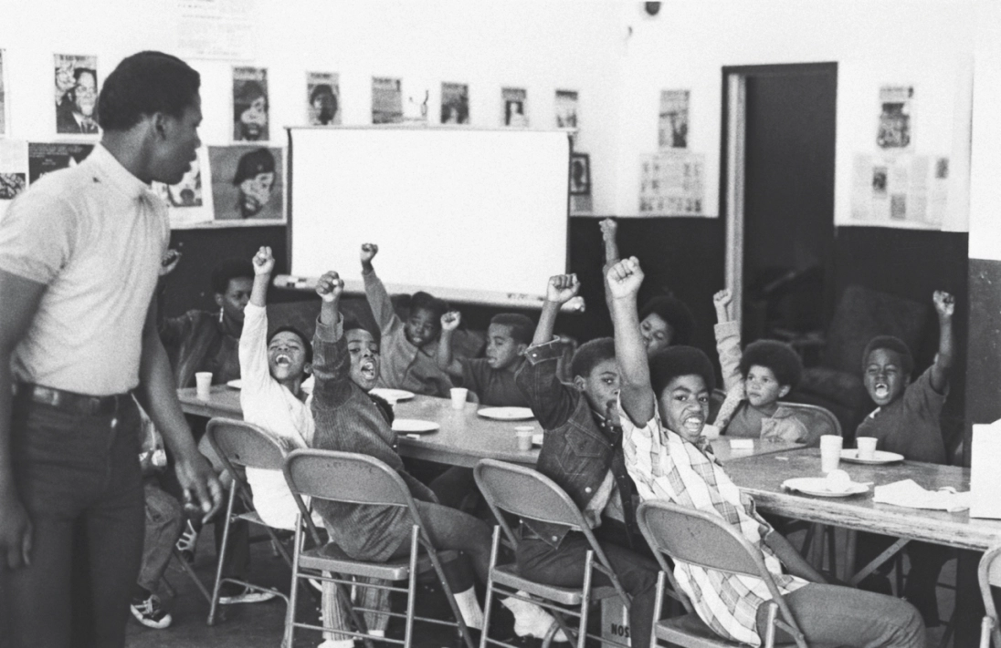
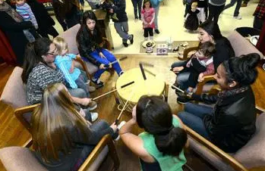
Reimagining and Transforming your Classroom
As individuals we may not be capable of truly addressing the impacts of colonialism in our society, however as instructors we can take the same concepts of decolonization and use them to envision a new learning environment that centers on the communities of the students present within.
Reimagining can include a transformation of lesson plans and curriculum to become more inclusive and to teach community empowerment
Transformation also includes transformation of the self to become more conscious of colonial structures and of their role in relation to students
To empower people from marginalized groups means to disrupt the current balance of power, something the powerful invariably resist. Politically conscious teachers prepare themselves and their students to confront, resist, and withstand such a backlash.
-Standing Committee on Global Citizenship

Slide 8
Roundtable Discussion #1:
Reflecting on our own pedagogies
Now that we have a better understanding of colonialism and its impact on our classrooms, let’s take a moment to reflect on our own pedagogical approaches. Use the link below to access our padlet and post a response to the following prompt:
Choose one element of your pedagogical or instructional approach (lesson plans, attendance policy, syllabus, technology, lecture style) and in a brief statement tell us how that approach may inadvertently perpetuate the negative impacts of colonialism.
Post your response by clicking on this link: https://padlet.com/ManuelJVelez/Ujima

Slide 9
Roundtable Discussion #2:
Reimagining our own pedagogies
Please share with us any practices or approaches you already utilize in your classrooms as a way of transforming them to more inclusive and empowering spaces. If you don’t currently use any of these approaches, which of your current practices would you transform to be more inclusive and empowering?
Post your response by clicking on this link: https://padlet.com/ManuelJVelez/Ujima

Slide 10
Thank You!
Resources for more information
Website: Decolonizing the Classroom: Step 1 From the NCTE Standing Committee on Global Citizenship
Curry, Stephanie and Manuel Velez “Academic Freedom and Equity” Rostrum (Nov. 2020 ASCCC: pg 24-8
Guerrero, Luis and Hassna Sadat-Ahadi “Decolonizing Your Syllabus: An Anti-Racist Guide for Your College” Rostrum (Nov. 2020) ASCCC: pgs. 42-8
Fanon, Frantz. The Wretched of the Earth. New York: Grove Press
Freire, Paulo. Pedagogy of the Opressed. New York: Bloomsbury, 2000
Video: Adichie, Chimamanda Ngozi. “The danger of a single story” TedTalk: 7 Oct. 2009

