Slide 1
Through the Gate:
Examining Factors That Impact Whether Students Achieve Transfer or Get Stuck Near or At the Gate
ASCCC Spring Plenary
April 11, 2019
Darla Cooper, EdD
Executive Director

Slide 2
The RP Group www.rpgroup.org
Mission
Strengthen CCCs’ ability to gather, analyze, and act on information in order to enhance student equity and success
Services
Research, evaluation, planning, professional development, and technical assistance—designed and conducted by CCC practitioners
Organization
501(c)3 with roots as membership organization

Slide 3
College Futures Foundation www.collegefutures.org
Vision
More graduates for a thriving California
Mission
Removing barriers so more low-income and underrepresented students attain bachelor’s degrees
Funder
Partner
Connector

Slide 4
Today’s Presentation Outcomes
Participants will…
Recognize the existence of a student population who are completing all or most of their transfer requirements, but not advancing to the university.
Learn what factors influence whether students transfer or stop at or near the transfer gate, and how these factors differ by region and student sub-group.
Understand what colleges can do to identify these students on their own campus and how to support their transfer journey.
Know next steps in this research that will inform practitioners and policymakers on how to address practices and policies hindering students’ transition to a university.

Slide 5
Today’s Presentation Outline
Through the Gate Study Recap
Examining Factors Determining whether Students Achieve Transfer or Get Stuck At or Near the Gate
Getting Better Directions: Phase II
Transfer Decision-Making Framework

Slide 6
Through the Gate Transfer Study
A Fresh Take on the Transfer Challenge

Slide 7
Through the Gate Aims to…
Identify individuals who have completed all or most of their transfer requirements, but who do not make it “through the gate” to university
Identify strategies for increasing transfer, boosting baccalaureate production, and enhancing students’ social and economic mobility--especially for underrepresented populations

Slide 8
Research Approach
Phase I:
Mapping the Transfer Landscape
Quantitative research to better understand the transfer landscape focusing on students who met all or most of their requirements but have not transferred
Phase II:
Getting Better Directions
Mixed-methods research to understand what factors impact these students’ journeys and how policy and practice might change to propel them through the gate

Slide 9
A Fresh Take on the Transfer Continuum

Slide 10
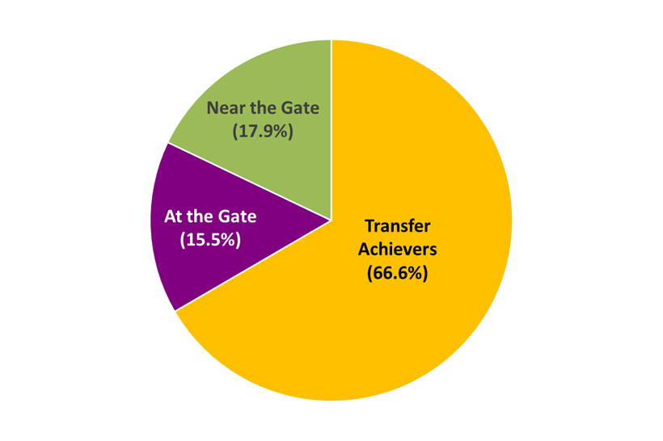
Study Sample
875,630 CCC students
Enrolled between 2010-2011 and 2014-2015
Outcomes through spring 2016
Three subgroups:
Transfer Achievers (583,074)
Students At the Gate (135,557)
Students Near the Gate (156,999)

Slide 11
Phase I Key Findings
Transfer Achievers
Majority transferred without a degree or certificate (68.5%, n=399,635)
75% of African American students achieve transfer
Students At the Gate
Over half of transfer-ready students left without a degree or credential
Latino students most likely to earn an AD-T but halt their transfer journey
Students Near the Gate
92% needed to complete transfer math requirements
Nearly half exited the system without a degree or credential
Time is the enemy; students who did not transfer within a year of becoming transfer-ready were less likely to transition to university

Slide 12
Group Discussion
How can the transfer continuum at your college help inform your:
Vision for Success Goals (local goal setting)?
Guided Pathways development?
Student Equity and Achievement planning?

Slide 13
Examining Factors Determining Whether Students Achieve Transfer or Get Stuck At or Near the Gate

Slide 14
Purpose
Further understand the connection between student and college factors and the odds of remaining near or at the gate rather than achieving transfer.

Slide 15
Methodology: Multinomial Logistic Regression
Predictor Variables
Outcome Variable
Demographic: Race/ethnicity [White]
Female
Age
Special Populations: Veteran
EOP&S
DSPS
Limited English Proficiency (LEP)
First Generation
Academic: Educational goal of transfer
Cumulative GPA
AA/AS Degree Attainment
Region: Region [San Diego]
Admissions rate at CSU campuses
# of AD-Ts offered per CCC
FTES
Higher education density
Miles to the nearest CSU/UC
At the Gate
Student Factors
Transferred
Near the Gate
College
Factors

Slide 16
Shared Factors for Near and At the Gate
Demographic
Special Populations
Academic
Region
(Higher) Age
Hispanic
Any Disability
First Gen
Limited Engl Proficiency
EOP&S
Transfer Educational Goal
AA/AS Attainment
Central Valley
Near the Gate:
Native American
At the Gate:
Asian
At the Gate:
Inland Empire
SF Bay Area

Slide 17
Factors for Transfer Achievers
Characteristics of students more likely to transfer than to be At or Near the Gate:
Higher GPAs (near the gate)
Females (at the gate)
Veterans
African Americans

Slide 18
Key Takeaways
Difficult to truly nail down which students (based on quantitative data) are truly transfer-seeking
Challenges current assumptions about which student groups are more likely to transfer, and where our intervention points are located along their transfer path
Need to learn from students themselves about what impacts their transfer progress and how to improve their success

Slide 19
Transfer Decision-Making Framework
Student Factors
College Factors
Academic (e.g., GPA, transfer units completed)
Transfer Support (e.g., robustness of Transfer Center)
Demographics (e.g., gender, race/ethnicity)
Culture (e.g., intersegmental alignment, messaging)
Psychological (e.g., confidence, fear of unknown)
Policy (e.g., # of AD-Ts available)
Sociocultural (e.g., family expectations)
Regional (e.g., proximity to university, population density)
Financial (e.g., college affordability)

Slide 20
Group Discussion
What about this framework resonates with you?
What, if any, factors/concepts are missing/ unclear/unnecessary?

Slide 21
Getting Better Directions
Phase II Research

Slide 22
Phase II Research Questions
Why do so many students who are close to achieving their transfer goal stop short of making this transition?
What can we do to help students who are at or near the gate transfer?
What is holding back different student groups, and how can we help them continue their journey?
What is impacting IE and CV students’ transfer progress, and what strategies can be pursued to increase their success?

Slide 23
Phase II Methodology
Study Sample:
31 CCCs with statewide regional representation
Near and At the Gate students still enrolled and exited
Online Student Survey:
Exploration of obstacles that prevented or dissuaded students from transferring, and the supports that could bring them back onto the transfer path
Telephone Interviews:
In-depth look at students’ non-transfer stories – what barriers emerged and how they faced them, what drove their decision-making at various exit points

Slide 24
In the Meantime, Colleges Can...
Figure out who these students are at your college
Identify how many students are at or near the gate
Analyze to see if certain student groups are more likely to be at or near the gate
Reach out to these students to explore barriers and identify needs
Develop plans to help address emerging barriers and needs

Slide 25
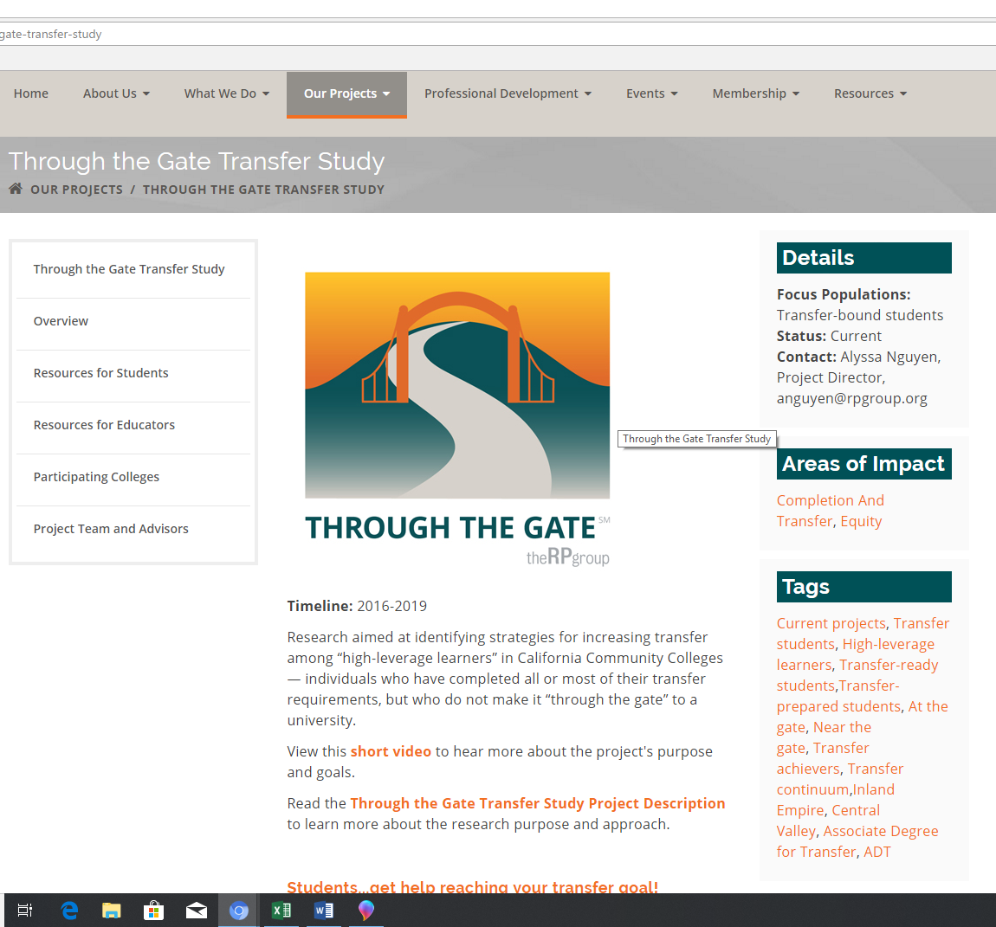

Slide 26
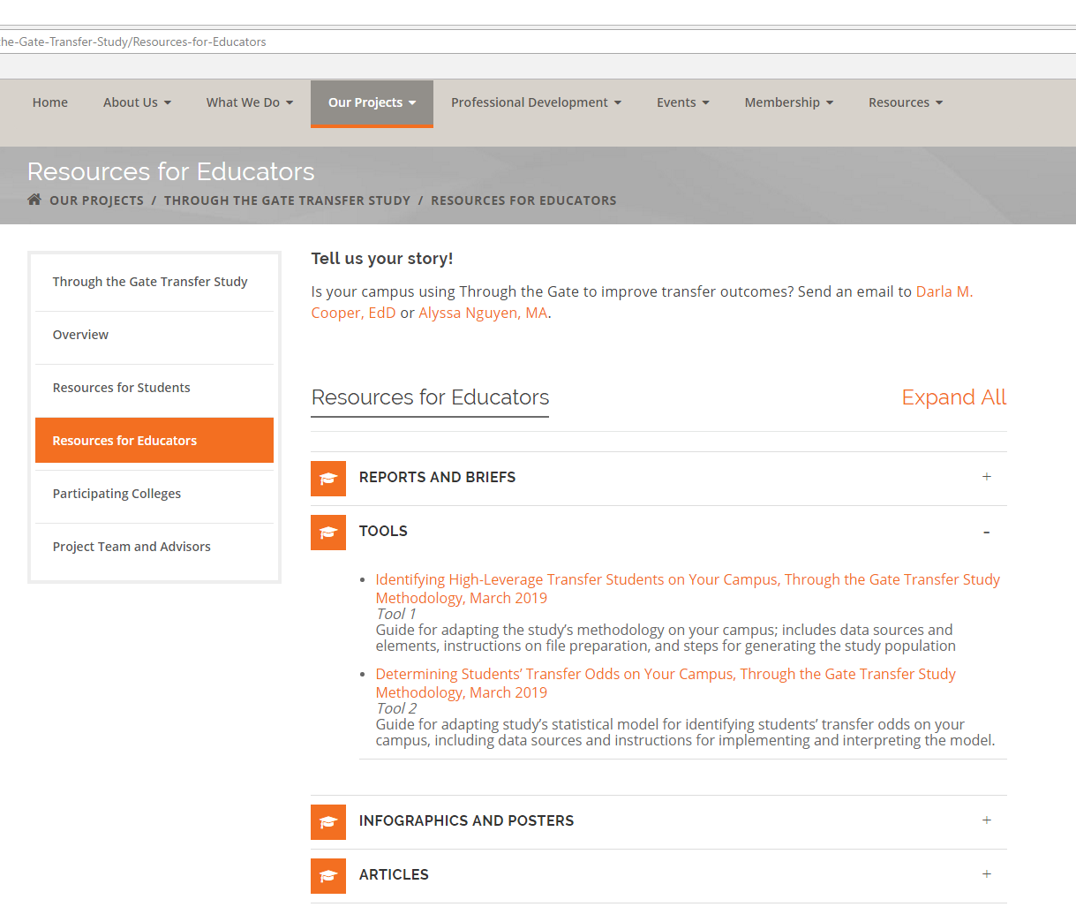

Slide 27
For more information on the Through the Gate Study
Project Directors:
Dr. Darla Cooper
dcooper@rpgroup.org
Alyssa Nguyen
anguyen@rpgroup.org
www.rpgroup.org/through-the-gate
#StudentsThroughtheGate

Slide 28
Questions?

Slide 29
Thank you!

