Slide 1
Engaging in Student Centered Instruction
Fenyx – ASCCC Part Time Committee Member
Sam Foster, PhD, ASCCC Area D Representative
Part Time Faculty Institute
The Westin San Francisco Airport
August 2-4, 2018
,

Slide 2
Presentation Highlights
Welcome to an interactive presentation and an open dialog about engaging students. Faculty will leave knowing diverse methods of inclusion from group work to technological application.
What is meant by ‘Student Centered, Engagement, and Inclusivity’?
Lead by example, creating an Inclusive Environment
How does Identity influence our classrooms?
How to engage in Hands-on Learning?
Assessment- equitable measurement
Questions and comments

Slide 3
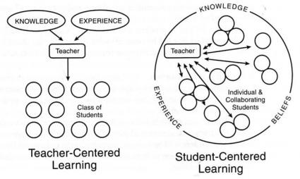
Definitions
Student Center: focus on students’ needs and participation
Engagement: students interact with the curriculum (via peers, experts, and technology) in and outside of the classroom
Inclusive: appreciation of students’ values, culture, and experience to maximize strengths and improve limitations

Slide 4
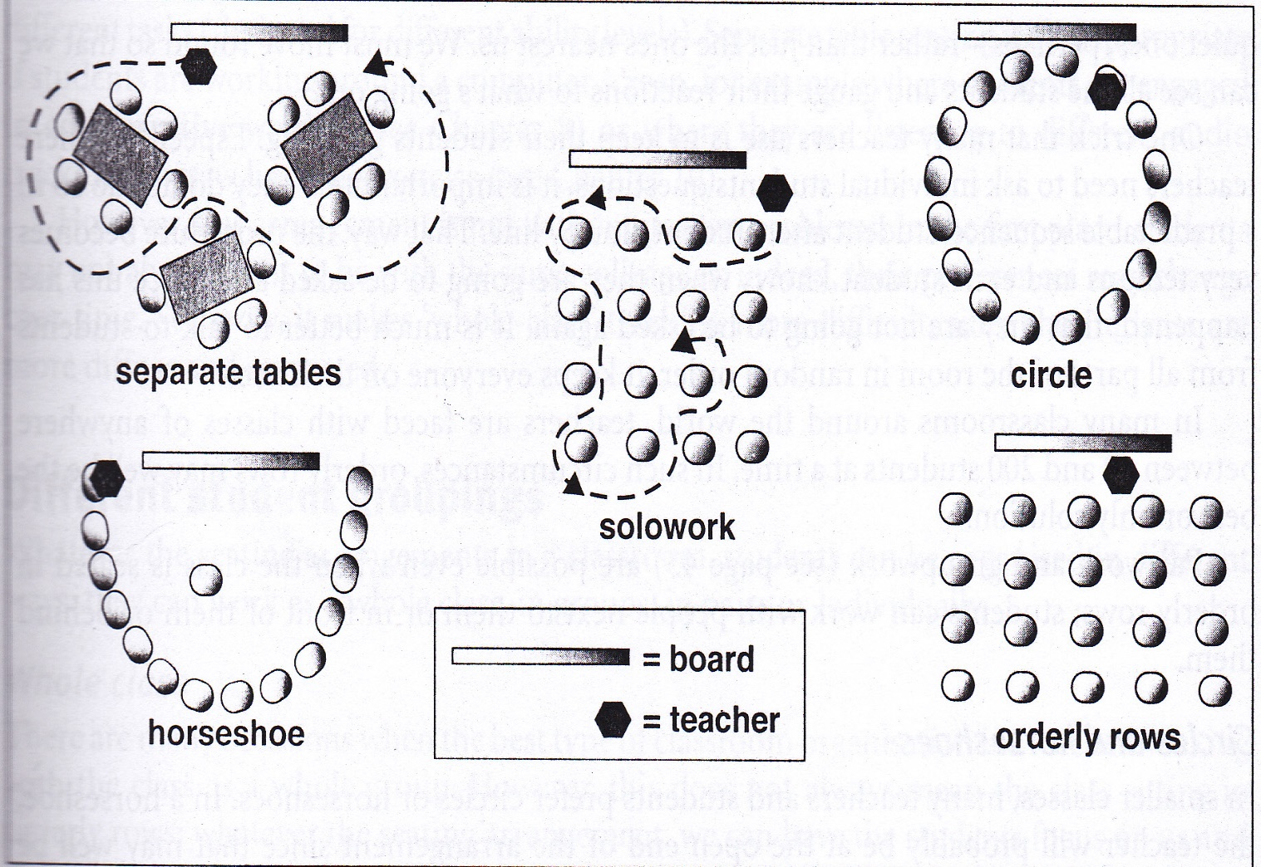
Inclusive Environment
Music, videos, quotes, or speeches
Holiday carols, Disney, MLK, MJ
Strategic sitting placement
Circle up, grouping, vs rows
Index Cards
Registered name vs preferred name
Necessary info
Participation
Small group to large group suggestions?

Slide 5
Identity Influences the Learning Process
Learners
kinesthetic
Visual
Audio
Reading/ writing
Personality
Introverts
Extroverts
Conscientiousness
Agreeableness v Aggression
Culture: learned behavior, values, beliefs, and symbols.
Ethnicity
Gender
Sexuality
Religion
Country
Citizenship
Is there others to consider?

Slide 6
Hands-on Learning: Discussions > Lectures
Assignments
Strategic Lecturing-consider timing
(7-10 minutes*)
Group work vs Pairing
Pair and Share exercise
Note taking
Hand-outs vs Power Point
Filling the blank lectures
Read and explain
External information
Review and rewind
Technology
Canvas- clear grading scales, discussion groups, Hallway conversations, low-stack testing online
Polling aps and controllers
Google and researching during class assignments
Board games and cards
Timelines, whiteboards
Textbooks and supplemental programs

Slide 7
Assessment of Student Engagement
How to equitably measure SLOs?
Goals:
Student centered
Inclusive of their identity: learning style, personality, and culture
Value engagement
Assign value to our goals via points and percentages:
How do you weigh your assignments?
Is your method reliable?
Low-stake preparation
Syllabus quiz
Letter to the expert
Assign points to:
Office hour visits
Classroom participation
Reading notes
Writing center
Worth of a point #weight
Extra credit
Test v quizzes
assignments

Slide 8
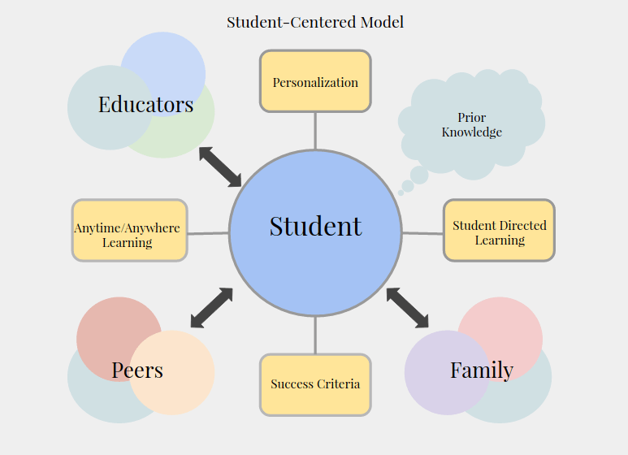
Questions & Comments
Please feel free to contact each of us for more information.
Fenyx xfenyx777@gmail.com
(208) 252-1852.
Sam Foster, Ph.D.
SFoster@fullcoll.edu
714-992-7439

