Slide 1
COMPETENCY BASED EDUCATION​ MAY 1, 2021​ 2:00-3:00PM​

Slide 2
Presenter Introductions
Cheryl Aschenbach, ASCCC Executive Member
Christie Dam, ASCCC-CTELC Member
Jess Guerra, Career Ladders Project
Sonia Ortega, Mt. San Antonio College

Slide 3
Importance of CBE
As the California community colleges continue with innovative strategies in support of student learning, Competency Based Education is one mechanism for students to demonstrate their learning, understanding, and application of necessary knowledge and skills. CBE can be utilized to design learning within courses and programs regardless of whether colleges participate in the Chancellor's Office CBE Collaborative.
This session is intended to share practices for utilizing CBE to facilitate student success within students' academic journeys. Presenters will discuss how CBE has been used in programs within the Career Ladders Project and how community colleges are integrating CBE into Career Technical Education curriculum.

Slide 4
Session Agenda
Statewide CBE Perspective
The local perspective & implementation of CBE
Noncredit implementation of CBE to CTE programs
CBE Processes
CBE in Career Ladders Project
CBE development
Share Out of Best Practices on your campus
Q & A
Resources

Slide 5
Why CBE – Statewide Perspective
CBE Collaborative
Local Examples

Slide 6
Direct Assessment CBE
Instruction not based on academic terms or credit hours
Both the evaluation of student achievement and the award of a degree or credential are based solely on the demonstration of competencies
Students proceed at their own pace rather than progressing through courses in a traditional academic term timeline
Conventional grades are not necessarily assigned; mastery is recorded
Students are expected to demonstrate the competency at a high level of achievement (mastery)
Establishes “credit-hour equivalencies” between CBE competencies and traditional course student learning outcomes to facilitate transfer

Slide 7
Why CBE?
Notes:
millions of Californians who have some college but no degree, minoritized students are over-represented in this population

Slide 8
Why CBE?
Competing Priorities for Learners
Family
Employment
Community Commitments
Unique Needs of Adult Learners
Need flexibility
Education now, not next term
Varied schedules
Progress at own pace
Need improved wages or job prospects
Need accessible and responsive support
Need more control over educational progress
Need relevant coursework
Increased Wage Gains for Degrees

Slide 9
CBE Regulations and Collaborative
CBE Regulations Framework & Guiding Principles
Student learning & equity as central to design
Intentional, transparent, meaningful competencies
Design for students – anytime, anywhere learning
Culturally responsive pedagogy
Equity-minded data collection and evaluation
Direct assessment CBE
Fully or partially online
Alternative Instructional Methodologies in Title 5
Separate program approval process
CBE Collarative:
Colleges working together to implement DA CBE as early adopters
Goals:
Establish a Direct Assessment CBE collaborative of early implementer colleges
Provide funding and implementation support to participating colleges
Create a blueprint (roadmap) for implementation of programs system-wide
Evaluate the implementation process and early student outcomes

Slide 10
CBE & Noncredit ESL
Notes:
Change image to make it match with ESL

Slide 11
We’re Doing “CBE,” Not CBE
CBE, as defined by the chancellor’s office, is currently not an option for noncredit.
Classes are reported as asynchronous noncredit DE.
We’re working with CBE on a course level, not the program level.

Slide 12
Attendance Collection
Currently using the Alternative Attendance Accounting Method and Noncredit DE formula for the course
As long as the student is progressing with coursework, completing assignments, and maintaining contact with faculty, they stay registered in the class.
Continuous engagement with students by faculty to keep students moving forward for purposes of using this attendance method.
Not currently using it for open-entry/open-exit courses

Slide 13
CBE Elements That Fit With Noncredit
Courses focus on demonstration of mastering skills rather than earning grades
Flexibility in completing competencies for working adults, parents, or those without transportation
With this kind of flexible online course, students have access not previously available

Slide 14
CBE Elements That Fit With Noncredit
Students can repeat noncredit courses.
They’re assigned a grade of Satisfactory Progress (SP) if they did not show mastery of the class or missed some of the modules or content.

Slide 15
Online Options for Students
Student schedules have been upended by the pandemic.
Uncertainties with work, K12 education, and childcare mean students need more flexible educational opportunities.

Slide 16
CBE ESL Classes
We’re offering three “CBE” classes in the ESL department:
Reading C
ESU Health
TOEFL
All of these classes are for advanced-level ESL students.

Slide 17
Reading C
Competencies are based on the course measurable objectives
Course design followed principles of backward design
Identify CMOs
Map CMOs to course modules
Determine assessments to measure student mastery
Develop practice activities
Create presentation materials

Slide 18
Module 1: Introduction
Assessment: Class preparedness
Module 2: Pre-Reading
Assessment: Evaluate textual elements
Module 3: Main Ideas
Assessment: Identify main ideas & details
Module 4: Vocabulary
Assessment: Context clues & vocabulary notebook
Module 5: Restating Main Ideas
Assessment: Accurately restate main ideas
Module 6: Summarizing
Assessment: Write a one-paragraph summary
Module 7: Review
Assessment: Skimming, vocabulary, writing the main idea, summarizing
All class readings are related to a central theme:
Fall 2020: The American Experience
Spring 2021: Relationships
Fall 2021: The Environment

Slide 19
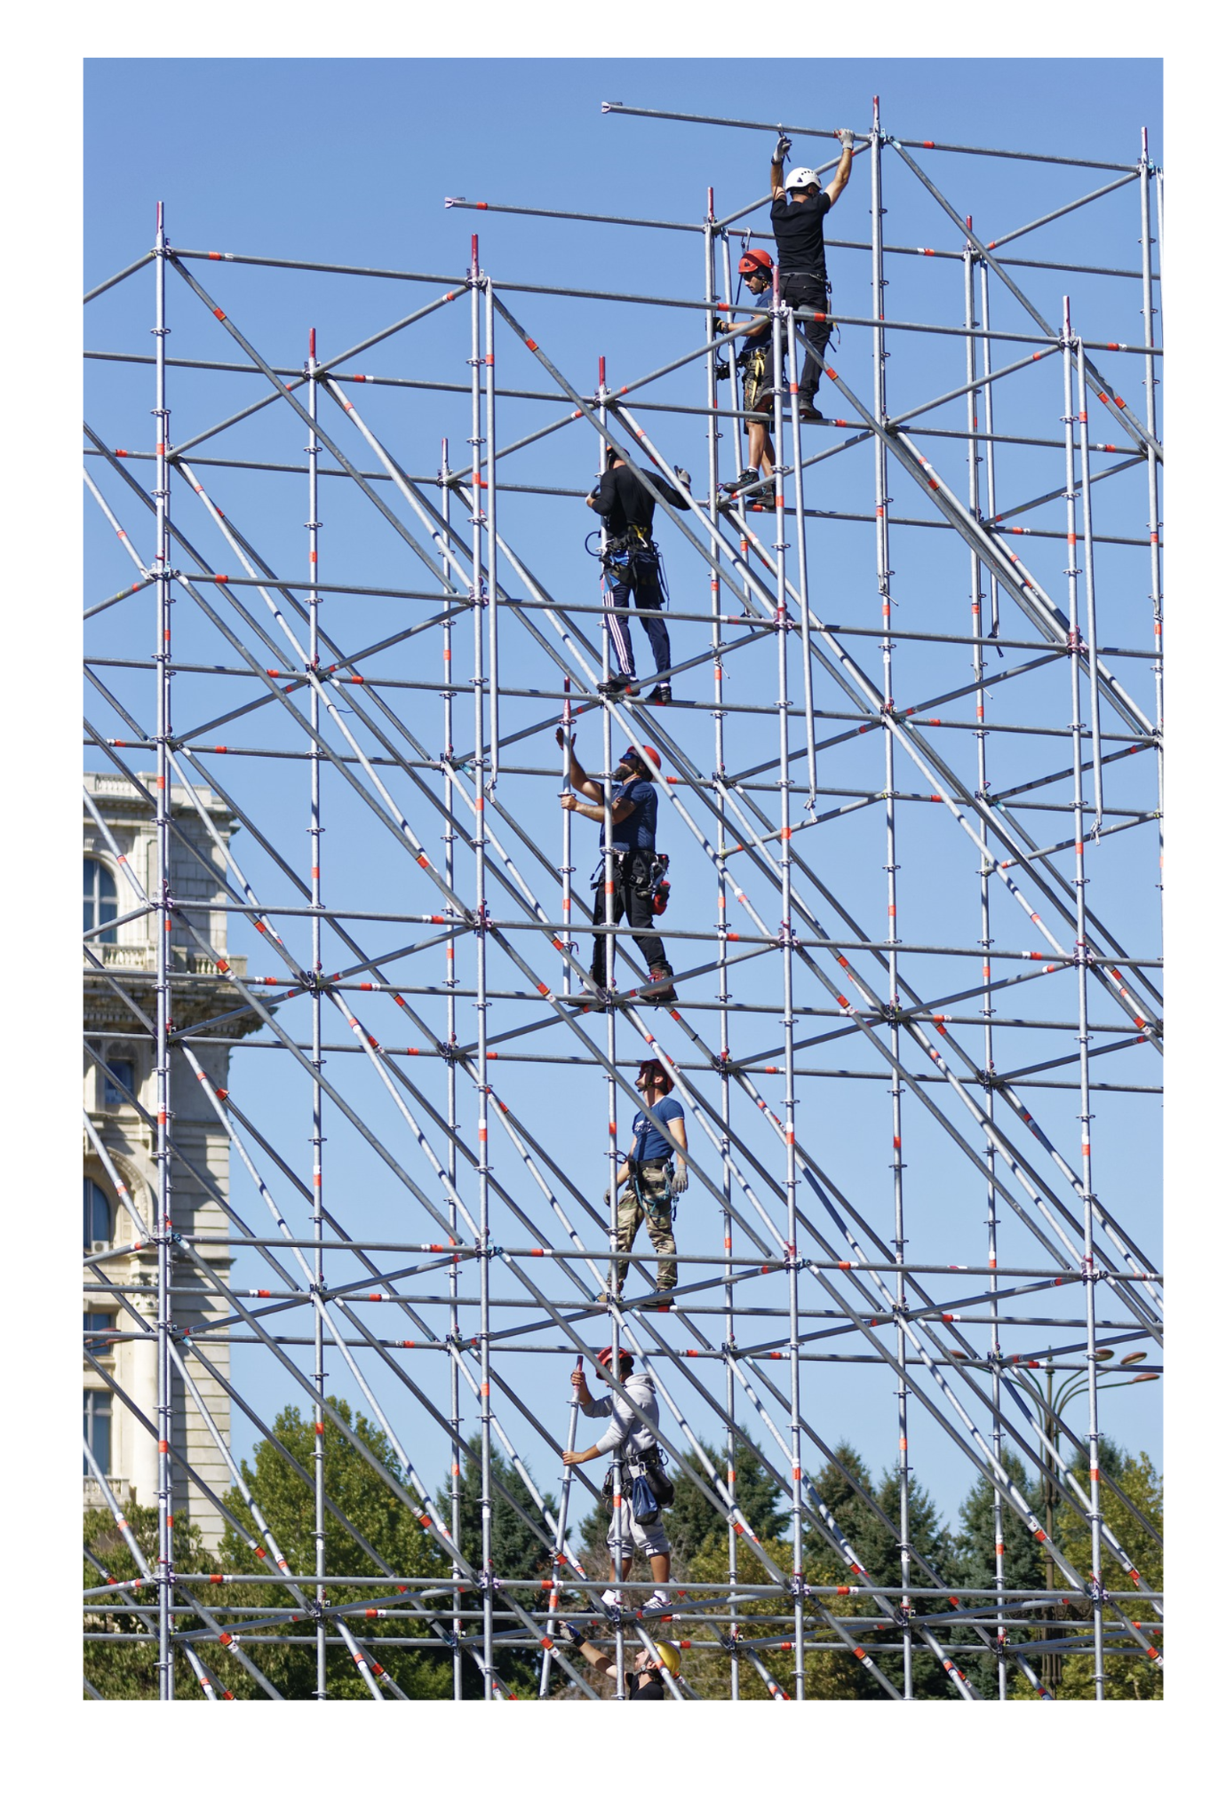
Module Structure
Introduction
Presentation
Presentation Quiz
Optional Resources
Pre-Reading Discussion
Practice 1 & Vocabulary Questions
Practice 2 & Vocabulary Questions
Assessment & Vocabulary Questions
Post-Reading Discussion
Module Summary

Slide 20
Class Progress
Students must complete one module before module before moving on to the next one.
A minimum score is needed on summative assessments.
Students must start with Module 1, so students are only added during the first three weeks of class.

Slide 21
Student Support
Weekly office hour on Zoom
Invitation to form study groups with classmates
Canvas announcements
Regular Canvas Inbox check-ins
If students are behind, encourage them to keep going.
If students are on track, encourage them to keep going.

Slide 22
Single Skill vs. Integrated Skills
This structure works for a reading class.
It’s more challenging to apply to an integrated skills course.
The instructors for the ESU Health and TOEFL courses chose to organize their modules based on topics.

Slide 23
What Students Say
The Good
Flexibility
Ability to review class content as often as they like
The Bad
Lack of contact with other students
Self-motivation and time management are more difficult

Slide 24
What Teachers Say
The Bad
Preparing the class in advance is so. Much. Work.
Grading is constant.
It takes time and planning to check in on students.
The Good
Once the class is ready, focus can be on student interaction.
It’s fun to continue to fine tuning the class.

Slide 25
CBE = Study Anytime

Slide 26
Career Ladders Project

Slide 27
Competency Based Education at LATTC

Slide 28
The Catalyst for CBE at LATTC
Started with Pathway Development in 2010-11; Pre-dates Guided Pathways
Poor performance on Student Success Scorecard metrics prompted a sense of urgency to change
Goal was to substantially increase student success: credential completions, transfer, and career outcomes
Career Ladders, “CBE Case Study and Discussion Guide: Focus on LA Trade Tech, https://www.careerladdersproject.org/cbe-case-study-and-discussion-guide-focus-on-la-trade-tech/

Slide 29
Six Step Implementation Process
1
Prepare
Alignment of goals and commitment; identification of key stakeholders and targeted industries
3
Design
2
The drafting and vetting process for the new institutional roadmap
Research
Compilation of the data providing foundation for redevelopment

Slide 30
Six Step Implementation Process
5
Launch
New support roles and infrastructural changes facilitate implementation
4
Build
Integration of the course sequences which are supported by experiential learning activities and other co-curricular enhancements (e.g., internship opportunities)
6
Evaluate
Consistent review and revision of student success and industry professional feedback

Slide 31
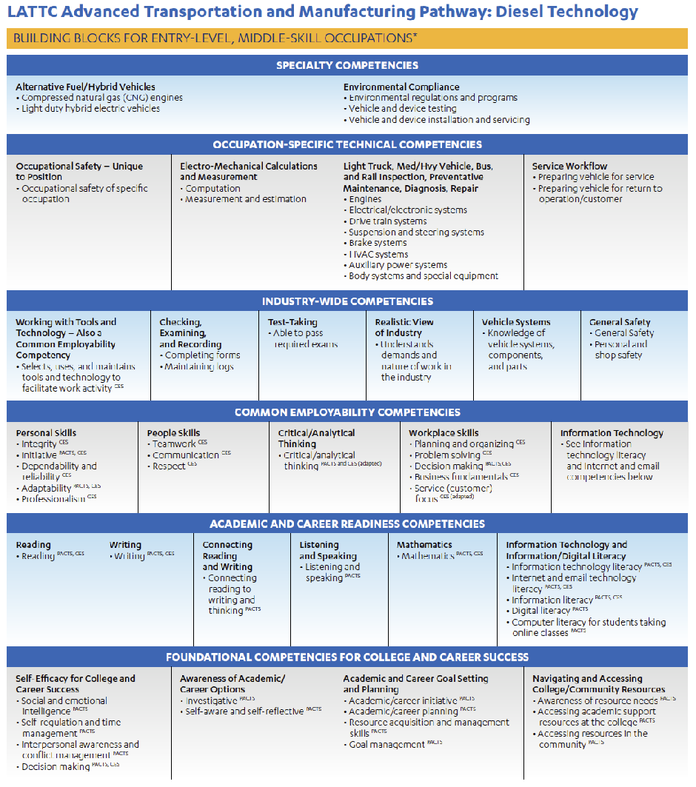
Diesel Technology Competency Framework Competencies Drive Program Design and Implementation

Slide 32
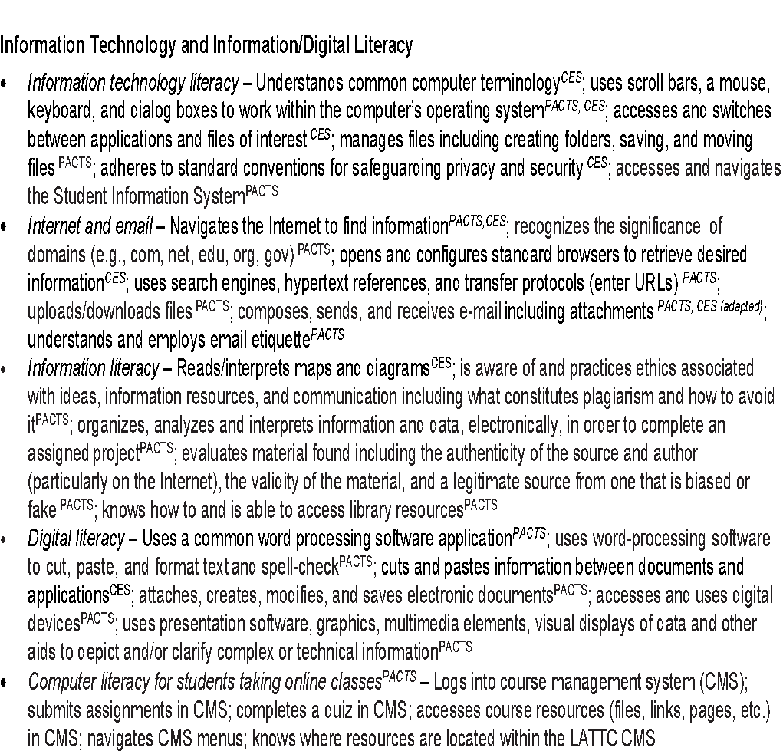
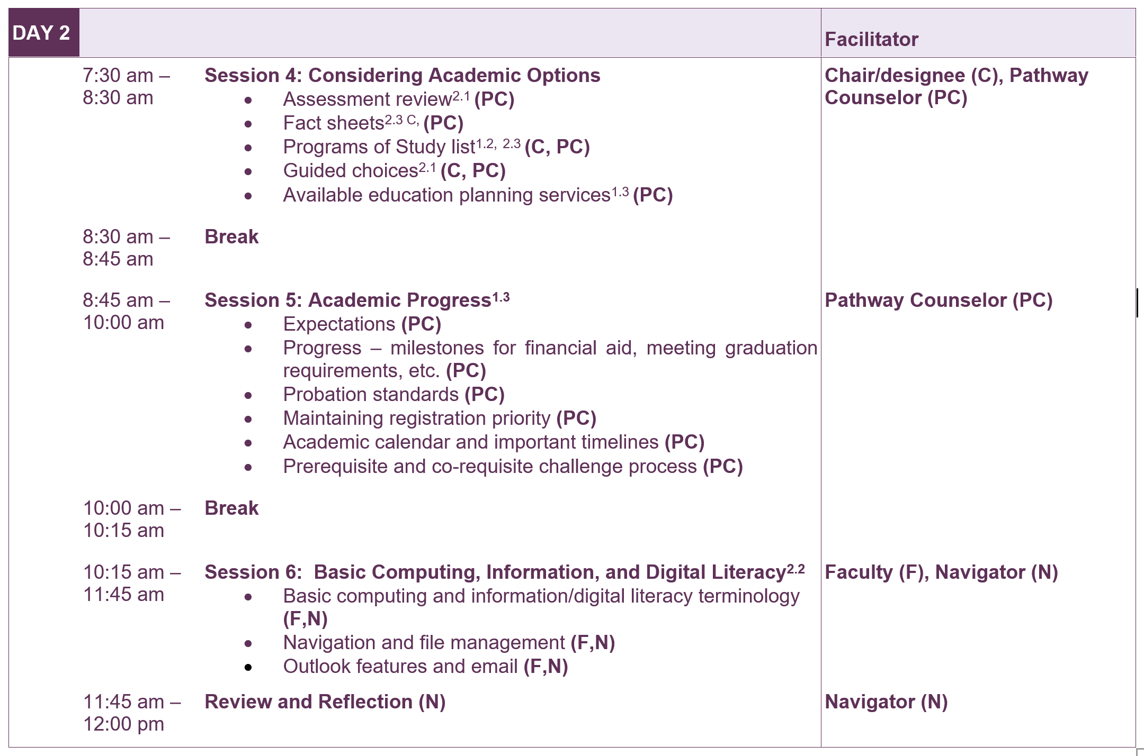
Competency Statements
Pathway Orientation
Build
Launch
Orientation Agenda

Slide 33
Steps for Development of the Instructional Roadmap
Faculty engagement and participation
Industry recognized certifications guide the process
Competency framework shared with industry advisory committee and other industry groups for input and approval
Curricular enhancement/redesign

Slide 34
Instructional Roadmap
What works:
Roadmap with competency and assessment criteria that sets clear expectations for students and industry
Built in strategies for acceleration and Credit for Prior Learning (CPL)
Student centered program that prepares students for multiple occupations

Slide 35
Instructional Roadmap
What Needs Work:
No Standardized CBE Strategy
EVERYTHING still revolves around the Carnegie Unit/Hour
Most CBE efforts made to fit within existing college educational structure

Slide 36
What is next in CBE at LATTC
Stacked and Latticed Credit, Noncredit, Not-for-Credit Programs
CBE, Asynchronous Not-for-Credit Industry Training
Re-examining Competencies – Future of Work
Badging Competencies
Modularizing Curriculum – Plug and Play
Experimenting with Flipped Learning Digital Learning (eCTE project) (accelerated with pandemic)
Removing “time” from the equation

Slide 37
SHARE OUT OF BEST PRACTICES

Slide 38
THANK YOU FOR JOINING US TODAY!
ANY QUESTIONS?

Slide 39
Resources
Board of Governor’s CBE Regulations Agenda Item(Nov. 2020)
California Community Colleges Vision Resource Center *FREE access to all in CCCs
See past webinars and slides in Communities → Competency Based Education
California EDGE Coalition (2021): Understanding Competency-Based Education, Credit for Prior Learning, and Other Flexible Learning Approaches in California
Career Ladders Project (2020): CBE at LATTC – Case Study and Discussion Guide
California Competes (2020): Side by Side: Comparing Credit for Prior Learning and Competency-Based Education
Education Trust-West (2020): Californian’s Deserve Credit: Recognizing All Learning to Help California Achieve Educational and Racial Equity
California EDGE Coalition (2019): Competency-Based Education: A Strategy for Skills Upgrading in California
Competency Based Education Network

