Slide 1
Work Based Learning Session May 1, 2021 12:30-1:30pm

Slide 2
Introduction of Presenters
Leslie Aaronson, LA Promise Fund
Cheryl Aschenbach, ASCCC Secretary
Marvin Da Costa, Los Angeles Trade Technical College
Marie Christie Dam, CTE Leadership Committee

Slide 3
Work-based learning provides students an opportunity as aspiring employees to explore careers and to turn theory into practice by gaining on-the-job experience. The experience gained from work-based learning opportunities, especially when considered in combination with the attainment and application of essential skills for college and employment success, is a critical component of career training and preparation. This session will focus on the opportunities for students completing CTE programs with work-based learning to be well-equipped to enter the workforce.

Slide 4
Session Overview
ASCCC/CCCCO lens: WBL, Internships, Cooperative Work Experience
Importance of WBL for community college students (both incoming and outgoing)
Benefits of internships and Work Experience Opportunities
Engaging HS students through dual enrollment
Engaging Industry and Career Readiness for College Students
How to create partnerships with community and industry
Sharing of Best Practices
Q&A?

Slide 5
ASCCC Perspective
Work-Based Learning
Internships
Cooperative Work Experience Education
Apprenticeships
ASCCC Paper (2019):
Work-Based Learning in California Community Colleges

Slide 6
An initiative of the LA Promise Fund.
Operating since 2014.
Contact Alex Rincon
AlexanderR@lapromisefund.org
Notes:
LA Promise Fund is nonprofit organization dedicated to preparing Los Angeles students for success in college, career, and life. We have multitude of services to SOUTh LA and LA County. We run a charter school which recently partnered with Russell Westbrook and the why not foundation who has adopted them, we programming and wraparound that focus on 15 south LA high schools and LA county such as girls Build, a leadership project, Arts Matter and the one we are focuins on today - The Intern Project.

Slide 7
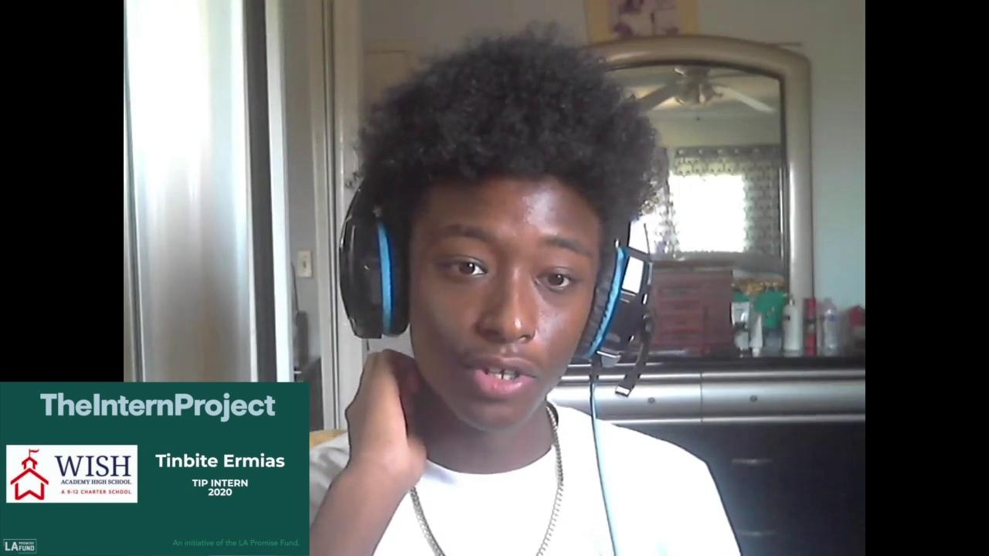
WHAT STUDENTS SAY
A paid internship in a dynamic industry can be a game changing experience for a student.

Slide 8
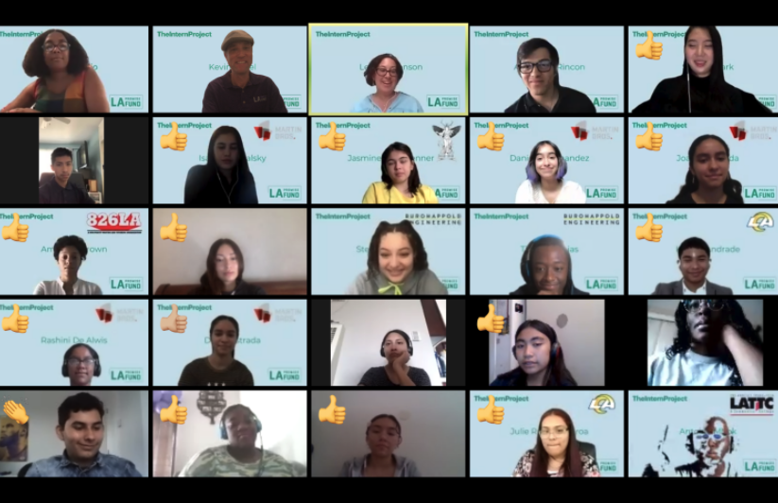
The Intern Project (TIP) provides public high school juniors and seniors across Los Angeles the opportunity to work in dynamic career areas through paid in person & virtual internships during their summer break.
Students Receive
4-8 weeks program paid $$
Paid internship $$
College Credit
Mentors
Work Experience
Learn More
TheInternProject.org
Notes:
Join us Feb 3 at 3pm - Juniors

Slide 9
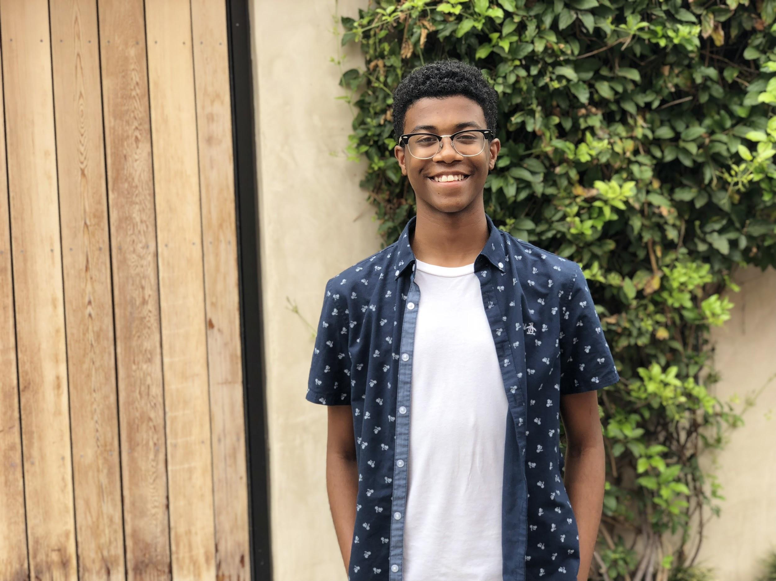
TIP provides an opportunity for businesses to:
Build a diverse pipeline of future talent
Cultivate a healthy and supportive workplace culture
Invest in and generate social impact
Notes:
Not old does this program provide an opportunity for students to grow professionally, introspectively, and develop new skills, but also for business to build a
Long term talent pipeline
Invest and generate social impact
Healthy / supportive workplace - feel good and leadership cultivation
So to give you some insight to our program, lets watch this video that has highlights from TIP 2020.

Slide 10
SOCIAL ROI
TIP’s 8 Impact Areas
350+
$490K+
100%
100%
Students
Served
Wages
Earned
Recommend to other Students
College Bound
88%
95%
75%
75+
Eligible for Free/Reduced Lunch
Students of Color
First Gen
College Goers
Companies Participated
Since 2014
Notes:
Leslie

Slide 11
PROGRAMMING
We build a diverse talent pipeline where college and career readiness is top of mind and incorporated throughout our summer programming.
Orientation
We host trainings to prepare interns for their first day at work. Workshops include: email and phone etiquette; office culture; Diversity, Equity, & Inclusion; case studies discussions, and more.
College Credit & Professional Development
Interns participate in a college and career readiness curriculum through our partnership with LA Trade Tech to ensure their placement is successful. All for college credit!
Field Trips & Networking
Interns take optional trips to visit other companies to learn about jobs and network with other professionals.
End-of-Year Celebration
The summer culminates with a networking event. Interns, their managers and colleagues join to celebrate with us.
Notes:
We begin the internship experience the week of June 15th - for a three day orientation. This is where we acclimate students to the process and review procedures and best practices to be as successful as possible. This includes case students, office etiquette, networking and more. Throughout the summer - in addition to working with your companies - we offer weekly coaching sessions, professional skills workshops and virtual field trips. We end the summer with a end of year celebration to celebrate the highlights.

Slide 12
OUR PARTNERS
Leading companies from diverse industries invest in TIP. (Past & Present)
826 LA
Amazon Web Services
Amgen
Ares Management
Atom Factory / Pop Water
August Getty / Strike Oil
Bad Robot
BeautyCon
Border Grill
Breadhead
Bruno Group, Inc.
BuroHappold
Causecast
Cedars-Sinai Accelerator
Chernin Entertainment
Comcast NBC/Universal
Community Health Councils
Education Pioneers
El Rey
Everydae
Expo Park
Fullscreen
Gagosian Gallery
Go Fast Pay Services
Goin
Goldhirsh Foundation
GOOD, Inc
Google
Guided Compass
Headspace
Heart of Los Angeles (HOLA)
ICM
Illumination
Jogg
Kaiser Permanente
Kids in Need of Defense
La Kretz Cleantech Incubator
LACI
LA Mas
LA Rams
Live.Love.Create. Events
Martin Brothers
Mattel
Mayor's Fund / City Hall
Michael S. Smith
Microsoft
Mobcrush
Omaze
Paradigm Talent Agency
Participant
Premiere Digital
Revelations Entertainment
Revolution Studios
Rightsline
Saban Brands
Saban Foundation
Salem Partners
Skanska
Social Justice Learning Institute
SpaceX
St. John's
Starz
Stray Angel Films
The Dress Outlet
The LA Fund
Trybe Beauty
UTA
Valley Economic Alliance
Weingart Foundation
WildCard
WME
Wondros
Writers Guild
Young Storytellers

Slide 13
VIRTUAL PROGRAM HIGHLIGHTS
Flexible and sustainable practices post covid
Increased morale
More opportunities for engagement & more access to employees worldwide
Office not required
No travel necessary
Notes:
Add rams logo

Slide 14
Cooperative Work Experience Education
COLLEGE CREDIT FOR WORK EXPERIENCE
CSU TRANSFER
FACILITATION OF COMPLETION AS ELECTIVE COURSE
CAREER PATHWAY ALIGNMENT
Notes:
Christie

Slide 15
Cooperative Work Experience Education
K-12
COLLEGE
CAREER
Notes:
Christie

Slide 16
Notes:
Christie

Slide 17
Notes:
Christie

Slide 18
Notes:
Christie

Slide 19
Notes:
Marvin

Slide 20
Notes:
Marvin

Slide 25
Share-Out of Best Practice
What’s working for you?
What are your challenges?

Slide 26
Thank you for joining the WBL session
ANY QUESTIONS?

