Slide 1
Regular and Substantive (plus effective) Contact
Wendy Bass, Pierce College
Vivian Varela, Mendocino College

Slide 2
A Definition
What precisely does regular and substantive or effective contact mean?
Who defines it?
Hint: Title 5 § 55204.
Regular effective contact is an academic and professional matter pursuant to sections 53200 et seq.

Slide 3
Methods of Instruction: Instructor/Student Contact Information Delivery
Procedural Announcements
Course Materials/Modules
Personalized Audio/Video Content
Library/Database Resources
Online Video Databases
Internet Resources
Discussion Forums

Slide 4
Methods of Instruction: Instructor/Student Contact Regular and Substantive Contact
Reactive and Observational Announcements
Chat Rooms
E-mail
Instant messaging
Private Messages
Responding to Bulletin Board/Public Message Forum

Slide 5
Regular and Substantive Contact
Responding to Discussion boards
E-Conferencing /Video Conferencing internet library resources
Timely Webcasts
Timely Podcasts
Others?

Slide 6
Methods of Instruction: Instructor/Student Contact Hybrid and In-Person Contact
Personal Orientation Sessions
In-Person Group Meetings
In-Person Review Sessions
In-Person Examinations
Synchronous Meetings
Others?

Slide 7
Now What?
Do you have a process to ensure regular and effective contact?
Was it initiated by and approved by your senate?
How are you verifying your courses meet your definition?
Documentation
COR or other approval process
Training & Professional Development

Slide 8
Now What?
What does your process look like?
What kinds of problems are you having with this issue on your campus?
What resources do you need?

Slide 9
Does your college have a Regular and Effective Contact policy?
Develop a policy in consultation with Academic Senate—Curriculum Committee & DE Committee
Policies often contain:
Definition of REC (use Title 5 language)
Instructor initiated focus
Guidelines for frequency of contact
Syllabus information
Variety of methods that constitute “contact”
Need for contact to be ongoing and consistent throughout semester
Best practices for engaging with students

Slide 10
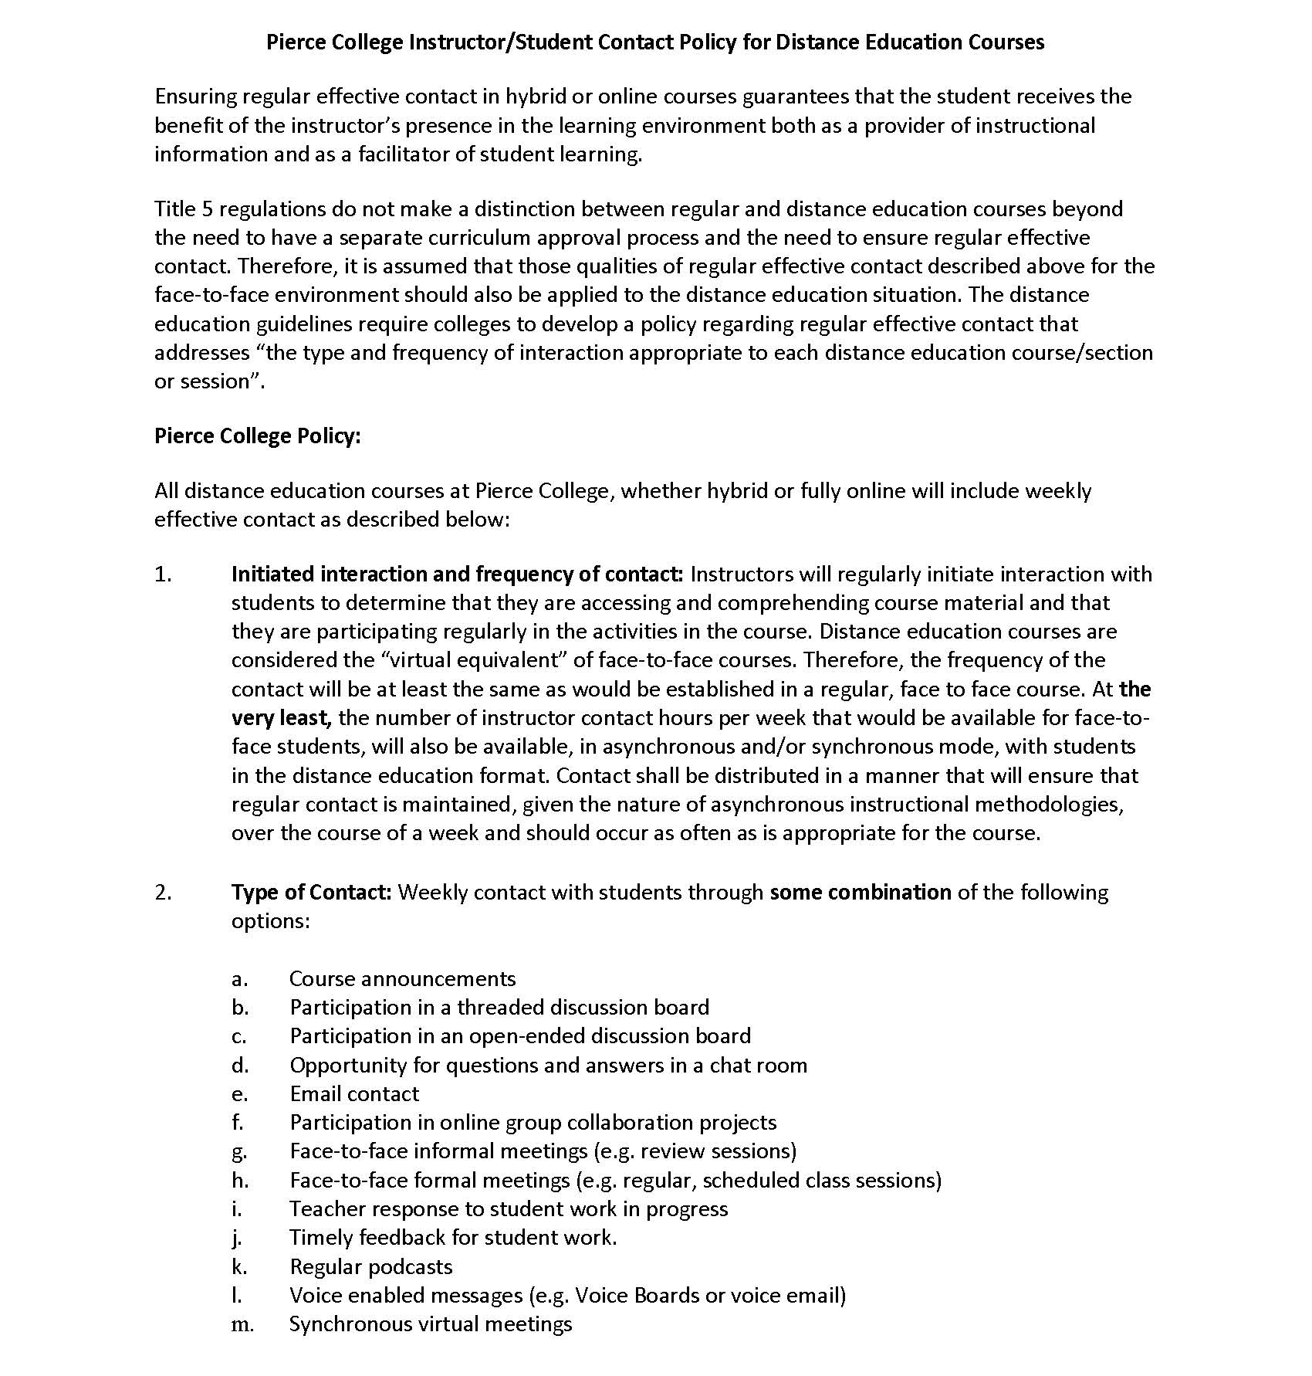
Example: Pierce College

Slide 11
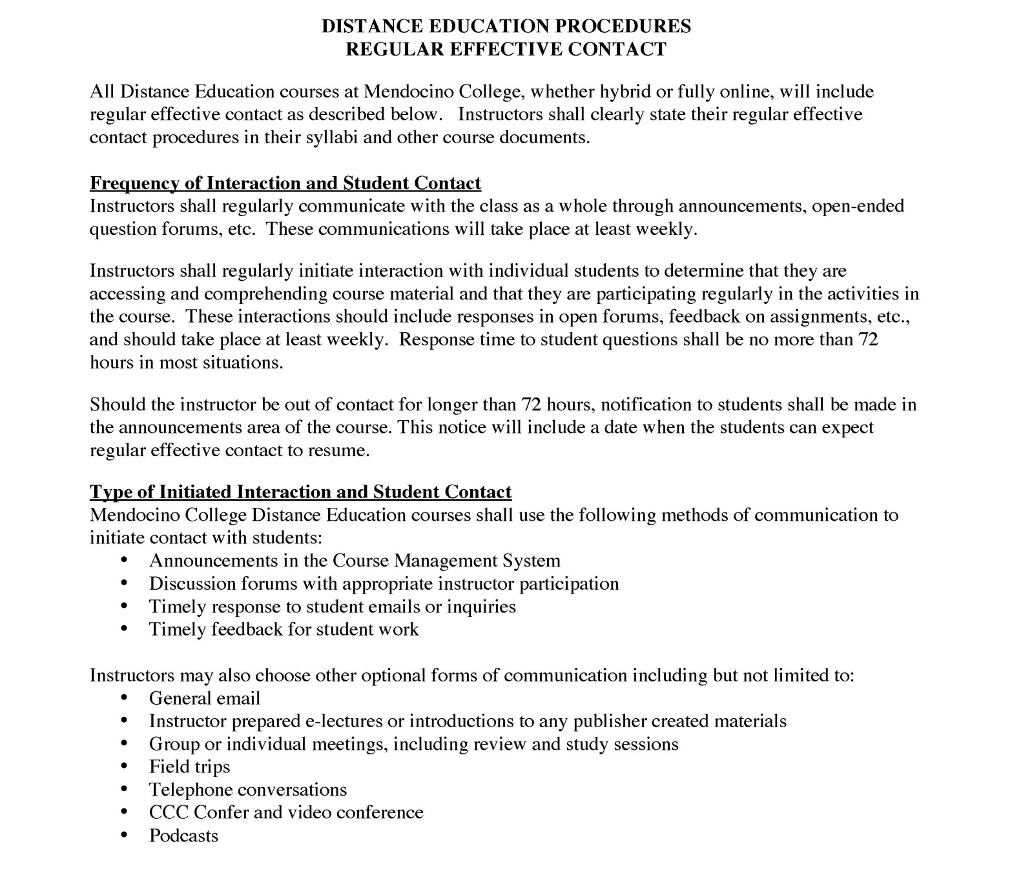
Example: Mendocino College

Slide 12
Thank You!
Wendy Bass bassw@piercecollege.edu
Vivian Varela varela@mendocino.edu

