Slide 1
Credit for Prior Learning (CPL): What’s New… and What Can You Do Next?

Slide 2
Introducing today’s presenters…
Chantée Guiney
Specialist, Educational Services and Support
California Community Colleges Chancellor’s Office
Jodi Lewis
Director of Strategic Initiatives
Success Center at the Foundation for California Community Colleges
Benjamin Mudgett
Articulation Officer/Associate Professor
Palomar College
Carrie Roberson
ASCCC North Representative
Candace Rose
CPL Coordinator/Associate Professor of Media Studies
Palomar College

Slide 3
Anticipated Outcomes
Learn how CPL is a student-centered, equity-driven, Vision for Success strategy
Learn about existing efforts and forthcoming guidance and resources to implement local CPL policies and practices
Share and learn from each other about next steps to implement CPL at your college/district

Slide 4
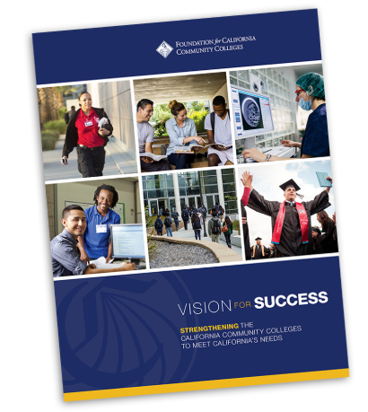
Vision for Success and Core Commitments
Vision for Success
Increase credential obtainment by 20%
Increase transfer by 35% to UC and CSU
Decrease unit obtainment for a degree
Increase employment for CTE students
Reduce and erase equity gaps
Reduce regional gaps
Core Commitments
Focus on students’ goals
Design and decide with the student in mind
Pair high expectations and high support
Evidence-based decisions
Own student performance
Enable innovation and action
Cross-system partnership

Slide 5
What is CPL?
Credit for prior learning is college credit awarded for validated college-level skills and knowledge gained outside of a college classroom.
Students’ knowledge and skills might be gained through experiences such as:
• Military training
• Industry training
• State/federal government training
• Volunteer and civic activities
• Apprenticeships, internships, work-based learning, or other industry-based experiential learning
CPL is not awarded for knowledge and skills already assessed and awarded credit through formal education at regionally accredited in-state and out-of-state institutions.

Slide 7
CPL is a Vision for Success Strategy

Slide 8
CPL is a Student-Centered Strategy
•Current students:
•More than 800,000 currently enrolled students over age 25
•Potential students:
•6.8 million California workers age 25-54 with high school diploma or some college but no degree
• 79% work 31 or more hours per week

Slide 9
CPL is an Equity Strategy

Slide 10
CCCCO Call to Action for Equity
Systemwide review of police and first responder training and curriculum.
Campus leaders host open dialogue and address campus climate.
Campuses audit classroom climate and create an action plan to create inclusive classrooms and anti-racism curriculum.
District Boards review and update your Equity plans with urgency.
Shorten the time for the full implementation of the DEI Integration Plan.
Engage in the Vision Resource Center “Community Colleges for Change.”

Slide 11
Sharing and Scaling
Admirable efforts happening all around the system with CPL:
Innovation Awards @ West Hills, Saddleback
Norco MAP
CPL Initiative Advisory Committee
CCCCO CPL Work Group
CPL discipline faculty pilots
CPL Task Force – Far North
Partnerships to advance CPL:
ASCCC
ACE
CAEL
CSU Chancellor’s Office
Legislature
Notes:
Faculty pilot discipline groups, Palomar College, Industry Employers, ACE, CAEL, Saddleback, Norco, Shasta, West Hills, Other groups (intersegmental partners), etc

Slide 12
The Student Experience
Student Survey
Identifying potential candidates for CPL
Providing students with “next steps”
Credit for Prior Learning Website
Resource for students, faculty/counselors, and staff
Filtering ability to see all CPL eligible courses
Canvas course sections for CPL
Credit by Exam
Portfolio Review
CPL Coordinator
Contact/resource for students, faculty/counselors and staff

Slide 13
CPL Logic Model Analysis
Stakeholder analysis (internal and external)
Affinity group breakouts
Academic Senate – faculty led
Collective bargaining organizations
Student Learning Outcomes
Curriculum Committee
Accreditation Liaison
Shared Governance (BP/AP)
Classified professionals (Instructional and Student Services)
Technology team (SIS and website development)
Administration
Resources
Guided Pathways
Release time?
Student Equity and Achievement (SEA)
Professional development
Faculty Champions
Council for Adult and Experiential Learning (CAEL)
American Council on Education (ACE)

Slide 14
CPL Implementation Timeline
Sep 2020
CPL Implementation Toolkits
CCCCO host CPL informational webinars
Dec 2020
District CPL policy certifications due to CCCCO*
CCCCO publish CPL memo
Jul 2020
Monitor AB 2494 status*
AB 2494 - Postsecondary education: course credit for prior military education, training, and service.
https://leginfo.legislature.ca.gov/faces/billTextClient.xhtml?bill_id=201920200AB2494
*AB 2494 could potentially impact (extend) the December 2002 due date for districts to submit CPL policy certifications to the CCCCO
Notes:
CHANTEE

Slide 15
Forthcoming CPL Guidance
What to expect in the next 90 days…
Guidance Memo from the Chancellor’s Office
CPL Implementation Toolkit
Vision Resource Center CPL Community
Professional Development Webinar
Notes:
CHANTEE

Slide 16
CPL Implementation Toolkit

Slide 17
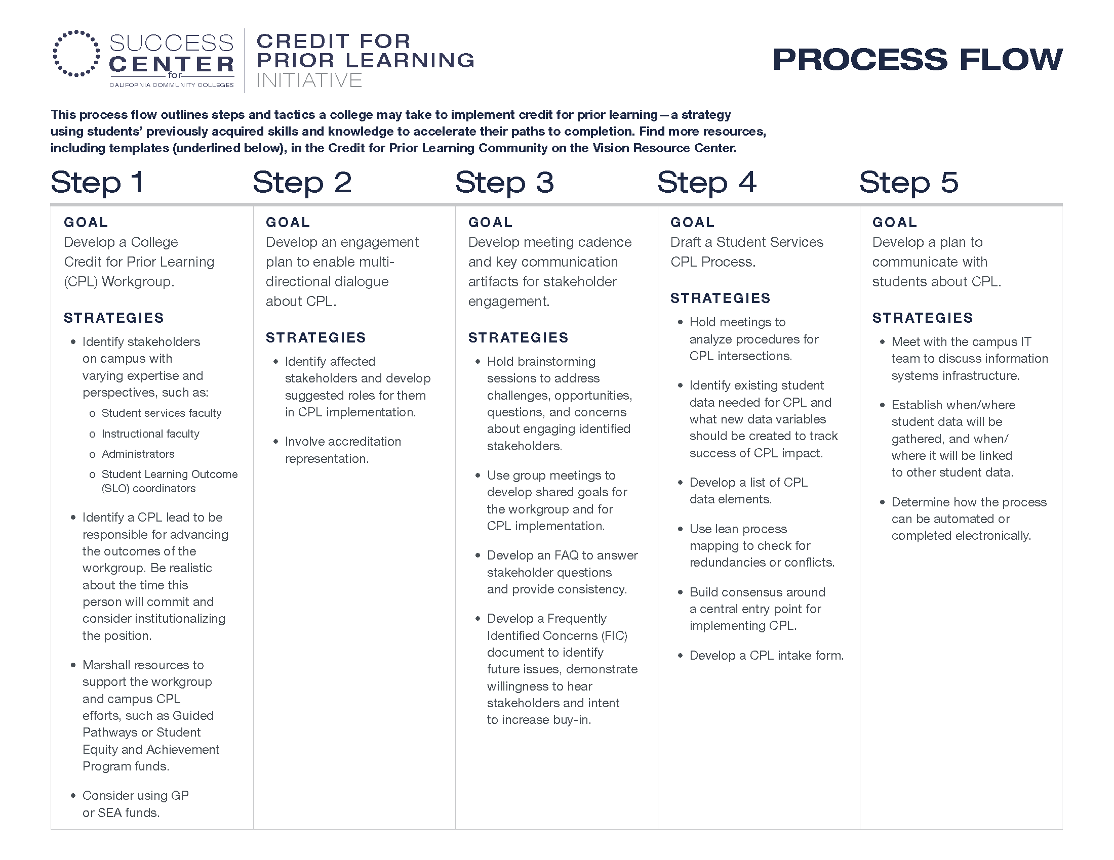

Slide 18
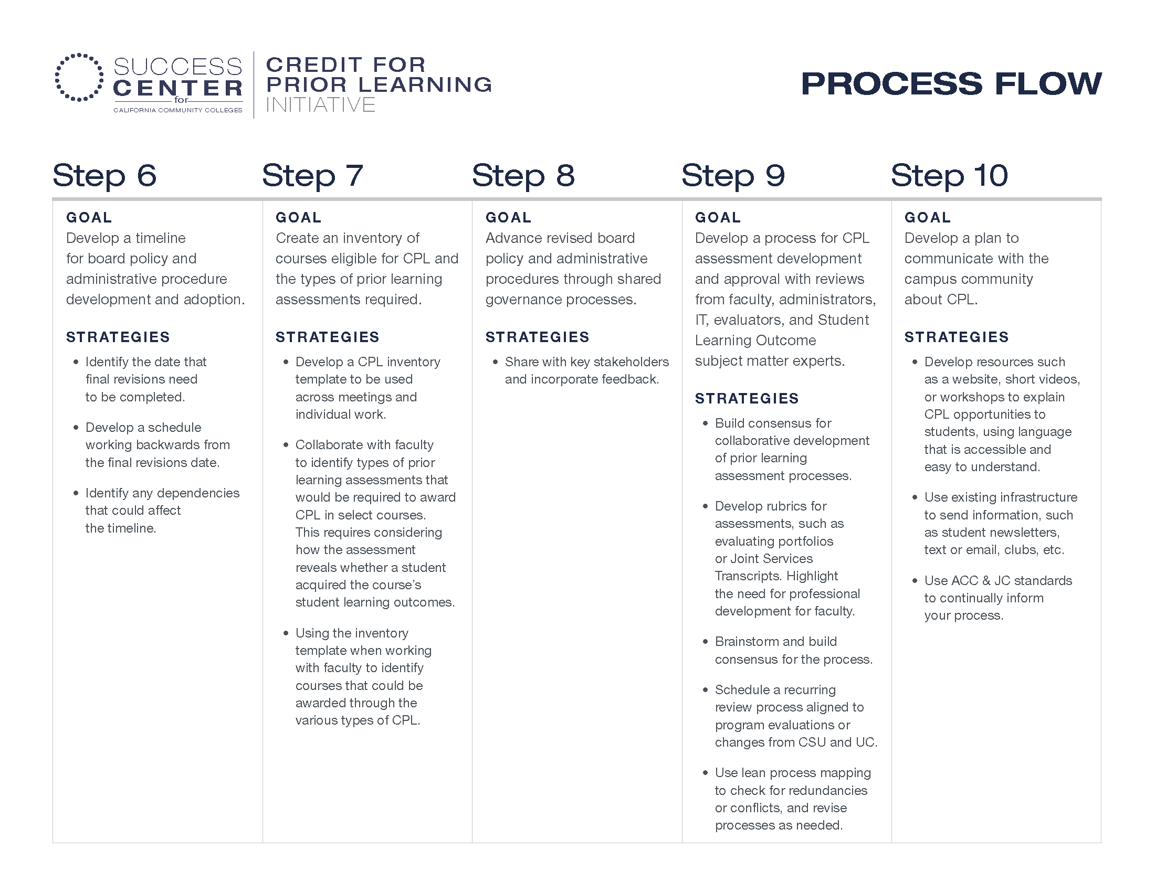

Slide 19
CPL Crosswalk Example – Business

Slide 20
CPL Crosswalk Example - CyberSecurity

Slide 21
HELP US, HELP YOU!
Thinking ahead and reflection… YOUR TURN!
What are the opportunities you see with Credit for Prior Learning?
What are obstacles you see with implementing Credit for Prior Learning?
What professional development is needed for CPL at your local college?
Access the GOOGLE DRIVE document
*Link available in the Pathable CHAT (ANYONE can access/edit)
*If unable to access, please put ideas (as prompted) in the Pathable CHAT

Slide 22
Questions?

Slide 23
Contact us for more information on CPL
Chantée Guiney
cguiney@cccco.edu
Jodi Lewis
jlewis@foundationccc.org
Benjamin Mudgett
bmudgett@palomar.edu
Candace Rose
crose@palomar.edu
Academic Senate for California Community Colleges (ASCCC)
info@asccc.org

Slide 24
Curriculum Team by Region
Name and Email | Region
Patti Blank pblank@cccco.edu | Macro Region A (Northern Inland, Northern Coastal, Lake Tahoe)
David Garcia dgarcia@cccco.edu | Macro Region A (Greater Sacramento) Macro Region E (San Diego/Imperial)
Chantee Guiney cguiney@cccco.edu | Macro Region B (North Bay, Mid-Peninsula, Silicon Valley, Santa Cruz/Monterey)
Zitlali Torres ztorres@cccco.edu | Region B (East Bay)
Kevin Lovelace klovelace@cccco.edu | Region C (Central Valley)
Kevin Olson kolson@cccco.edu | Region D (South Central Coast) Region F (Inland Empire/Desert)
Njeri Griffin ngriffin@cccco.edu | Region G (Los Angeles/Orange County)

Slide 25
Contact the CCCCO for more information
•Noncredit – Chantee Guiney (cguiney@cccco.edu); Neil Kelly (nkelly@cccco.edu)
•ADT – Kevin Olson (kolson@cccco.edu); Njeri Griffin (ngriffin@cccco.edu)
•Financial Aid – Gina Browne (gbrowne@cccco.edu)
•Apportionment - Wrenna Finche (wfinche@cccco.edu)
•Articulation – Bob Quinn (bquinn@cccco.edu); Devin Rodriguez (drodriguez@cccco.edu)
•Competency Based Education – Chantee Guiney (cguiney@cccco.edu)
•Credit for Prior Learning – Chantee Guiney (cguiney@cccco.edu)

