Slide 1
Roles and Responsibilities of Administrators in Curriculum
Karen Daar, Los Angeles Valley College
Virginia Guleff, Butte College
Michelle Sampat, Mt. San Antonio College
Notes:
All three--Presenters introduce themselves, including their official and philosophical roles in curriculum development.
Karen--Find out who is in the room—roles on their campus. How many brand new curriculum administrators?

Slide 2
Do All Campus Constituents Understand the Roles Involved in Curriculum Development?
How do you know?
What constitutes Curriculum Training at your campus? Who gets trained? Is it sufficient?
Who is responsible for Curriculum Training?
Notes:
Michelle--Curriculum training for curriculum committees, faculty and administrators (first-year training programs for faculty and administrators should have on curriculum) .

Slide 3
Purpose of the Curriculum Committee
The expertise of the faculty—what does “rely primarily” mean?
The administrative voice (what expertise do CIOs and Deans bring?)
How does your college bring in the administrative voice during discussions on curriculum?
Being an “active” (how should this be defined?) member of the Curriculum Committee.
Notes:
Michelle--Respecting AB 1725, setting ground rules (faculty preview) but also create an open environment for discussion.
How do they define administrators as being “active”—resource/voting, involved at every step/passive? CIO and/or dean? When does and when should the administrative voice come in? Why?

Slide 4
New CCCCO Directions and Expectations
Streamlining curriculum processes—Program Approval.
Guided Pathways.
AB 705.
Budgetary Emphasis on Completions.
Notes:
Virginia--Discussion at the State level on streamlining program approval processes.
The Curriculum Chair/Committee and Curriculum Dean/CIO working together to implement structures needed to support Guided Pathways, AB 705 compliance, and increase in completions.
Acquiring the soft skills needed for enhanced collaboration and communication among the Curriculum Chair, Curriculum Dean, and CIO/building relationships as a co-responsibility between the Curriculum Chair and CIO.

Slide 5
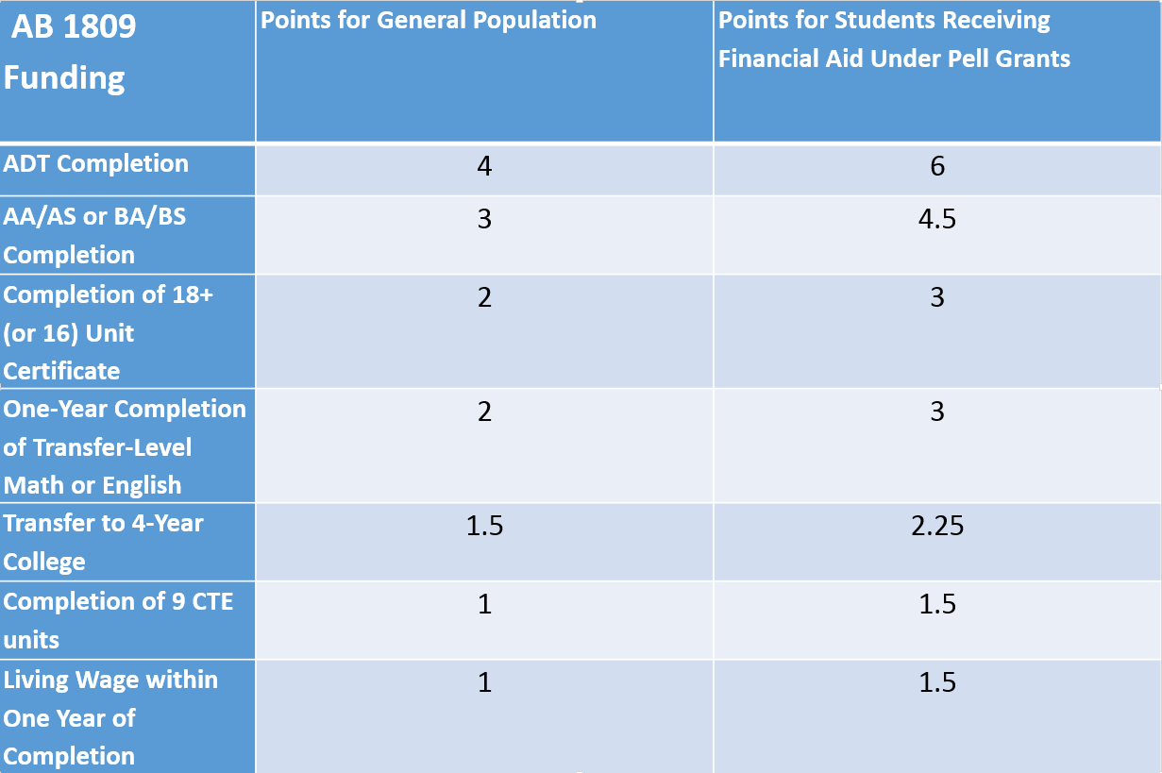
Notes:
Virginia

Slide 6
Roles in action.
Describe the roles Curriculum Chairs, Articulation Officers, Curriculum Specialists and Administrators on your campus are expected to take in program approval, Guided Pathways, AB 705 compliance, and increasing completions.
Define the roles district representatives are expected to take during these initiatives.
Notes:
Karen--Initiate small group discussion. What additional issues do they experience when dealing with their districts? Have them share out.

Slide 7
Filling in the gaps
Identifying and addressing challenges/problems earlier.
How to bring student support services into the mix (the impact of curriculum decisions in advising and articulation.)
Triangulating among faculty, the curriculum analyst/technician and the Articulation Officer.
Notes:
Virginia--Audience shares best practices on how their colleges are doing this. Monthly meetings between CIOs and Curriculum chairs locally and within district?
Making sure that student services knows of college changes. (including student services administrators).

Slide 8
Working as a team when navigating curriculum processes within a multi-college district
Identifying earlier the potential unintended impact of curricular changes to other colleges in the district.
What is the impact for the student who takes classes at multiple colleges?
Notes:
Karen

Slide 9
Take Aways
Sharing the 100 foot view before entering the weeds of technical review.
Shift from course-level thinking to program-level.
Always keeping the students in mind.
Administrators can help communicate how curricular changes will impact other areas of the college.
Look at curriculum holistically rather than one class at a time.
Notes:
Virginia--Going beyond conferring courses/programs to the philosophy of why they should be created.

Slide 10
“
Questions
OR COMMENTS?

