Slide 1
Driving Local Action: Leadership is Sometimes Lonely
Cheryl L. Aschenbach, ASCCC North Representative, Lassen College
Mayra Cruz, ASCCC Representative At-Large, De Anza College

Slide 2
Description & Outcomes
Provide senate leaders with a space to discuss insights on finding the inspiration we need ourselves.
Determine ways as a leader you can increase your inspiration, inspire your team and encourage the engagement of each team member.
Discuss on how you as a Senate leader can achieve work-life balance as a dedicated leader.
Notes:
Maybe- Introductions thru general call-out
Leadership role and why are you here

Slide 3
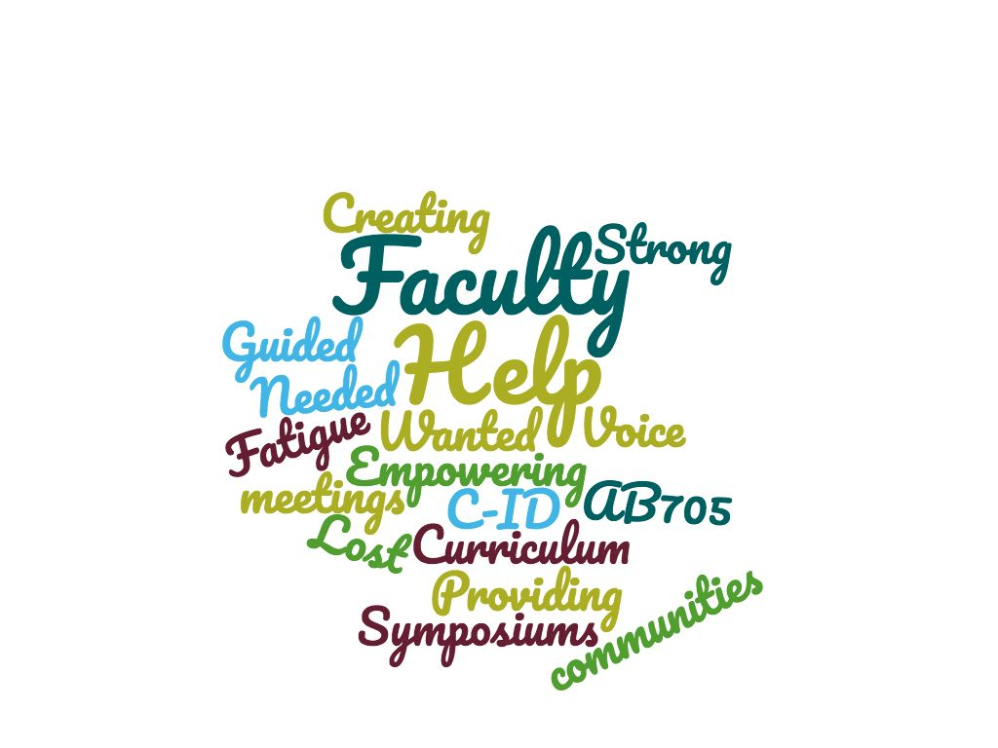
Notes:
Mayra intro; Cheryl activity
Word Cloud on initiative fatigue-
Activity: Pair & Share (2 min)
What are your challenges as leaders?
Share (2 min)

Slide 4
Theodore Roosevelt once said
“It is not the critic who counts; not the m(wom)an who points out how the strong m(wom)an stumbles, or where the doer of deeds could have done better. The credit belong to the m(wom)an who is actually in the arena, whose face is marred by dust and sweat and blood; who strives valiantly; who errs, who comes short again and again…who at best knows in the end the triumph of high achievement, and who at the worst, if h(sh)efails, at least fails with daring greatly.” Brenné Brown, Dare to Lead
Notes:
Cheryl
Acknowledge the courage to lead
Resource:
Brown, Brenné (2018) dare to lead: Random House: New York
Dare to Lead Resource Hub on brennebrown.com

Slide 5
The Inspiration We Need Ourselves
Notes:
Mayra
Self-awareness and Self-love matter. Who we are is how we lead (Daring Leadership) Brenné Brown

Slide 6
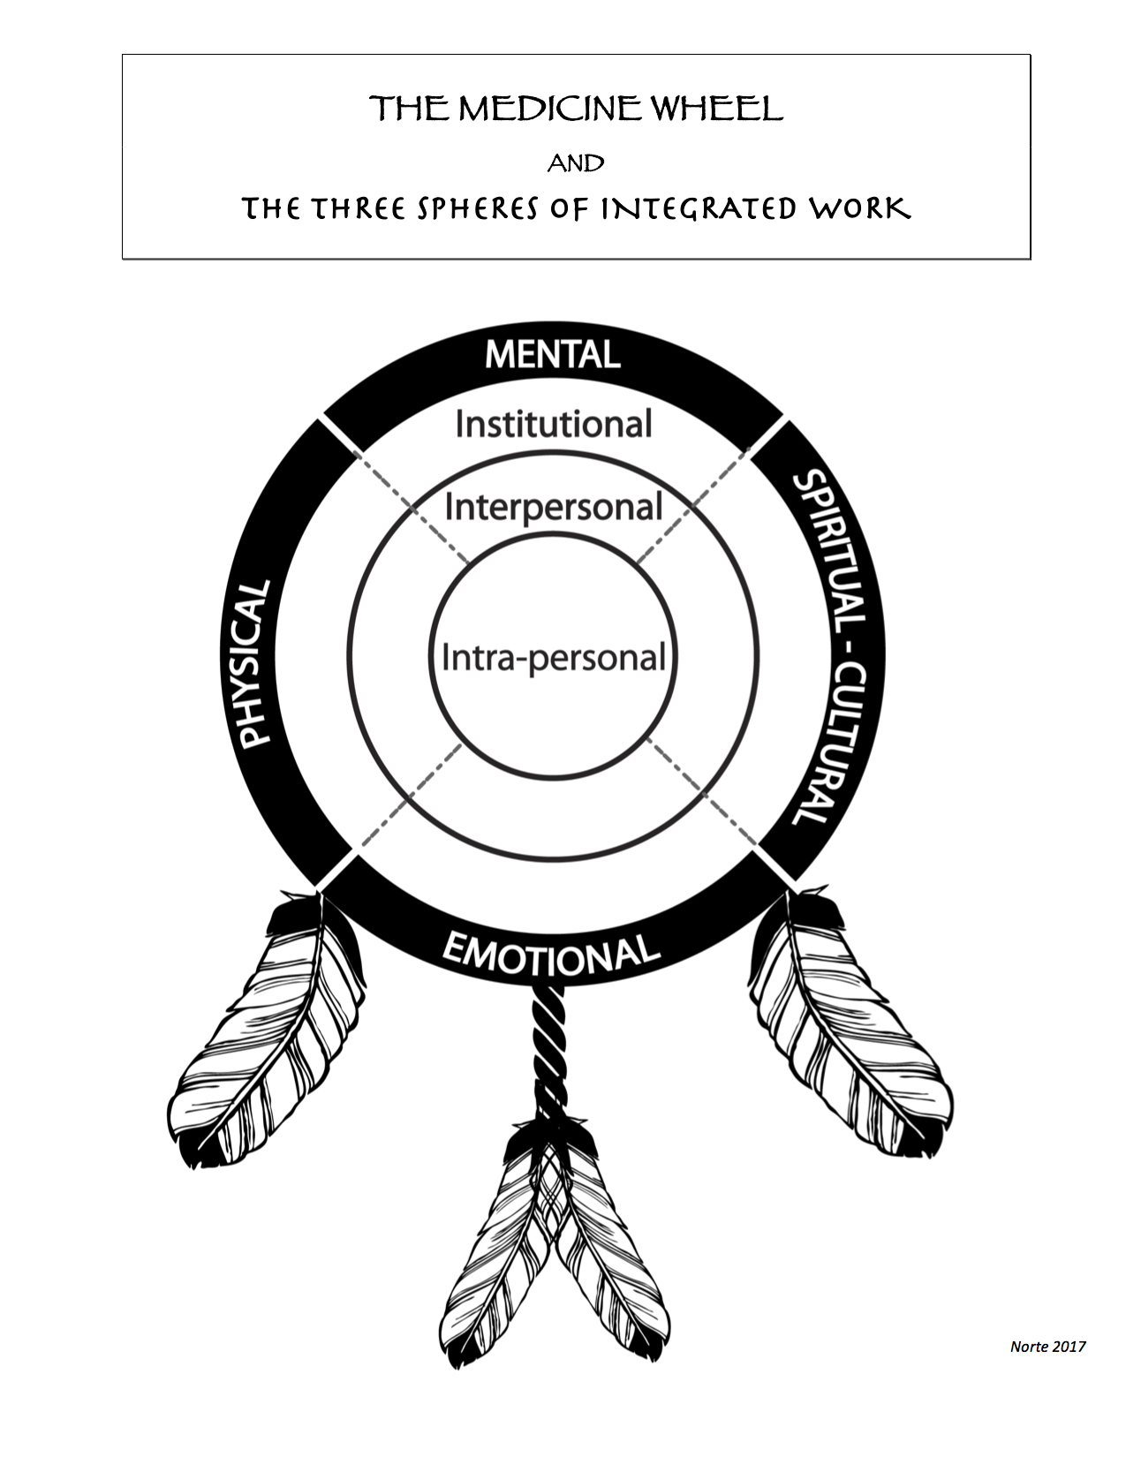
Notes:
Mayra
Context:
Teaching by the Medicine Wheel https://www.edcan.ca/articles/teaching-by-the-medicine-wheel/
Indigenous, culturally relevant educational process is how to create a schooling environment that reflects Indigenous culture and instils traditional values while providing the students with the skills they need to “survive” in the modern world.
Indigenous knowledge thus becomes important to understand. This knowledge is crucial to creating a culturally relevant space, pedagogy, and environment for teaching children and adults
In many Indigenous cultures, the Medicine Wheel[1] metaphor contains all of the traditional teachings and can therefore be used as a guide on any journey, including the educational process. While there is some variation in its teachings and representations, the underlying web of meaning to Medicine Wheels remains the same: the importance of appreciating and respecting the ongoing interconnectedness and interrelatedness of all things.
The wheel drawing simply begins by making a circle. Superimposed on this circle are four equidistant points. These points symbolically identify the power/medicine of the four directions (east, south, west, north)

Slide 7
Notes:
Mayra
Activity: "Time to Breathe" 3 min
http://www.mindfulteachers.org/2015/04/time-to-breathe-awareness-of-present.html
"Time to Breathe" is a mindfulness practice that was developed by Mindfulness Without Borders and is reproduced here with their permission. A first step to developing more mindfulness in your daily life is learning new ways to pay attention and connect to experiences in the moment. One easy way to bring your awareness to the present moment is developing a consistent breathing practice. We call this core mindfulness practice "time to breathe."
To get started, schedule specific times in the day that you can stop, take time to breathe and observe how that works for you. Ideally, practice breathing mindfully for 3-5 minutes a day.
Sit in a comfortable position. Allow both soles of your feet to connect to the floor.
Rest your hands on your thighs and let your shoulders drop.
Gently close your eyes or look for a reference point somewhere on the floor where you can return your eyes when they get distracted.
Let your spine grow tall and noble like the trunk of a tall tree.
Take a moment to notice how your body feels as you bring your attention to the flow of your breath. You don’t need to breathe in a special way. Your body knows how to breathe.
Simply notice each breath coming into the body with an in-breath, and leaving the body with an out-breath.
If you notice your mind is caught up in thoughts, concerns, emotions or body sensations, know that this is normal.
Notice what is distracting you and gently let it go without judgment, by redirecting your attention back to the breath.
Keep escorting your attention back to the experience of breathing.
When you are ready, slowly bring your attention back to your surroundings and let how you feel now guide you.

Slide 8
Practicing Mindfulness
The awareness that emerges through paying attention on purpose, in the present moment, and non-judgmentally to the unfolding of experience moment to moment
The non-judgmental observation of the ongoing stream of internal and external stimuli as they arise
Keeping one’s complete attention to the experience on a moment to moment basis
Notes:
Mayra
About Mindfulness: Mindfulness Exercise http://www.mindfulteachers.org/p/free-resources-and-lesson-plans.html

Slide 9
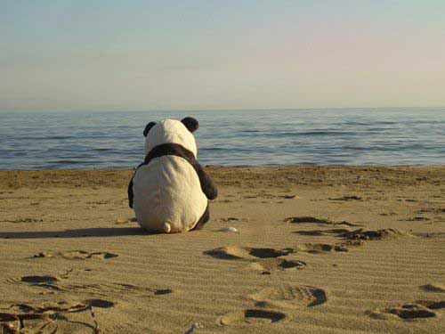
Considerations
Leadership and loneliness go
hand-in-hand
There is no conflict of interest
Responding to dissent and resistance
The team will bond
Achieve work-life balance
Notes:
Cheryl
Resources:
https://www.inc.com/mandy-gilbert/feeling-lonely-that-means-youre-actually-a-good-leader.html
Dissent & resistance- ackowledge and build relationships

Slide 10
Six Attributes
Successful leaders
have the ability to build a context for success.
have set high expectations and standards for themselves and others.
have the ability to model the behavior they expect by others in the college.
personally recognize and reward the accomplishments of outstanding faculty and staff.
demonstrate a persistent willingness to discourage unproductive behavior.
are consistent.
Notes:
Mayra/Cheryl
Resource: http://ccweek.com/article-4137-effective-community-college-leadership:-six-attributes.html

Slide 11
Multicultural Leadership
Learn from the past
I to We
Mi Casa es Su Casa (My home is your home)
A leader among equals
Leaders as guardians of public values
Leaders as stewards
La Familia, The Village, The Tribe
Gratitude, Hope & Forgiveness
Notes:
Mayra/Cheryl
Boardas, Juana. (2007) Salsa, Soul & Spirit. Leadership for a Multicultural Age. BK PublishersL San Francisco.
Activity: Groups of 3 (3min)
How do you inspire others to be involve in the work?
How do you or could you leverage the elements of multicultural leadership to inspire others to be involved?
Share – 2min

Slide 12
Work-Life Balance Activity
Sharing space to benefit us
Self-Care practice
Complete the Self-Care Assessment (tool) What do you do well and do you want to improve? (Individual)
Share what you do well or need to improve (small groups)
Ideas to benefit the rest of the class. self-care ideas, strategies, & experiences (large group)
Notes:
Mayra
Handout: Self-Care Assessment Worksheet (10-15min)
Complete the Self-Care Assessment (tool) What do you do well and do you want to improve? (Individual)
FN: A powerful leadership practice that many don’t take on is the self check-in. The best leaders have always been someone who checks in with themselves, frequently. This is a chance for us to check in with ourselves in a purposeful and meaningful way, in addition to a way where we can support each other with our own collective wisdom.
Share what you do well or need to improve (small groups)
FN: Within your table, we ask you to share what is going well and where in your self-care practice, you can improve upon.
Ideas to benefit the rest of the class. self-care ideas, strategies, & experiences (large group)
FN: In the spirit of sharing our collective wisdom to support each other, what do you find helpful in improving your self-care practice.

Slide 13
Takeaways

Slide 14
Contacts
Please feel free to contact each of us for more information.
Mayra Cruz cruzmayra@fhda.edu
Cheryl Aschenbach
caschenbach@lassencollege.edu

