Slide 1
Faculty Leadership, Professional Development & the Intersection with Gender, Race & Ethnicity
Mayra Cruz, At-Large Representative, De Anza College
Silvester Henderson, At-Large Representative, Los Medanos College
Michelle Bean, English Instructor and Senate President at Rio Hondo College
Mandy Liang, Associate Dean of Matriculation & Assessment, City College of San Francisco
Notes:
Welcome by Mayra
Introduce ourselves

Slide 2
Description
How do senate leaders engage faculty in dialogue about gender, race and ethnicity to build an equity minded culture?
Discuss professional development activities and the intersectionality with gender, race and ethnicity.
Introduce Uniqueness + Belonging = Inclusion (UBI) tool for difficult conversations.
Discuss challenges and “roadblocks” as we move to achieve equity goals and courageous conversations.
Notes:
Mayra

Slide 3
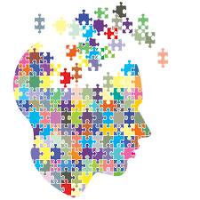
What brings you to this breakout? What do you hope to learn?
Notes:
Mandy
Request 2-3 answers from participants

Slide 4
Icebreaker
Idea Wave
What is your favorite place to eat?
Notes:
Michelle 3-4 minutes
Objective: Valuing different cultures and preferences and making continued connections.

Slide 5
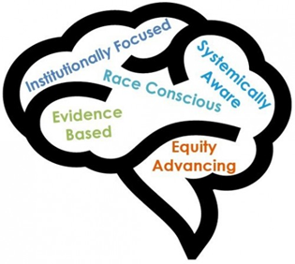
Equity Mindedness
The Center for Urban Education created the concept of “equity-mindedness” to describe actions that demonstrate individuals’ capacity to recognize and address racialized
structures, policies, and practices that produce and sustain racial inequities. (Bensimon & Malcom, 2012; Dowd & Bensimon, 2015)
Notes:
Silvester

Slide 6
Notes:
Silvester
Add Challenging unconscious bias “Unconscious bias applies to how we perceive other people. We are all biased and becoming aware of
our biases will help us mitigate them in our work [with students and colleagues].”
– NX Leaders (2012)

Slide 7
“Although women students may be the majority within higher education today, female faculty and administrators have not yet achieved equity in numbers, positions, salaries, or status (Chamberlain, 1991; Chliwniak, 1997; Fogg, 2003; Nidiffer, 2001; Shavlik & Touchton, 1984; Tinsley, Secor, & Kaplan, 1984; Touchton & Davis, 1991). In addition, women of color and various ethnicities may encounter microaggressions and/or need help with navigating multiple identities in the workplace.”
Notes:
Mandy
Source: Kuk, Linda & Donovan, Jody Women in Higher Education Revisited: Intergenerational Conversations
http://citeseerx.ist.psu.edu/viewdoc/download?doi=10.1.1.577.661&rep=rep1&type=pdf

Slide 8
Think About
Our identities affect our experiences
Our backgrounds and cultures shape our identities, values and beliefs
Discussing how some aspects of our identities differ from other people’s— and ways we may experience privilege and disadvantage—can feel uncomfortable, accusatory, and potentially threatening
Notes:
Mayra
Reflect internally.

Slide 9
Why are conversations difficult?
Gender inequities, racial/ethnic tensions, and everyday bias are embedded in human history and everyday interactions. They determine the relative value of our multiple identities.
These tensions and issues are amplified in current events, news coverage, and social media—and may feel even more polarizing.
Taking the perspective of someone who is different from you requires openness and courage—and some level of vulnerability.
Our fears and desire to find exactly the right words can reinforce our silence.
Notes:
Michelle

Slide 10
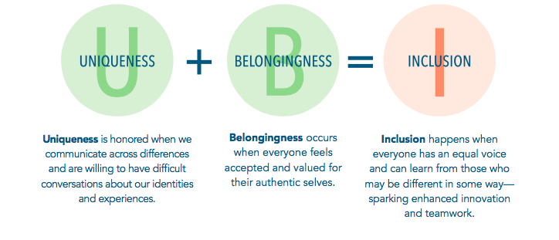
Uniqueness + Belonging = Inclusion
Notes:
Mayra

Slide 11
Challenges
There Isn’t a Problem
There’s No Benefit to Talking
There Will Be Negative Consequences to My Actions
Notes:
Silvester

Slide 12
“Roadblocks”
“Gender differences don’t matter—we view women and men equally.”
“We don’t see color— only people.”
“Race and ethnicity are not relevant in certain places.”
“Talking about our differences can only further divide us.”
“Talking won’t solve anything.”
“People think I’m overly sensitive, and I feel that my experiences are minimized.”
“I will say something inappropriate—or worse, be viewed as racist or sexist.”
“It’s not safe to speak up.”
Notes:
Mandy

Slide 13
What are the next steps to take once you get back to your campus?
To whom would you talk and how would you turn your idea to action?
How do you strategically engage your college community in conversation about gender, race and ethnicity?
Notes:
Mayra
Small large group dialogue
What would be one professional development idea to increase colleagues’ understanding on the intersection of gender, race and ethnicity you would implement once you get back to your campus?

Slide 14
Resources
Engaging in Conversation About Gender, Race, and Ethnicity in the Workplace https://www.catalyst.org/system/files/engaging_in_conversations_about_gender_race_and_ethnicity_in_the_workplace.pdf
Kuk, Linda & Donovan, Jody. Women in Higher Education Revisited: Intergenerational Conversations http://citeseerx.ist.psu.edu/viewdoc/download?doi=10.1.1.577.661&rep=rep1&type=pdf
Mellody Hobson. Color Blind or Color Brave? Ted Talk https://www.ted.com/talks/mellody_hobson_color_blind_or_color_brave?language=en

Slide 15
Contacts
Mayra Cruz cruzmayra@fhda.edu
Silvester Henderson Shenderson@losmedanos.edu
Michelle Bean mbean@riohondo.edu
Mandy Liang mliang@ccsf.edu

