Slide 1
Effective Practices in Accreditation: Standard I Mission, Academic Quality and Institutional Effectiveness, and Integrity
Stephanie Curry—Reedley College
Maria del Rosario C. Biddenback, Napa Valley College

Slide 2
Breakout Outcome
Attendees discuss Standard I and effective practices for meeting relevant ACCJC eligibility requirements and policies.
Notes:
Not sure of the thought behind this slide.

Slide 3
ASCCC Paper
Effective practices in Accreditation: A Guide to Support Colleges in the Accreditation Cycle (Adopted Fall 2015)

Slide 4
Standard IA: Mission
Makes sure that all college programs and services align with the mission
Mission must contain: broad educational purpose, intended student population, types of degrees and certificated offered (need to address if in the bachelors degree pilot) and a commitment to student learning and achievement
Mission must be linked to: Decision Making, Planning and Resource Allocation
Achievement of the mission must be qualitatively and quantitatively shown through data and data analysis

Slide 5
Effective Practices: IA
Review your mission systematically, not just
the year before a visit.
Reference you mission in all your planning documents
Use the mission as a guiding force for resource allocation
Publish the mission far and wide on campus in documents to the public
Require each program to write how they address the mission through the program review process
Identify specific data that can show college is meeting its mission

Slide 6
Standard IB: Academic Quality and Institutional Effectiveness
Focus on Data and Dialog
Data:
Student Learning Outcomes
Student Equity Data
Achievement Data
Intuitional Set Standards
Disaggregated Data
Dialog:
Indentify Performance Gaps
Implement Improvement Plans

Slide 7
Effective Practices: 1B
Identify processes and procedures for collecting and analyzing and using outcome data for student learning and achievement
Collect disaggregated data on achievement of student learning outcomes and use that data in discussions of student equity
Create and assess intuitional set standards
Identify short and long-range needs based on data

Slide 8
Standard IC: Institutional Integrity
Providing Clear and Accurate information to faculty, staff, students and the public.
Information should be provided:
Online
College Catalog
Correspondence with the Commission
Need to regularly review its policies,
procedures and publications
Academic Freedom and Academic honesty/dishonesty

Slide 9
Effective Practices: IC
Confirm all information in institutional documents and publications are clear and accurate
Confirm that students can complete degrees and certificated in a reasonable time
Make sure that the college/district has an academic freedom statement, a policy on academic integrity (including academic honesty/dishonesty)
Provide evidence that policies and procedures are followed.

Slide 10
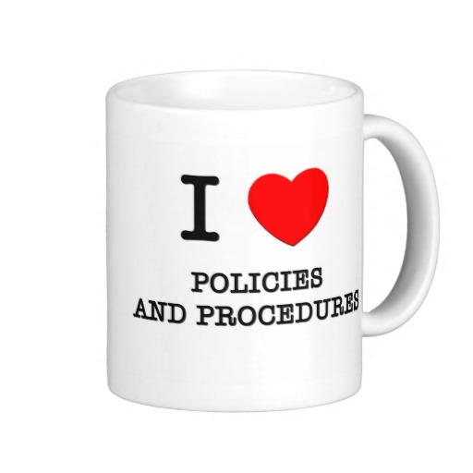
Eligibility Requirements linked to Standard I
ERs
6 (Mission)
11 (Student Learning and Achievement)
13 (Academic Freedom)
19 (Institutional Planning and Evaluation)
20 ( Integrity in Communication with the Public)
21 ( Integrity in Relations with the Accrediting Commission)

Slide 11
Widely distribute and Publish
Need to widely distribute data and information related to Standard I
Information should be distributed to faculty, staff, administration and the community

Slide 12
Faculty Involvement in Standard I
Faculty (Academic Senates) should be involved through:
Assessment of the current mission and revisions
Making sure that the mission is part of the program review process
Producing, Collecting and Reviewing Student learning outcomes
Identify strategies for improvement based on data and dialog
Creating and discussion of Institutional Set Standards
Reviewing the colleges Academic Freedom Policy
Crafting academic dishonesty policy (cheating and plagiarism)

Slide 13
“
Questions?

