Slide 1
Recognizing the Full Humanity of Our Asian and Pacific Islander Student Communities in the California Community Colleges
ASCCC Virtual/Zoom Webinar
February 7, 2023
12:30-2:00 PM

Slide 2
Presenters
resi
dent, San Jose City College
Presentes:
Dr. Rowena Tomaneng, President, San Jose City College
Dr. Karen Chow, ASCCC Area B Representative, & De Anza College Faculty
Dr. Aida D. Cuenza-Uvas, Director, Arise Program, Mt. San Antonio College
Bethany Tasaka, ASCCC API Caucus Chair & San Bernardino Valley College Faculty
Dr. Rowena M. Tomaneng, President, San Jose City College, & Founding Tri-Chair for CEO Racial Equity & Inclusive Task Force
College P

Slide 3
Webinar Description
Students who identify as Asian and Pacific Islander make up around 13% of California Community College students. Asian and Pacific Islanders are the fastest-growing ethnic group in California since 2011, growing an additional 25% statewide. After the pandemic, Asian and Pacific Islanders also experienced an explosive increase in racially motivated incidents. These increases should motivate faculty to look at what faculty can do on campus to support our Asian and Pacific Islander student communities. During this webinar, we will discuss some issues currently facing Asian and Pacific Islander students, and pedagogical and student services strategies and supports that faculty can take back to campus.

Slide 4
Contextualization of IDEAA work in ASCCC
Notes:
Karen & Bethany

Slide 5
IDEAA Work in ASCCC
Brief history of ASCCC’s work and development of DEI (Diversity, Equity, Inclusion), now expanded to IDEAA--Inclusion Diversity, Equity, Anti-Racism, and Accessibility
CCCCO DEI Integration Plan & Call To Action -- 60 Recommendations to our system that came out of CCCCO Workgroup with main stakeholder associations
CCC Ethnic Studies graduation requirement (now in Title 5)--prompted by Resolution from field & Student Senate of CA Community Colleges, implemented in collaboration with CCC Chancellor’s Office & CCC Ethnic Studies Faculty Council & CCC Curriculum Committee
Rostrum articles
Papers– Equity Driven Systems: Student Equity & Achievement in the CA Community Colleges
Toolkits
DEI in Curriculum
Model Hiring Principles and Processes
Cultural Humility Tool
Open Educational Resources Initiative IDEA Framework
Part-Time Faculty Nexus
IDEAA Liaisons (for local Senates)
ASCCC Caucuses: Black Caucus, Latinx Caucus, API Caucus, LGBTQ+ Caucus, Womyn’s Caucus
ASCCC Equity Diversity Action Committee
Notes:
Karen & Bethany

Slide 6
IDEAA Work in ASCCC
Adopted ASCCC Resolutions from the field:
09.03 Fall 2020: Ethnic Studies Graduation Requirement
03.03 Spring 2021: Denounce Anti-Asian American Pacific Islander (AAPI) Racism
03.05 Spring 2022: Disaggregate Asian and Pacific Islander Student Data
10.01 Spring 2022: Disciplines List: Asian American Studies (CCC Ethnic Studies Council)
Notes:
03.03: Resolved, That the Academic Senate for California Community Colleges condemn the oppressive forces of anti-AAPI racism, denounce xenophobia and anti-AAPI sentiment, and urge the documentation and investigation of all reported incidents in order to promote respect and protection of the AAPI community;
Resolved, That the Academic Senate for California Community Colleges create opportunities for faculty to engage in ongoing critical reflections, conversations, and intentional efforts – such as educating from culturally appropriate curriculum – in addressing racial, social, and economic injustices and inequities, within AAPI communities, thereby further humanizing AAPI students, faculty, staff members, and administrative colleagues; and Resolved, That the Academic Senate for California Community Colleges engage in advocacy and collaborative efforts to protect AAPI students, employees, communities, and victims of discrimination and commit to working with campus groups, administration, students, and classified professional colleagues across the system to organize and present local campus and district anti-racism advocacy and education events and efforts.
03.05: Resolved, That the Academic Senate for California Community Colleges collaborate with the California Community Colleges Chancellor’s Office to refine data disaggregation processes to increase transparency of and access to CCCCO data so colleges can better serve misrepresented student populations such as South East Asian Americans and other unidentified disproportionately impacted Asian and Pacific Islander groups; Resolved, That the Academic Senate for California Community Colleges urge local academic senates to apply fully disaggregated data to allocate resources relating to equity initiatives and provide guidelines to make equitable decisions relating to students; Resolved, That the Academic Senate for California Community Colleges work with the California Community Colleges Chancellor’s Office to develop guidelines for regularly reviewing and revising data practices to ensure students are correctly represented; and Resolved, That Academic Senate for California Community Colleges work with local academic senates to implement best practices regarding regularly reviewing data to ensure that disproportionately impacted Asian and Pacific Islander students are identified.

Slide 7
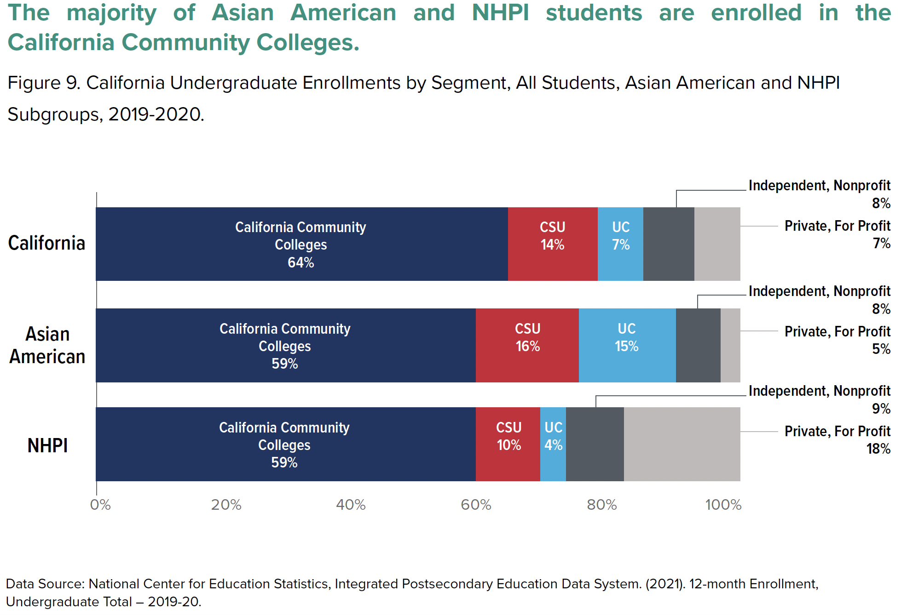

Slide 8
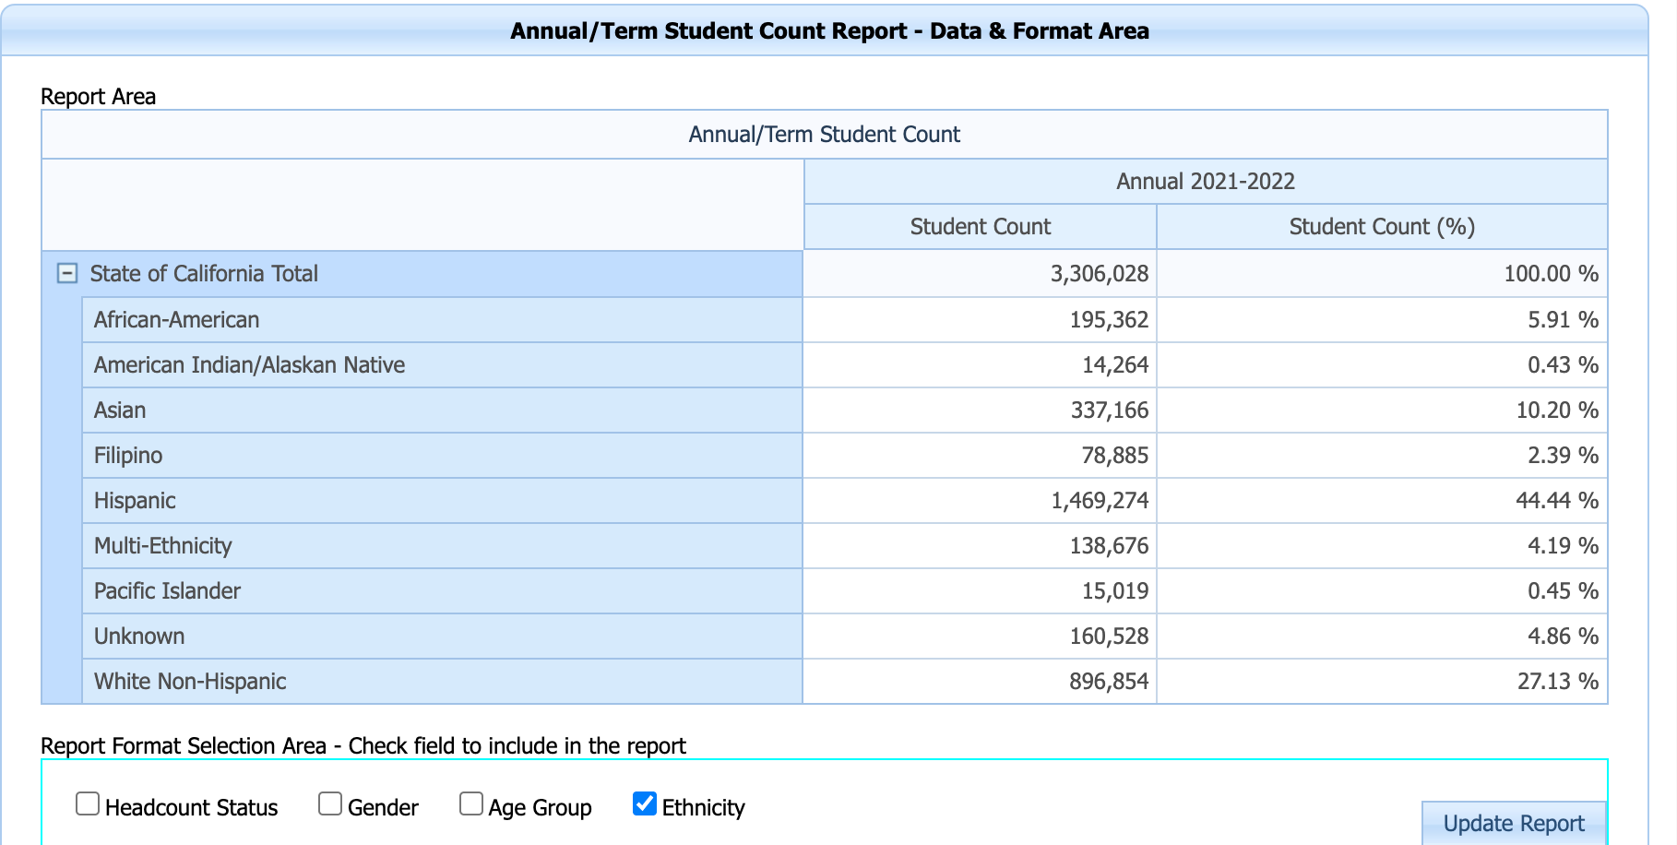
AAPI students in CCC
As of latest CCCCO Datamart for most recent year available (‘21-’22):
Approximately at least 13% of CCC students (431,070) identify as Asian, Filipino, or Pacific Islander
At least 43 CCCs have AAPI student populations at or above 10% Asian, Filipino, and Pacific Islander
CCCCO site for AAPI students:
https://icangotocollege.com/student-support-services/asian-american-and-pacific-islander-success

Slide 9
The Asian & Pacific Islander Caucus
Meetings:
Second Mondays
5 - 6 p.m.
Zoom
Contact:
Bethany Tasaka, Chair btasaka@valleycollege.edu

Slide 10
History and Context of AANAPISI Programs
&
CA Investments in AANHPI Students in CCC, CSU, UC
Notes:
Rowena

Slide 11
History and Context of AANAPISI Programs
AANAPISIs (Asian American Native American Pacific Islander Serving Institutions) received their designation as an MSI in 2007 through the College Cost Reduction and Access Act, which expanded in 2008 under the Higher Education Opportunity Act
Response to the misconceptions related to the model minority stereotype and in recognition of the vast and diverse needs of underserved and underrepresented AAPI groups
Involved decades of collaborative advocacy from community organizers, students, policy makers, and researchers
Key leaders of legislation included Congressperson Robert Underwood (D-Guam), David Wu (D-OR), Senator Barbara Boxer (D-CA), Daniel Akaka (D-HI), the Congressional Asian Pacific American Caucus, and the White House Initiative on Asian Americans and Pacific Islanders
Notes:
AANAPISIs are youngest of all MSIs, and there is a need for more research to better understand these institutions, their programs, and the AAPI students they serve

Slide 13
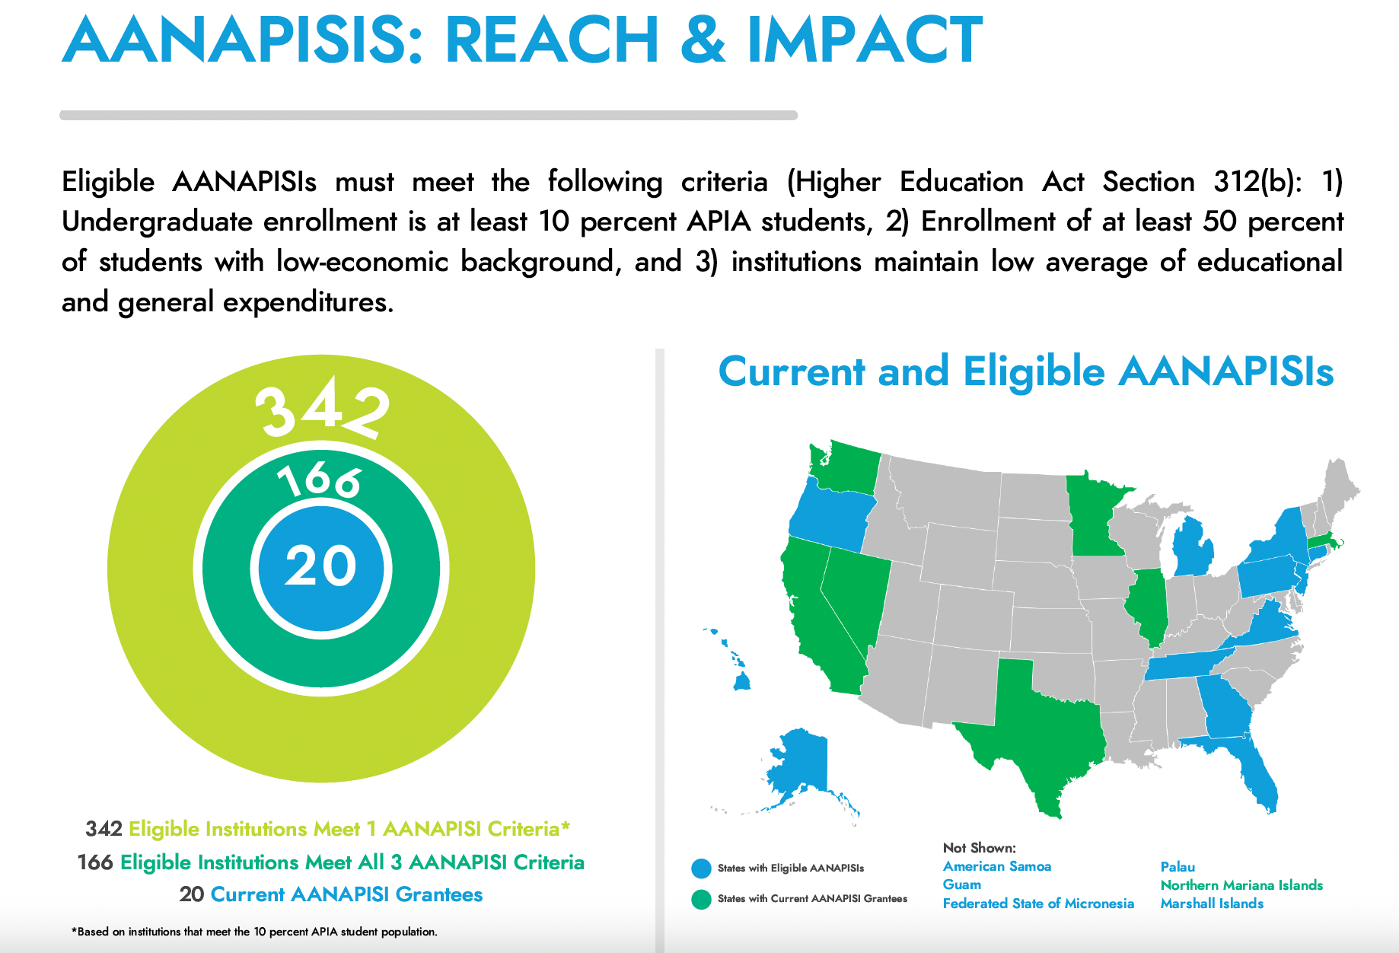

Slide 14
How do AANAPISI Programs Serve AANHPI Students?
To provide multiple offerings that serve AANHPI students, AANAPISI programs have used the following effective strategies::
Data-Informed Assessment: Strategically developing or strengthening data-informed student programming in conjunction with assessment efforts of AANHPI students’ unique needs
Culturally Relevant Curriculum: Collaborating with the institution’s Asian American and/or Pacific Islands Studies program to update or create new courses that incorporate AANHPI history, communities, or issues into curriculum and pedagogical practices
Connection to Families and Communities: Intentionally developing and implementing culturally relevant and community-based co-curricular programing specific to AANHPI student populations that connect and engage their families and communities
Undergraduate Research Agenda: Providing undergraduate students opportunities to engage in research on topics relevant to AANHPI communities in order to build a pipeline for AANHPI students towards graduate education and/or research opportunities
APIA Scholars Policy Brief September 2022-AANAPISI Impact and Growth Report

Slide 15
CA Investments in AANHPI Students in CCC, CSU, UC
Research Findings on AANHPI Students from The Campaign for College Opportunity
CCC AANHPI Student Achievement Program - 8 million ongoing
CSU AANHPI Student Achievement Program - 8 Million ongoing
UC Multimedia Textbook on AAPI Experience & Faculty Diversity -25 million
UC AANAPISI Initiative - Launched fall 2022

Slide 16
Research Findings - The Campaign for College Opportunity’s Report on AANHPI Students in CA
Only 22% of NHPI Californians between the ages of 25 and 64 have a bachelor’s degree, one of the lowest rates among all racial/ethnic groups in the state.
In the wake of the COVID-19 global pandemic, Asian American and NHPI enrollment at the California Community Colleges plummeted by 20%.
COVID-19 also took a heavy toll on Asian Americans and NHPI in the workforce, with unemployment rates rising faster than those for white Californians, from three percent to 15% for Asian Americans. Asian and NHPI workers have experienced a greater amount of long-term unemployment.
Southeast Asians experience high levels of poverty, with more than one in three (33%) Hmong children in California living in poverty. Laotian and Cambodian children in California also have high rates of poverty at 25% and 22%, respectively.
The UC admit rate for NHPI students (62%) is considerably lower than that for Asian Americans (78%).
Relative to their overall share of California’s Asian and NHPI populations, Filipinos, Native Hawaiians, Samoans, Guamanians or Chamorros, and Fijians are underrepresented within the UC system.
The four-year high school graduation rate for NHPI students enrolling in 2017 was 82%, with less than half (44%) of graduates completing the A-G curriculum necessary for CSU and UC eligibility.

Slide 17
California Education Code Section 79511 AANHPI Student Achievement Program CCC
(I) The Asian American, Native Hawaiian, and Pacific Islander (AANHPI) Student Achievement Program is hereby established at the California Community Colleges to provide culturally responsive services to enhance student educational experiences and promote higher education success for low-income, underserved, and first-generation AANHPI students and other underrepresented students.
CCC Central Office under CCCCO and its auxiliary, Foundation for CCC working in collaboration with the CA Commission on Asian Pacific islander Affairs and stakeholder groups such as APAHE.
Five positions already posted: Director, Program manager, 2 program specialists, coordinator
43 CCCs are AANAPISI eligible w/majority also HSIs
Notes:
-Funding under 2021 API Equity Budget to support STOP AAPI Hate research
-(2)It is the intent of the Legislature that these programs be coordinated/work with each other
her
-CCC Central Office under CCCCO and its auxiliary, Foundation for CCC working in collaboration with the CA Commission on Asian Pacific islander Affairs and stakeholder groups such as APAHE. 5 positions have been posted: Director, Program manager, 2 program specialists, coordinator

Slide 18
California Education Code Section 89297.1 - AANHPI Student Achievement Program CSU
(1)The Asian American, Native Hawaiian, and Pacific Islander (AANHPI) Student Achievement Program is hereby established at the California State University to provide culturally responsive services to enhance student educational experiences and promote higher education success for low-income, underserved, and first-generation AANHPI students and other underrepresented students.
Intent of Legislature that CSU coordinate/work with CCC
CSU Chancellor’s Office has RFP out to the 23 campuses to house the Central Office. Campus must be AANAPISI eligible and have experience serving AANHPI students
14 campuses are AANAPISI eligible: Maritime, San Francisco, East Bay, San Jose, Sacramento, Stanislaus, Fresno, San Luis Obispo, Northridge, Los Angeles, Long Beach, San Diego, Fullerton, Pomona
Notes:
-Funding under 2021 API Equity Budget to support STOP AAPI Hate research
-(2)It is the intent of the Legislature that these programs be coordinated/work with each other
her

Slide 19
UC Open Access AAPI Multimedia Textbook
The UCLA Asian American Studies Center has received $10 million in funding to develop a free multimedia learning experience that will help teachers around the country fill a curricular gap about the histories, struggles, cultures and contributions of Asian Americans and Pacific Islanders.
The AAPI Multimedia Textbook will feature an open-access, online platform with customizable chapters using visual, audio and archival artifacts that bring history to life.
The curriculum will support educators at a time when California and other states have made ethnic studies a graduation requirement for some public high schools and colleges.
The 2022 Social Tracking of Asian Americans in the U.S. Index found the contributions of Asian Americans continue to be invisible to much of the American public. 58% percent of Americans were unable to name a prominent Asian American and 42% were unable to name a significant Asian American historical moment more recent than the incarceration of Japanese Americans during World War II.
https://newsroom.ucla.edu/releases/asian-american-studies-center-free-resource-high-school-teachers
Notes:
-Championed by AAPI Legislative Caucus which secured an additional $45 million to the $165 million API Equity Budget passed in 2021 to combat hate crimes
-UC Berkeley Asian American and Diasporic Studies also funded 15 million to increase faculty diversity and community engagement

Slide 20
UC AANAPISI Initiative
Launched fall 2022 at UC Irvine
Similar to UC Office of the President’s HSI Initiative
Creation of Systemwide Learning Community that brings together faculty, administrators, staff, and students at AANAPISI Convenings
Strengthening system networks to better support AANHPI students
Production of data and reports to disseminate internally and externally to the broader AANAPISI field
9 campuses eligible: Berkeley, Davis, Irvine, Los Angeles, Merced, Riverside, San Diego, Santa Barbara, Santa Cruz

Slide 21
Arise: Mt. SAC’s AANAPISI Program
Notes:
Aida

Slide 22
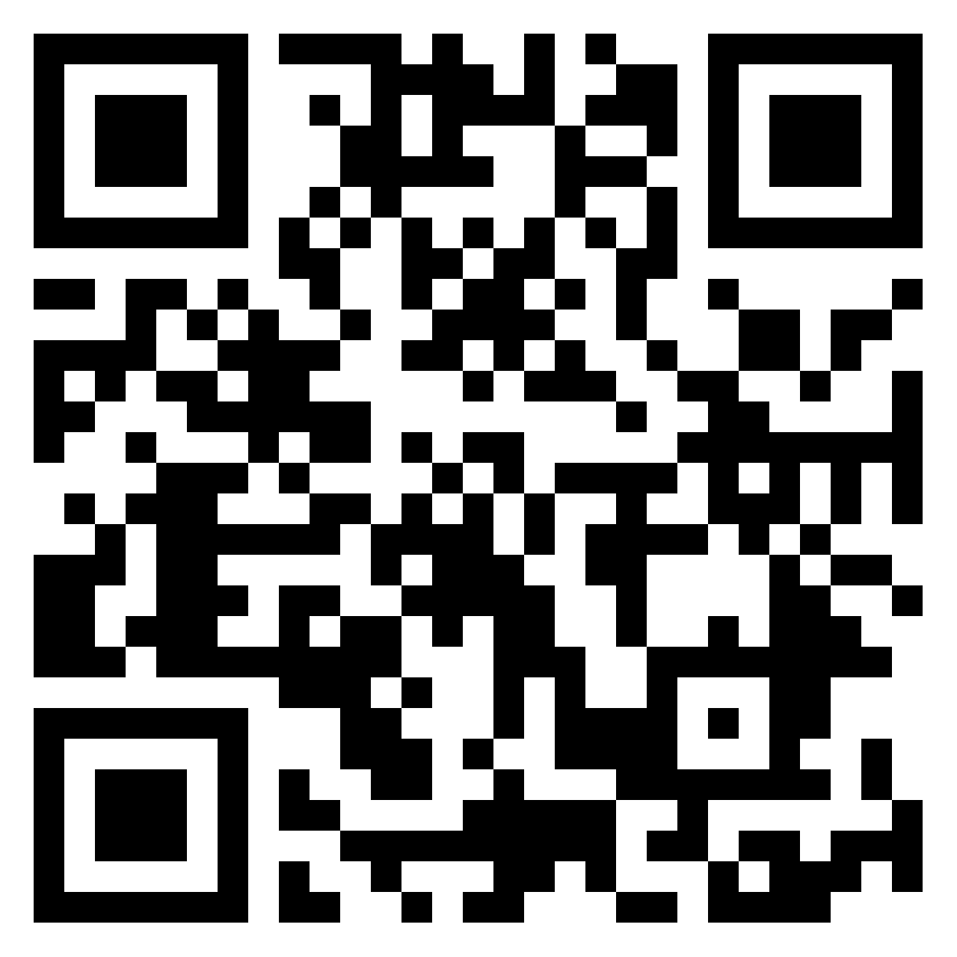
Mt. San Antonio College Arise Program (AANAPISI)
Framing our Conversation: Abby’s Digital Story
SCAN to engage with Padlet.
Part of our 2nd cohort of digital storytellers: Abby portrays the complexity of her Pacific Islander humanity while offering a context for educators who are a part of the California Community College system.
PADLET LINK: https://bit.ly/ASCC_API_Full_Humanity
Notes:
Rowena & Aida
ASK KAYLA TO STOP RECORDING DURING STUDENT DIGITAL STORY

Slide 23
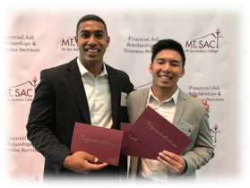
AANAPISI @ Mt. SAC: Arise Program
Our Timeline
Eligible institutions: At least 10% API, 50% financially-needy - Competitive Applications for AANAPISI (Federal Title III) five-year grants
Past: Two AANAPISI Part F awards (2011, 2016)
Current: AANAPISI Part A Cooperative (partner: CPP)
Institutionalization over time (unrestricted general funds, SEAP)
Notes:
Rowena & Aida

Slide 24
AANAPISI @ Mt. SAC: Arise Program
Background and Context
First grant established the Arise Program
Grant activity areas: academic support, counseling intervention, student development, professional development, research/evaluation
The new cooperative: transfer collaborative, community engagement, holistic support, academic development
Two Pronged: Support Services & Culturally Affirming Space
Notes:
Grant 1: DLAs for AMLA/ESL (Writing Center-Directed Learning Activities; Non-Native English Speakers (NNES) workshops developed by AMLA faculty, NNES tutors, Conversation Circles; Fale Fono- Samoan for House Meeting (first talking circles), counseling, advisement
Supplemental awards (not always guaranteed): Digital Stories, Leadership
Grant 2: Digital Stories, Arise Student Leadership
Major events: APIHM, Milestones Recognition Ceremony
Pandemic Innovations: VFD, virtual events- That’s Major (Career Exploration)
Emerging: Pasifika Family Education Day, APIDA Family Community, Knowledge is Power Learning Community
Reimagining: Cultural Immersion experiences (HIstoric Filipino Town, Little Saigon, Little Tokyo, Delano: Larry Itliong, the Musical/Delano/University Tour (AANAPISI/Ethnic Studies)

Slide 25
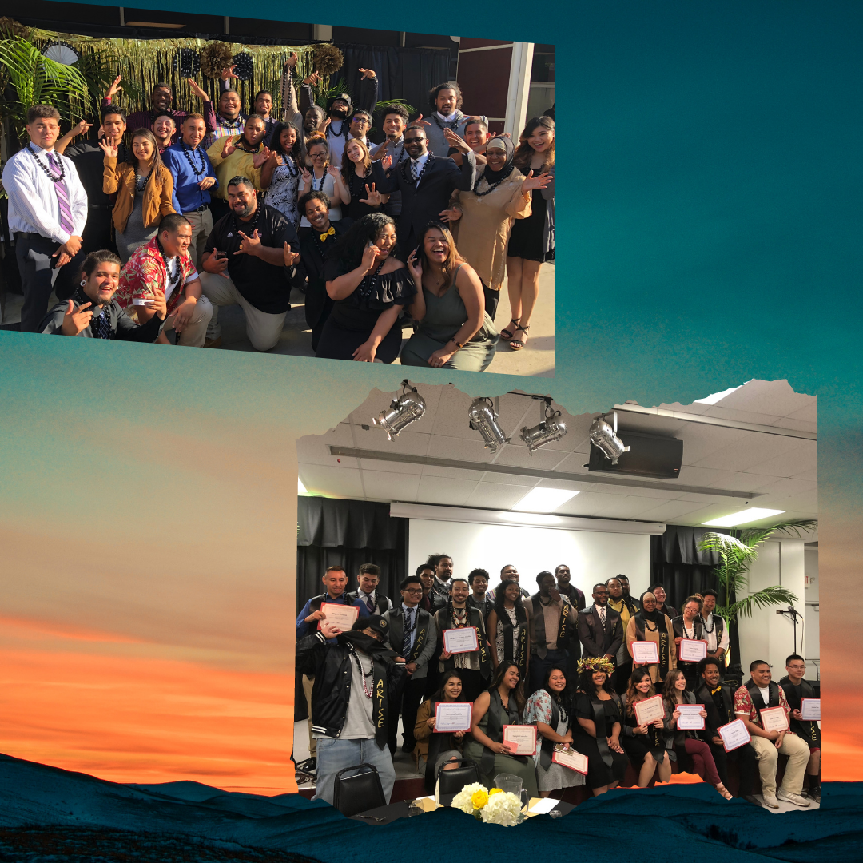
AANAPISI @ Mt. SAC: Arise Program
Student Services Support
Counseling (in-person and virtual)
Educational Advisement
Peer mentors
ASAP! Letter
Transfer and Scholarship Assistance (collaboration, access, and technology)
Tutoring in the Equity Center
Resource Referrals (Basic Needs, food pantry, Laptop Loans, book rentals, student health services, emergency funds request)
School supplies (backpacks, school supplies, blue books, scantrons)
Notes:
ASAP! Letter: Arise Student Action Plan-Sharing a personalized student academic progress snapshot/end of major terms; emailed with information about recommended progress points (e.g., term/cumulative performance on units completed, GPA, English & math completion, recommended actions, group performance (GPA distribution and average GPA)

Slide 26
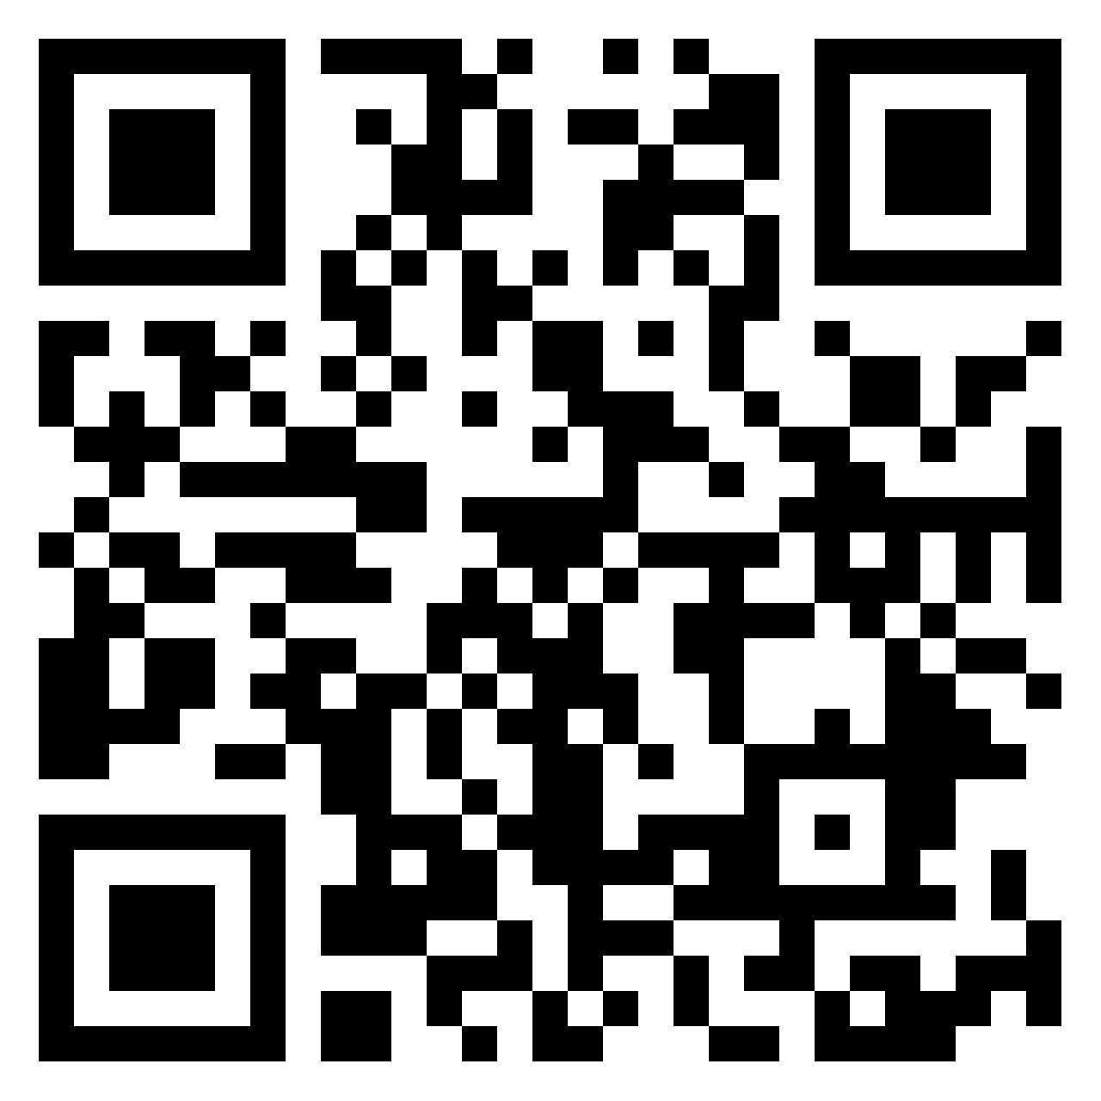
AANAPISI @ Mt. SAC: Arise Program
Culturally-Affirming Space
Digital Stories
Taking Circles: Fale Fono, SEAA Space, Ates & Titas, NHPI male athletes, TPacific Islander women, FilipinX
Leadership Development (3-day, off-site end of Summer)
Educational Field trips (e.g., Manzanar, Delano, JANM, PIEAM)
Collaborations
Knowledge is Power Learning Communities
Programming: Student Equity Speaker Series, El Centro, Pride
Conferences (APAHE, NASPA WRC)
Pasifika Family Education Day
APIDA Family Day (new-May 2023)
Cultural Series: Lunar New Year, API Heritage Month, FilipinX History Month
Workshops: Anti-Asian racism guest speakers, community talking circles in response media coverage (Monterey Park, Atlanta Shootings)
AANAPISI Week 2021
SCAN for Programming Samples
Notes:
Digital Stories: student development, cultural competency, understanding our students
Talking Circles: small group interactions to discuss relevant issues for a cross-section (example: Pinay students talking bout colorism, female expectations, conflicts tied to major/career choices; normalizing mental health, understanding mental health)
Leadership Development: Framing leadership with cultural wealth, influence of culture identity, leadership styles and values, communication and risk-taking, and opportunities/challenges.
Collaborations: El Centro & Arise Hidden Stories of the farm worker’s Movement (amplifying Flipino activists)
KPLC (piloting): Learning communities focused on APIs (HIST 9, SOC 36) and paring with English (Freshman Comp & Critical Thinking)

Slide 27
Mt. San Antonio College Arise Program (AANAPISI)
Recognizing the full humanity of our Asian Pacific Islander Students: Relationships and Representation matters
As far as coming into class and just being the only one in class and then, you know, when the teacher calls your name in roll, they don’t know how to say it . . . And then, you, like, off the bat, you don’t even want to be in there . . . It’s, like, little stuff like that chases them away. It makes them feel like they don’t belong, and then nowhere in the curriculum, you’re gonna find yourself in there. Alfred (Male, 28 years, Samoan)
I’d say a sense of family, like, you don’t have to be, like, blood related, but you technically say even though we’re not blood related, there is that sense of family that maybe even if you’re struggling, like, with the program, they’re still gonna care for you because sometimes the other staff members will give up on you if they see that . . . you’re wasting my time. . . . That’s when a sense of family would be the thing, even though you keep failing and failing, they’re still gonna keep trying. John (Male, 22 years, Tongan)
Notes:
Relationships and Representation matters (anchors for recognizing the full humanity of our API students:
Name pronunciation
Stereotype threats
Creating a sense of family
Representation in the curriculum, staff and facullty

Slide 28
Recommendations for Effective Practices To Identify and Serve Underrepresented AAPI students
\
Educators should create courses, lessons, and assignments that allow students to learn about issues that exist within their own cultural communities.
Educators should foster connections with community leaders and organizations and collaborate with them to construct more culturally relevant curricula, such as community service learning.
Educators should consider ways to integrate culturally relevant courses into structured learning communities, in which students take multiple courses together as a cohort.
Educators should commit adequate physical space for AANAPISI programs.
Educators working in AANAPISI programs should spend time developing relationships with other support offices on their campuses and in the larger AAPI community. Such relationships can ensure that AANAPISI educators have the capacity to refer AAPI students to the supports, services, and opportunities that they require.
Educators working in AANAPISI programs should create professional development opportunities to educate other professionals on campus about the AANAPISI program and the significance of culturally relevant practices.
Museus et al . (2018) .HOW ASIAN AMERICAN AND NATIVE AMERICAN PACIFIC ISLANDER SERVING INSTITUTIONS ARE CREATING THE CONDITIONS FOR STUDENTS TO THRIVE
Notes:
Karen

Slide 29
Resources - Organizations
ASCCC IDEAA (Inclusion, Diversity, Equity, Anti-Racism and Accessiblity) Toolkits and Resources: https://asccc.org/asccc-inclusion-diversity-equity-anti-racism-and-accessibility-ideaa-tools
ASCCC Caucuses (API, Black, Latinx and others): https://asccc.org/communities/caucuses
AERA Research on the Education of Asian and Pacific Americans: https://www.aera.net/SIG094/REAPA-SIG-94
CARE-National Commission on Asian American and Pacific Islander Research in Education, http://care.gseis.ucla.edu/
APAHE (Asian Pacific Americans in Higher Education): http://apahenational.org/; APAHE National Conference in Oakland CA, April 26-28
AAAS (Association for Asian American Studies) conference in Long Beach in April 2023: https://aaastudies.org/announcements/2023-conference-theme-sustainable-publics/
CCC Ethnic Studies Faculty Council: http://www.cccesfcouncil.org/
The Coalition (A2MEND, APAHE, COLEGAS): https://www.thecoalitioncc.org/

Slide 30
Resources - Publications & Research
“An In-Depth Look At Asian American, NHPI Students” Community College Daily, American Association of Community Colleges, June 1, 2022. https://www.ccdaily.com/2022/06/an-in-depth-look-at-asian-american-nhpi-students/
Cuenza-Uvas, Aida and Toso-Lafaele Gogue, Demeturie. "An Ethic Of Care In Student Affairs: Humanizing Relationships And Asserting Cultural Values At An AANAPISI" UCLA AAPI Nexus, Volume 19: 1&2(2022)
Fong, T., Marimba,D., Nguyen, M. (2020). Models of Change: AANAPISIs in Action (spring) http://www.aapinexus.org/2022/03/28/models-of-change-aanapisis-in-action-spring-2022/
“The State of Higher Education For Asian American, Native Hawaiian, and Pacific Islander Californians,” Campaign for College Opportunity, May 2022
ASIAN AMERICAN AND NATIVE AMERICAN PACIFIC ISLANDER SERVING INSTITUTIONS (AANAPISIs): A RESOURCE GUIDE, University of Pennsylvania Center for MSIs https://cmsi.gse.rutgers.edu/sites/default/files/AANAPISI%20Guide.pdf
Fong, T., Maramba, D (2020). Transformative Practices for Minority Student Success: Accomplishments of Asian American Native American Pacific Islander-Serving Institutions, Stylus Publishing, LLC.
Mike Hoa Nguyen (2021). Building Capacity at Asian American and Native American Pacific Islander-Serving Institutions (AANAPISI): Transforming the Educational Experiences of Asian American and Pacific Islander (AAPI) Students, The Journal of Higher Education, DOI: 10.1080/00221546.2021.1996170

Slide 31
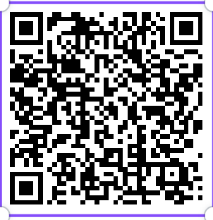
Q&A and Exit Survey
Thank you!
For more information: info@asccc.org
Dr. Rowena Tomaneng: Rowena.Tomaneng@sjcc.edu
Dr. Aida Cuenza-Uvas:
acuenzauvas@mtsac.edu
Please complete this Exit Survey to help us plan follow-up Webinars:
https://docs.google.com/forms/d/e/1FAIpQLSfaSaA3Kup0PD2MLrcfHiWc6xO-8x0Q7LQSXYtvSChCAB9Yfg/viewform

