Slide 1
Integrated Planning and Some Best Practices for Using Data to Inform Continuous Quality Improvement February 25 | 4:15-5:30
Notes:
Ginni

Slide 2
Presenters
Description
A challenge for many colleges is clearly demonstrating how integrated planning and data is used to make resource allocation requests. This session will focus on resource planning through integrated planning and how to make data accessible and meaningful for planning. Additionally, developing an evaluation plan of your local planning processes is important as we consider our institutional effectiveness during lean times as well as during periods of growth.
Ginni May
ASCCC Vice-President
Aaron Voelcker
Dean, Institutional Effectiveness, Library & Learning Support Services, Santiago Canyon College
Notes:
Ginni

Slide 3
Overview
Introductions
Accreditation Standards: Data and Resource Allocation
Making Data Accessible and Meaningful
Resource Allocation Informed by Planning and Data
Challenges
Solutions
Working Together: Faculty; Institutional Research, Planning, and Effectiveness (IRPE) Professionals; and Accreditation Liaison Officers (ALO)
Communicating Processes and Evidence to the Visiting Team
Q and A, sharing (as time permits)
Resources
Notes:
Ginni

Slide 4
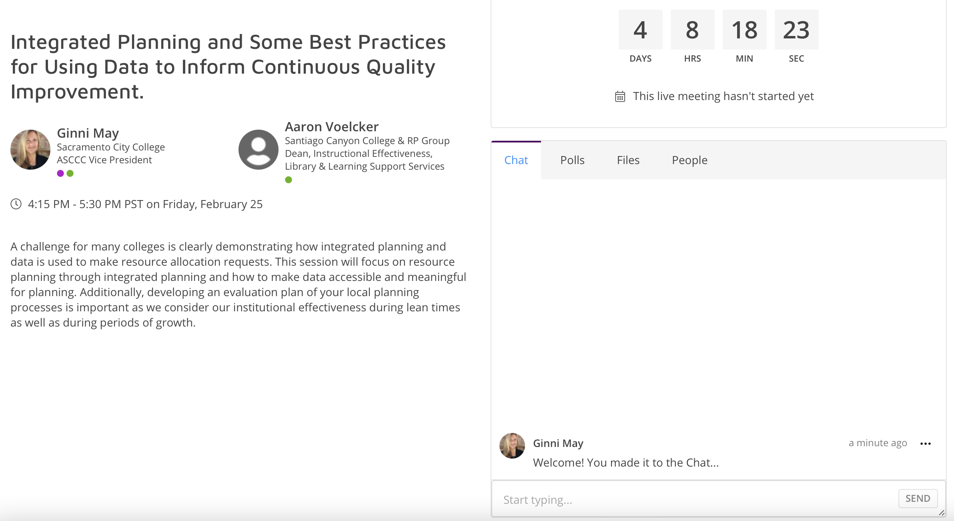
Using the Pathable Chat…
Notes:
Ginni

Slide 5
Introductions
Who are you?
In the Pathable Chat share:
Your name
College/Organization
Position
Challenge/Solution you have experienced or encountered regarding Resource Allocation Informed by Planning and Data
Who are we?
The presenters will introduce themselves…
Notes:
Ginni and Aaron

Slide 6
Accreditation Standards: Using Data
Standard I:
…Using analysis of quantitative and qualitative data, the institution continuously and systematically evaluates, plans, implements, and improves the quality of its educational programs and services…
Notes:
Ginni

Slide 7
Question: How is Data used in Planning?
Respond in the Pathable Chat…
What data is needed?
What are the sources for that data?
How is the data collected and organized? Is it readily available or are there “request protocols”?
Who performs the statistical analysis and draws conclusions?
Notes:
Ginni and Aaron

Slide 8
Making Data Accessible and Meaningful
Faculty and Researchers working together…
What data is needed?
Aggregated vs Disaggregated
Quantitative vs Qualitative
What is the data telling you? What is the data not telling you?
Causal vs Correlation
Bias
Availability
Notes:
Ginni

Slide 9
Accreditation Standards: Resource Allocation and Planning
I.A.3. The institution’s programs and services are aligned with its mission. The mission guides institutional decision-making, planning, and resource allocation and informs institutional goals for student learning and achievement.
I.A.9. The institution engages in continuous, broad based, systematic evaluation and planning. The institution integrates program review, planning and resource allocation into a comprehensive process that leads to accomplishment of its mission and improvement of institutional effectiveness and academic quality. Institutional planning addresses short- and long-range needs for educational programs and services and for human, physical, technology, and financial resources.
Notes:
Ginni

Slide 10
Question: Why should Planning inform Resource Allocation?
Respond in the Pathable Chat…
Big Audacious Goals – concept
Funding Capacity – reality check
Planning – setting priorities
Resource Allocation – funding the work
Notes:
Ginni and Aaron

Slide 11
Resource Allocation Informed by Planning and Data: How it Works at Santiago Canyon College…
Challenge:
Provide evidence that demonstrates integrated planning informs resource allocation.
Through which institutional processes might the need for resources be identified?
Annual Planning
Program Review
Outcomes assessment results analysis
Student success and achievement data analysis
Notes:
Aaron

Slide 12
Resource Allocation Informed by Planning and Data: How it Works at Santiago Canyon College…
Drawing from existing institutional processes, the college determined that answers to the following questions would be needed in order to appropriately evaluate and rank resource requests:
Do requested resources support the mission of the college?
Do requested resources support the goals of the college?
Have requested resources been identified as a need in short-term plans?
Notes:
Aaron

Slide 13
Resource Allocation Informed by Planning and Data: How it Works at Santiago Canyon College…
Drawing from existing institutional processes, the college determined that answers to the following questions would be needed in order to appropriately evaluate and rank resource requests:
Have requested resources been identified as a need in near-term plans?
Are outcomes assessment data (course or program) available to substantiate the need for requested resources?
Are student achievement data available to substantiate the need for requested resources?
Notes:
Aaron

Slide 14
Resource Allocation Informed by Planning and Data: How it Works at Santiago Canyon College…
With the aforementioned questions in mind, the college developed a resource request form that draws from identified sources of planning information.
An accompanying resource request ranking rubric, utilized by the college’s Planning & Institutional Effectiveness Committee, was also developed.
Resource requests that meet rubric criteria are scored higher in the ranking process than those that do not.
Notes:
Aaron

Slide 15
Resource Allocation Informed by Planning and Data: How it Works at Santiago Canyon College…
Notes:
Aaron

Slide 16
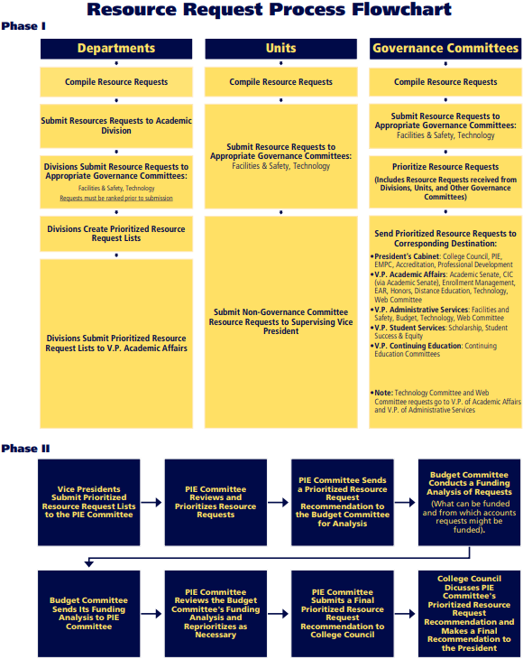
Resource Allocation Informed by Planning and Data: How it Works at Santiago Canyon College…
As tools were being developed, parallel processes that utilize these tools were simultaneously developed.
Lessons Learned
Developed processes will not work if constituents do not understand it.
It is important to communicate the process as often as possible.
Evaluate regularly to refine and improve.
Notes:
Aaron

Slide 17
Resource Allocation Informed by Planning and Data: How it Works at Santiago Canyon College…
Challenge:
Provide evidence that demonstrates integrated planning informs resource allocation.
Sources of Evidence:
Examples of completed annual plans and program reviews
Completed resource request forms
Completed resource request ranking rubrics
Process instructions and flowcharts
Notes:
Aaron

Slide 18
Working Together: Faculty; Institutional Research, Planning, and Effectiveness (IRPE) Professionals; and Accreditation Liaison Officers (ALO)
Meet early
Faculty Leadership (Academic Senate, Union, Department Chairs, Committee chairs, others)
IRPE Professionals (Administrators, Classified Professionals, Faculty)
ALOs (often an administrator, sometimes a faculty member)
Identify each group’s responsibilities, priorities, and challenges
Refine, augment, or redesign and then communicate planning processes that are understandable, reasonable, and doable by all
Be sure to explain the “How”, “Why”, and “When or how often” of the process
Notes:
Ginni

Slide 19
Communicating Processes and Evidence to the Visiting Team
Concise
Lots of material to read and comprehend
Team members have fulltime jobs and are volunteering their time
Clear – Team members have a wide range of institutional experience
Truthful – open and honest about processes: what’s working well and where improvements need to be made
Supported by evidence
Process documents
Reports
Meeting minutes
Notes:
Ginni

Slide 20
Q and A | Sharing
Thank You!
Notes:
Ginni and Aaron

Slide 21
Resources
ACCJC: https://accjc.org
ASCCC Accreditation Resource Teams: https://www.asccc.org/services/accreditation-resource-teams
ASCCC information email: info@asccc.org
Santiago Canyon College planning: https://sccollege.edu/Departments/outcomesassessment/Pages/Planning.aspx

